Slide 1

So now you're a Churchwarden!

Slide 2
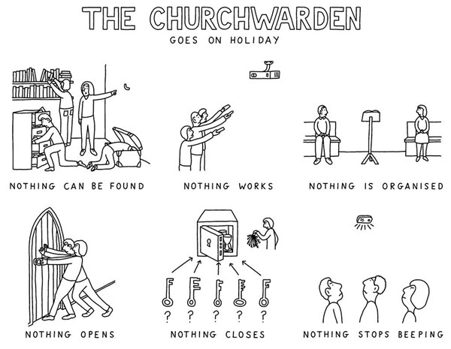

Slide 3
The churchwardens, when admitted, are officers of the Bishop of the Diocese. They shall discharge such duties as are by law and custom assigned to them; they shall be foremost in representing the laity and in co-operating with the incumbent; they shall use their best endeavours by example and precept to encourage the parishioners in the practice of true religion and to promote unity and peace among them. They shall also maintain order and decency in the church and churchyard, especially during the time of divine service.

Slide 4
One of the key ideas behind being a churchwarden is the opportunity to work in partnership and develop relationships that help people grow as the people of God. It is to share in parish leadership in a way that recognises Christ at the heart of all we do, and God’s mission as our agenda.

Slide 5







Slide 6
Modelling:
How to be a senior Lay Leader
Leading by example
Unity and peace
Keeping order

Slide 7
Being:
An encourager
Prayerful and supportive
Tuned-in and attentive
A sounding board
Supportive and caring

Slide 8
You don’t have to be perfect to be a churchwarden, but it helps if you are willing to learn, to listen, to work collaboratively, and are not afraid to ask for help.
Underpinning all this is your own continuing discipleship and prayer life, keeping in mind our common vision to become a more Christ-like Church for the sake of God’s world: contemplative, compassionate and courageous.

Slide 9
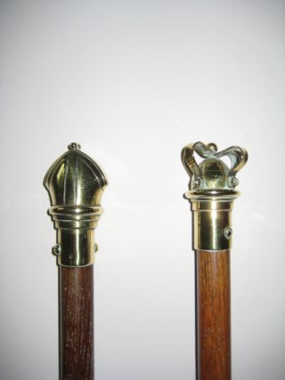
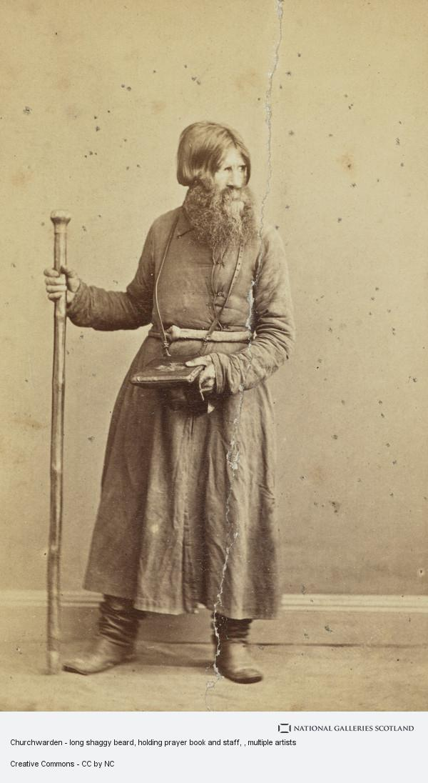
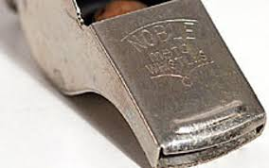
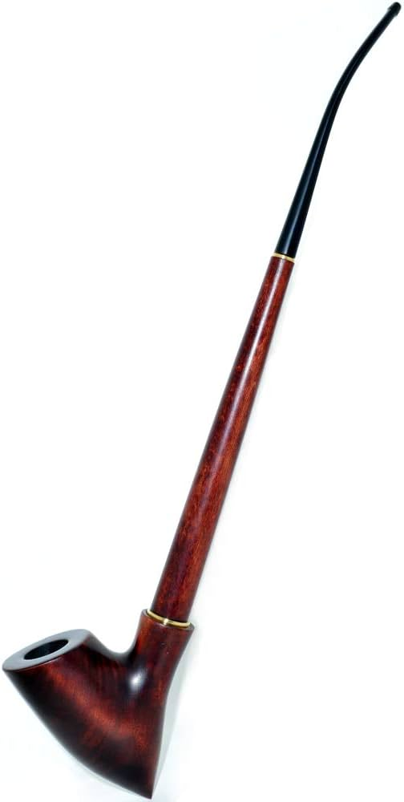
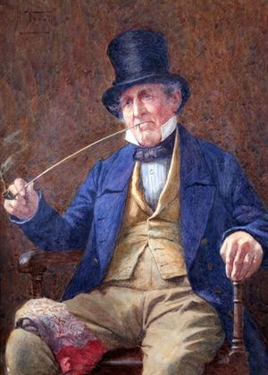


Slide 10
