Slide 1
Safeguarding - Delivering Safely
QUESTIONS
Sean Augustin
Diocese Safeguarding Advisor
Safeguarding@Chester.Anglican.org
Safeguarding
Promoting a Safer Church

Slide 2
Safeguarding - Delivering Safely
AIMS and OUTCOMES
Aims and outcomes:
The aim is to provide Church Wardens with an awareness of safeguarding risk, to identify it, evaluate it and manage it in a church setting.
Understand what they are dealing with from a safeguarding perspective.
Recognise risk as it present itself in a range of contexts.
Identify what good planning looks like.
Apply a clear process in the handling of concerns, information between ministry and safeguarding whilst recognising the boundaries of their own role.

Slide 3
Safeguarding - Delivering Safely
The Role of Church Wardens and the PCC
Church Warden
PCC
Leadership
Safer Recruitment
Healthy Environment
Risks
PSO
Archdeacon Visitations
DBS Administrator
Vacancy
Role Model
Duty of Care
Policies
H&S
Confidentiality
Integrity
Children
Hirings
Insurance
Conduct
Activities
Supervision
Training
Trust
Complaints/Grievances’
Promoting a Safer Church
Vulnerable Adults
Record Keeping
Notes:
All the ball we juggle.
The expectations of the role

Slide 4
Safeguarding - Delivering Safely
Build a Successful Team

Slide 5
Safeguarding- Delivering Safely
National Safeguarding Standards
1
2
3
4
5
Culture, Leadership
Recognising & Managing Risk -
Prevention
Victims & Survivors
Learning

Slide 6
Safeguarding - Awareness
What are the Safeguarding Considerations for Church wardens?
Proportional, Necessary, and Legal
Church Activity
Accountability
Church Culture
Integrity is Non-Negotiable
Notes:
Link slide – look back, pause and then next section

Slide 7
Safeguarding - Delivering Safely
What do we need to do?
Listen Well
Build Effective Structures
Ensure Good Governance
Communicate Well
Model Safe Behaviours
Notes:
Build effective structures – Be alert to the formal and informal structures and accountabilities that exist in your church or organisation – it will make all the difference to the long-term sustainability of your culture-setting efforts. Ensure that shadow structures (i.e., informal, and often unrecognised) don’t undermine your efforts and reduce accountability.
Listen well – Pay attention and genuinely listen to what is being said about your church or organisation, both by those inside and those outside. How do people think you have managed challenging issues? Can you demonstrate that you are prepared to learn lessons from what didn’t go well?
Establish good governance – Make sure you are clear about how your church or organisation is governed. Would people know who to speak to and know the difference between organisational governance and spiritual leadership? Ensure you give the maintenance of your culture sufficient attention alongside the pursuit of mission and vision.
Communicate well – Make every effort to be clear in your intention to facilitate and foster safer practices. Ensure that people know who your key contacts are and that you welcome comments and concerns being shared appropriately. Reinforcing positive messages about safer places within services will help too.
Model safe behaviours – Encourage and model the day-to-day behaviours and ways of working that you want to see in your church or organisation. Welcome appropriate and respectful challenge to behaviours and attitudes that threaten or conflict with safer, healthier culture.

Slide 8
Safeguarding - Delivering Safely
Concerns - How safeguarding issues present
What has been
Said?
Abuse
suggested
Observation
Physical
evidence
Heath
concerns
Social Media
Through an
Incident
.
Anonymous
sources
Suspicion
Notes:
Safeguarding considerations for visits
Question what you see and notice

Slide 9
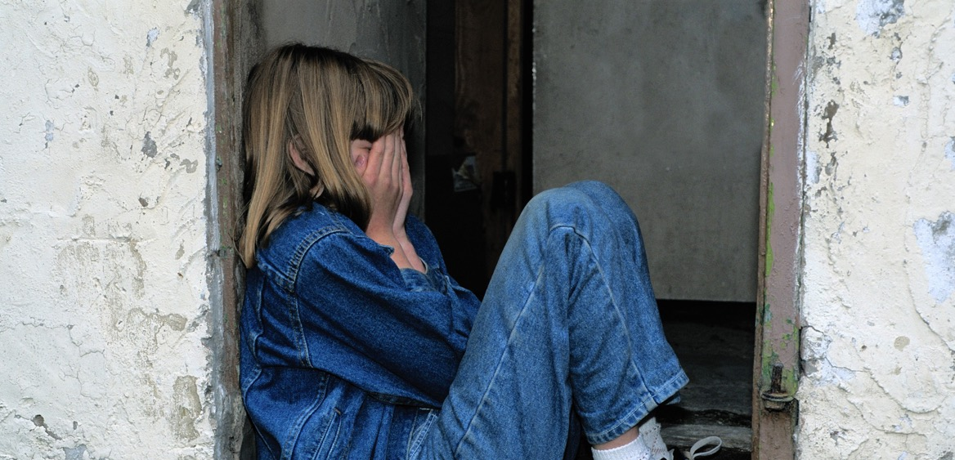
Safeguarding - Delivering Safely
ABUSE – How it presents in church
NEGLECT
DOMESTIC
ABUSE
PHYSICAL
ABUSE
SEXUAL
ABUSE
FINANCIAL
ABUSE
EMOTIONAL
ABUSE
SELF
NEGLECT
MODERN
SLAVERY
DISCRIMINATORY
ABUSE
ORGANISATIONAL
ABUSE
COERCIVE
CONTROL
SPIRITUAL
ABUSE

Slide 10
Safeguarding - Delivering Safely
RISK – How do we respond well?
RISK
To ourselves
To others
To the organisation
What We Know:
Identifying risk
What We Don’t Know: Dealing with uncertainty…
What Can Reasonably Be Expected:
Managing risk
Notes:
Risk is where the danger is

Slide 11
Safeguarding - Delivering Safely
Best Practice – Managing Risk
Identify
Analyse
Action
Monitor
Control

Slide 12
Safeguarding- Delivering Safely
CONSIDERATIONS - Five points
1
Planning - Considerations
What’s the approach
Who is involved
2
3
4
5
Information -
What do we know?
What do we want to deliver?
Risk -
Known?
Unknown?
Contingency -
The What ifs?
What if the plan changes?
Actions –
Recognise
Respond
Record
Refer
Notes:
What do you want to deliver?
Planning considerations of activity
Briefing sheet at this point

Slide 13
Safeguarding - Delivering Safely
Best Practice – Safeguarding Delivery Planning
Plan – Observe — Orient — Decide — Act
Orient
Risks – known
Risks – unknown
Notice – what’s happening
Mitigation
Monitor
Review
Plan
Risk Assessment (Safeguarding & H&S)
PCC agreement
Records
Team comms
Transport
Venue
Insurance
Understand
Expectations
Boundaries – emotional/physical
Process
‘Safe Spaces’
Your wellbeing
Decide
Clarify ‘what next’
Consider further actions if things change
Act
Reflective practice/team review
Record keeping
Notes:
Briefing sheet

Slide 14
Safeguarding - Delivering Safely
Planning – Activities
Information
Intention
Method
Administration
Risk Assessment
Communication
Humanitarian Issues

Slide 15
Safeguarding Scenario
Scenario - Andrea’s story
Andrea married her partner David 3 years ago. She has a learning disability. Shortly after their marriage Andrea was diagnosed with rheumatoid arthritis. The disease progressed rapidly, and Andrea now suffers from significant pain in her joints and has mobility problems.
Andrea used to work as a cleaner, but she became unable to cope with the demands of the work and left the job a year ago.
Listen to or read the conversation between Andrea and a pastoral visitor by playing the video. Then take a few minutes to think through the scenario, before proceeding to the questions that follow.
Part 4 - Safeguarding vulnerable adults

Slide 16
Safeguarding
Scenario - Andrea’s story Q1 - 3
1. What are your initial thoughts?
A. Andrea has a learning disability - she is misreading her husband’s treatment of her.
B. Andrea is anxious, unhappy and fearful about her current circumstances.
C. Andrea may feel bad about letting the pastoral visitor down by not answering her calls
2. How should the pastoral visitor respond?
A. Wait till Dave arrives and challenge him about Andrea’s car keys and bus pass?
B. Arrange to come back on another occasion when Dave is not there?
C. End the visit by saying, “don’t worry about the food hygiene course, it’s not important, what matters is whether or not, you are ok.
3. What else should the pastoral visitor do?
A. Make a note about this conversation and speak with a safeguarding officer at the earliest opportunity.
B. Speak with Andrea’s neighbours or family and ask their opinion about Dave and Andrea, to get a fuller picture.
C. Call the police and report the situation.
Part 4 - Safeguarding vulnerable adults
Notes:
not you are OK.”

Slide 17
Safeguarding - Delivering Safely
ACTION- the 4 R’s
Recognise — Respond — Record — Refer
Recognise
Respond
Record
Refer
Write accurate notes
Use the 4 W’s:
WHO was involved?
WHAT happened? WHEN did it happen? WHO have you referred the issue on to?
Pass the information to the Safeguarding Lead or Diocesan Safeguarding Advisor in your setting within 24 hours
In case of an emergency call the Police or dial 999.
Accept and take seriously
Do not interrogate
Do not judge truthfulness
Be alert to signs and symptoms of abuse.
Reassure
Be honest
Don’t promise confidentiality
Share next steps
Do not introduce personal information
Do not investigate
Notes:
Accept and take seriously what is being said without displaying shock or disbelief.
Let the person tell their story and don’t push for information or ask leading questions.
Do not interrogate or decide if they are telling the truth.
Be alert to signs and symptoms of abuse.
Reassure the individual they have taken the right step in sharing this information and they are not to blame.
Be honest; never make promises to keep what you are being told confidential. If abuse is involved, you will need to tell someone.
Tell them what you will do with the information they have shared and that they will be kept informed.
Do not introduce personal information or from either your own experience or that of others.
Do not investigate the matter any further for yourself, or approach the person about whom allegations may have been made.
Write down, concisely, exactly what is seen, said or heard and make clear where you have added your views or interpretation.
You may find it helpful to use the 4 W’s, as follows:
WHO was involved? Name the key people
WHAT happened? Facts not opinions
WHEN did it happen? Date and time
WHO have you referred the issue on to?
Pass the information to the Safeguarding Lead or Diocesan Safeguarding Advisor in your setting within 24 hours
In case of an emergency call the Police or dial 999.

Slide 18
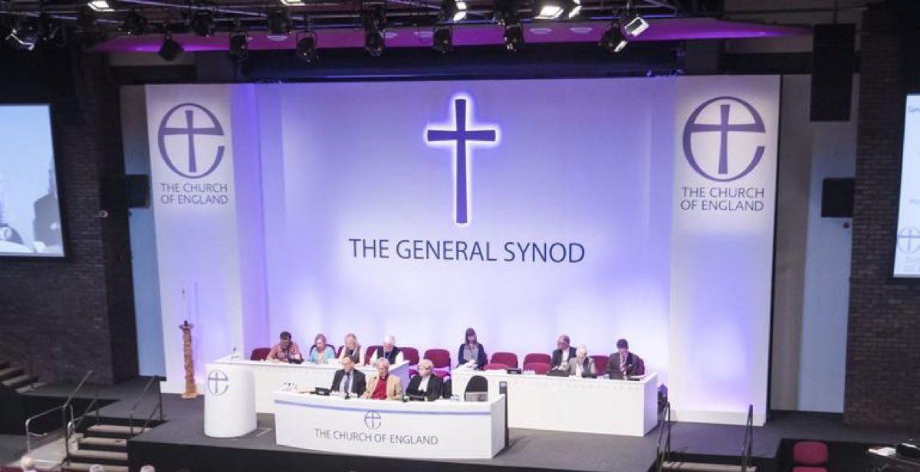
Safeguarding - Delivering Safely
Useful Reference Sources
Safer Environments & Activities Oct 2019
The Code of Safer Working Practice
Practice Guidance – Safer Recruitment, July 2016
Parish Safeguarding Handbook 2019

Slide 19
Safeguarding - Delivering Safely
QUESTIONS
Questions?
Safeguarding@Chester.Anglican.org

