Slide 1
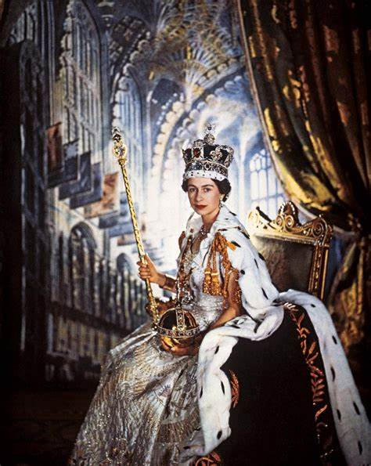
Queen Elizabeth II
1926-2022

Slide 2
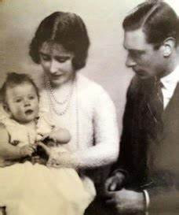
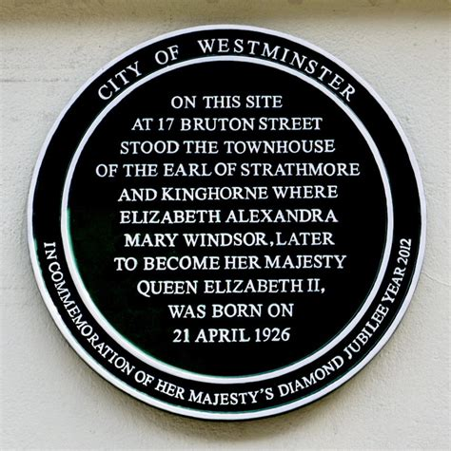
Who was Queen Elizabeth II?
Elizabeth Alexandra Mary, later to become Queen Elizabeth II, was born on 21 April 1926 in Mayfair, London.
She was the first child of The Duke and Duchess of York, who later became King George VI and Queen Elizabeth.
The Queen’s birthday was officially celebrated in Britain on the second Saturday of June each year. This special day is referred to as ‘The Trooping of the Colour’.
The Queen was also known as the British Sovereign.
The Royal Family chose the name ‘Windsor’ as their surname after Windsor Castle.

Slide 3
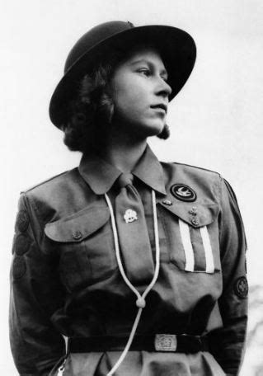
Elizabeth’s Early life
In 1936, King Edward VIII stepped down from the throne.
Elizabeth’s father was crowned King George VI. Her mother became Queen Elizabeth, and Elizabeth and her sister
Margaret were now Princesses.
Princess Elizabeth was taught at home, not at school.
She studied art and music and enjoyed drama and swimming.
Elizabeth undertook her first public engagement on her 16th birthday, when she inspected the soldiers of the Grenadier Guards.
When she was 11, she joined the Girl Guides.

Slide 4
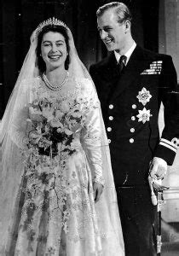
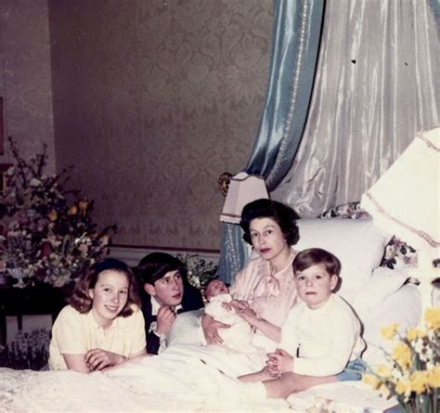
Elizabeth got married in Westminster Abbey
on 20th November 1947, when she was 21 years old.
Her husband Prince Philip, also known as the
Duke of Edinburgh, was the
son of Prince Andrew of Greece.
In 1948, the Queen’s first child
Prince Charles was born.
Two years later Princess Anne was born.
Elizabeth had two more children, Prince Andrew
and Prince Edward in 1960 and 1964.

Slide 5
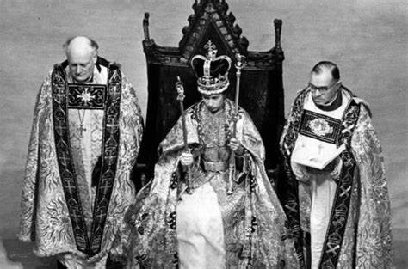
Becoming Queen
In 1952, when she was just 25, Elizabeth’s father King George VI died.
Elizabeth was in Kenya when she heard the sad news. She immediately returned home and she chose to be known as Elizabeth II.
Her Majesty Queen Elizabeth II’s coronation took place in 1953 at Westminster Abbey in London. The Queen celebrated her
Golden Jubilee – 50 years since her accession to the throne – in 2002.

Slide 6
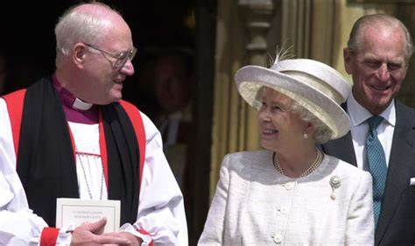
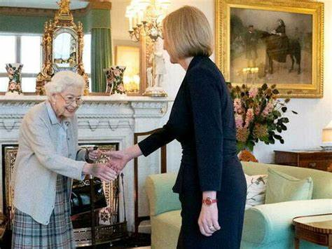
The Queen did not govern the country, but did carry out many important tasks on behalf of the nation.
The Queen was Head of the Church of England. She appointed Bishops and Archbishops on the advice of the Prime Minister.
The Queen was Head of the Armed Forces, and was the only person who could declare and end war with other countries.
The Queen had to remain impartial in matters of Government, and was not allowed to vote. However, she met weekly with the Prime Minister and opened Parliament, amongst other duties.

Slide 7
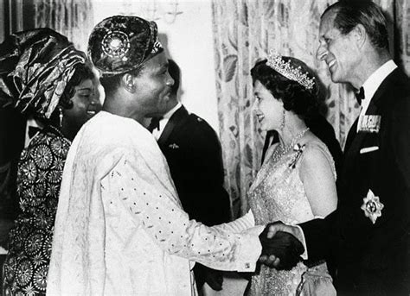
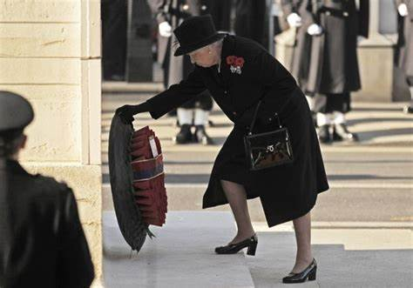
As Head of State, the Queen travelled abroad on official State visits. She also invited other Heads of State from around the world to visit the U.K.
The Queen represented the country at times of celebration, or sorrow. One of her most important duties was on Remembrance Sunday, when the Queen laid a wreath at the Cenotaph in London to remember members of the armed forces who died fighting for their country.

Slide 8
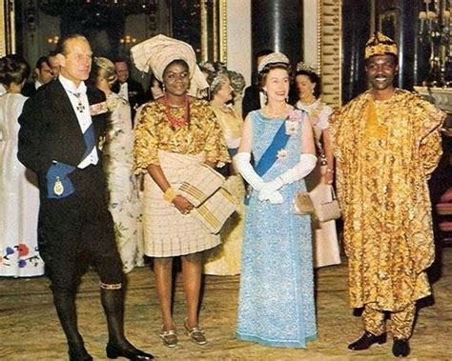
The Queen and the Commonwealth
The Commonwealth is a
voluntary association
of 53 independent countries,
almost all of which were
formerly under British rule
as part of the British Empire.
After achieving independence, many countries decided that they still wanted to remain within the Commonwealth. The Queen was Head of the Commonwealth and during her reign had made more than 200 trips abroad to visit Commonwealth Countries. The Queen often attended the games to open or close them.

Slide 9
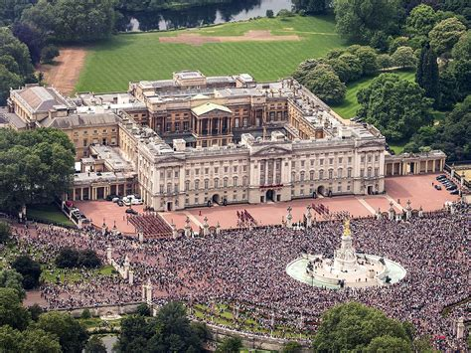
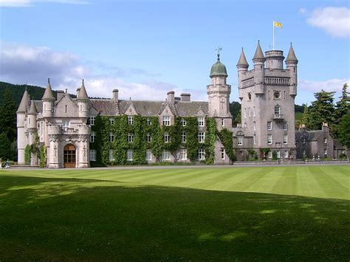
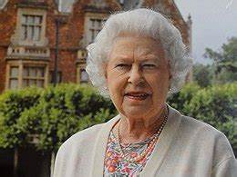
Home for the Queen
Her Majesty’s official residence in London was Buckingham Palace, but she also spent lots of time at Windsor Castle.
The Queen loved Scotland, and spent her summers at Balmoral Castle. Her official residence in Scotland was The Palace of Holyrood House in Edinburgh.
The Queen also enjoyed spending time at Sandringham House in Norfolk, which she inherited from her father.

Slide 10
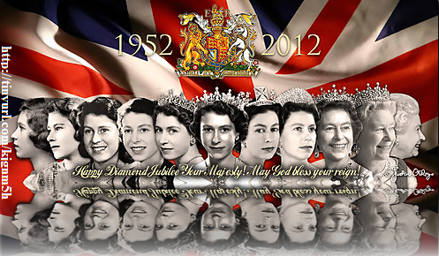
A Long-reigning Monarch
Her Majesty Queen Elizabeth II served for 70 years. September 9th 2015 was an extraordinary milestone in the Queen’s history. On this day, she became the longest-ever serving British monarch and broke Queen Victoria’s impressive record of a 63 years and seven months reign.
‘God Save the King’ was a patriotic song first performed in London in 1745. Today, it is known as the National Anthem.
In the words of the National Anthem, the Queen certainly is “long to reign over us”.

Slide 11
Key moments in her Life
1964
The Queen’s youngest child is born.
2015
The Queen became the longest serving Monarch.
2022
Elizabeth celebrated her Platinum Jubilee.
1936
Elizabeth’s father becomes King.
1992
A fire destroys part of Windsor Castle.
1926
Elizabeth Alexandra Mary is born.
1977
The Queen’s Silver Jubilee.
2016
The queen turned 90.
1952
King George VI dies and Elizabeth becomes Queen.
2002
Princess Margaret and the Queen Mother die.

Slide 12
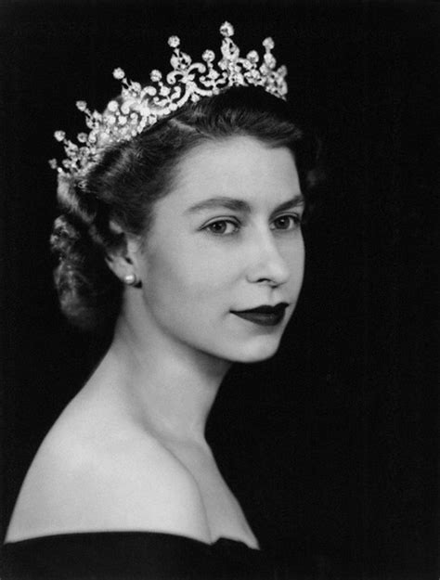
Fantastic Facts
She was the first, and so far the only, female member of the Royal Family to serve in the armed forces.
She had nine thrones; six at Buckingham Palace!
In 1954, she became the first serving monarch to circumnavigate the globe on a six month round-the-world tour with her husband.
Corgis were her favourite dogs. She owned more than 30 corgis during her reign. She also liked Dorgis; a cross between a Corgi and a Dachshund.
She sent cards to congratulate people who reach the age of 100.
For her 6th birthday, she was given a miniature Welsh cottage.
She had ‘sat’ for her portrait to be painted over 130 times!
She was 5'4" (160cm) tall.

Slide 13
