Slide 1
Practising Presidency
Revd Clair Jaquiss
Revd Andy Stinson

Slide 2
Outline
7.00pm Opening Worship
7.15pm Session 1 – Thinking about presidency
8.00pm Session 2 – Getting Practical
9.15pm Reflection

Slide 3
Opening Worship
Hear my cry, O god; All Listen to my prayer
From the end of the earth I call to you. All When my heart is faint

Slide 4
Opening Worship
Lead me to the rock All that is higher than I;
For you are my refuge, All a strong tower against the enemy.
So I will always sing praises to your name, All as I pay my vows day after day.

Slide 5
Opening Worship
O God make speed to save us All O Lord, make haste to help us

Slide 6
Song
Be still for the presence of the Lord, The Holy One is here; Come bow before Him now With reverence and fear. In Him no sin is found, We stand on holy ground; Be still, for the presence of the Lord, The Holy One is here.

Slide 7
Song
Be still, for the glory of the Lord Is shining all around; He burns with holy fire, With splendour He is crowned. How awesome is the sight, Our radiant King of light! Be still, for the glory of the Lord Is shining all around.

Slide 8
Song
Be still, for the power of the Lord Is moving in this place; He comes to cleanse and heal, To minister His grace. No work too hard for Him, In faith receive from Him; Be still, for the power of the Lord Is moving in this place.

Slide 9
Bible Readings
Mark 14:22-25
1 Corinthians 11:23-26
We hold a period of silence to reflect

Slide 10
Intercession
A time of open prayer
Give thanks for what was good
Offer to God what was difficult
Invite God to be with us this evening
Bless us with generosity to hear others and through them, to hear you

Slide 11
Collect
Lord Jesus Christ, we thank you that in this wonderful sacrament you have given us the memorial of your passion: grant us so to reverence the sacred mysteries of your body and blood that we may know within ourselves and show forth in our lives the fruits of your redemption; for you are alive and reign with the Father in the unity of the Holy Spirit, one God, now and for ever.
All Amen.

Slide 12
Lord’s Prayer
Our Father in heaven, hallowed be your name, your kingdom come, your will be done, on earth as in heaven. Give us today our daily bread. Forgive us our sins as we forgive those who sin against us.

Slide 13
Lord’s Prayer
Lead us not into temptation but deliver us from evil. For the kingdom, the power, and the glory are yours now and for ever. Amen.

Slide 14
Opening Worship
Let us bless the Lord.
All Thanks be to God

Slide 15
Thinking about Presidency
Revd Andy Stinson

Slide 16
Thinking about Presidency
‘The unity of the liturgy is served by the ministry of the president, who, in presiding over the whole service, holds word and sacrament together and draws the congregation into a worshipping community.’
Common Worship, Main Volume

Slide 17
Thinking about Presidency

Slide 18
Aims of the session
Explore the components of presidency
Breadth of tradition
Prepare to lead services in other churches

Slide 19
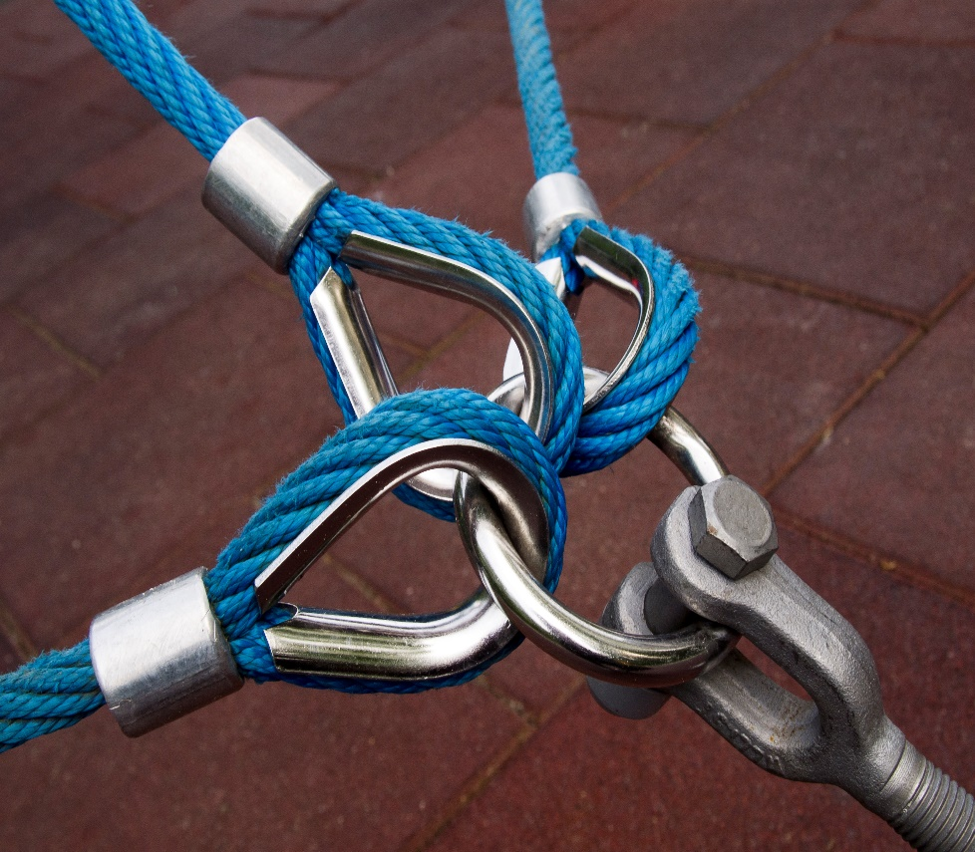
The Components of Presidency
What is it that we are holding?
What holds us?

Slide 20
(Some of) The Components of Presidency
Words,
Actions
Movement
People
Theology
Music
Worshipping God
Encountering God
Helping people understand the service
Accessibility
Tradition
Sound systems

Slide 21
Breadth of Tradition
Walking Survey
Different, contrasting ideas about the Eucharist
Imagine a spectrum between the statements
Move to where you feel you stand
No conferring
Go with your gut instinct

Slide 22
Walking Survey
I understand what we are doing
I don’t know what I’m meant to do

Slide 23
Walking Survey
Eucharist
Communion

Slide 24
Walking Survey
Communion
The Lord’s Supper

Slide 25
Walking Survey
Table
Altar

Slide 26
Walking Survey
Common Worship
Book of Common Prayer

Slide 27
Walking Survey
East Facing
West facing

Slide 28
Walking Survey
East or West, either’s best
North Facing

Slide 29
Walking Survey
Cup
Chalice

Slide 30
Walking Survey
Ciborium
I don’t know what that is

Slide 31
Walking Survey
Wafers
A bread roll

Slide 32
Walking Survey
Chasuble & Robes
Everyday clothes

Slide 33
Walking Survey
Lavabo hand washing
Anti-bacterial gel

Slide 34
Walking Survey
Genuflect
Stay standing

Slide 35
Walking Survey
Elevate the elements
Leave everything where it is

Slide 36
Walking Survey
Hand actions and movements
Keep still

Slide 37
Walking Survey
Sanctuary Bell
Just the words are heard

Slide 38
Walking Survey
Burse & Veil
Clear everything away

Slide 39
Walking Survey
Consume and ablutions
Sort it out after the service

Slide 40
Walking Survey
We encounter Christ through the Communion Service
Agree
Disagree

Slide 41
Walking Survey
Christ is present in the bread and wine
Agree
Disagree

Slide 42
Walking Survey
The consecrated bread and wine are united with the body and blood of Christ
Agree
Disagree

Slide 43
Walking Survey
The Christ is present in the bread and wine alongside the presence of the bread and wine themselves
Agree
Disagree

Slide 44
Walking Survey
The substance of the bread and wine become the body and blood of Christ, although the accidents, the physical properties of the bread and wine remain.
Agree
Disagree

Slide 45
Walking Survey
It’s a mystery – Christ is present, but we’re not sure how…
Agree
Disagree

Slide 46
Walking Survey
How we dispose of the bread and wine after consecration matters
Agree
Disagree

Slide 47
Walking Survey
My answers to this survey would match the answers of my curacy church
Agree
Disagree

Slide 48
Walking Survey
Was this a helpful exercise?
Did other people stand where you thought they would?
How do you remain faithful to the whole church?

Slide 49
The Usual Way…
Everywhere has the usual way
You need to find out what that is
Practicalities are important

Slide 50
Theology
What theology are you trying to express?
What is the direction of this part of the service? Towards God? Receiving from God?
Is the space sacred?

Slide 51
Theology
Is there room to respond to what’s happening?
Do your actions stop other people from engaging with the service?
Crumbs…
How do others respond to what is happening?

Slide 52
Theological Images
Private communion of one person with their creator
A homely gathering of like-minded people
The Messianic Banquet
The ‘outward and visible sign of an inward and spiritual grace’
The road to Eammaus – Christ revealed in the breaking of bread
The Lord’s Supper
Breaking the word and the bread
A radical meal

Slide 53
Any Questions?

Slide 54
Getting Practical
How Anglicanism shapes what we do
Bible
Tradition
Reason

Slide 55
The Usual Way – The BCP
Boilerplate worship
Legally the foundation of worship in the Church of England
One order for Lord’s Supper (or Holy Communion)

Slide 56
The Usual Way – The BCP
The Table in the Chancel or the body of the church
White Table Cloth
Stand at the North side
The priest shall place…

Slide 57
The Usual Way – The BCP
…take the Pattern into his hands
And here to break the bread
And here to lay his hand upon the bread
…take the Cup into his hand.
And here to lay his hand upon every vessel [of wine]
Then receive….

Slide 58
Threefold Action
1 Cor 11.13-26
Jesus took bread and wine
He gave thanks
He broke it and gave it to the disciples

Slide 59
The Usual Way – The BCP
…take the Pattern into his hands
And here to break the bread
And here to lay his hand upon the bread
…take the Cup into his hand.
And here to lay his hand upon every vessel [of wine]
Then receive….

Slide 60
Common Worship
BCP becomes formational tradition
Liturgy is tradition vs evangelism
Reason shapes how we hold this together

Slide 61
Visual Clues Reinforcing Learning
Take bread and wine
Give thanks
Break bread
Action of the Holy Spirit (Epiclesis)

Slide 62
Visual Clues Reinforcing Learning
Prayer of Preparation
Sursum Corda
Thanksgiving
Words of institution
Words of consecration
Anamnesis
Epiclesis
Doxology
Fraction
Offering

