Slide 1
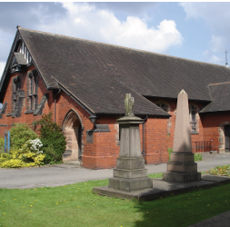
PARISH PROFILE

Slide 2
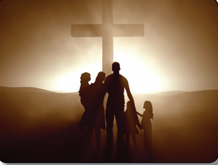
Summary
We hope as a church family that you will read this profile and feel excited at the prospect of becoming part of our kind and united family. We are praying that our Lord will bring the right person to minister to us where they can feel happy and fulfilled in God’s work. We will be welcoming and supportive as you begin this new chapter in your life as well as a new chapter in ours. We are a very happy, God serving and loving church needing a spiritual leader for us to walk alongside

Slide 3
We are praying for a vicar who will
As we look at our vision, we have set ourselves five aims:
To grow our children's and family work.
To take our community work to a new level.
To secure our financial position going forward.
To grow our church family, ensuring new people joining the church including, international members, are made to feel welcome and integrated into the church family and find a place to serve and grow at St Chad’s.
To lead people to Our Lord by proclaiming His Word.

Slide 4
We are praying for a vicar who will
Is prayerful and Spirit led, continuing our traditions of the Bible teaching of God’s word aiming the teaching towards a multi-generational and multi-cultural congregation.
Has plenty of energy and enthusiasm to encourage old and young adults alike within our church to take an active and full part in church life.
Will help us to grow our church by engaging in the community seeking to encourage more people of all ages to become part of our church family.
Is keen to participate in village life and our community as it expands to build a support for within and outside St Chad’s.
Will be an active supporter of Hope Central and ensure it remains part of our church life and community .
Will consider how we can move forward as a church with modern and up to date aspects.
Is approachable and compassionate to individual needs and has the patience to help and support each and everyone who comes to them.
Will help us to strengthen our finances so that we can continue to maintain our buildings and secure our future.

Slide 5
About St Chad’s - Community
St Chad’s is the local Anglican parish church of Handforth, Cheshire. We are a Christian fellowship whose vision is to “Know Christ and make Him known” in our community. We are a diverse group of people from all ages , cultures and backgrounds. Everyone is welcome to our church to grow and develop and seek God’s love and forgiveness.
A Community in which real life is shared, lived out and celebrated and worship is marked by a sense of God’s presence and life changing power.
A Community where generosity flows in response to God’s generosity – where we are all encouraged to give as well as receive.
We believe God has made Himself known in the person of Jesus Christ and principally through his revealed word, the Bible and the dynamic work of His Holy Spirit in our hearts and minds.
We are looking for a new vicar to reach out to our community with a message and demonstration of God’s love. A vicar who will be vibrant and pro-actively appeal to our community to grow our church family. A vicar with renewed vision for our community.

Slide 6
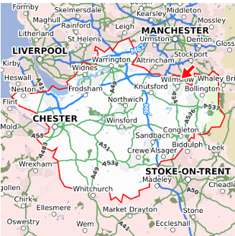
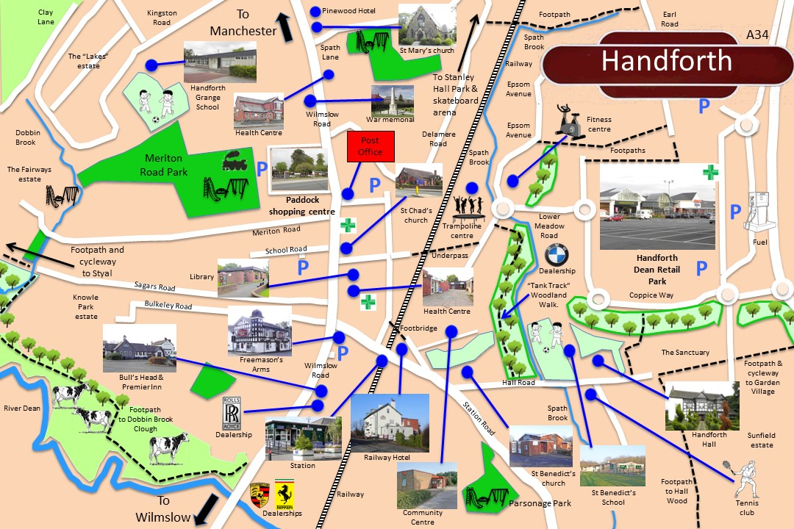
About St Chad’s - Our Parish
The parish of Handforth has a population of approximately 10,000 persons and is now beginning to think of itself as a town rather than a village due to new local housing developments on all sides. The motorway network is easily accessible having the A555 on the doorstep connecting to the A34 leading to Manchester City Centre approx. 9 miles to the north. A main line railway station lies at the edge of the village with direct links to Manchester Piccadilly in one direction and Crewe in the other. Manchester Airport is approximately 2 miles away.
The village itself includes a small shopping area with a choice of cafes and restaurants. There is a local Park which includes tennis courts and children's play area. The local library and Health Centre are adjacent to the church.
Handforth is privileged to be nestled close to the Cheshire and Derbyshire countryside offering many beauty spots.

Slide 7
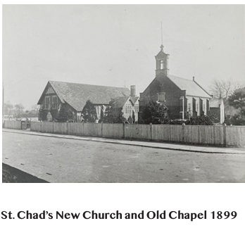
About St Chad’s - Our Buildings
The new St Chad’s church was consecrated by Dr F Jayne Bishop of Chester on St Chad’s Day 2nd March 1899 after the chapel was no longer large enough for the growing community.
St Chad’s church including the gallery has a seating capacity of about 200 people.
Connected to the church building is a large church hall and a church lounge together with a recently refurbished kitchen which serves both rooms.
We have a resource committee that manage the maintenance of the church. They are currently considering a replacement to our church heating system, working towards an eco-friendlier system.
We have a small dedicated prayer room/meeting room which has a capacity of around 20 people.
The Quinquennial inspection was last conducted in 2021 and so is due again in 2026.

Slide 8
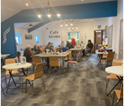
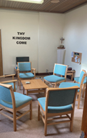
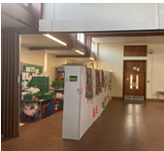
About St Chad’s - Our church rooms
We run a community café (Café Aroma ) in the lounge, which is open to the public twice a week. Run by St Chad’s working alongside Pure Innovations who support people across Greater Manchester with disabilities or health related issues to lead a fulfilling life with a sense of purpose and belonging.
The lounge is also used for many activities organised by the church and the charity Hope Central.
The Church Hall currently houses Hope Central’s Foodbank serving the community and has recently started a new service called The Pantry.
The hall is also used weekly by the Brownies and Rainbows and St Chad’s Sunday Club also meet here twice a month during the Sunday services.
Our peaceful quiet room is used for prayer and private meetings.

Slide 9
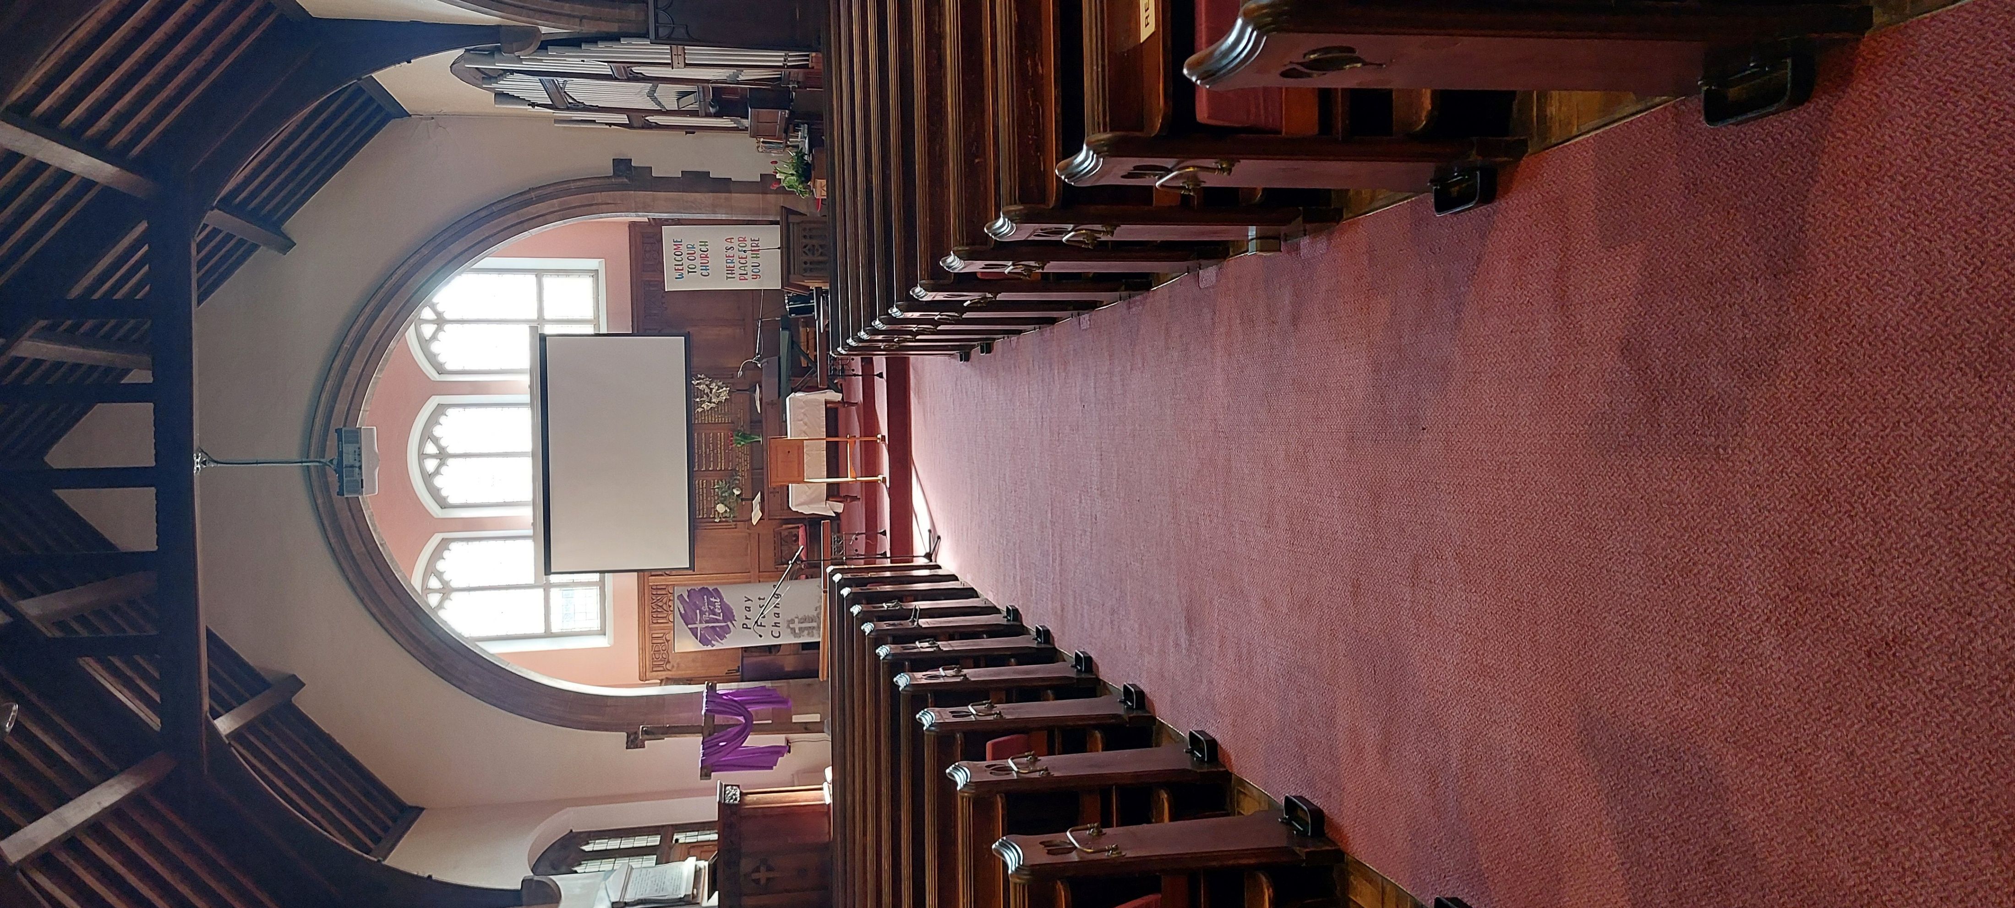
Worship at St Chad’s
As we meet regularly, we seek to worship God , to hear Him, to pray to Him and to see Him transforming us spiritually into his children.
10am every Sunday we have our all-age worship service. On the 2nd and 4th Sunday of each month we have a Holy Communion service. Our Sunday worship consists of a mixture of traditional hymns and more contemporary modern songs. We have a small accompanying music group with a group of singers led by our worship leader. .
10.30am every Wednesday we have a Book of Common Prayer (BCP) service offering Holy Communion on the 1st and the 3rd of the month. The Wednesday service is based on the Book of Common Prayer, with traditional hymns being accompanied by the church organ or piano.
We have a prayer meeting in the lounge once a month for approximately one hour and open to all.

Slide 10
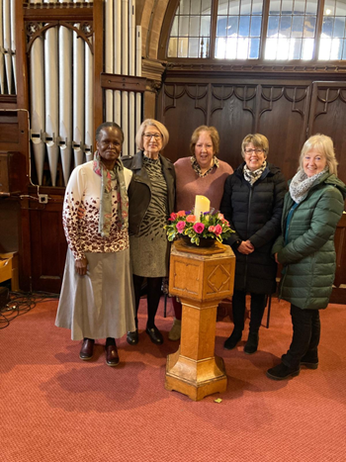
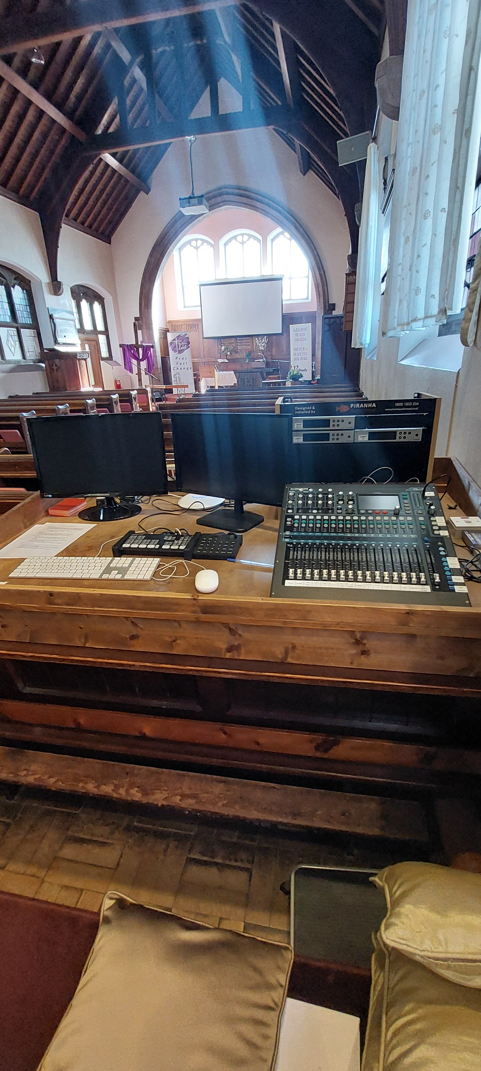
Worship at our Church
We broadcast our services through our YouTube channel enabling us to extend our reach and allow us to connect with our wider community and beyond. We have recently upgraded the computers in our church allowing us to enhance our broadcasting.
We have a dedicated flower team who keep our main church flowers renewed and refreshed.

Slide 11
Pastoral Care activities
Pastoral care continues to remain a priority in our church life. We have a team of around 7 people along with the clergy who are dedicated to ensuring that people in our church and those known to us are cared for pastorally. Other members of the congregation also are known to care for those they know to be in need. The team meet on a monthly basis to update each other on people who have been visited and contacted. We pray for them and ensure that as far as possible people receive the support and care that a church family should offer one another.
With many members of our church family increasing in age and loss of mobility the pastoral team help to form a link between individuals and the church so we can ensure that they can be represented. We also have links with local care homes.

Slide 12
Home Groups
St Chad’s have several home groups meeting every other week. These are a vital part of our fellowship. Our groups are relaxed and informal offering one another guidance through God’s word and support for our prayer lives , personal lives , strengthening our faith.
Our home group leaders are guided and supplied with current material from our clergy.
We want to share total trust, honesty and confidentiality amongst ourselves which help us to strive to be all God wants us to be.

Slide 13
Children's Work
We have been building children's ministry at St Chad’s and run a Sunday club for ages 4-11 during the Sunday service twice a month. We usually have around 8-10 children but would love to see this number grow. We provide a creche on the same Sundays.
We see children and youth work as a high priority in our church and have been working towards expanding the work. Our support for work in schools is important and we support Christians In Schools Trust both financially and prayerfully.
We also have current links to lunchtime Christian Union sessions at the local high school and have a good relationship with the local primary school.

Slide 14
Safeguarding at St Chad’s

Slide 15
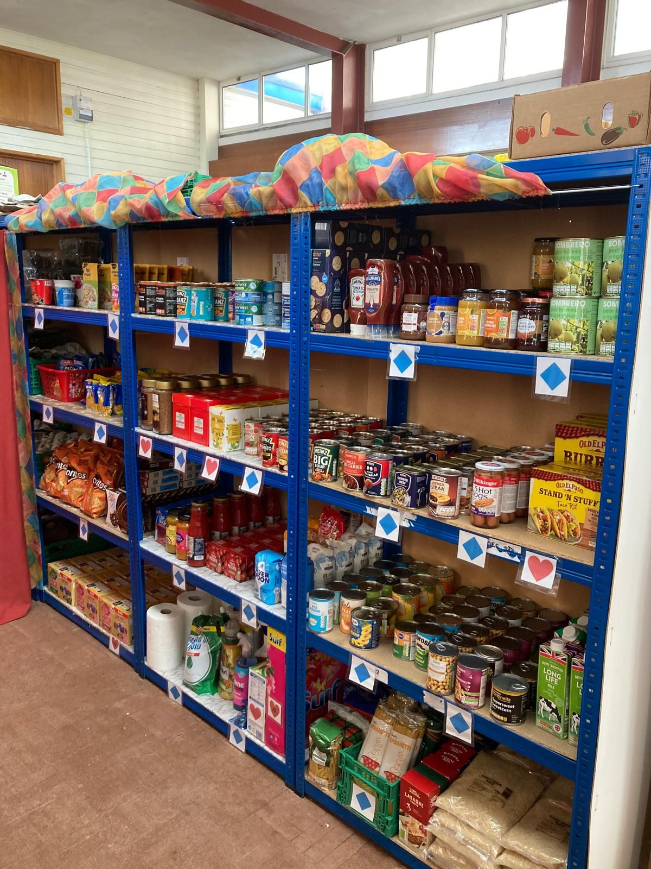
Hope Central
The charity Hope Central was founded in 2019 as in response to the increased need for support within our community for many things but essentially food. The charity was formed by St Chad’s, Vinelife Wilmslow and St John’s Knutsford. Many churches in the area now support the work with volunteers and donations.
As well as meeting the immediate need for food they are also able to support people at a critical time so will try and fill other needs as well. They can help with debt support, money management, job clubs and life skills courses .
At St Chad’s we host Hope Central’s Foodbank four days a week and the charity's new venture a pantry in collaboration with ‘My Pantry’ one day a week.
Additionally, we host the charity’s English classes for displaced persons, Alpha courses and some of the charity’s prayer meetings.

Slide 16
Hope Central & Christians Against Poverty
Hope Central has a partnership with Christian’s Against Poverty (CAP) by hosting Job clubs, Life Skills workshop, and money coaching classes at St Chad’s.
Several members of our congregation actively volunteer including working as CAP befrienders as part of Hope Central’s CAP debt centre which supports people in the community that have financial problems.
We have witnessed many individuals come to faith as part of this process.

Slide 17
Outreach Ministry
Our Outreach Ministry is a major part of what we do at St Chad’s and can be divided into three areas. Our support is financial and prayerful.
Ministries of mercy – We offer local and global acts of love and kindness to people in need, as does our work in partnership with Hope Central.
International church growth and evangelism – We have built strong links with ministries in Nepal and Turkey.
National and local school evangelism and outreach – Our support for work in schools is done through Christians in Schools Trust. We have also run local Alpha courses.
St Chad’s donates a percentage of its donated income every year many charitable organisations. We currently make donations to national and international charities. Current recipients include Christian In Schools Trust (CIST), Tearfund, Open Doors and others.
Donation in some cases come through specific donations from the congregation. As a church we have raised funds by organising each year a Tearfund “Big Quiz Night”.

Slide 18
Finance
A high level of giving to St Chad’s comes from standing orders from the congregation. Along with collections and donations the total amounted to £105K in 2024. This was down on the 2023 figure of £118K.
Donations can be made by standing order, cash or by contactless means.
Other income from such items as hall lettings, fees and the Aroma Café receipts at £21K were also stable.
Major outgoings are staff salaries and of course the parish share which this year amounts to £78K per annum and is fully paid each month.
We have in the past donated nearly 20% of our donated income to missions and charities but have had to reduce this to 15% in the current year.
As a church we own a local house with a rental value of £1800 per month. The house was last valued in 2021 at £340,000.
Our current accounts as at February 2025 total £13K with £70K held on deposit.
Our budget for 2025 showed a deficit of £22k together with a further £4.5 K of expenditure to replace old office equipment.

