Slide 1
Chester Diocese December 2023

Slide 2
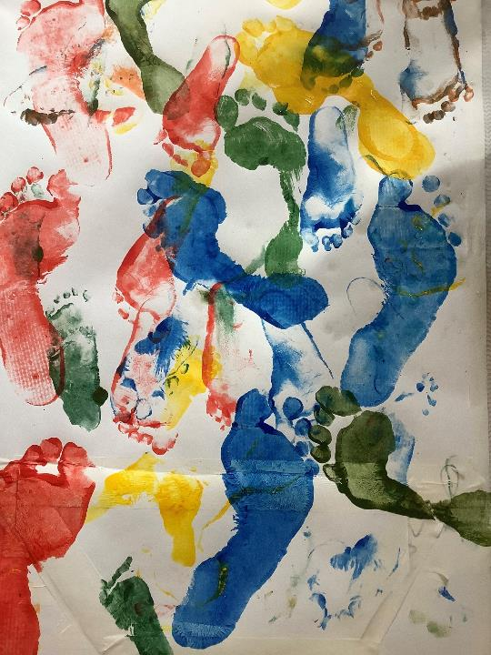
To come away
informed about Growing Faith
gleeful about God’s Spirit at work in Chester Diocese
excited by the direction of the Church of England
inspired to prioritise cyp in your ministry
equipped to know where to find resources and support
keen to listen to cyp voices

Slide 3
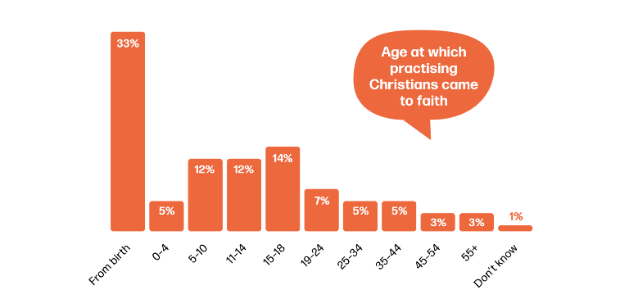
When you were young(er)….
What was your favourite toy when you were about 8?
Did you have a ‘special place’?
When do you first remember having a sense of the sacred?

Slide 4
Notes:
Up to the tree or Ezra, if time (4’45)

Slide 5
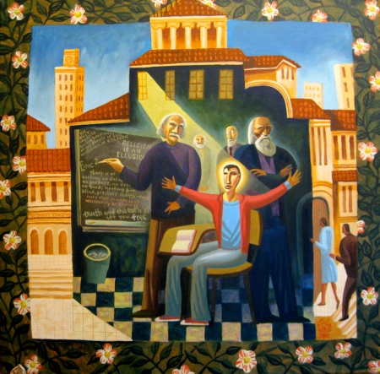

Slide 6
Every year Jesus’ parents went to Jerusalem for the Festival of the Passover. When he was twelve years old, they went up to the festival, according to the custom. After the festival was over, while his parents were returning home, the boy Jesus stayed behind in Jerusalem, but they were unaware of it. Thinking he was in their company, they travelled on for a day. Then they began looking for him among their relatives and friends. When they did not find him, they went back to Jerusalem to look for him. After three days they found him in the temple courts, sitting among the teachers, listening to them and asking them questions. Everyone who heard him was amazed at his understanding and his answers. When his parents saw him, they were astonished. His mother said to him, ‘Son, why have you treated us like this? Your father and I have been anxiously searching for you.’ ‘Why were you searching for me?’ he asked. ‘Didn’t you know I had to be in my Father’s house?’ But they did not understand what he was saying to them. Then he went down to Nazareth with them and was obedient to them. But his mother treasured all these things in her heart. And Jesus grew in wisdom and stature, and in favour with God and people. Luke 2: 41-52 NIVUK

Slide 7
And Jesus grew in wisdom and stature, and in favour with God and people. Luke 2: 52 NIVUK
Jesus in the Temple by James B Jangknegt 2009 used with permission

Slide 8
a safe, intergenerational community a community where family is key a community with rhythms and seasons a community with space for listening and questioning and answering a community with different interlinking structures working together a community where a child’s spirituality is already flourishing independently a community where a child can flourish physically, cognitively and relationally to become the adult capable of fulfilling their calling a community where adults learn with and from a child

Slide 9
a safe, intergenerational community a community where family is key a community with rhythms and seasons a community with space for listening and questioning and answering a community with different interlinking structures working together a community where a child’s spirituality is already flourishing independently
a community where adults learn with and from a child a community where a child can flourish physically, cognitively and relationally to become the adult capable of fulfilling their calling
Where have you seen this sort of community in 21st century UK?

Slide 10
A kairos moment
Notes:
God has given us a ‘use it or lose it’ moment post pandemic, where the old has been stripped away to make space for a new approach, a new attitude, new practices, new adventures

Slide 11
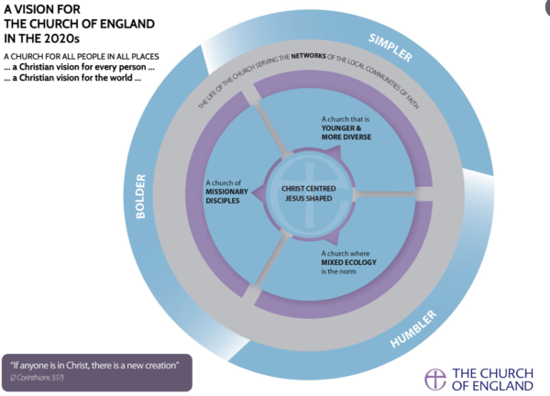
A perfect time to be someone who cares about children and young people!

Slide 12
Home - church - school

Slide 13
Growing Faith
Growing Faith is the movement that exists to change the culture of the Church of England so that everyone instinctively puts put children, young people and families at the heart of all the mission and ministry of the Church.
It involves churches, schools and households working together to help children, young people and families have life in all its fullness.
(John 10:10)

Slide 14
Church
Home
School

Slide 15
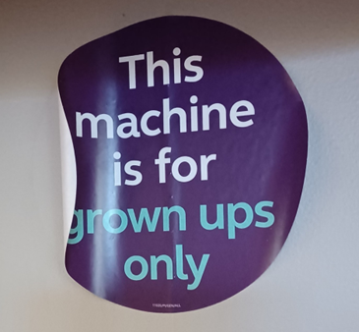
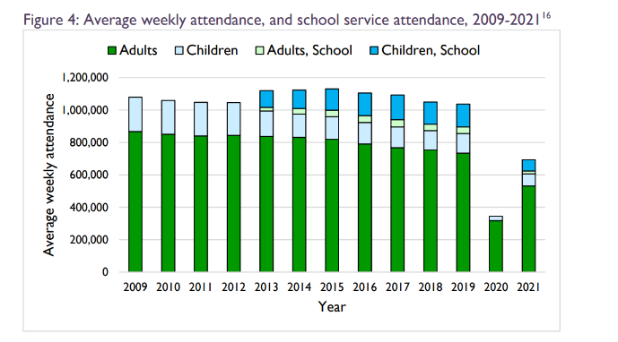
2021 – distribution of under-16s (average weekly attendance) in churches
25% have 0
25% have 1
25% have 6
25% have 22
Average awa of under-16s is 5.1 (in 2019 8.3)

Slide 16
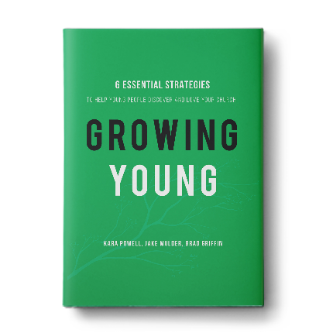
Unlock keychain leadership
Empathize with today’s young people
Take Jesus’ message seriously
Fuel a warm community
Prioritize young people everywhere
Be the best neighbors
Growing Young
Powell, Mulder, Griffin Bakerbooks 2016

Slide 17
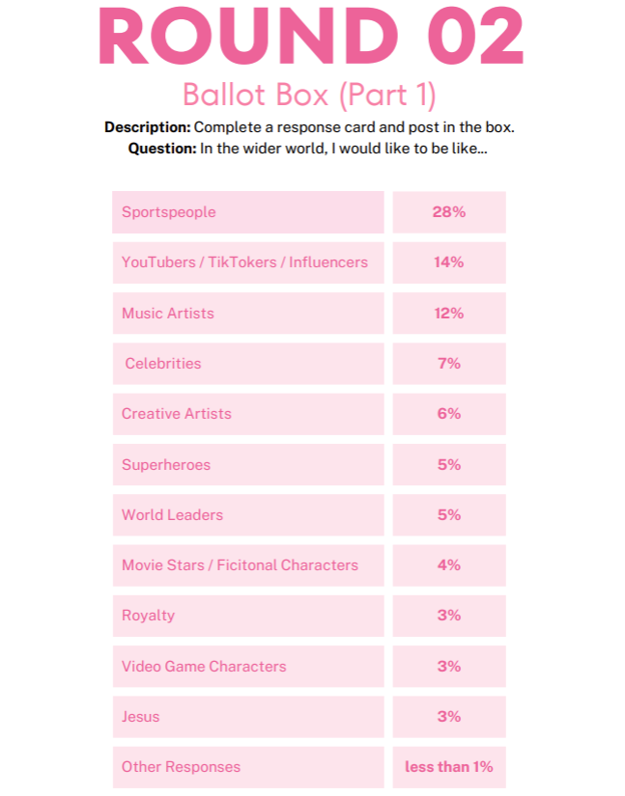
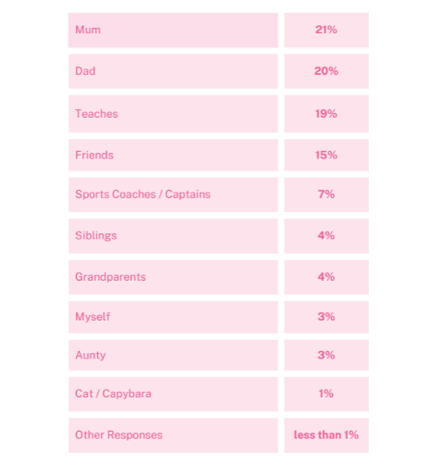
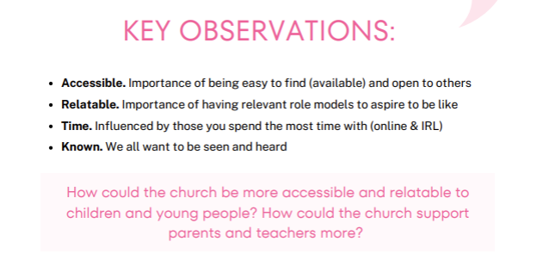

Slide 18
There are around a million under-16s in Church of England schools
Jesus went….
As Jesus went on from there…
Jesus went out to them, walking on the lake…
These twelve Jesus sent out…
Jesus went out and saw a tax collector…
The Lord appointed seventy-two others and sent them two by two…
Jesus and his disciples went out into the Judean countryside…
Go and make disciples….
Instead of staying grieving where they’re not, why not go out rejoicing to where they are?

Slide 19
The research from NICER on which Growing Faith is based concludes that where school, church and home act together, a child’s spirituality has the best chance of being nurtured:
• A strong relationship between church and the school has a strong association with attitudes and behaviours which facilitate faith-talk and interactions at home.
• Flourishing connections between school, home and church nurtures relationships between individuals and these institutions.
• Positive relationships between church and school are characterised by invitational worship, the celebration of festivals, the minister’s presence, and a sense of belonging and connection to the church community and building.
• The powerful impact these positive relationships have on aspects of family faith life is mostly unseen but is apparent in the significance for church school families of their connection with the local church.
(p11 Faith in the Nexus Final Report 2020 faith-in-the-nexus-final-report.pdf (nicer.org.uk))
Notes:
Why do we think our approach has a good chance of working? It’s based on research, particularly from National Institute for Christian Education Research: Faith in the Nexus 2020.

Slide 20
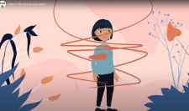
‘Positive relationships between church and school are characterised by
invitational worship,
the celebration of festivals,
the minister’s presence,
and a sense of belonging and connection to the church community and building.’
(Faith in the Nexus)
Where do you see any of these happening well in your context and/or elsewhere in the diocese?
What else would you add to the list?

Slide 21
Talking Jesus research 2022

Slide 22
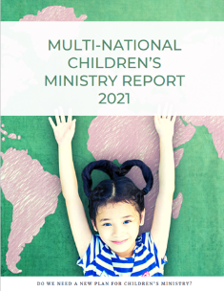
The Multinational Children’s Ministry Research indicates that children and young people’s spirituality thrives through safe and close connections with all generations.
What opportunities do you have in your parish for even greater intergenerational relational connection?

Slide 23
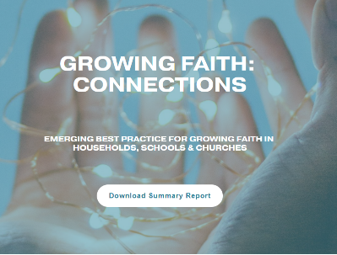
The Growing Faith - Connections research suggests four fruitful ways forward to help children and young people’s spirituality flourish:
Voices
(making space for the voices of children and young people)
Rhythms
(making the most of festivals and seasons)
Relationships
(creating connections for genuine community across generations)
Purpose
(doing worthwhile activities together)
What do you already do across ch/hh/sch that could be done even more intentionally through the lens of these four suggestions?
In your context, which of these is strongest and which is an area you would like to develop?

Slide 24
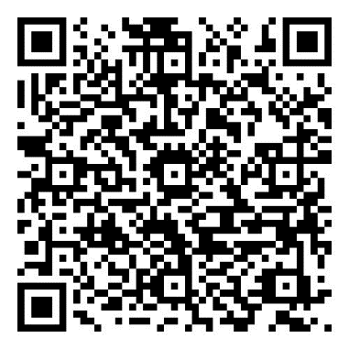
What the Growing Faith Foundation is doing 2022-3 to effect culture change
Prayer
Networks
Hubs
Programmes
Research
Church in school
Podcasts and videos

Slide 25
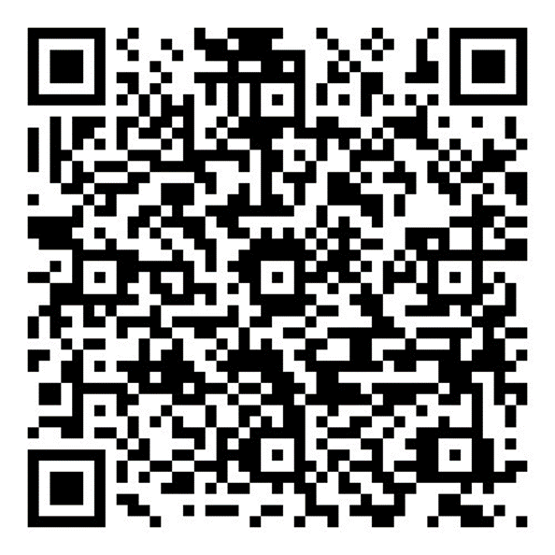
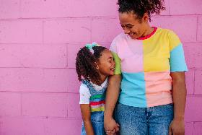
Prayer
A short weekly email reminder to pray for children and young people and the work of Growing Faith
Tuesdays 1.00-1.20 on Zoom
Prayer for doubling the number of children and young people who are active disciples https://cofe.io/doublecyp

Slide 26
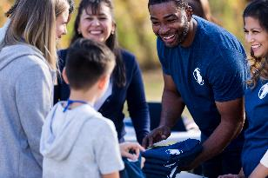
Networks
School-church connection
Chaplains
Parachurch organisations
Toddler group leaders
Listening and Responding to CYP

Slide 27
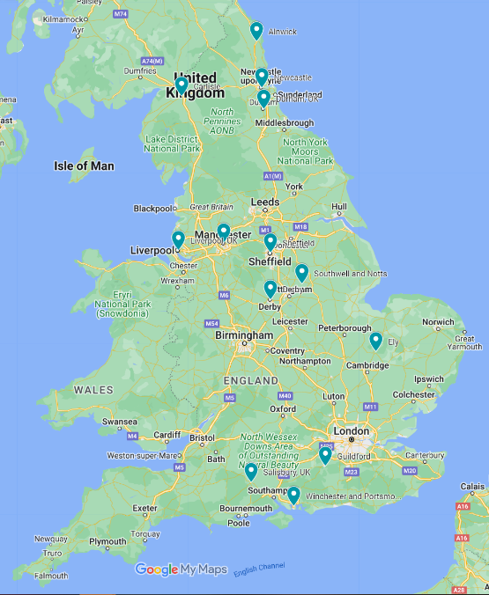
Hubs

Slide 28
Programmes
Growing Faith Strategic Leaders’ Programme
Provide a space for a collaborative learning community which models the intersections of Growing Faith
Professionally develop leaders, and aspiring leaders bringing sustained change in a range of contexts
Have a transformative impact on children and young people’s faith formation.

Slide 29
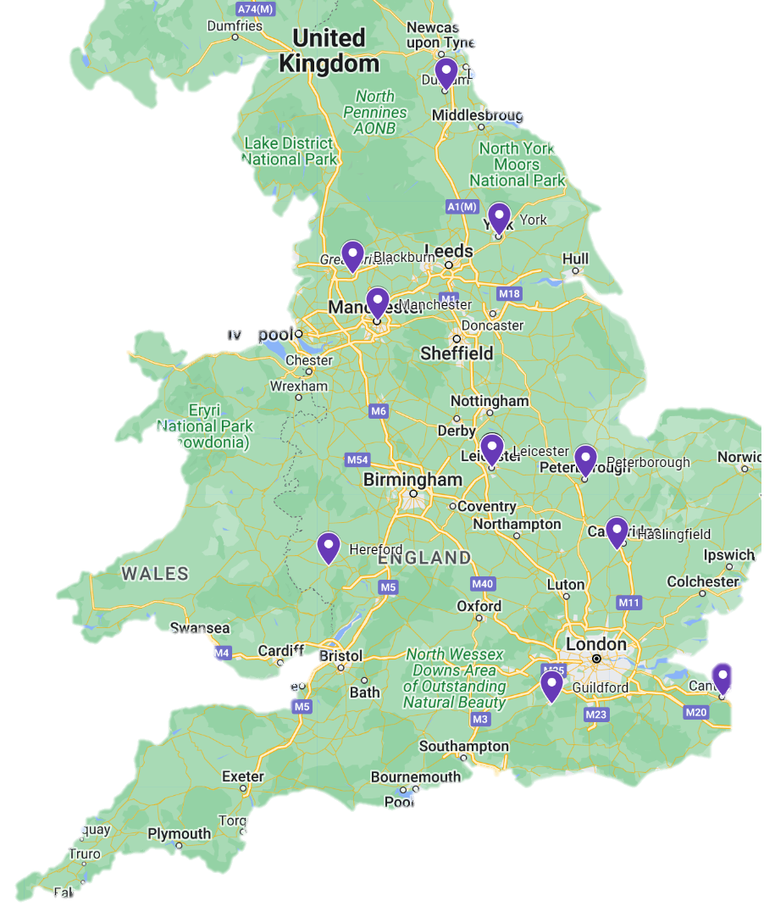
Faith and belonging in intergenerational church
Research
A shared community of priests and headteachers for mutuality in mission
Children and holiness
Let us pray… anywhere?
Happiness Club with church/school
intergenerational cohort
Intergenerational worship at all-age services
Empowering parents
The change agents: children in spiritual leadership in schools
Growing Faith in Minster Communities
Are we listening?
Faith in transition
Church/school partnership and the
spiritual development of children
Finding and growing in faith: the voices of LGBTQ+ Christians

Slide 30
Young people’s voices are instinctively at the centre of all leadership decision-making and implementation Clearly articulated and shared purpose to grow a younger and more diverse community of Christian disciples Strategic leadership partnership between school/college and at least one church community (with appropriate long-term governance and resource commitment) Intergenerational faith development experiences involving children and their families of all ages Worship that is fully integrated into the regular rhythms, practices, structures and resources of the school/college’s vision for flourishing of children and adults
FLOURISH
New worshipping communities in schools

Slide 31
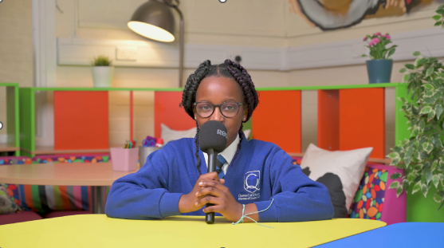
Videos and Podcast
Where do you feel close to God?
Who helps you learn about God?
New episodes monthly

Slide 32
Dreaming dreams….
What if your local church’s ‘centre of gravity’ was in the school rather than in the church building?
What if your diocese asked if you would like a church in your school?
What might be the impact if one of the school staff wore a dog collar to work? A crossing patrol-priest, a SENCO-vicar, an ordained lunchtime supervisor, a teacher-priest… ?

Slide 33
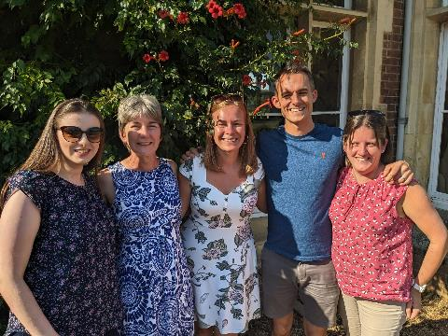
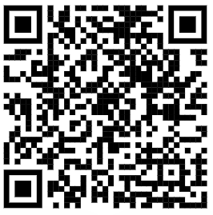
Contact
Growingfaith@churchofengland.org
Our newsletter! Scan to sign up!
One stop shop

Slide 34
And Jesus grew in wisdom and stature, and in favour with God and people. Luke 2: 52 NIVUK
Jesus in the Temple by James B Jangknegt 2009 used with permission

Slide 35
Discussion
Which parts of this made your soul sing?
What parts of this resonate with what God is doing in your own context at the moment?
What practical changes would help put children and young people (even more) at the heart of what you do in your parish?
Doodle the three intersecting circles. What do you already do in the intersections of home / church / school? Could any of this be taken on a step?
What questions do you need to find answers to?

