Slide 1
Financial Update
George Colville

Slide 4
Parish Share
£68,434
Standard Parish Share = Total amount required
Number of clergy in Diocese
Clergy Number
X
Parish Share =
Banding
X
Standard Parish Share

Slide 5
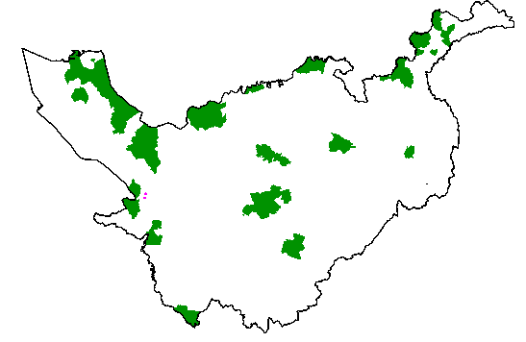
Parishes 0.25 – 0.95
Birkenhead / Wallasey
Stockport
Runcorn
Crewe

Slide 6
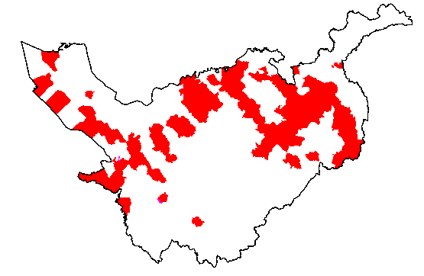
Parishes 1.15 -1.45

Slide 7
£58.9k

Slide 8
£12k

Slide 9
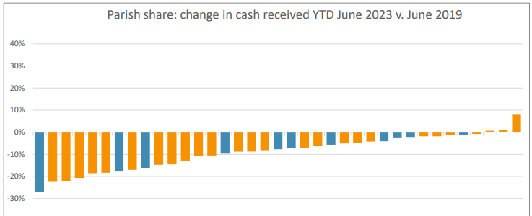
Parish Share 2019/2023

Slide 10
2024 and beyond?
2023 budget deficit £0.4m (about 90% parish share)
looking at present like might be bit better than this
2024 budget and beyond
Currently deficit looks similar
Likely higher stipend rises (5%?)
Inflation impacting other costs as well
Safeguarding / DBS
Bank interest / investment income bit better
What will come out of the Strategy work?
What will Parish share (5%?)

Slide 11
More information
01928 718834
www.chester.anglican.org
firstname.lastname@chester.anglican.org

