Slide 1
Churchwardens and Finance
What to do in practice
May be cheque signatory
Member of standing committee
Take an interest
Encourage and support
Provide backup for treasurer
if unable to act or if no candidate
Ask questions, watch and check – Internal control
Problems are rare but they do happen

Slide 4
Parish Share
£71,756
Standard Parish Share = Total amount required
Number of clergy in Diocese
Clergy Number
X
Parish Share =
Banding
X
Standard Parish Share

Slide 5
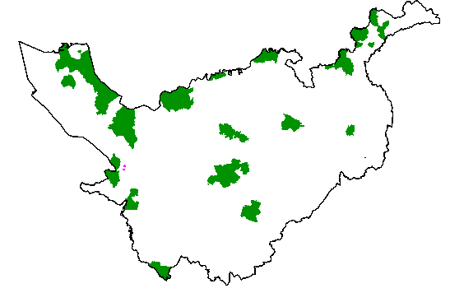
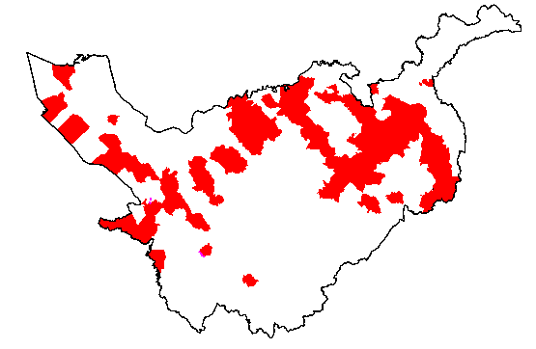
Parishes 0.25 – 0.95
Banding
Parishes 1.15 -1.45

