Slide 1
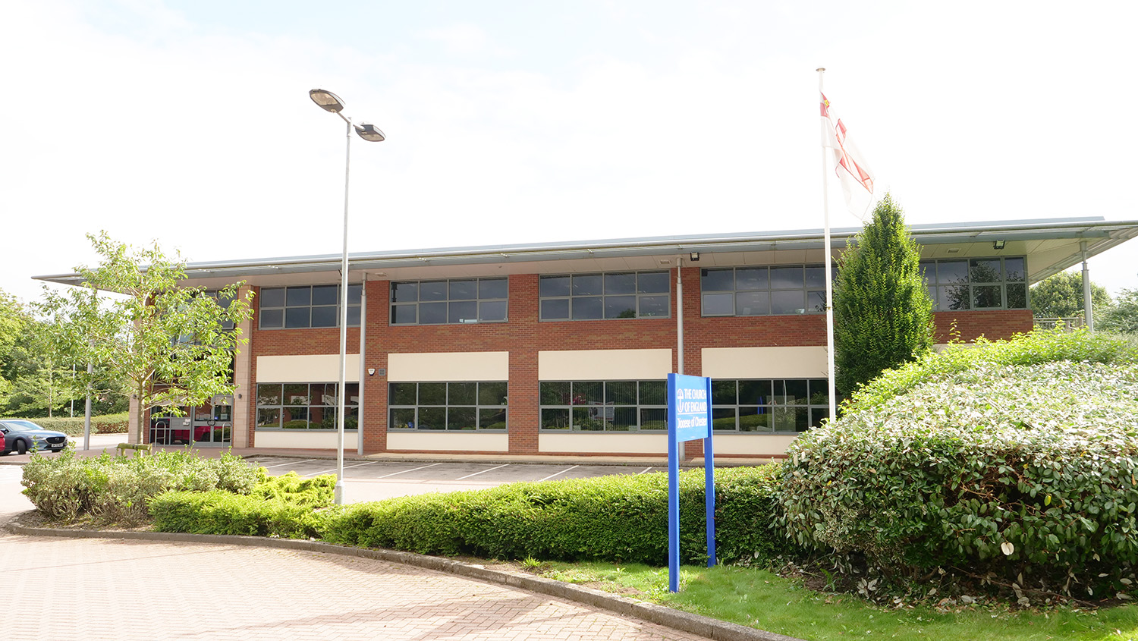
ASK US
INVITE US
VISIT US

