Slide 1

The Role of the
Churchwarden

Slide 2
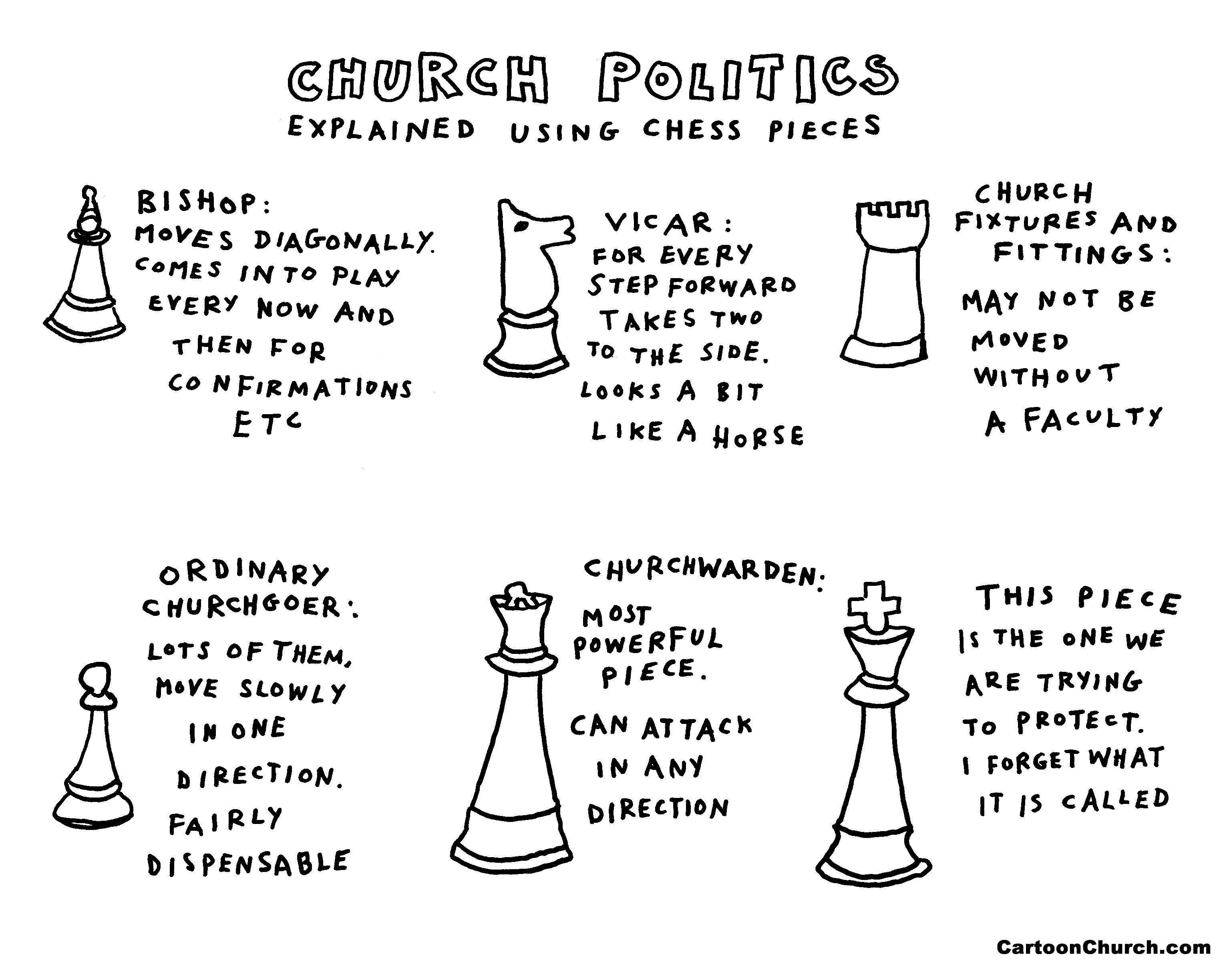

Slide 3
The churchwardens, when admitted, are officers of the Bishop of the Diocese. They shall discharge such duties as are by law and custom assigned to them; they shall be foremost in representing the laity and in co-operating with the incumbent; they shall use their best endeavours by example and precept to encourage the parishioners in the practice of true religion and to promote unity and peace among them. They shall also maintain order and decency in the church and churchyard, especially during the time of divine service.

Slide 4
Leadership
Example
Unity and peace
Order

Slide 5


Slide 6
Encouragement
Prayer and support
A sounding board
Eyes and ears

Slide 7
The churchwardens, when admitted, are officers of the Bishop of the Diocese.

