Slide 1
Financial Update
George Colville

Slide 2
Churchwardens and Finance
Member of PCC
Churchwarden Trusts
All PCC members have financial responsibilities

Slide 3
Churchwardens and Finance
What to do in practice
May be cheque signatory
Member of standing committee
Take an interest
Encourage and support
Provide backup for treasurer
if unable to act or if no candidate
Ask questions, watch and check – Internal control
Problems are rare but they do happen

Slide 6
Parish Share
£68,434
Standard Parish Share = Total amount required
Number of clergy in Diocese
Clergy Number
X
Parish Share =
Banding
X
Standard Parish Share

Slide 7
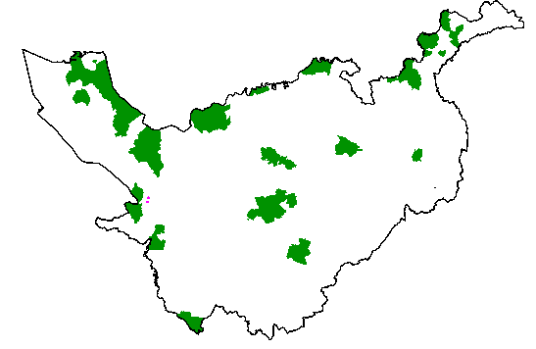
Parishes 0.25 – 0.95
Birkenhead / Wallasey
Stockport
Runcorn
Crewe

Slide 8
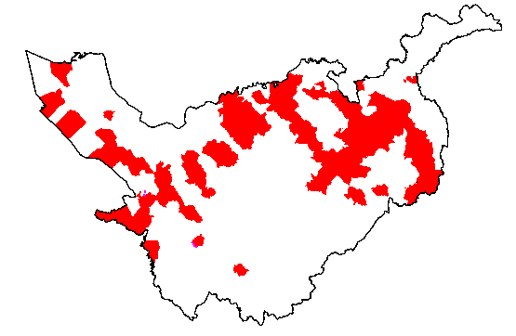
Parishes 1.15 -1.45

Slide 9
£58.9k

Slide 10
£12k

Slide 11
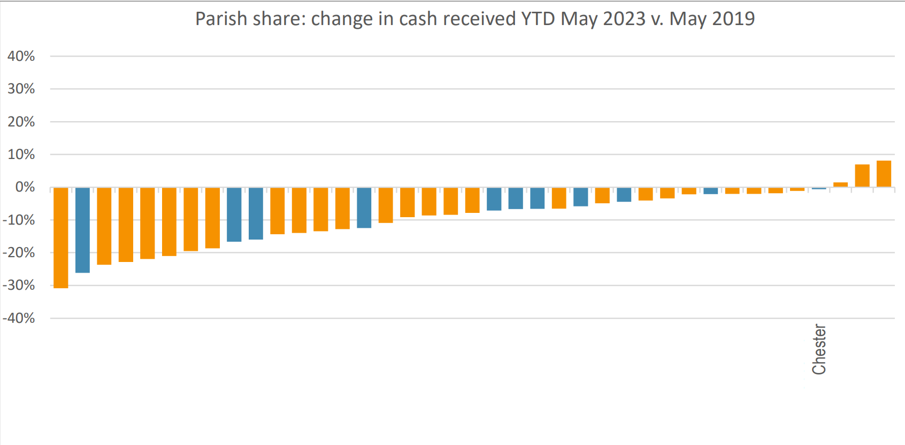
Parish Share 2019/2023

Slide 12
2024 and beyond?
2023 budget deficit £0.4m (about 90% parish share)
looking at present like might be better than this
2024 budget and beyond
Currently deficit looks similar
Likely higher stipend rises
General inflation impacting other costs
Bank interest / investment income bit better
What will Parish share collection be?
What will come out of the Strategy work?

Slide 13
More information
01928 718834
www.chester.anglican.org
firstname.lastname@chester.anglican.org

