Slide 1
Buildings for Mission What’s that all about?
Sheena Wilson – Buildings for Mission Advisor
Diocese of Chester

Slide 2
Chester Diocese – Church House, Daresbury
Ministry Team
Communications
DAC
Safeguarding
Outreach Team
Property Management
Finance
HR
Archdeacons

Slide 3
Chester Diocese – Outreach Team
Mission
Buildings for Mission
Digital Giving
Counseling
Youth and Families
Engagement and Inclusion

Slide 4
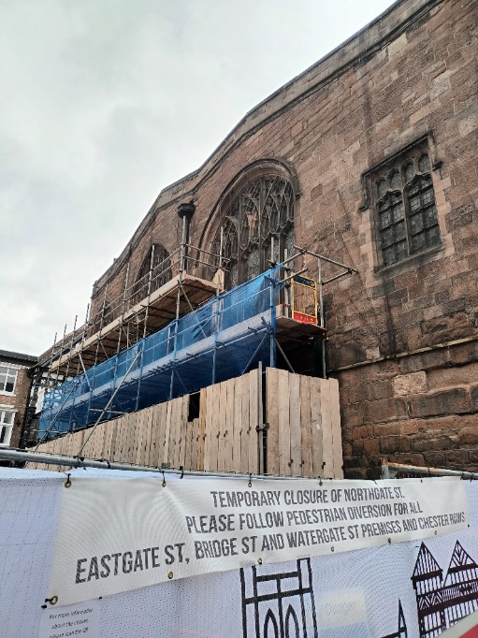
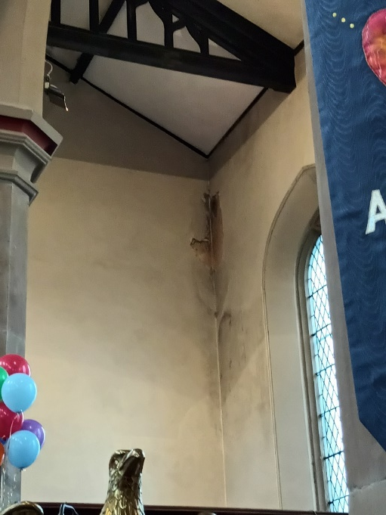
Building Stewardship
PPM
Insurance
Quinquennials
Inspections
Graveyards
Boundary Walls
Bats

Slide 5
Planned Preventative Maintenance (PPM)
“Take proper care of your monuments and you will not need to restore them. A few sheets of lead put in time upon the roof, a few dead leaves and sticks swept in time out of a water course, will save both roof and wall from ruin. Watch an old building with an anxious care; guard it as best you may, and at any cost, from every influence of dilapidation”
John Ruskin, speaking at Rouen Cathedral in 1859
“stave of decay by daily care”
William Morris in1877

Slide 6
Insurance
Insurance is one of the two highest spend areas for parishes, so it’s important to make good decisions when buying cover.
The Link to the full Buying Guide for advice on how to make a decision when buying Insurance cover.
Ecclesiastical was established in 1887 and is a specialist church, charity and heritage insurer. In 2022, Ecclesiastical updated its parish policy, Parish Plus, and launched a new policy Parish Protect. Ecclesiastical is wholly owned by a charity, Benefact Trust. All available profits are distributed to Benefact Trust, who in turn make donations back to the Church.
Trinitas Church Insurance’s ParishCare policy is underwritten by Aviva and has been developed after discussion with the Church of England to meet the typical needs of parishes for buildings, contents and liability risks associated with parish activities.
Trinitas and Aviva are commercial companies but will cap their profits with any surplus profits being returned to participating parishes.

Slide 7
Quinquennials and Other Inspections 1/2
Quinquennial Inspection - Every five years, your church building must be inspected by a suitably experienced and qualified professional, appointed after consultation with the Diocesan Advisory Committee. They will help you make sure your building is kept in good repair.The link to Church Buildings Guidance to Quinquennial Inspections.
Fire Risk Assessment - Churches are required to undertake a Fire Risk Assessment in accordance with the Regulatory Reform (Fire Safety) Order 2005. This assessment should be reviewed at least annually unless there is a change that materially affects the fire risk
Electrical Inspections - Churches should have their electrical installations (including the organ blower box if appropriate) inspected and tested every five years in accordance with the recommendations of The Church Buildings Council.

Slide 8
Quinquennials and Other Inspections 2/2
Lightning Protection - A lightning strike to a church can be devastating. A large church might expect to be struck by lightning once every 50 years. It's important to have suitable protection in place and to have it tested every two and a half years.
Asbestos Inspections - each PCC has a duty in law actively to manage asbestos in its church and church hall in order to protect the well-being of anyone who may come into contact with the material. Ensure that your church has had an asbestos survey in the last five years

Slide 9
Graveyards
Graveyards - A consecrated burial ground of a Church of the Church of England is subject to legal control which is exercised by the Chancellor of the Diocese on behalf of the Bishop. No memorials may be erected, or any works undertaken, in a churchyard except by written authorisation or faculty. A faculty is an Order made by the Chancellor as Judge of the Consistory Court of the Diocese.
Churchyards - display a variety of historic structures, many listed in their own right. The good management of a churchyard needs to take into account a range of issues, from the burial rights of parishioners to the wildlife management of the churchyard. Here is the link to the document Memorials-in-churchyards
Trees - can be both beautiful and dangerous and therefore many regulations apply to them. They should be inspected before and after instances of severe weather, particularly in areas of high public footfall such as adjacent to roads or paths. A professional inspection is required every 5 years and should be included as an annex to the quinquennial inspection report on the church building.

Slide 10
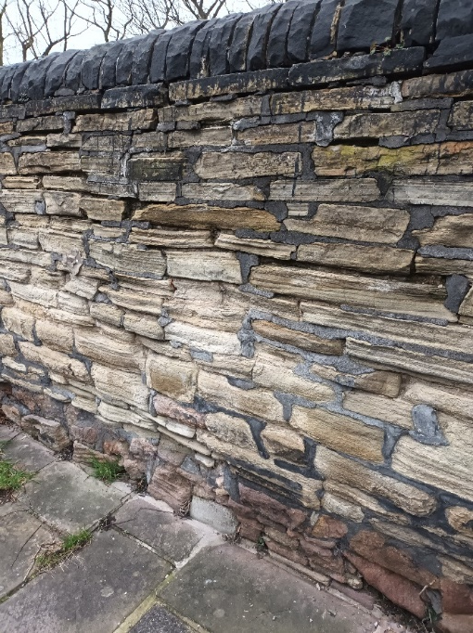
Boundary Walls
Boundary Walls - so placed as to separate two parcels of land in different ownership. They should be inspected as part of the Quinquennial Inspection and are often listed as part of the curtilage of the church.

Slide 11
Bats & Nesting Birds
Bats - It is an offence for anyone to kill, injure or capture a bat, or to disturb a colony in any way which is likely to have a negative impact on their continued survival. Further guidance for property owners and all involved in managing, maintaining or making changes to buildings, or using the buildings is provided through Historic England's Building Works and Bats guidance.
Nesting Birds - All birds, their nests and eggs are protected by law and it is thus an offence, to: Intentionally kill, injure or take any wild bird. Intentionally take, damage or destroy the nest of any wild bird while it is in use or being built. Most birds generally nest between March and August.

Slide 12
Funding
Fund Raising
Grants
Minor Repair Funding
Digital Giving
Faculties

Slide 13
Grants

Slide 14
Missional Use
Reordering
Inclusivity Provision
Engaging with the Community
Warm Spaces
“Places of Welcome”
“Filling the Gap”

Slide 15
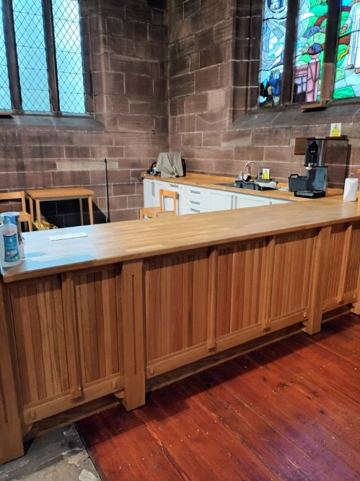
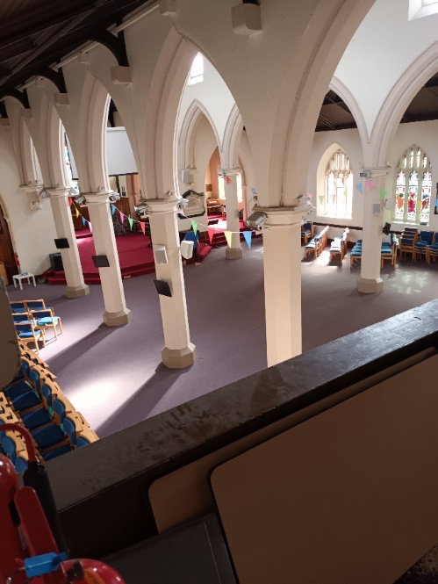
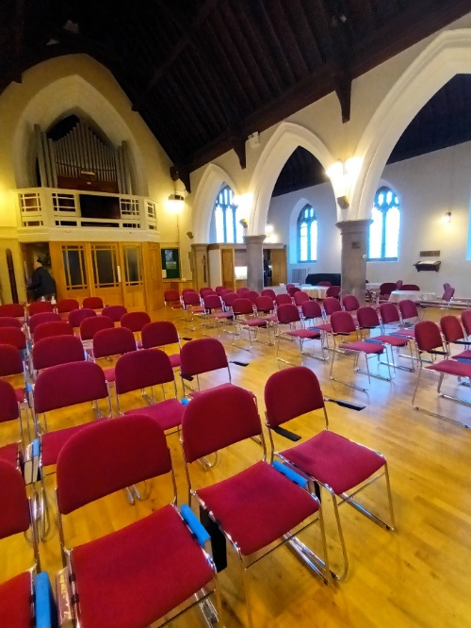
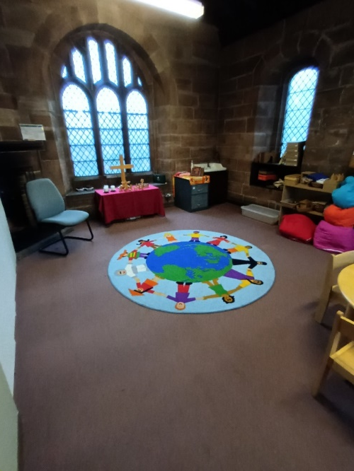
Reordering
Do you have a plan? (short, medium or long term)
How often do you review what you offer the community?
Do you know what skills you have available within the congregation?
How are you showing the 5 Marks of mission in everything you do in your Parish

Slide 16
Inclusivity
Do you understand the needs of all your congregation?
Do your spaces work for impaired mobility, partially sighted, deaf etc
How are you showing the 5 Marks of mission in everything you do in your Parish

Slide 17
Engaging with the Community
Warm Spaces
“Places of Welcome”
Have you asked the local community what their needs are?
Vision?

Slide 18
Net Zero Carbon 2030
Energy Footprint Tool
Energy Assessment
Heating Options
Insulation
Lighting
Eco-Church

Slide 19
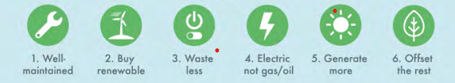
Routemap Scope

Slide 20
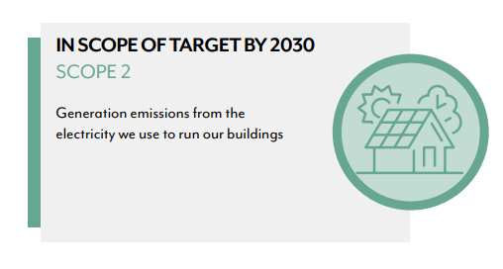
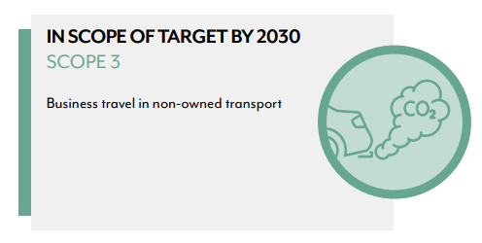
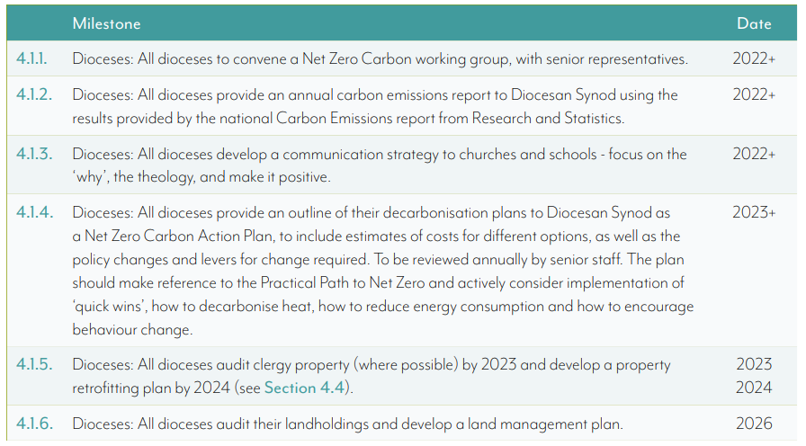
Scope

Slide 21
Milestones

Slide 22
Buildings for Mission – What’s that all about?
Buildings Maintenance
PPM
Insurance
Quinquennials
Inspections
Graveyards
Boundary Walls
Bats
Missional Use
Reordering
Inclusivity Provision
Engaging with the Community
Warm Spaces
“Places of Welcome”
“Filling the Gap”
Funding
Fund Raising
Grants
Minor Repair Funding
Digital Giving
Faculties
Net Zero Carbon 2030
Energy Footprint Tool
Energy Assessment
Heating Options
Insulation
Lighting
Eco-Church
What Else?
Environment Forum
Sharing of Best Practice
Database of Specialist Contractors
Sheena Wilson (Mrs) IEng MICE
Buildings for Mission Advisor
Diocese of Chester
T: 01928 718834 ext. 236
M: 07729 072228

Slide 23
Buildings for Mission – What’s that all about?
Thank you
Sheena Wilson (Mrs) IEng MICE
Buildings for Mission Advisor
Diocese of Chester
T: 01928 718834 ext. 236
M: 07729 072228

