Slide 1

Welcome to Churchwarden’s Training 2024
Thank you!

Slide 2
Programme for the day
Housekeeping
Breaks and lunch
Speakers
Follow-up

Slide 3
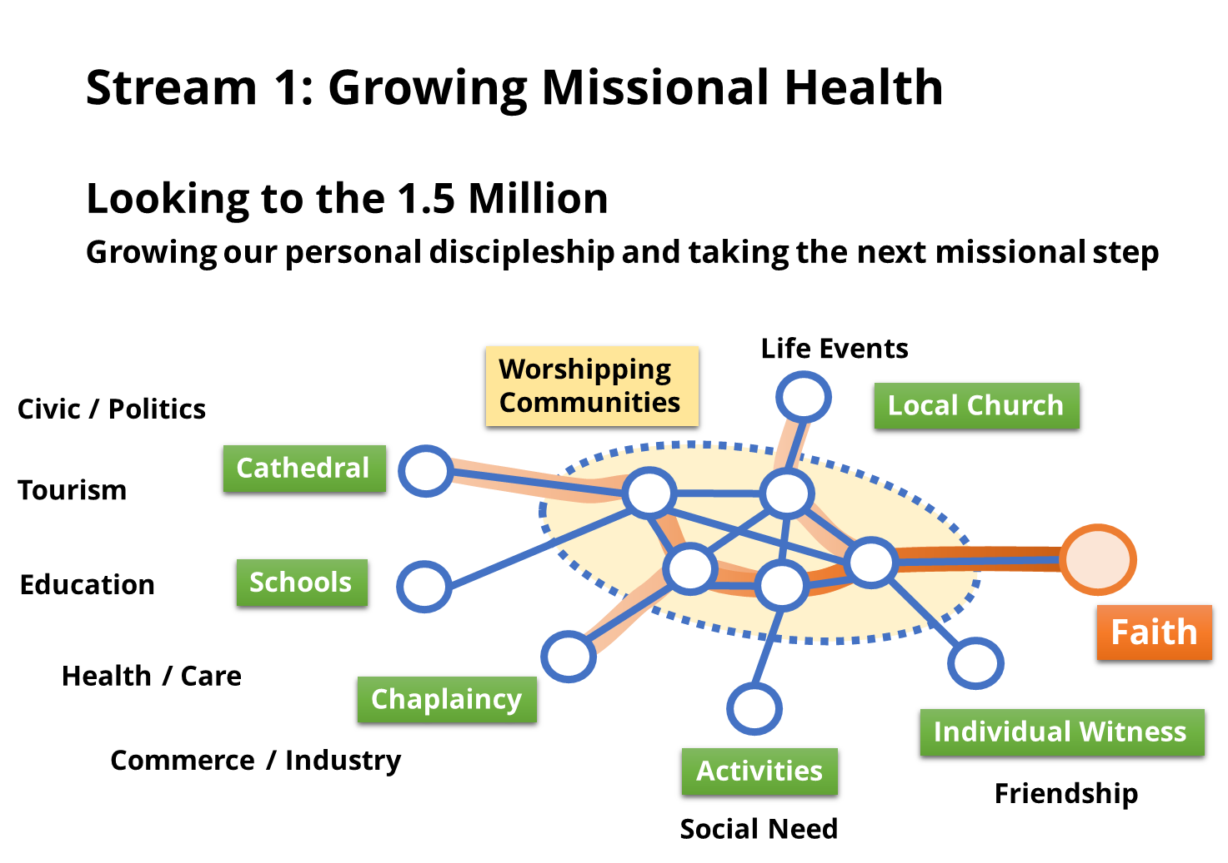
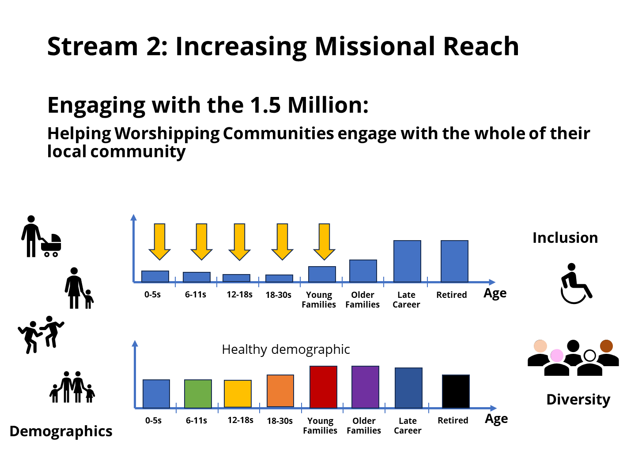
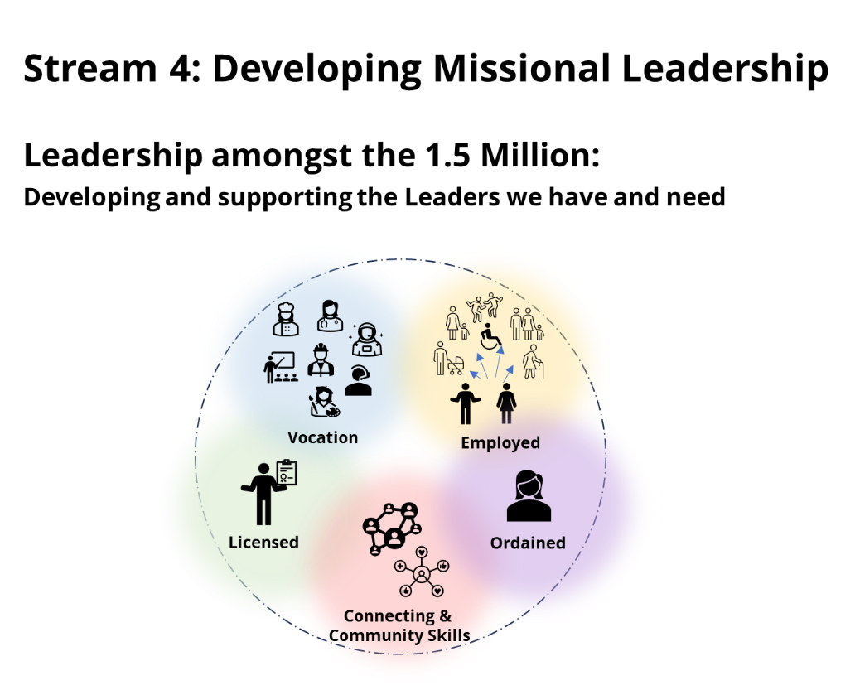
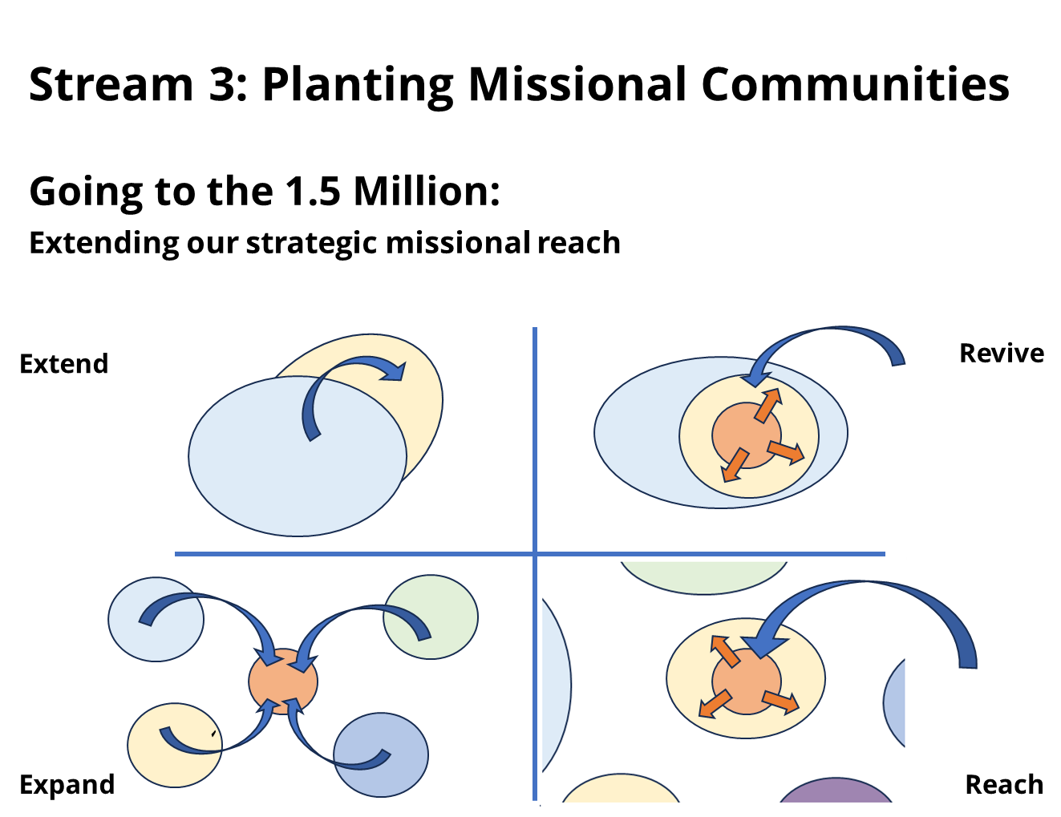
Growing, Braver, Fuller Faith
Blessing 1.5 million people, 1 life at a time
Transformative loving service
Engaged locally, working together

Slide 4
Time frames & SMMIB “Glidepath” to DIP funding approval
High level description of strategy:
Our vision – the WHY
Scoping
Core Idea
Development
Initial
Proposition
SMMIB
Draft Proposal
Nov 2024
Detailed description of strategy:
Exactly what are we going to focus on
How SMMIB funding will help us
Further
Development
Detailed Proposition
SMMIB
Detailed
Proposal
Feb 2025
Formal submission to SMMIB:
Addressing concerns/issues raised
Addressing
Outstanding
Concerns
Final
Proposition
SMMIB
Final
Proposal
1 May 2025 for 12 June 2025

