Slide 1
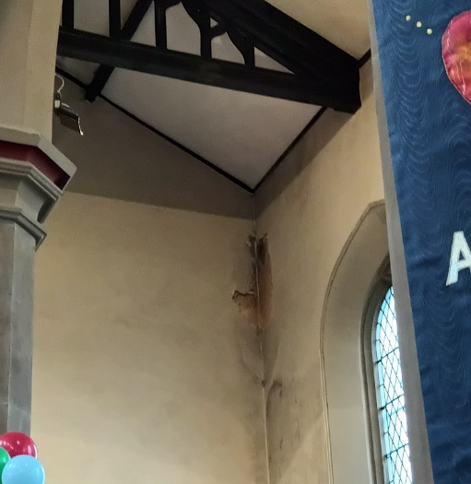
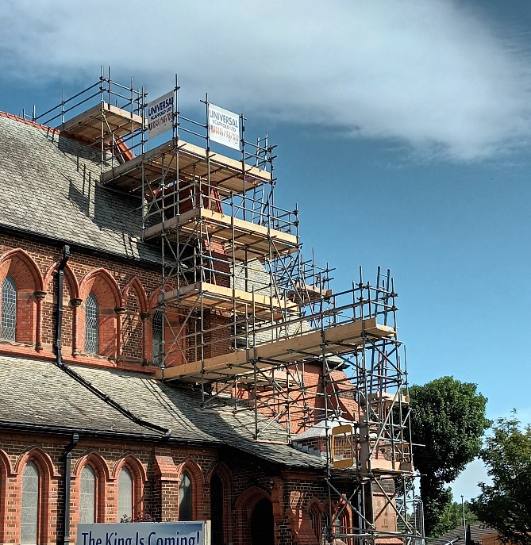
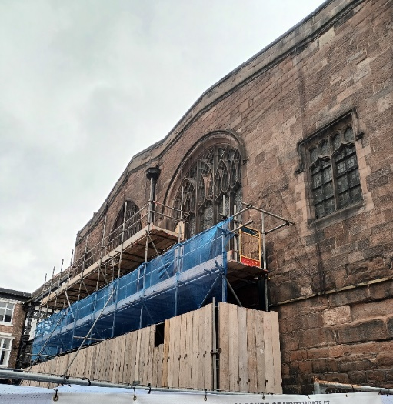
Building Stewardship
PPM
Insurance
Quinquennials
Inspections
Graveyards & Boundary Walls
Bats
Notes:
Just forget today that the Church is the people. For today the church is the building!!!!
For some of us buildings are “marmite” we both love them, and we hate them sometimes at the same time!
I would argue that they are an essential part of the equipment we need for ministry but realise that they can also be an unwelcome distraction from our ministry.

Slide 2
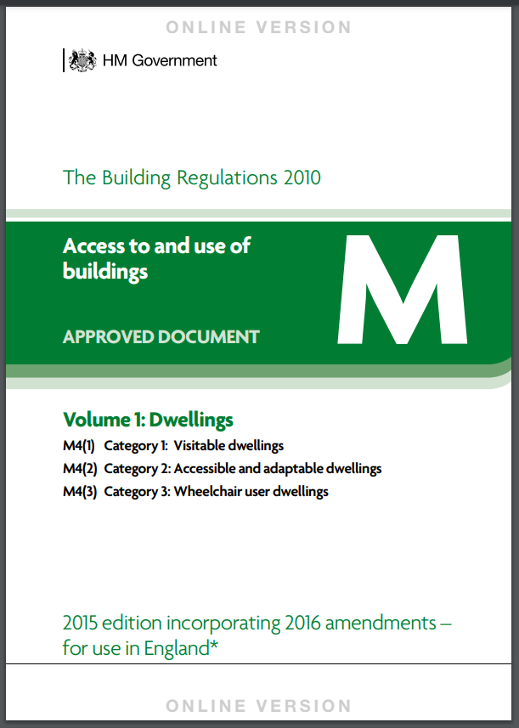
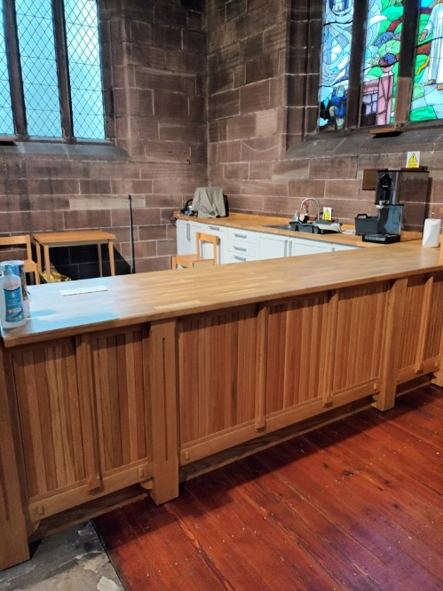
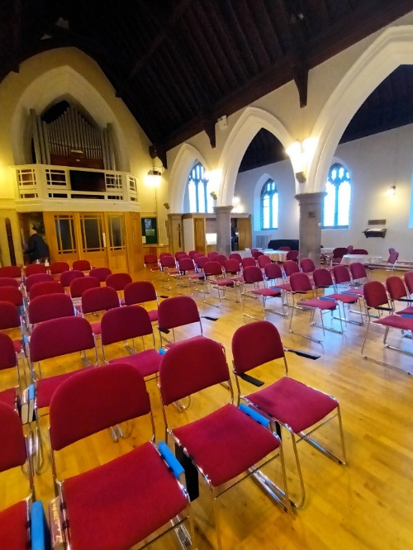
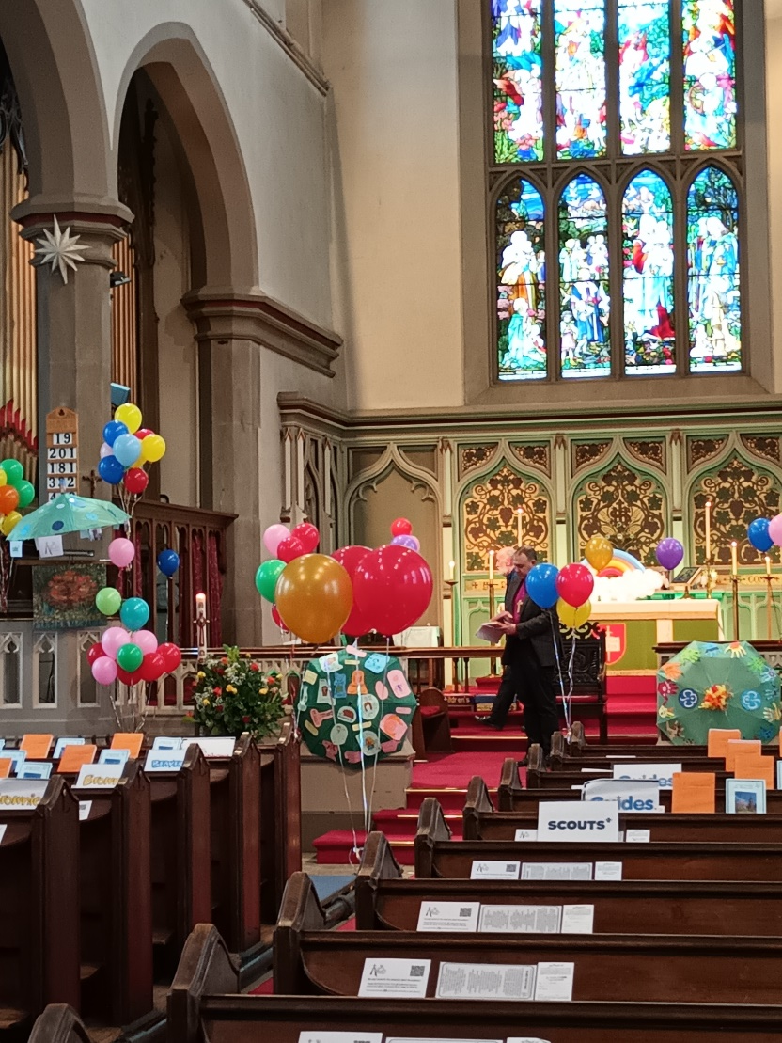
Missional Use
Reordering
Accessibility Provision
Inclusivity Provision
Engaging with the Community
Warm Spaces - “Places of Welcome”
Notes:
Here are a few things to think about when looking at the functionality of your church building

Slide 3
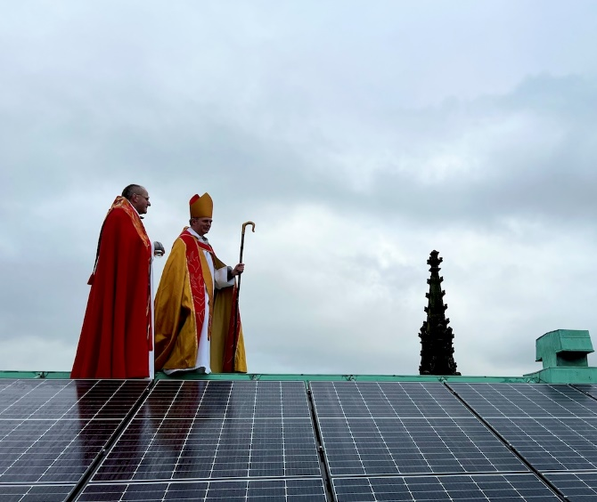
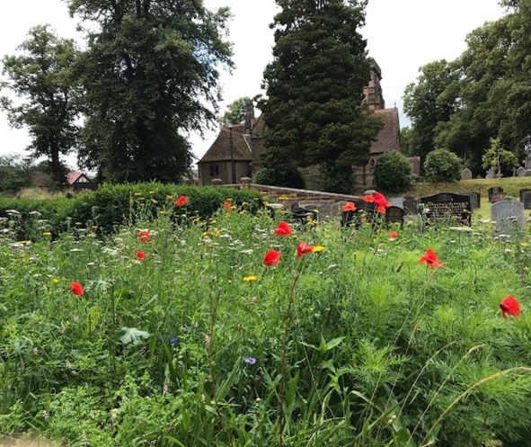
Environment
Energy Footprint Tool & Energy Assessment
Caring for Gods Acre
Eco-Church
Net Zero Carbon 2030

Slide 4
Funding
Fund Raising
Grant Funding
Minor Repair & Improvement Fund

