Slide 1

Churchwardens training
Some ideas to help you cope!
20th July 2021

Slide 2
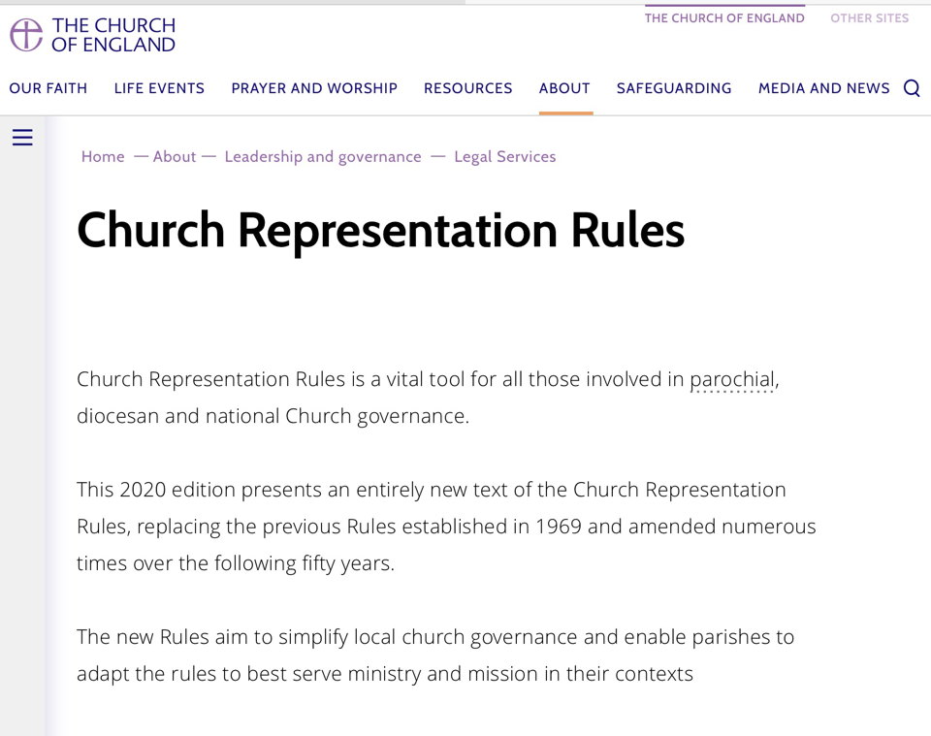
Online Resources

Slide 3
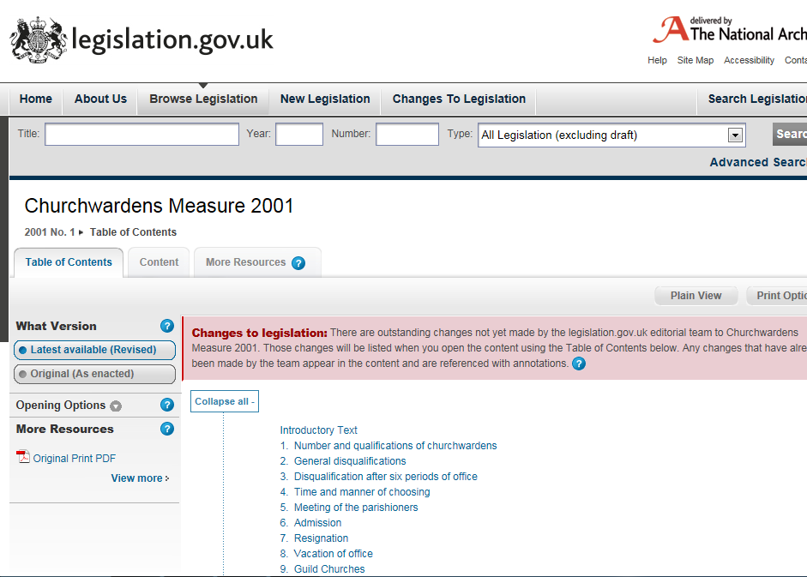
Available at

Slide 4
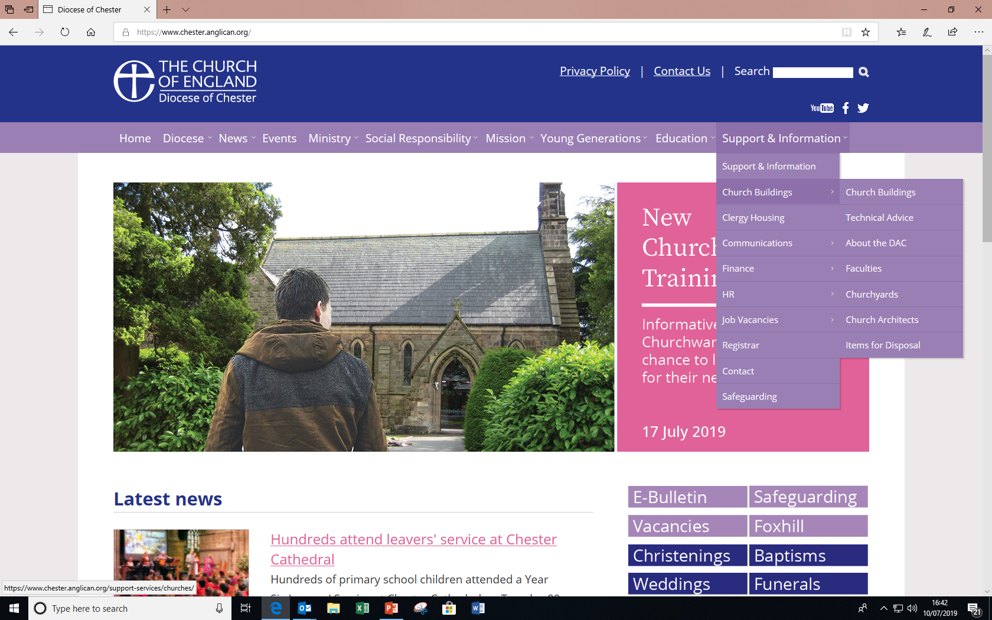
Diocesan support with church buildings
www.chester.anglican.org /Support and information / Church buildings

Slide 5
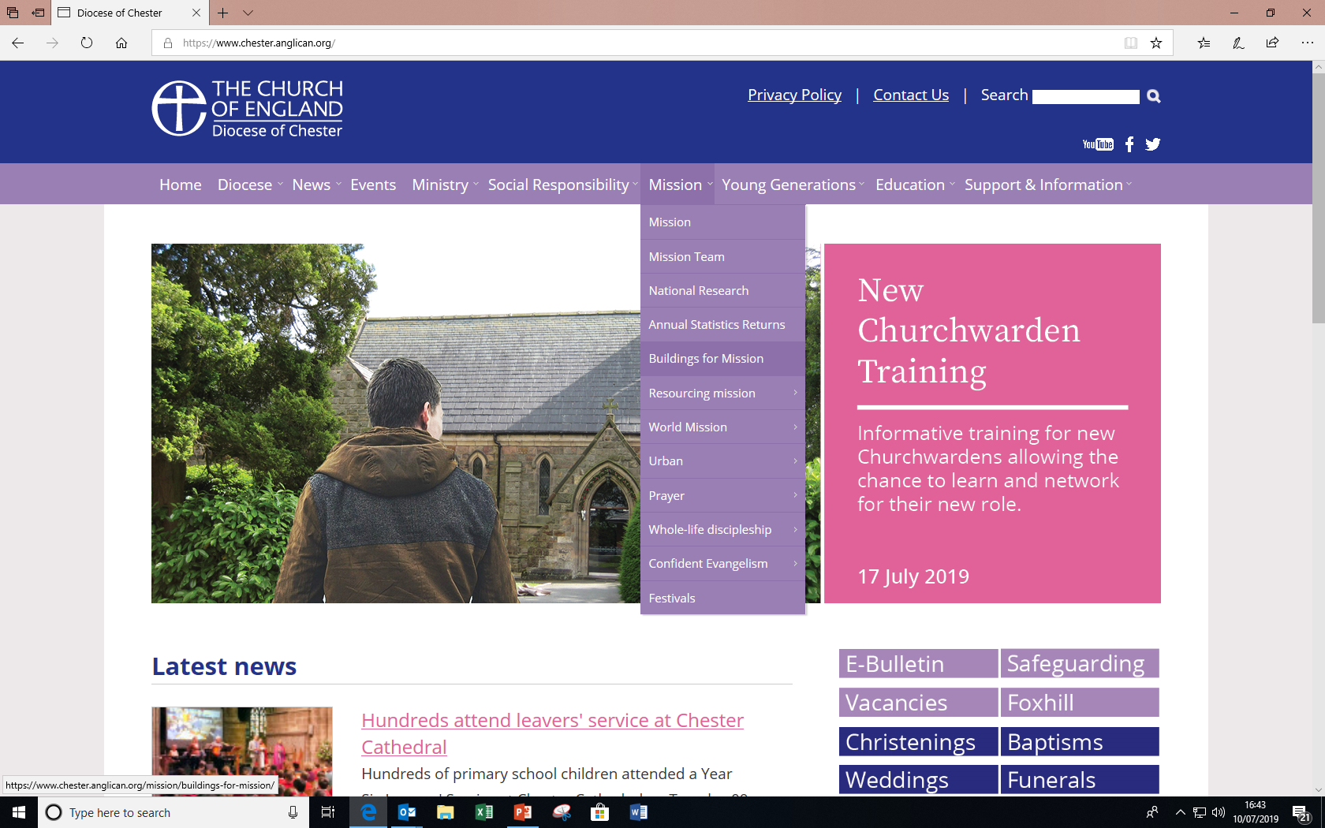
Diocesan support with church buildings
www.chester.anglican.org / Mission / Buildings for Mission

Slide 6
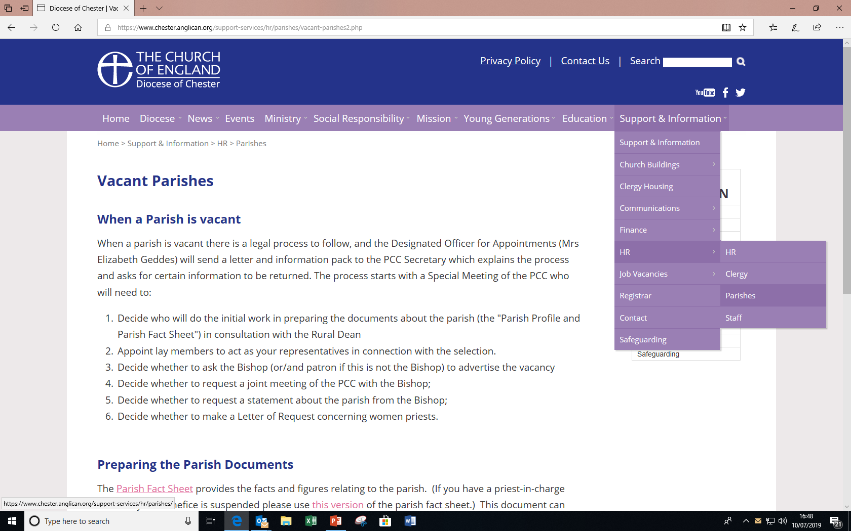
Diocesan support with parish matters
www.chester.anglican.org /Support and information/ HR/Parishes

Slide 7
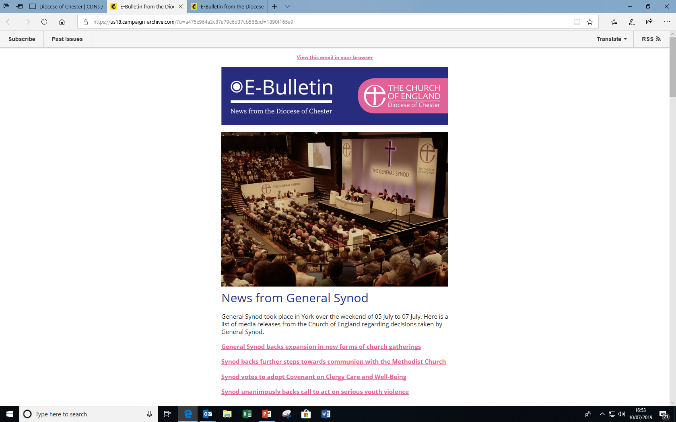
Diocesan communications
www.chester.anglican.org / Support and Information / Communications / CDN and E bulletins

Slide 8
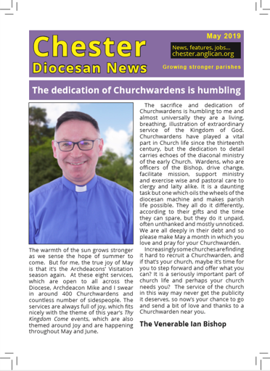
Diocesan communications
Chester
Diocesan News (CDN)

Slide 9
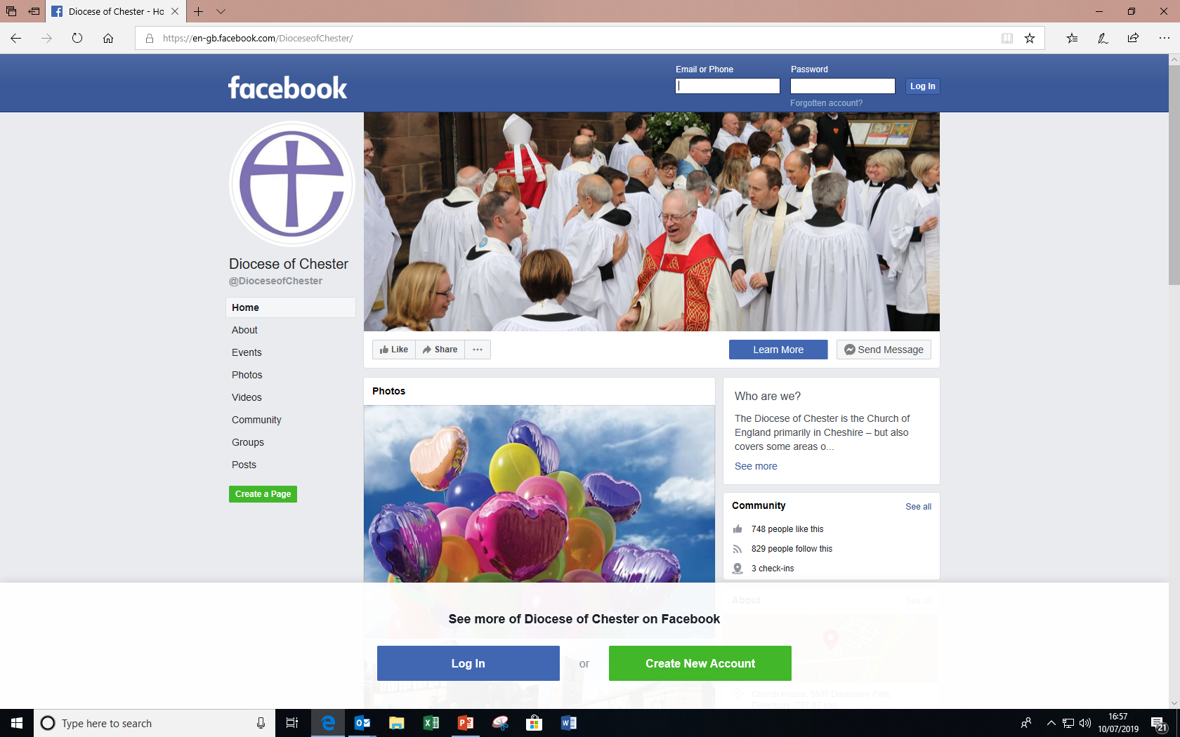
Diocesan communications
Facebook - Diocese of Chester

Slide 10
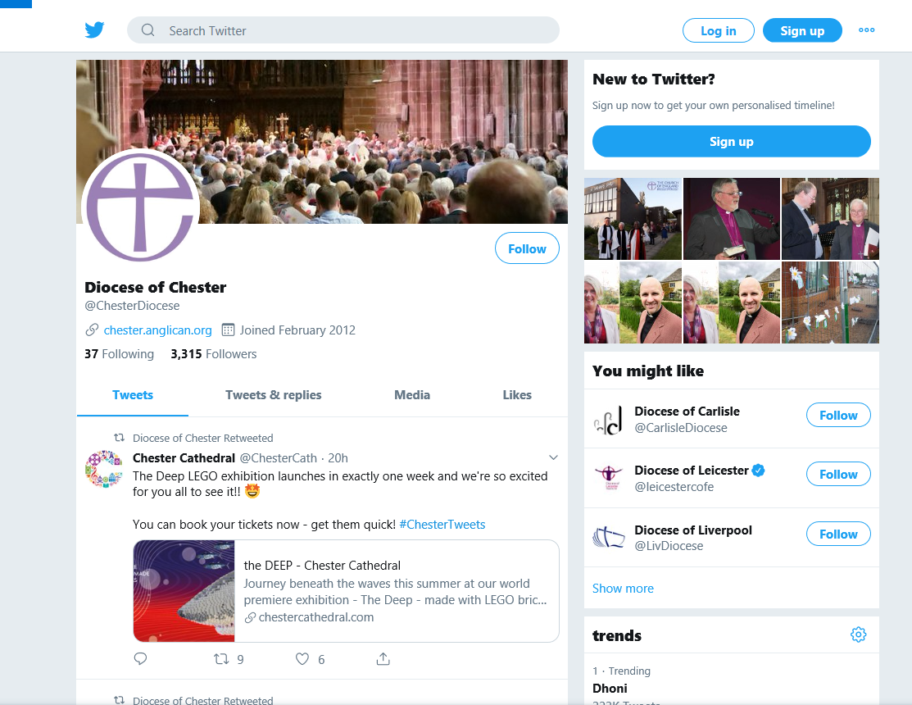
Diocesan communications
Twitter - @ChesterDiocese

Slide 11
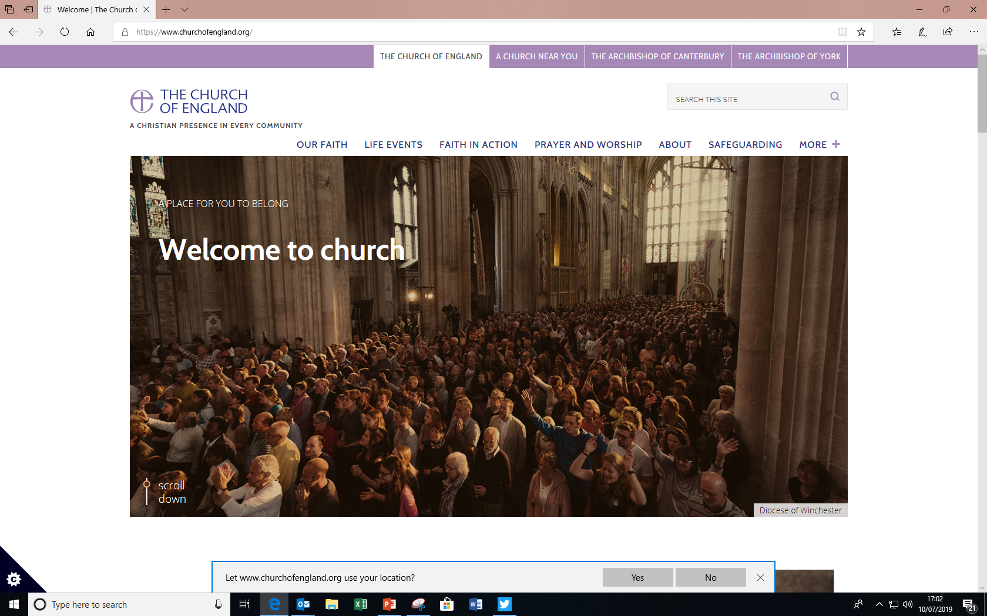
Church of England website
www.churchofengland.org

Slide 12
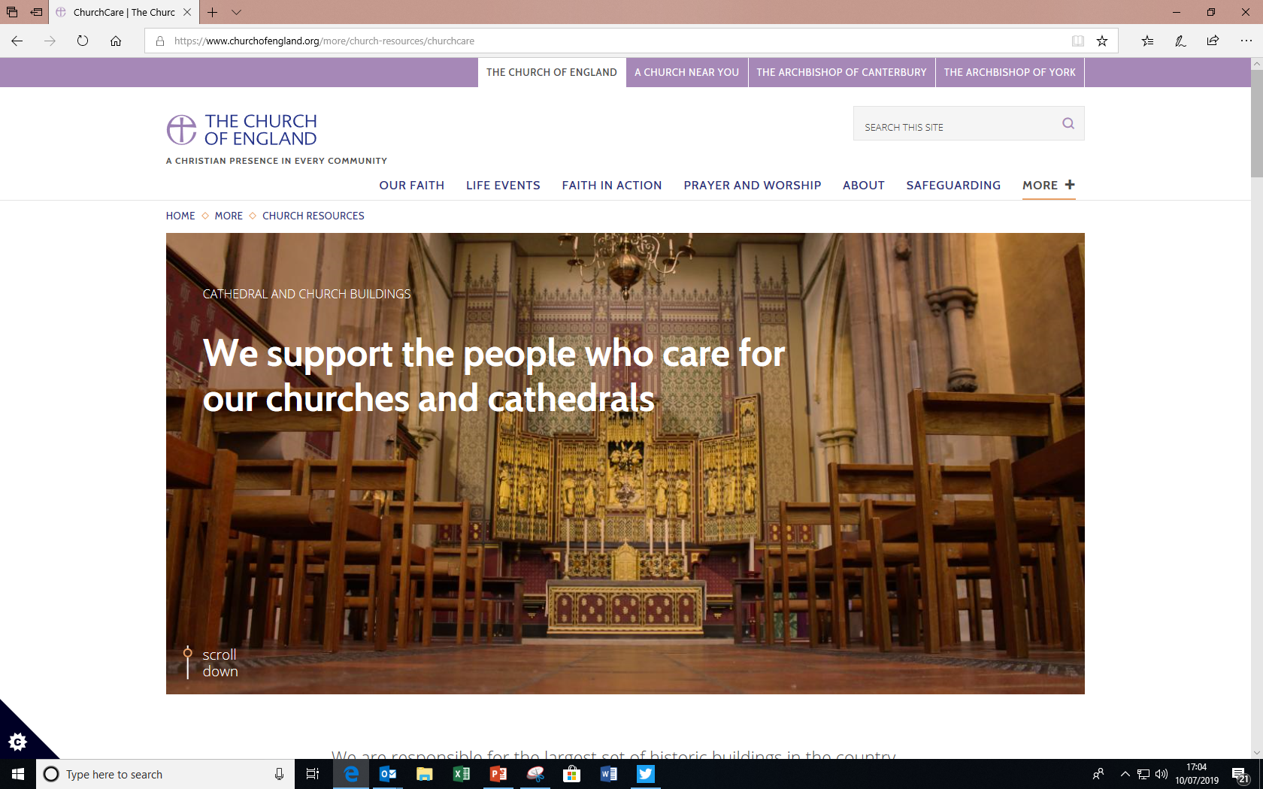
ChurchCare website www.churchofengland.org/more/church-resources/churchcare

Slide 13
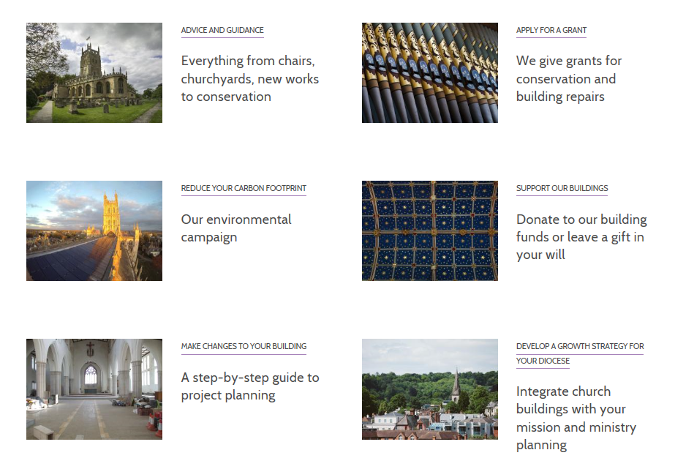
ChurchCare website
How the Church Buildings Council can help

Slide 14
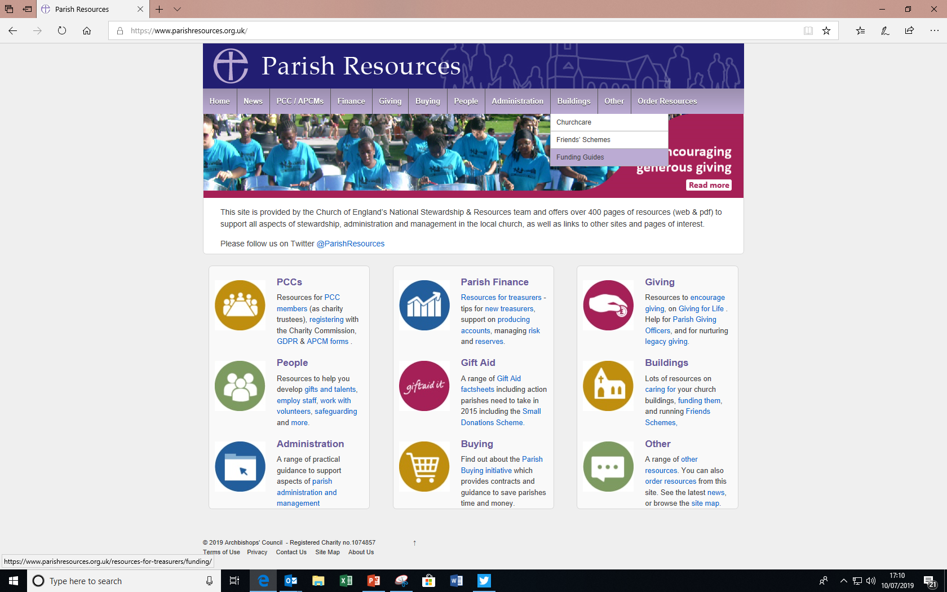
Parish Resources website www.parishresources.org.uk / Buildings
(Includes fundraising guides)

Slide 15
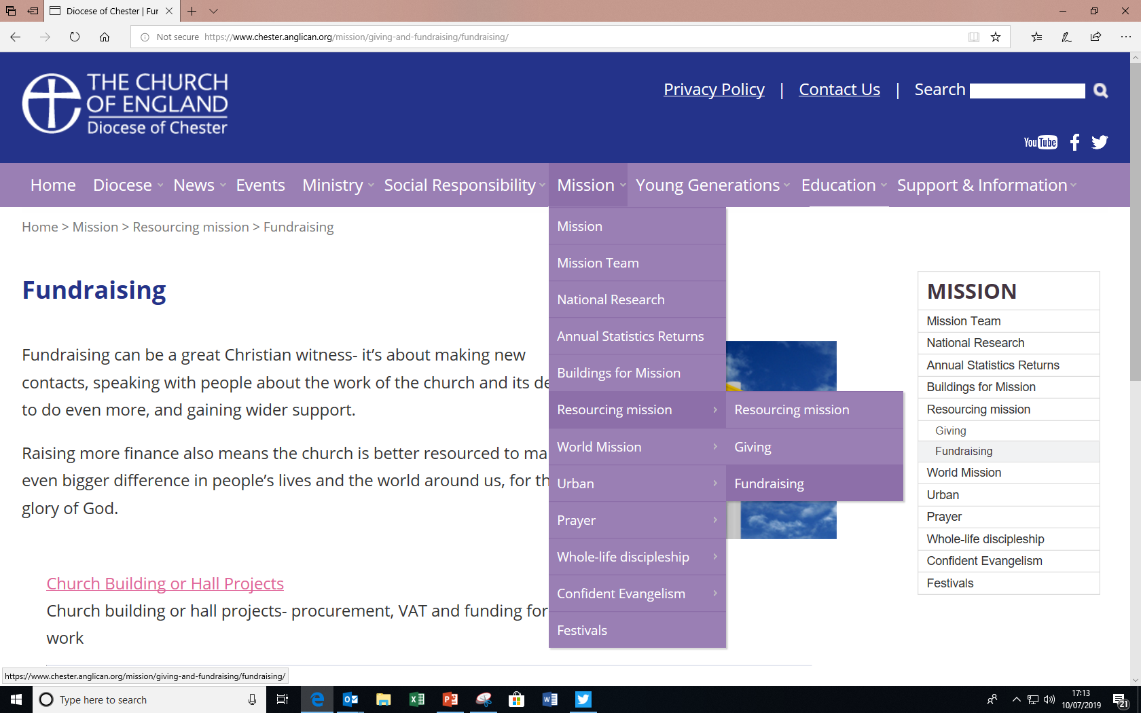
Diocese of Chester Fundraising Guide www.chester.anglican.org/mission/giving-and-fundraising/fundraising/

Slide 16
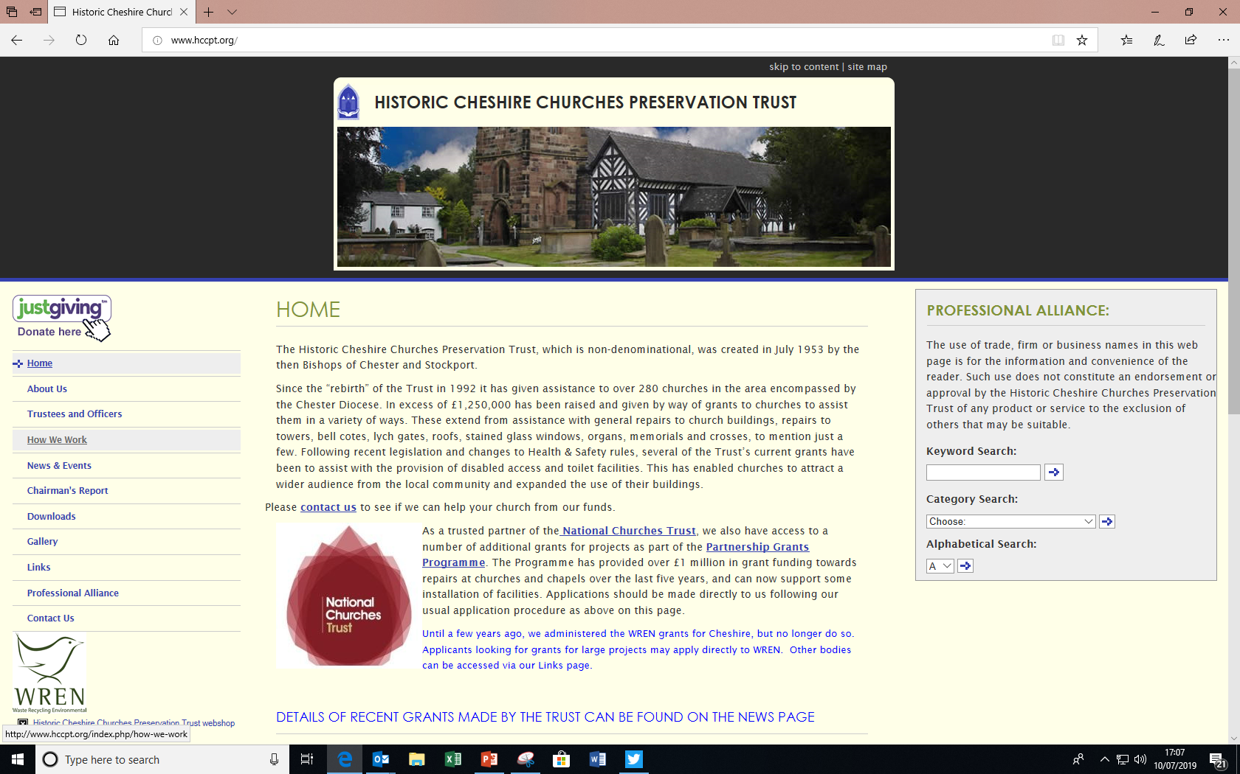
Our local county church trust www.hccpt.org

Slide 17
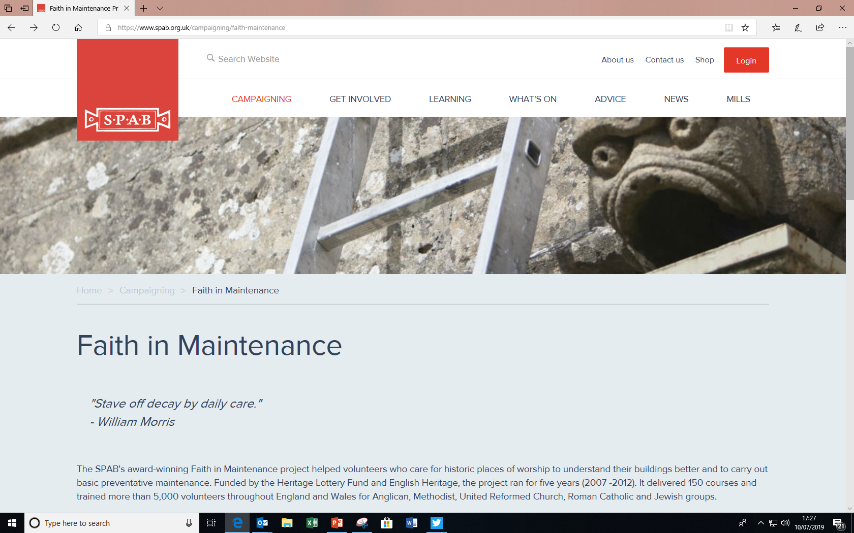
Caring for buildings
Faith in Maintenance project www.spabfim.org.uk
Notes:
If you’d rather watch and listen to a guided tour of a church building, pointing out how to look after different features, then watch this free to download film. You can also purchase a book from the Society of Protection of Ancient Buildings bookshop online, called ‘Faith in Maintenance’, along with a maintenance calendar. c. 55 minutes long, very practical, easy to understand guide to maintaining the fabric of a church building.

Slide 18
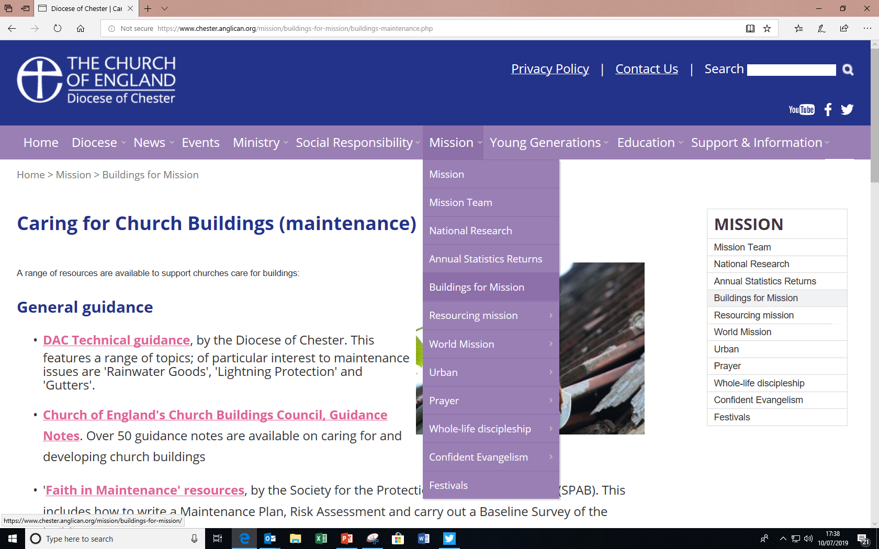
Caring for buildings www.chester.anglican.org/mission/buildings-for-mission/buildings-maintenance.php

Slide 19
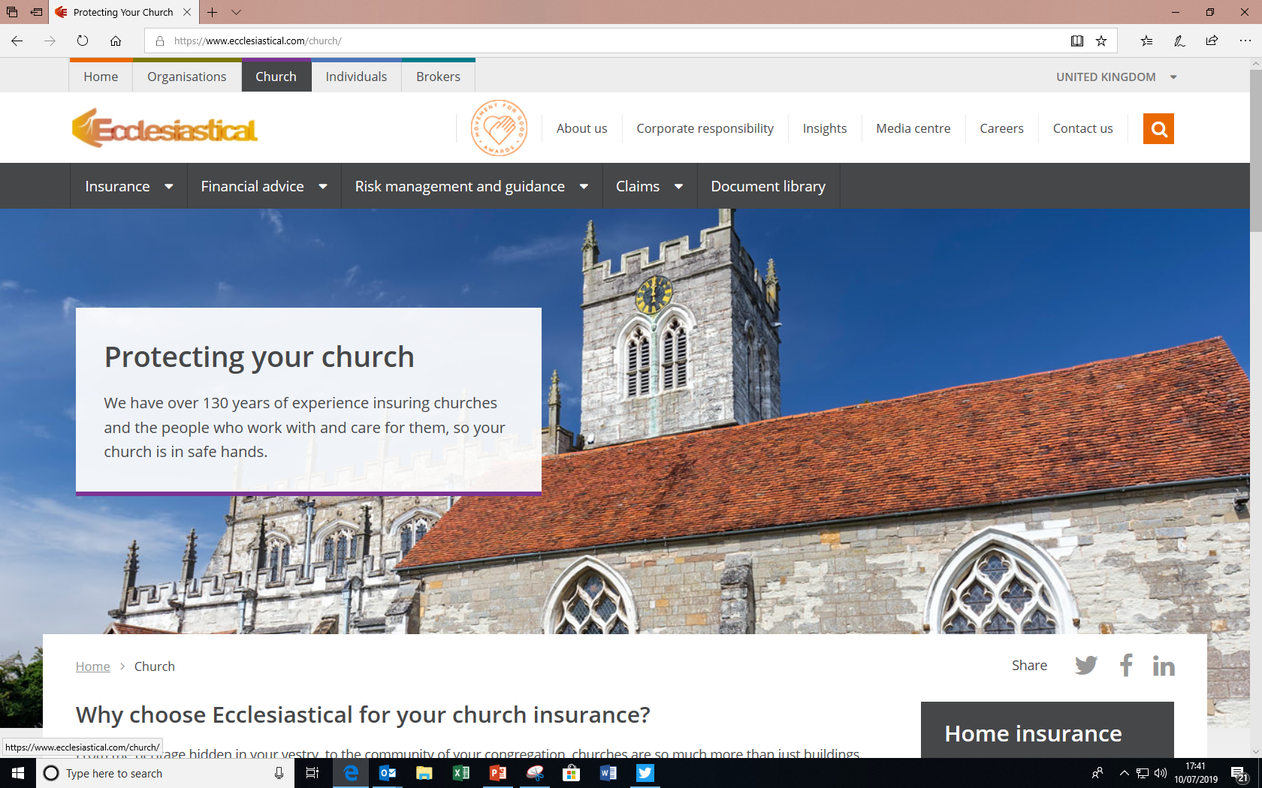
Caring for buildings - insurance www.ecclesiastical.com/church

Slide 20
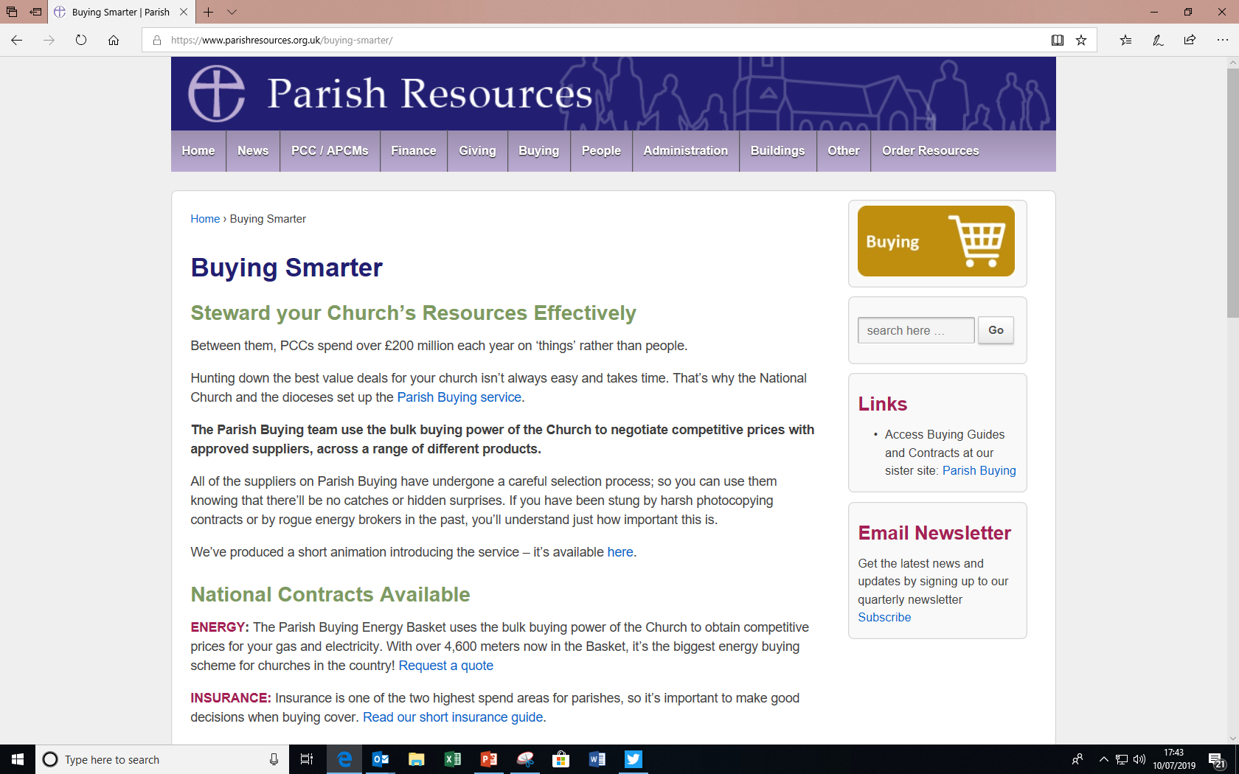
Parish Buying www.parishresources.org.uk/buying-smarter/

Slide 21
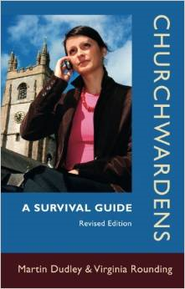


Useful books

Slide 22




Slide 23


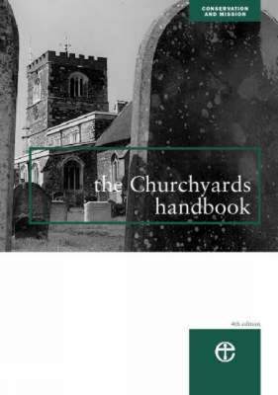

Slide 24
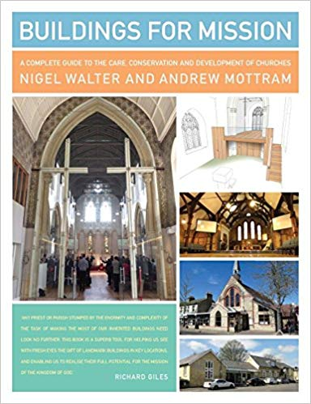
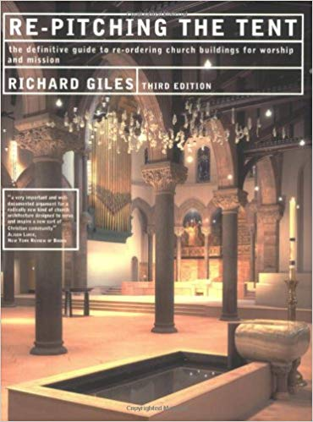
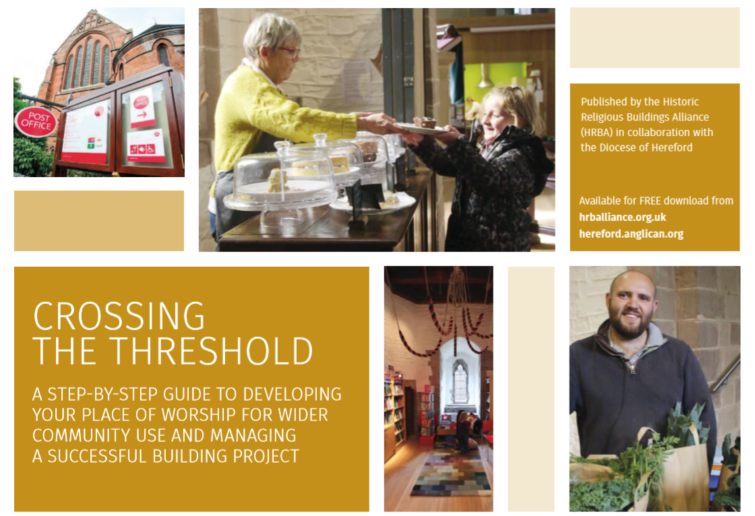

Slide 25
Useful people
Archdeacons - Ven Mike Gilbertson/ Ven Ian Bishop
Finance - Nigel Strange/ George Colville/ Sharon Taylor-Booth
Safeguarding - Pauline Butterfield
HR - Liz Geddes
Vicarages - Alan Kempster-Down
Church Buildings - Caroline Hilton and Emily Allen
Outreach – Peter Froggatt/ Johnny Masters/ Vanessa Layfield and team
Your Rural Dean
EIG

