Slide 1
Financial Update
George Colville
Diocesan Secretary

Slide 2
Churchwardens and Finance
Member of PCC
Churchwarden Trusts
All PCC members have financial responsibilities

Slide 3
Churchwardens and Finance
What to do in practice
May be cheque signatory
Member of standing committee
Take an interest
Encourage and support
Provide backup for treasurer
if unable to act or if no candidate
Ask questions, watch and check – Internal control
Problems are rare but they do happen

Slide 6
Parish Share
£66,349
Standard Parish Share = Total amount required
Number of clergy in Diocese
Clergy Number
X
Parish Share =
Banding
X
Standard Parish Share

Slide 7
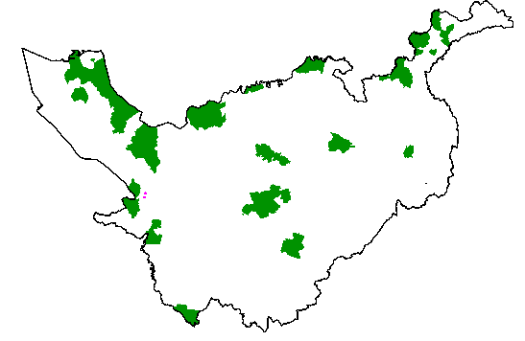
Parishes 0.25 – 0.95
Birkenhead / Wallasey
Stockport
Runcorn
Crewe

Slide 8
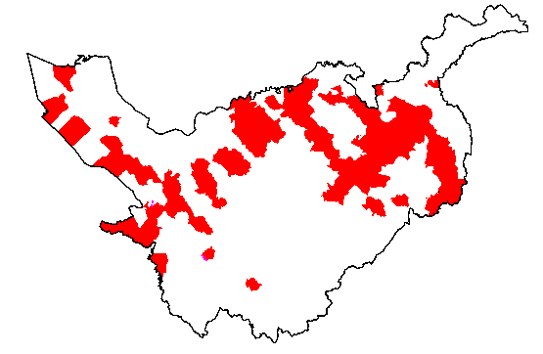
Parishes 1.15 -1.45

Slide 9
£59k

Slide 10
£11k

Slide 11
2023 and beyond?
2022 budget deficit £0.9m (90% parish share), at present we think will be similar
2023 Budget
clergy pension contributions / NI
Inflation (6% stipends)
Parish share rise 3% (90% collection)
Safeguarding
Deficit but reduced on 2022

Slide 12
More information
01928 718834
www.chester.anglican.org
firstname.lastname@chester.anglican.org

