Slide 1
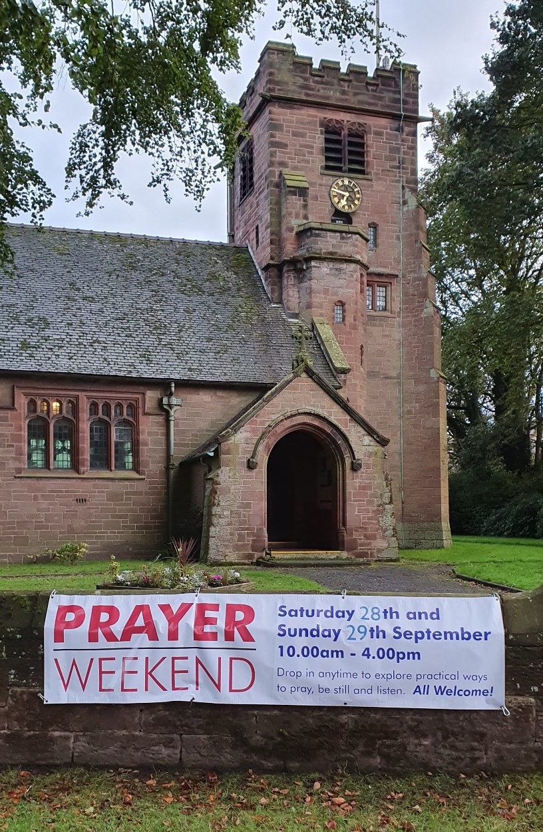
Houses of Prayer
https://www.chester.anglican.org/outreach/prayer/houses-of-prayer/
Would your parish like to be part of opening its doors to visitors for prayer or quiet reflection?
Free resources available

Slide 2
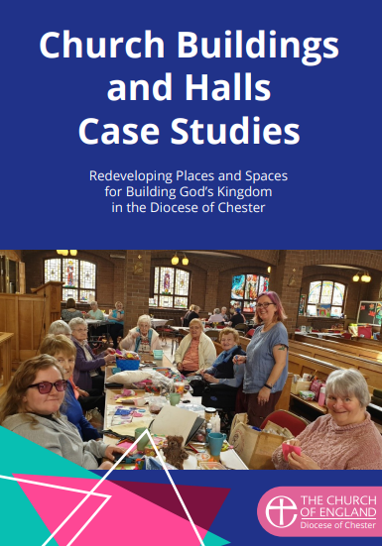
Redeveloping church buildings
1. Building God’s Kingdom: 14 church building/hall case studies www.chester.anglican.org/outreach/buildings-for-mission/buildings-for-mission.php
2. Webinars
a) Fundraising in a Box, 20 Oct 2021
b) Explorers of church buildings: Redeveloping Holy Trinity Blacon, 26 Jan 2022
See www.chester.anglican.org/events
This Photo by Unknown Author is licensed under CC BY-SA-NC

Slide 3
Useful webpages for church wardens
Diocesan Advisory Committee for the Care of Churches (DAC) www.chester.anglican.org/support-services/churches
Buildings for Mission www.chester.anglican.org/outreach/buildings-for-mission
Giving and Fundraising www.chester.anglican.org/outreach/giving-and-fundraising
Training/events www.chester.anglican.org/events

