Slide 1
Financial Update
George Colville
Diocesan Secretary

Slide 2
Churchwardens and Finance
Member of PCC
Churchwarden Trusts
All PCC members have financial responsibilities

Slide 3
Churchwardens and Finance
What to do in practice
May be cheque signatory
Member of standing committee
Take an interest
Encourage and support
Provide backup for treasurer
if unable to act or if no candidate
Ask questions, watch and check – Internal control
Problems are rare but they do happen

Slide 6
Parish Share
£65,048
Standard Parish Share = Total amount required
Number of clergy in Diocese
Clergy Number
X
Parish Share =
Banding
X
Standard Parish Share

Slide 7
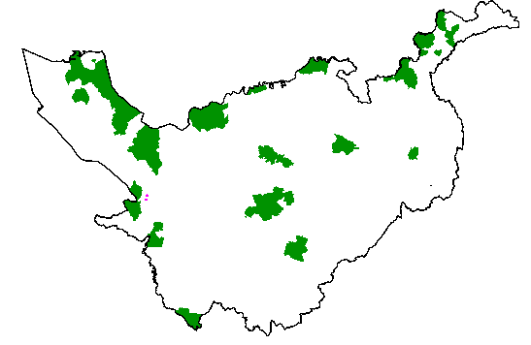
Parishes 0.25 – 0.95
Birkenhead / Wallasey
Stockport
Runcorn
Crewe

Slide 8
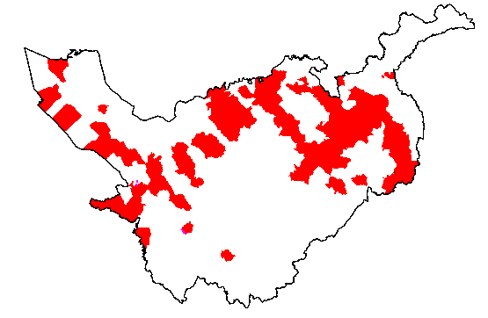
Parishes 1.15 -1.45

Slide 9
£59.7k

Slide 10
£14.6k

Slide 11
2022 and beyond?
2020 budget deficit £0.5m (about 90% parish share)
2021 budget deficit £1.8m (85% parish share) – looking at present like might be a bit better than this
2022 budget deficit £1.1m (90% parish share)
Looking at trying to find £300k pa savings
2025 Breakeven? (95% parish share)
Expect to use £4-5m DBF reserves

Slide 12
More information
01928 718834
www.chester.anglican.org
firstname.lastname@chester.anglican.org

