Slide 1
Digital giving
Bessia Kanengoni
bessia.kanengoni@chester.anglican.org

Slide 2
Overview
Online giving and QR codes
Contactless donation devices
Building a generous church
Generosity resources

Slide 3
Card overtook cash as the preferred form of payment in 2017
In 2020, cash use fell to 17% of all payments made in the UK compared to 45% in 2015
We have the responsibility to disciple generosity. One way we can do this is by improving giving practice in our churches

Slide 4
Online giving
2)
1)
3)

Slide 5
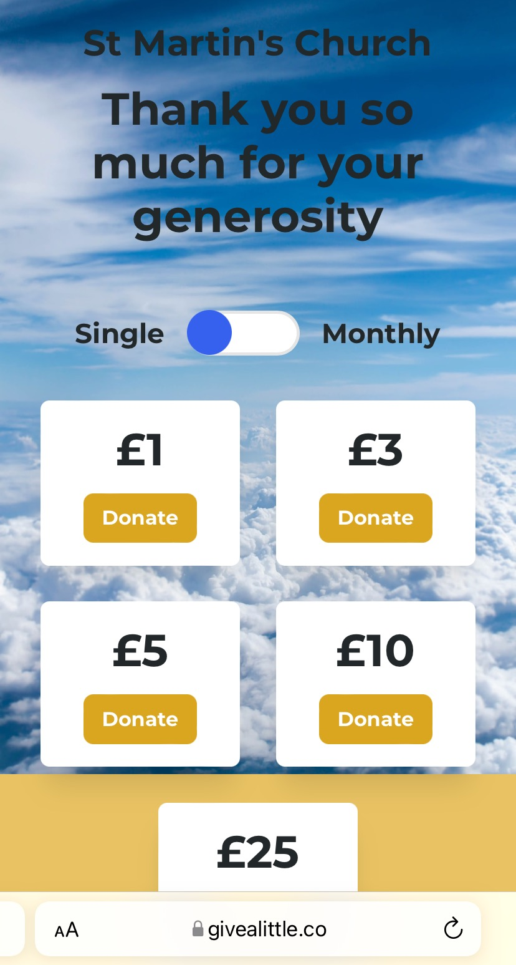
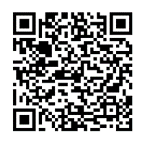
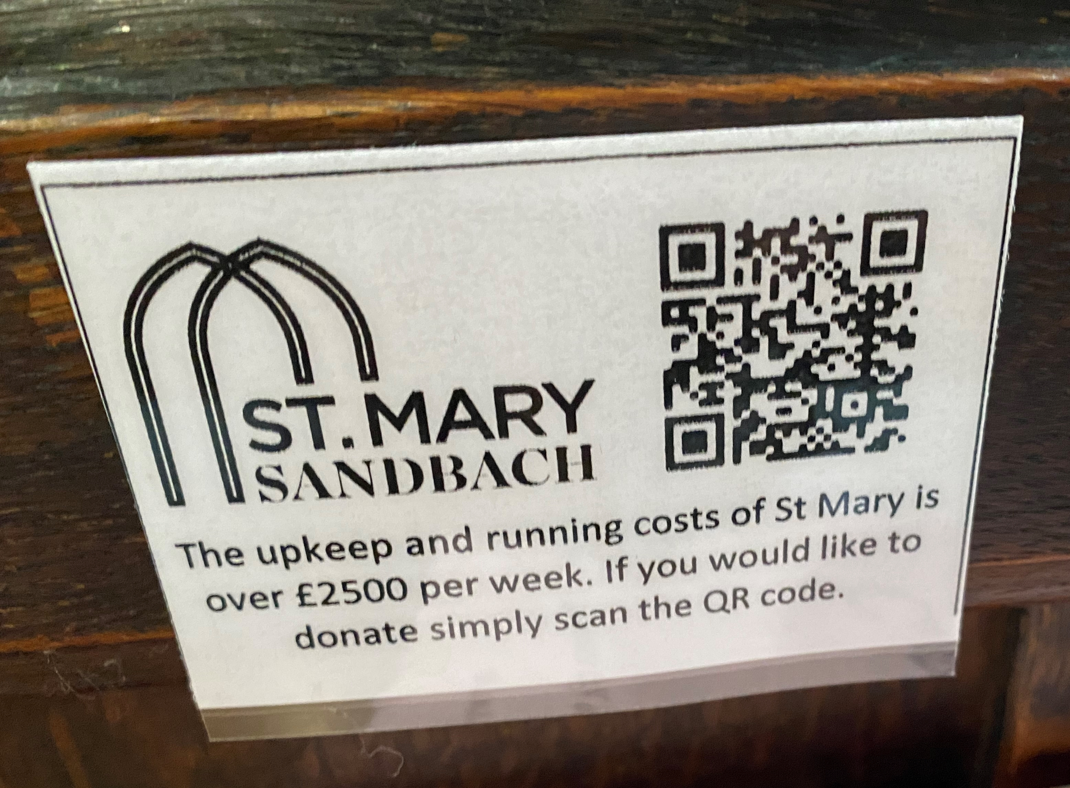
QR codes

Slide 6
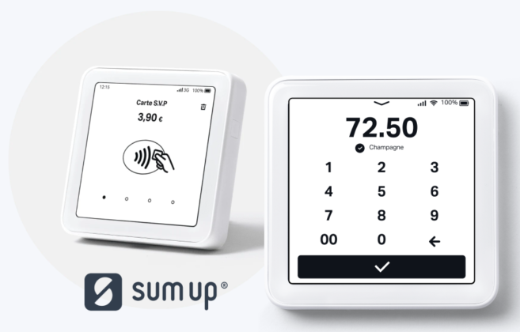
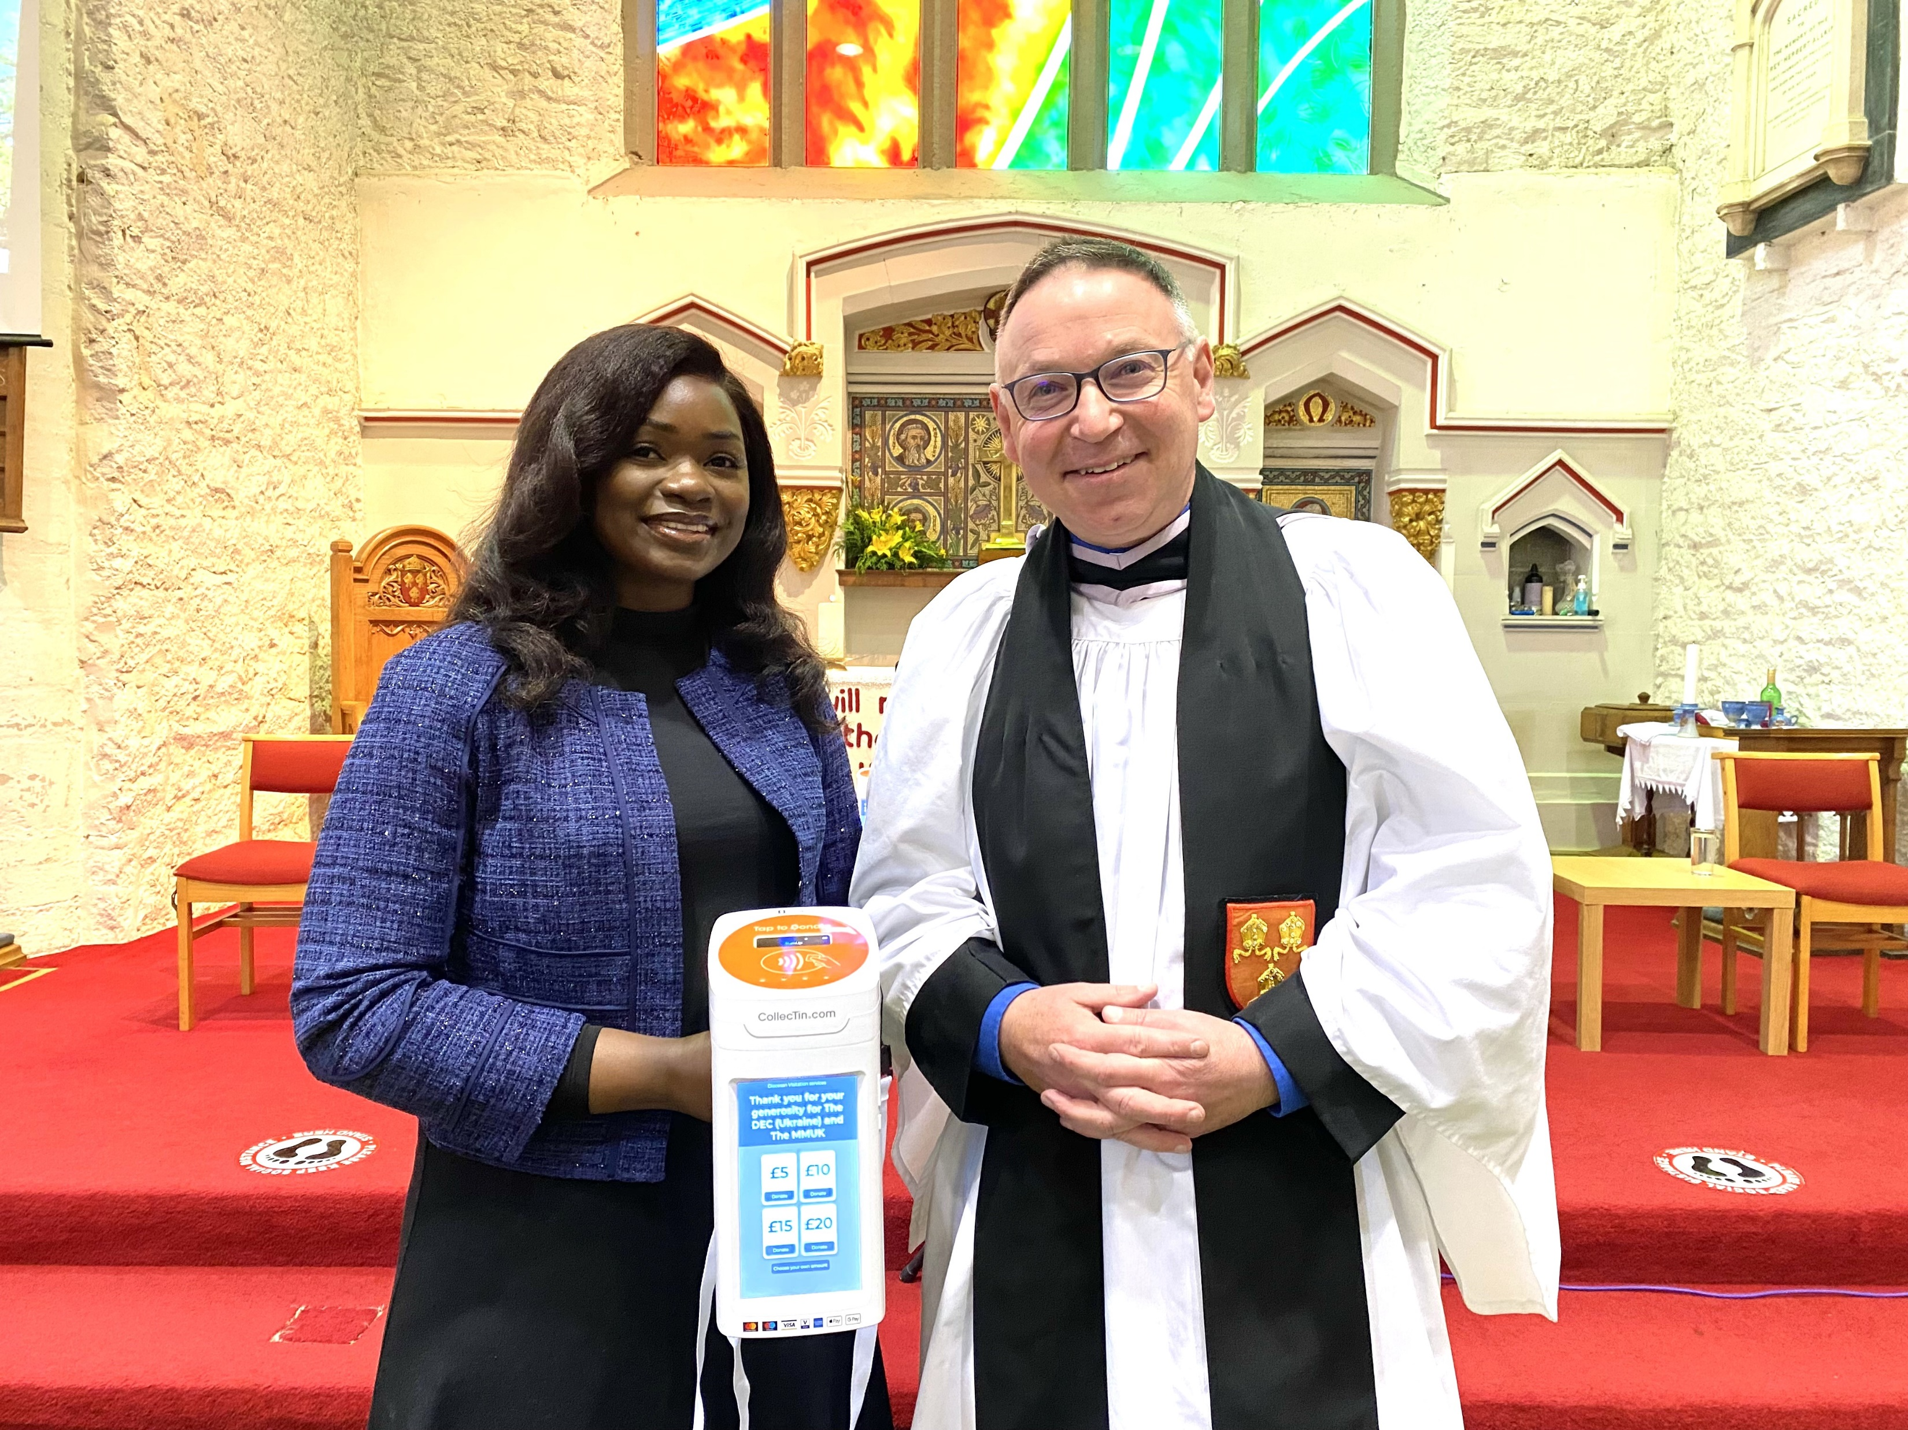
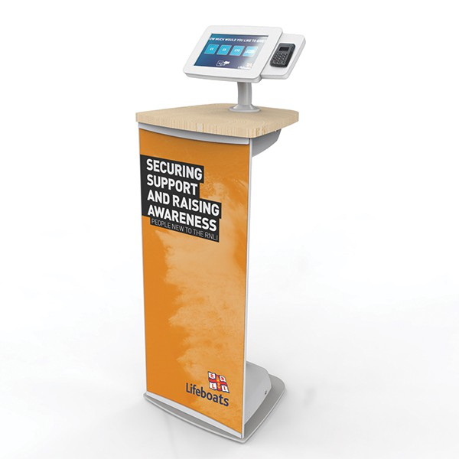
Contactless donations

Slide 7
Generous culture
MINT is used to increase the giving within your church

Slide 8
Generous culture
IDEA is used to grow a more generous culture

Slide 9
Resources
Parish Buying: step by step guides
Church of England: Building a generous church
The generosity learning hub
The Diocese of Rochester: Preaching generosity

