Slide 1
How can we help?
Heather Ford BA Pg Dip – Church Insurance Consultant
Church Warden Training – Chester Diocese 20th July 2021

Slide 2
Agenda
Who are Ecclesiastical
Church Insurance Consultants
How We Can Help
Resources
Questions

Slide 3
Who we are
130+ years insuring churches
Leading UK insurer of churches and heritage buildings
Owned by a charitable trust – Allchurches Trust Ltd
Specialist Church team:
Underwriters
Claims
Risk Management Surveyors
Church Insurance Consultants
If you would like to find out more please email the team at meetus@ecclesiastical.com
Notes:
Owned by All Churches Trust Ltd. All available profits, along with those of the other businesses in the group, are passed to ATL and used to make grants to a wide variety of charities including Anglican churches
ATL grants for large and small projects and for smaller projects valued up to £1m over 90% of applications get some grant, and you can apply for one every 2 years – so if you need funding for keeping your church open it’s worth an application. Also Roof alarms up to £2.5k per church
Our specialist church team has over 1000 years church experience between them. UWs in Gloucester who you’ll deal with on a day to day basis.
Claims team – if you’ve ever needed to make a claim you’ll know we try and find reasons to pay the claim rather than deny it
Surveyors will carry out valuations and risk management surveys, either in person or desktop.
RMCs for technical risk management advice eg if you’re thinking of putting in an alarm. CICs we are the local face of Ecclesiastical for the parishes and here to help support Parishes on all matters insurance and risk related, providing a range of expert guidance, advice and support.
What things might you have heard about keeping your church open? What myths are there around?

Slide 4
Your Church Insurance Consultant
Started with Ecclesiastical – January 2020
Church Buildings Officer for 7 years with Manchester Diocese
Housing Association Development Manager for 15 years – project managing large residential capital projects
Centred on ;
Built environment & Community development
Enabling parishes to do God’s work

Slide 5
How can we help?
We aim to provide support, guidance and assistance for your church
Some of the services we provide include:
An introduction to church insurance
Meet Ecclesiastical
Risk Management seminars
Workshops and training
Share and support events
Attend PCC, and Deanery and other meetings
Provide support at Diocesan, Archdeaconry and Deanery events
We can work with you to help support you and your church, and at no additional cost to you!
If you would like to find out more please email the team at meetus@ecclesiastical.com

Slide 6
Examples of How can we help?
Security
Health & Safety
Risk Management
Cyber security
Fundraising
We offer practical help and a friendly listening ear
We have worked with, and continue to work with dioceses to develop a variety of topics, information and to support churches.
In addition to face to face contact we also use digital platforms for meetings and training events on a whole range of topics
These are just some of the topics covered
If you would like to find out more please email the team at meetus@ecclesiastical.com

Slide 7
Risk Management

Slide 8
Risk Management Resources
Guidance Notes
Self-assessment tools
Videos & animations
Templates
Health & Safety policy
Risk Assessment
Fire Risk Assessment
Approved Suppliers lists
Risk Advice Line - 0345 600 7531 / risk.advice@ecclesiastical.com
https://www.ecclesiastical.com/risk-management/
If you would like to find out more please email the team at meetus@ecclesiastical.com

Slide 9
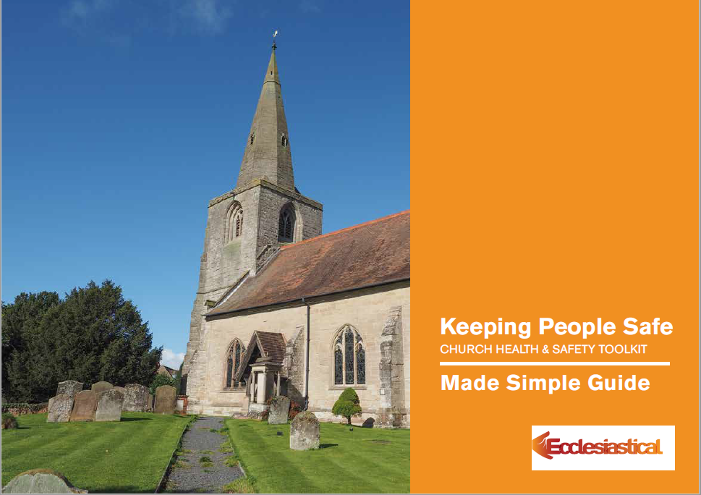
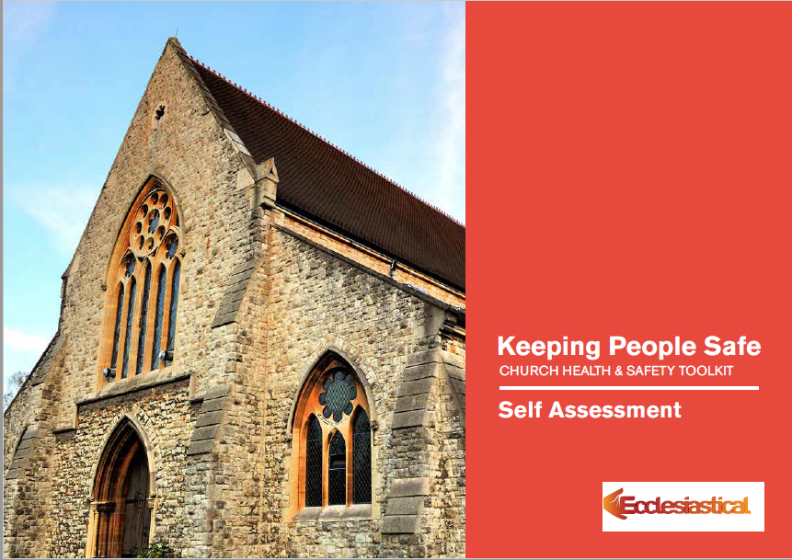
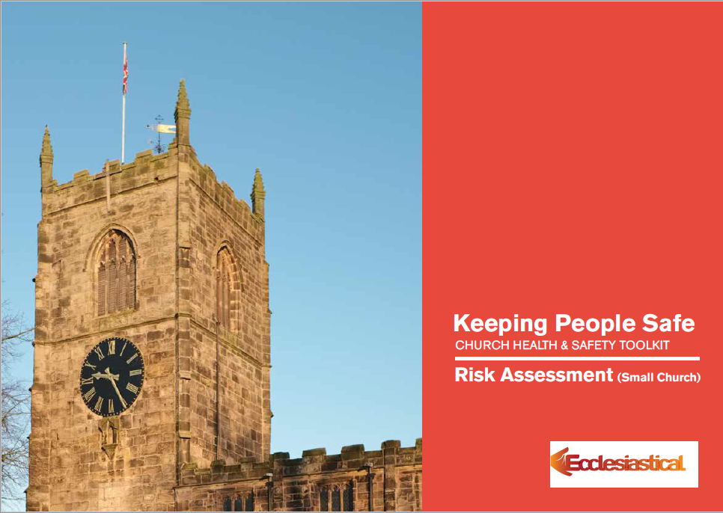
Health and safety resources
On our website you can find resources on:
Understanding your health and safety responsibilities
Checking the adequacy of what you have done or if there is more that you can do
Writing a health and safety policy if you need one
Completing risk assessments if you need them
Dealing with specific hazards such as slips and trips or using ladders
Managing the risk from COVID-19
If you would like to find out more please email the team at meetus@ecclesiastical.com

Slide 10
Fundraising

Slide 11
Fundraising support for your church
We have developed a range of resources to help with funding; making the journey simpler and more successful.
Fundraising hub: Online webpages packed with guidance, checklists and video webinars.
Fundraising helpline: A dedicated fundraising helpline to talk to your local Church Insurance Consultant. Call the helpline on 0345 601 995 or request a call back on our site
Fundraising in a box: A printed toolkit for church customers, providing step-by-step guides with the fundamentals of fundraising.
www.ecclesiastical.com/churchfundraising
Church fundraising helpline: 0345 601 995
If you would like to find out more please email the team at meetus@ecclesiastical.com

Slide 12
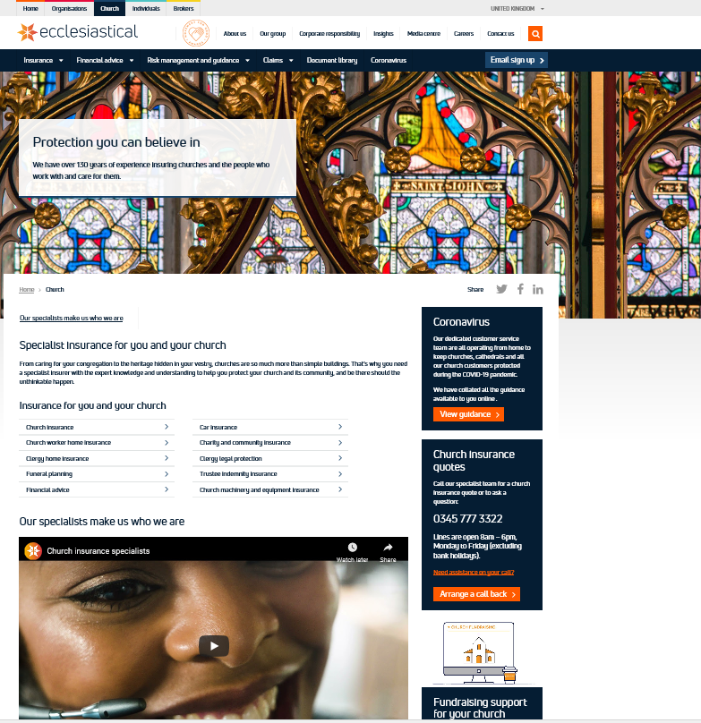
Ecclesiastical Support for Churches
Website - https://www.ecclesiastical.com/church
Heather Ford– Church Insurance Consultant
Heather.ford@ecclesiastical.com
07765 246720
Church Underwriters
Churches@ecclesiastical.com
0345 777 3322
Church Claims Churchclaims@ecclesiastical.com
0345 603 8381
Risk Advice Line
risk.advice@ecclesiastical.com 0345 600 7531
If you would like to find out more please email the team at meetus@ecclesiastical.com

Slide 13
Questions?
Ecclesiastical Insurance Group Benefact House 2000 Pioneer Avenue Gloucester Business Park Brockworth Gloucester GL3 4AW
0345 777 3322 information@ecclesiastical.com
Ecclesiastical Insurance Office plc (EIO) Reg. No. 24869. Registered in England at Benefact House, 2000 Pioneer Avenue, Gloucester Business Park, Brockworth, Gloucester, GL3 4AW, United Kingdom. EIO is authorised by the Prudential Regulation Authority and regulated by the Financial Conduct Authority and the Prudential Regulation Authority. Firm Reference Number 113848.
© Ecclesiastical Insurance Group 2021

