Slide 1
Harriet Roberts Director of Development (Vision and Strategy)

Slide 3
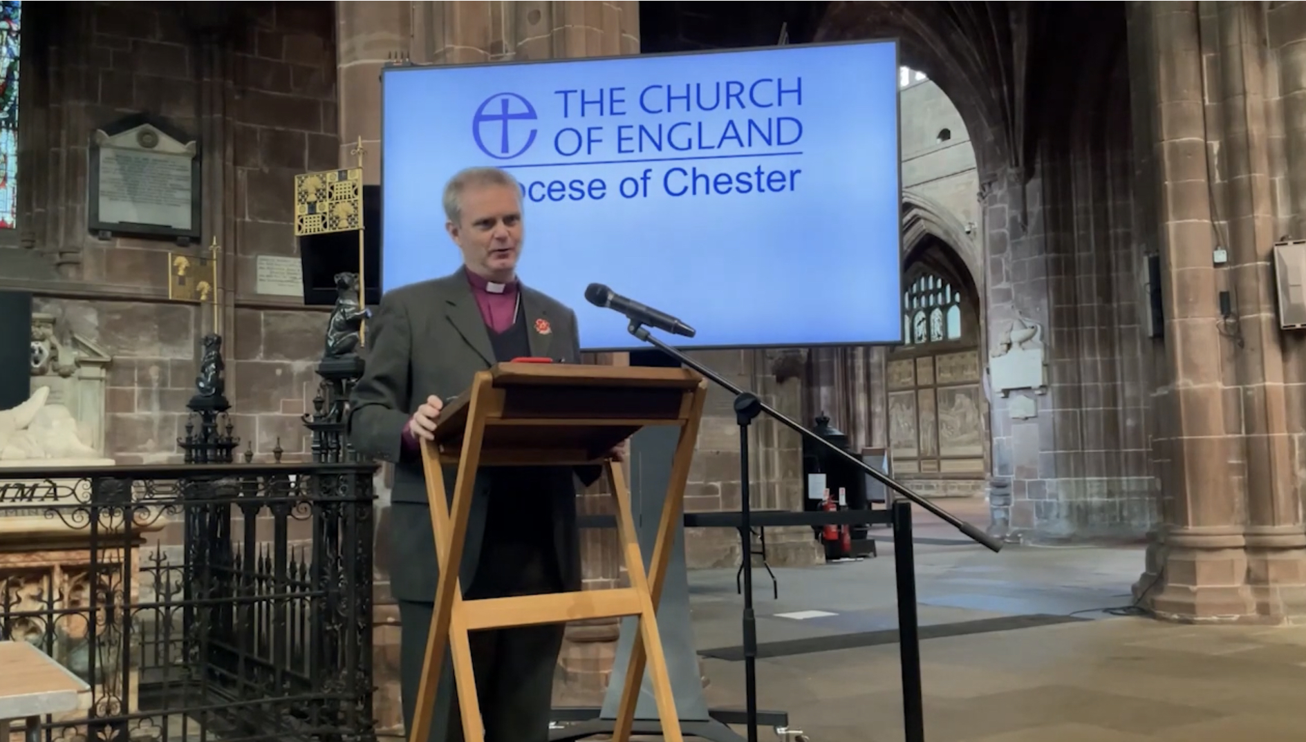
… local
… in Christ
… together

Slide 5
The Lost Sheep
1.5 million
Matthew 8:10-14

Slide 6
Preparing
Caring
Declaring

Slide 7
Preparing

Slide 8
VISION
What is it? What’s our opportunity?

Slide 9
Shared Vision is not about ideas to save church buildings
… although that could happen ….

Slide 10
Shared Vision is not about how we get more people to come into church on a Sunday
… although that could happen ….

Slide 11
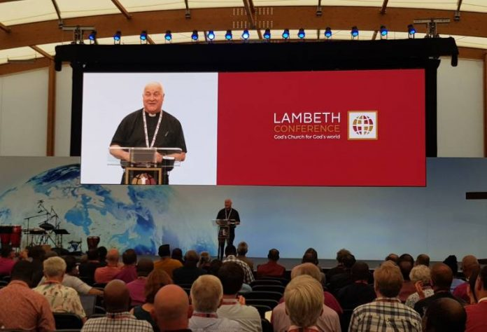
“We are not trying to build the earthly empire of an institution called the church. What we are about is this: Thy kingdom come. Thy will be done. That is our prayer, and our motivation.”

Slide 12
‘Hit the Ground Kneeling’ Stephen Cottrell
‘Vision is the mountain top; the destination we long to reach.’
‘It is the vision of how things can be at the end that motivates and inspires everything else’

Slide 13
A vision is a future facing story that shapes strategy
What we say
What we do
What we produce
How we behave
What we build
How to invest
COMMON LANGUAGE
SHARED NARRATIVE
UNDERSTANDING PURPOSE
KNOW WHERE WE ARE HEADING
AGREED GOALS

Slide 14
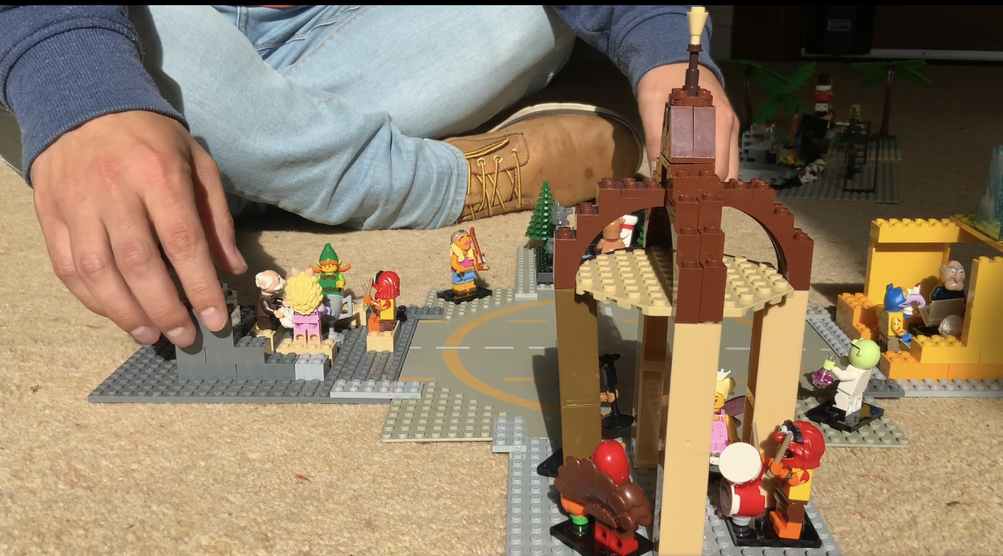
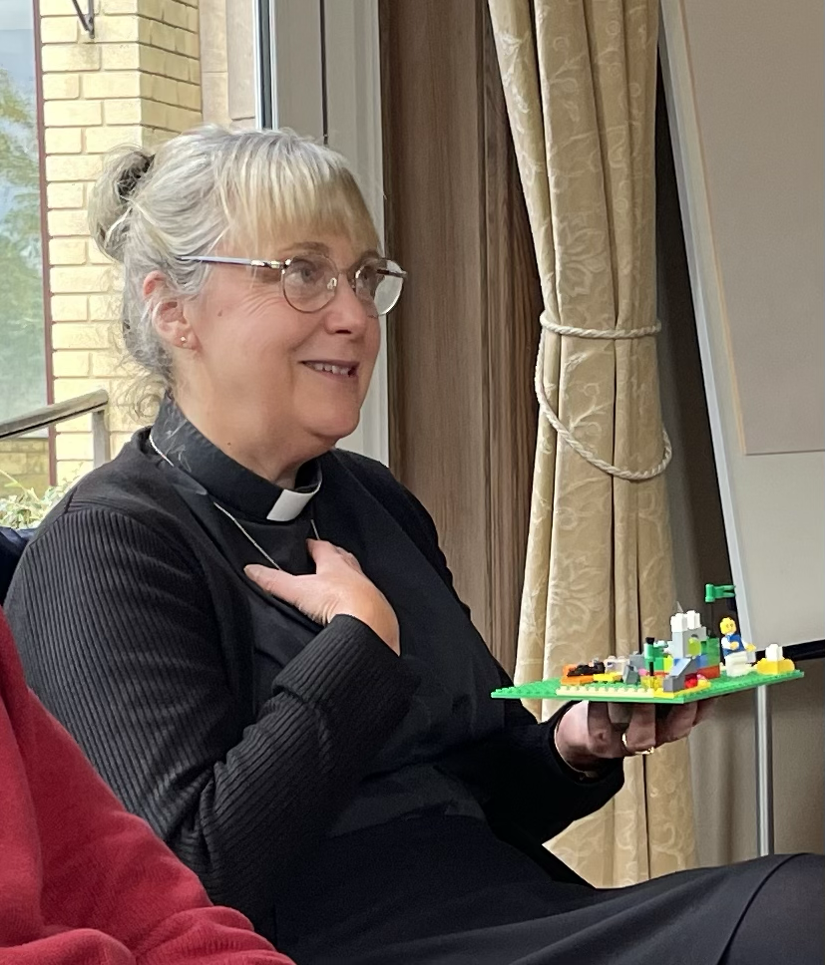
CREATIVE COLLABORATIVE CONVERSATIONS

Slide 15
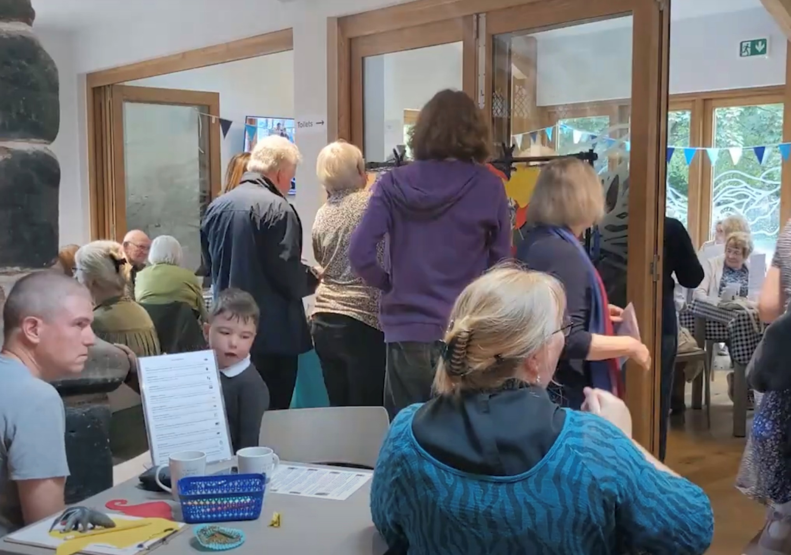

Slide 16
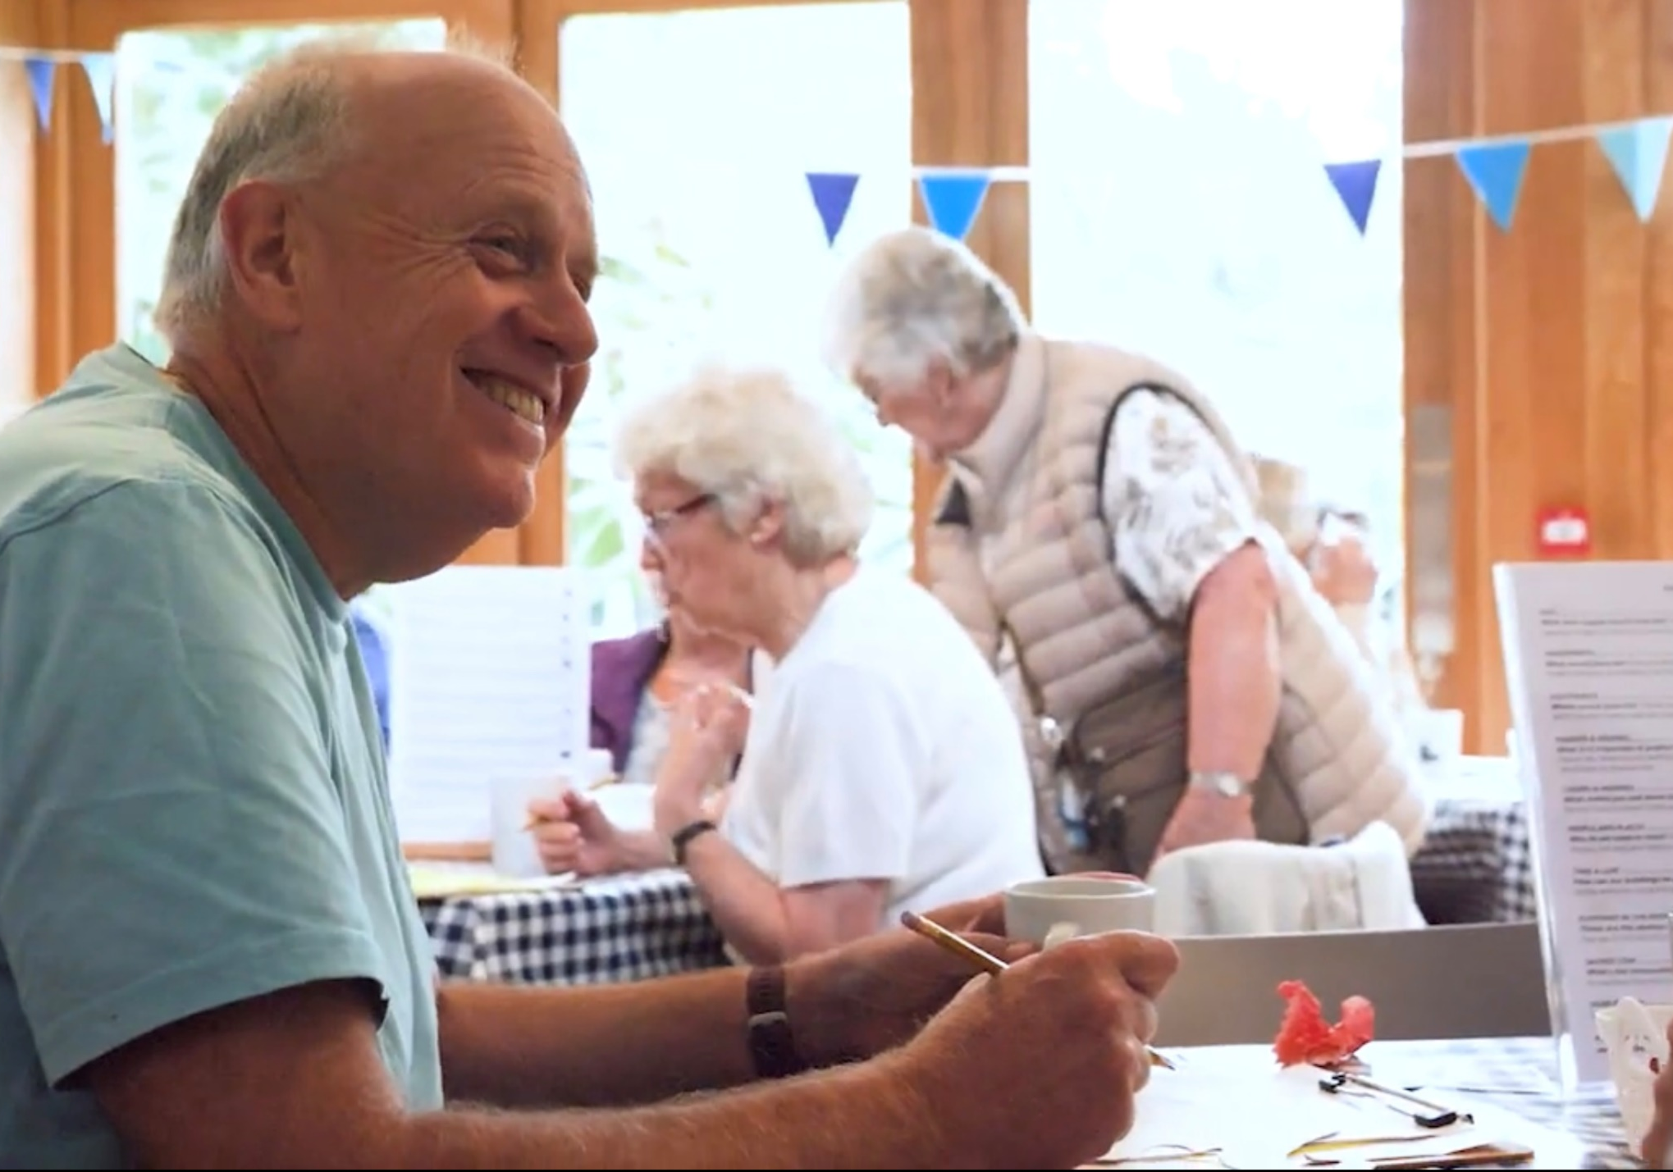

Slide 17
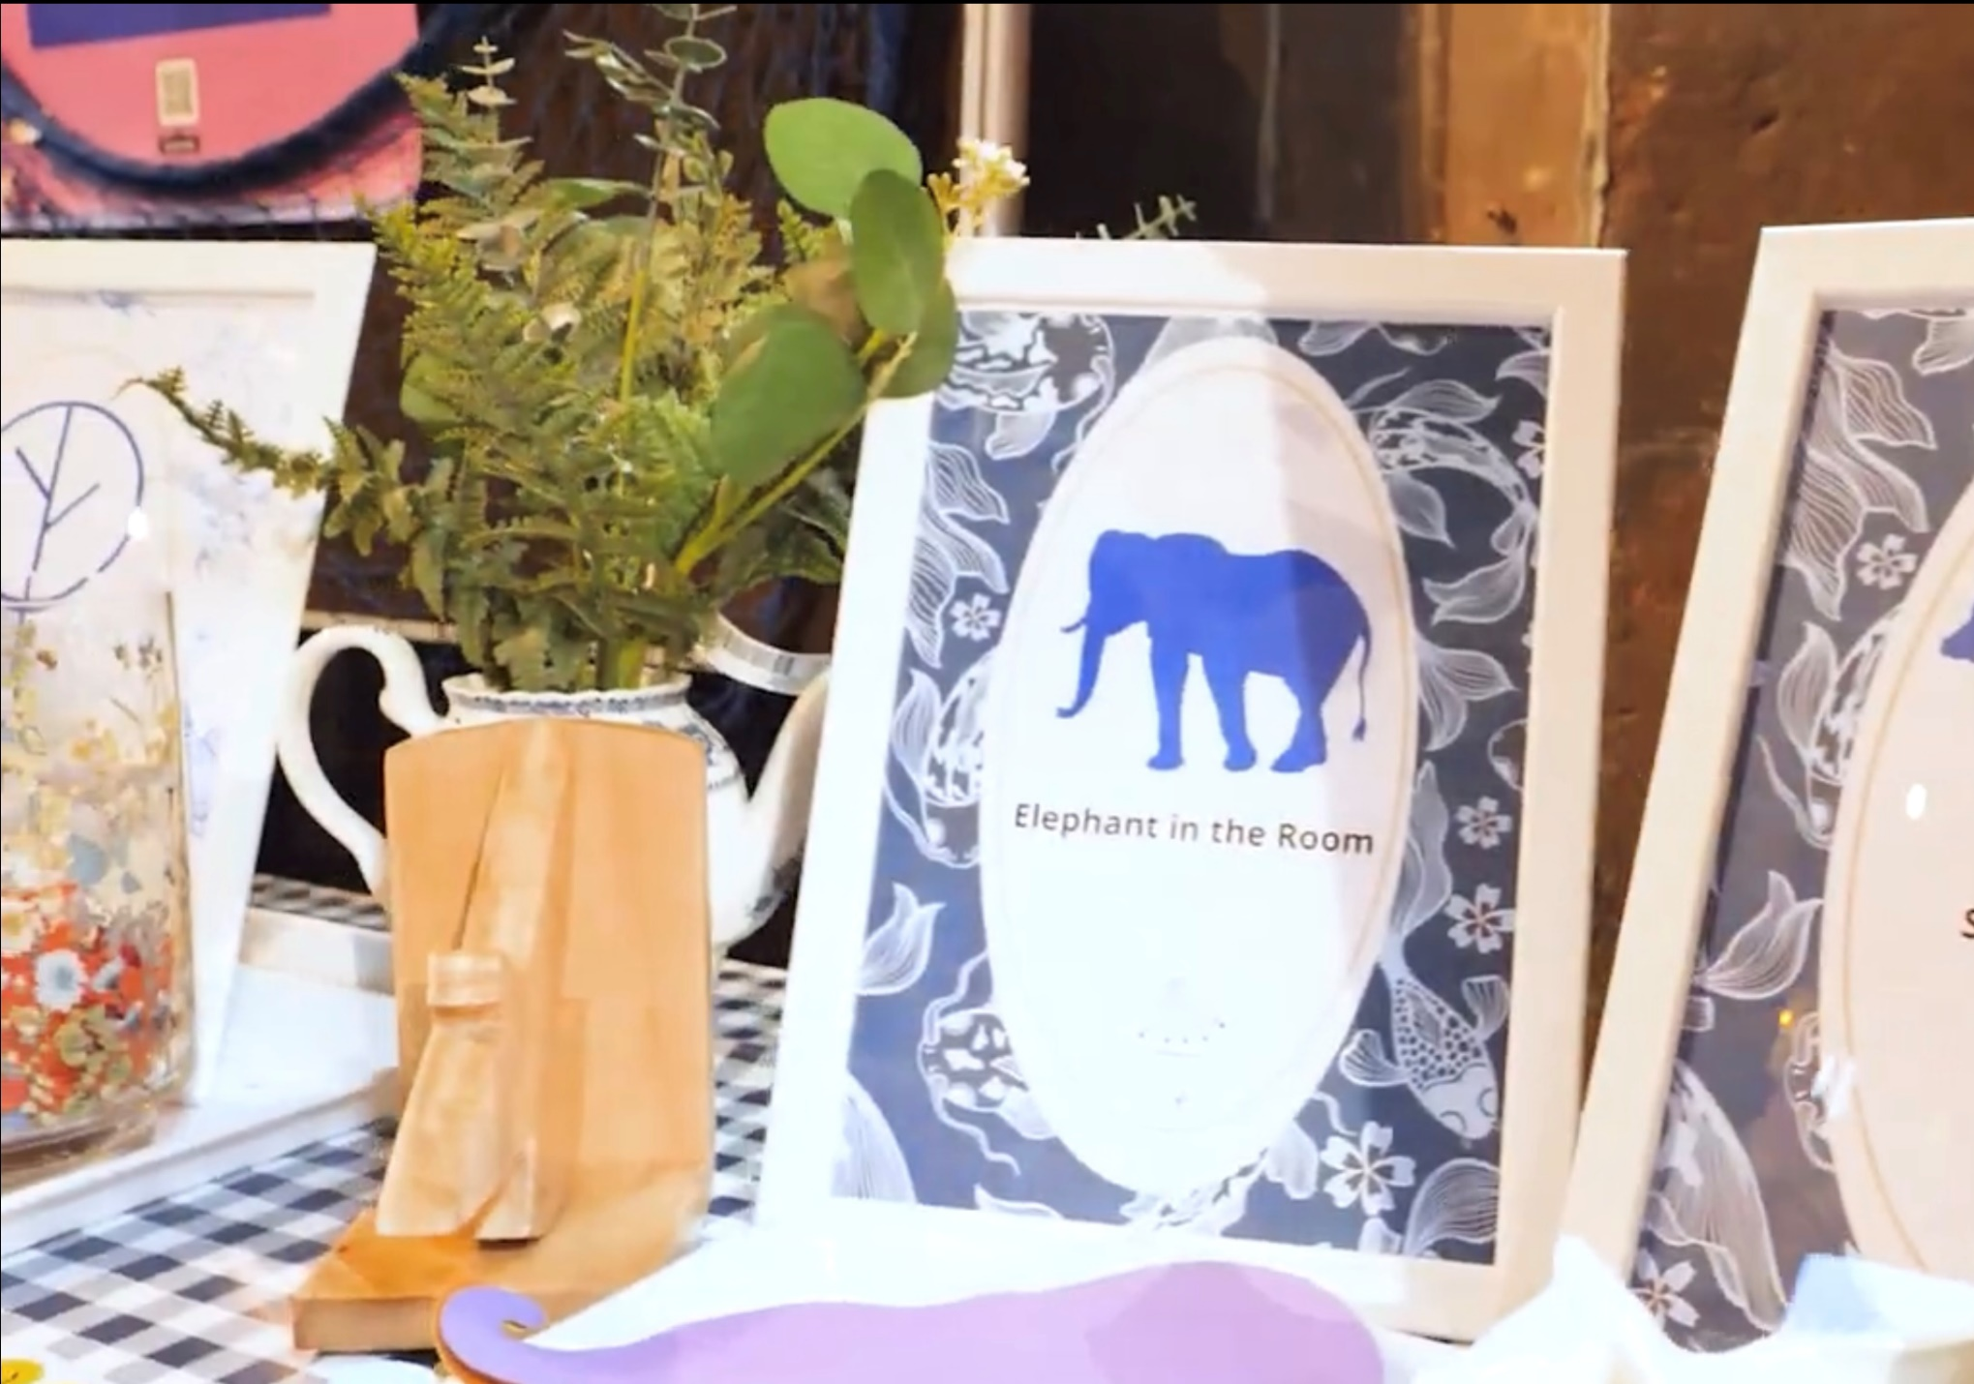

Slide 18
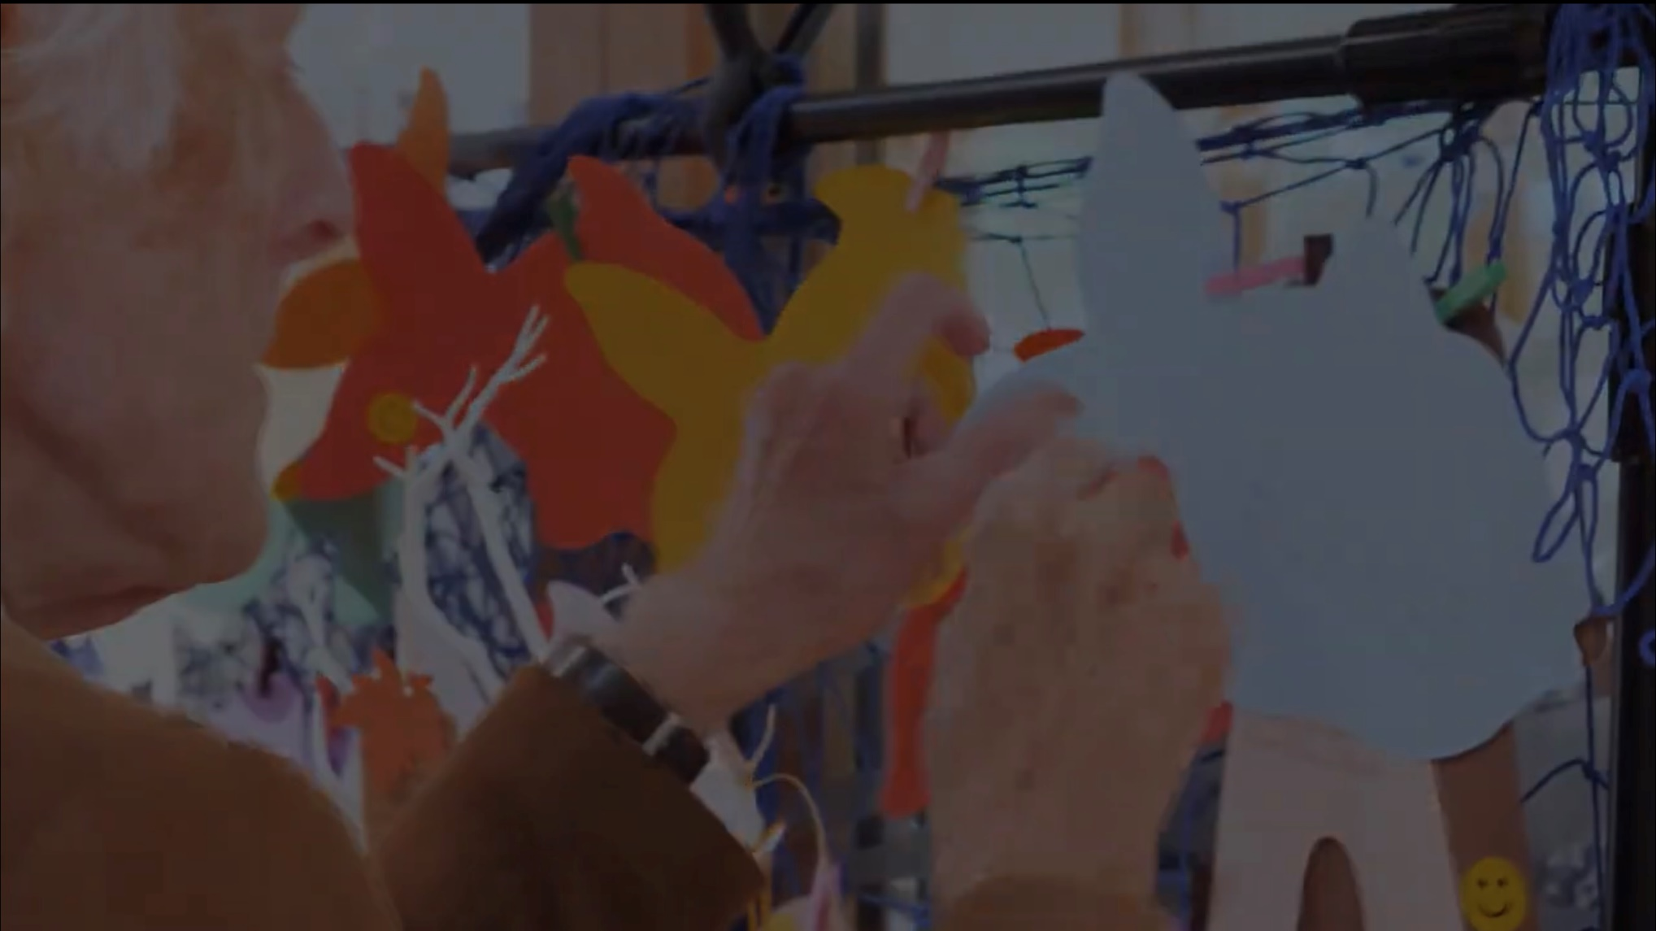

Slide 19
Creative tools = creative responses
‘would smell of sweaty feet’
‘frightened to put down your handbag’

Slide 21
Caring
What would Jesus do?
Where would Jesus go?

Slide 22
Matthew 25: 31-46
Caring
³⁵ For I was hungry and you gave me something to eat, I was thirsty and you gave me something to drink, I was a stranger and you invited me in, ³⁶ I needed clothes and you clothed me, I was sick and you looked after me, I was in prison and you came to visit me.’
^{40 …} ‘Truly I tell you, whatever you did for one of the least of these brothers and sisters of mine, you did for me.’

Slide 23
Where does it hurt?
LOVE
Jesus shaped Christ centred
In the same way, faith by itself, if it is not accompanied by action, is dead.
James 2: 17

Slide 24
What would Jesus do? Where would Jesus Go?
How do we support families of all shapes and sizes
In the context of previous research and what’s happened since in the Pandemic?
How can we use our buildings and resources to help bring transformation, hope and healing?
How can we bring people to experience the love of Christ?
What’s already happening – where are the gaps?
Who can we work with?

Slide 25
Caring for God’s Earth
How can churches be a blessing not a burden on the environment?

Slide 26
Declaring
Who do we need to reach?
How do we reach them?

Slide 27
relational – sticky faith
Declaring = sharing
EVERY ENCOUNTER
Is an opportunity to support the Spirit already at work in every person in our every day lives

Slide 28
Bishop Mark – Clergy Gathering 2022
‘… we need to learn how to proclaim in every generation the good news that we have received …’
How do we do that
How do we resource it?

Slide 29
What do we treasure and want to grow? What do we need to lose and leave in the past?

Slide 30
What’s the elephant in the room? – big obvious problem that we avoid talking about? What’s the sacred cow? – the thing we cannot change – that stops us moving forward?

Slide 31
What’s your dream for the Diocese?

