Slide 1

Financial Update
Sharon Taylor-Booth

Slide 2
Churchwardens and Finance
Member of PCC
Churchwarden Trusts
All PCC members have financial responsibilities

Slide 3
Churchwardens and Finance
What to do in practice
May be cheque signatory
Member of standing committee
Take an interest
Encourage and support
Provide backup for treasurer
    if unable to act or if no candidate
Ask questions, watch and check – Internal control
    Problems are rare but they do happen

Slide 6
Parish Share
£66,349
Standard Parish Share = Total amount required
Number of clergy in Diocese
Clergy Number
X
Parish Share =
Banding
X
Standard Parish Share

Slide 7
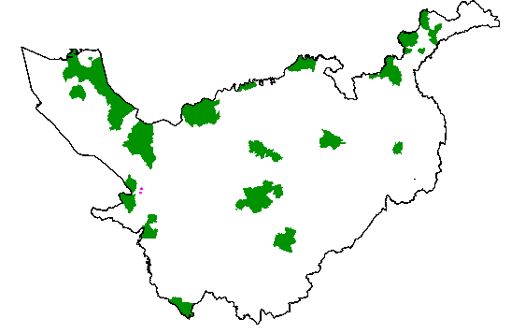
Parishes 0.25 – 0.95
Birkenhead / Wallasey
Stockport
Runcorn
Crewe

Slide 8
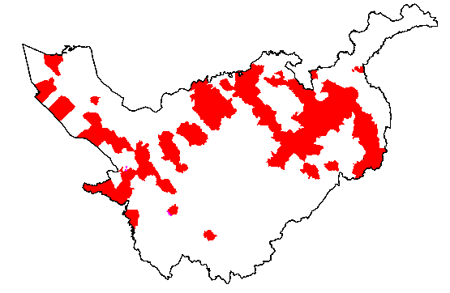
Parishes 1.15 -1.45

Slide 9
£59.1k

Slide 10
£11k

Slide 11
2023 and beyond?
2022 budget deficit £0.9m (about 90% parish share)
looking at present like might be better than this
2023 budget and beyond
Clergy pension costs reduced
Likely higher stipend rises
What will Parish share collection be?
What will come out of the Values, Vision, Strategy work?

Slide 12
More information
01928 718834
www.chester.anglican.org
firstname.lastname@chester.anglican.org

