Slide 1
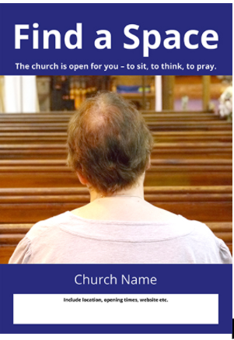
2021 summer/autumn
www.chester.anglican.org/outreach/prayer/find-a-space
Would your parish like to be part of opening its doors to visitors for prayer or quiet reflection?
Free resources available

Slide 2
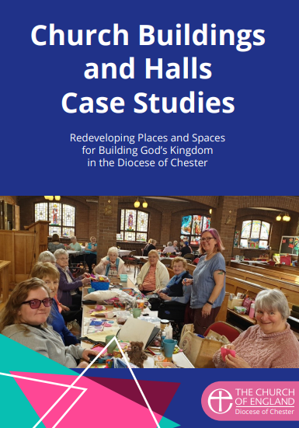
Redeveloping church buildings: inspiration
1. Building God’s Kingdom: case study report of 14 church building and hall projects
www.chester.anglican.org/outreach/buildings-for-mission/buildings-for-mission.php
2. Webinars
Fundraising in a Box, 20 Oct
Explorers of church building/hall projects, dates to be announced. See www.chester.anglican.org/events

Slide 3
Useful webpages for church wardens
Diocesan Advisory Committee for the Care of Churches (DAC) www.chester.anglican.org/support-services/churches
Buildings for Mission www.chester.anglican.org/outreach/buildings-for-mission
Giving and Fundraising www.chester.anglican.org/outreach/giving-and-fundraising
Training/events www.chester.anglican.org/events

