Slide 1
Biblical Reflections as our school community comes back together
Suitable for staff meetings or could be adapted for use Collective Worship
Notes:
Each slide contains a bible verse and reflections around it, that can be used to begin a staff meeting or be developed further to form an act of Collective Worship for pupils. There are suggestions for songs that could be sung, or musical background for a time of reflection / personal prayer. Each slide can be taken as a stand alone reflection and is expected to last no more than 10 minutes. The musical aspects are time for reflection rather than singing along with due to advice to avoid collective singing for the time being.
It is hoped that these will facilitate schools in coming together to reflect on the heartbeat of what makes your school distinctive, to put the faith aspect of the school right at the centre of returning – of looking back and acknowledging the difficulties and pain, and also the blessings that have gone on during this time of lockdown – but also in looking forward with confidence, to what may be familiar or new, trusting in God’s goodness for our schools.

Slide 2
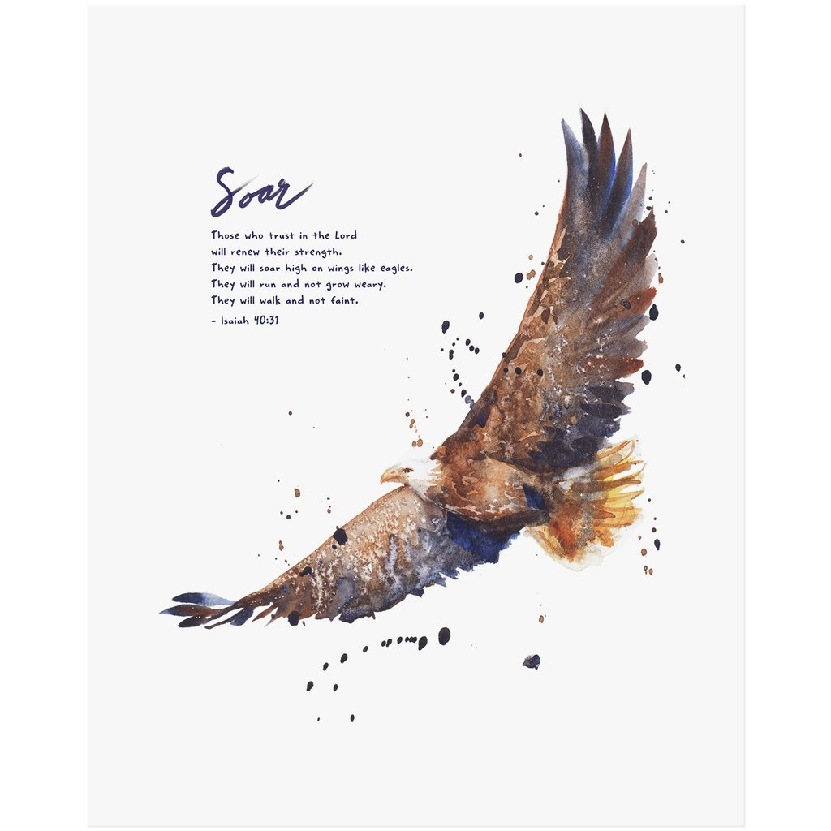
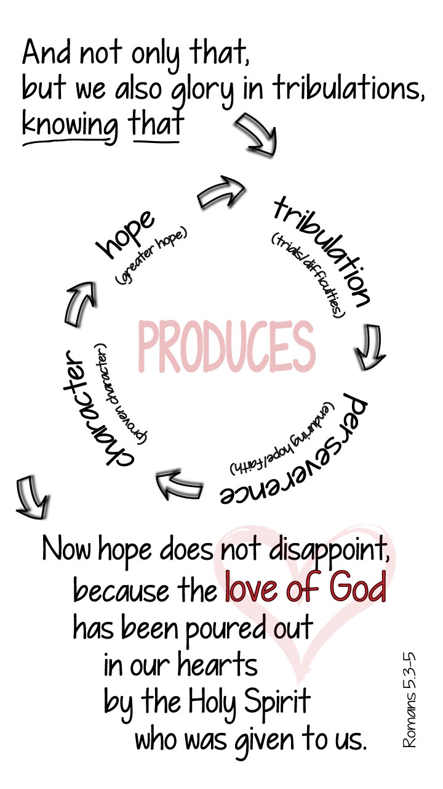
Notes:
Isaiah 40:31
The demands on our time, physical and emotional energy have been huge. Some days have been easier than others, but for some it has felt relentless working longer hours and through the holidays. For others who have had covid-19, it has completely zapped your strength and set a mountain of recovery before you.
Looking forwards, there is no definitive end yet in sight – small milestones are achieved, and some days it can feel two steps forward, one step back! Recall how far you have come.
What sustains you during this time? Where do you draw your energy, inspiration and hope from that you might continue to give out to others and keep going yourself?
Isaiah recognised the people of Israel felt this way too; “Have you not known? Have you not heard? The LORD is the everlasting God, the Creator of the ends of the earth. He does not faint or grow weary…He gives power to the faint, and to him who has no might he increases strength….”40:28-29
Prayer reflection:
In what has been, or will be, a busy week (month, term…) take time to be still. Listen to Vaughn Williams, ‘Lark Ascending’, you may want to pray, you may want to recall a bible verse, people, places, experiences from where you draw strength, you may just want to be quiet / practice mindfulness.
Image from www.godsfingerprints.co.uk

