Slide 1
Biblical Reflections as our school community comes back together
Suitable for staff meetings or could be adapted for use Collective Worship
Notes:
Each slide contains a bible verse and reflections around it, that can be used to begin a staff meeting or be developed further to form an act of Collective Worship for pupils. There are suggestions for songs that could be sung, or musical background for a time of reflection / personal prayer. Each slide can be taken as a stand alone reflection and is expected to last no more than 10 minutes. The musical aspects are time for reflection rather than singing along with due to advice to avoid collective singing for the time being.
It is hoped that these will facilitate schools in coming together to reflect on the heartbeat of what makes your school distinctive, to put the faith aspect of the school right at the centre of returning – of looking back and acknowledging the difficulties and pain, and also the blessings that have gone on during this time of lockdown – but also in looking forward with confidence, to what may be familiar or new, trusting in God’s goodness for our schools.

Slide 2
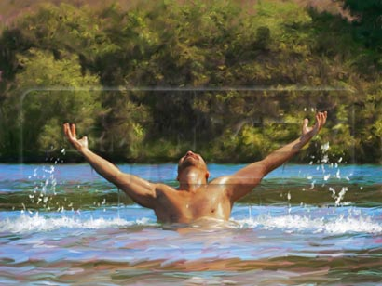
Notes:
2 Kings 5:1-14
Namaan had expected a completely different treatment, a complicated ritual, as he was probably used to with the heathen magicians in his own country (v. 11). Surely he was deserving of an honourable treatment. After all, he was not just somebody. Surely he was able to reward Elisha nicely for his services, wasn't he? What an order: "Go and wash in the Jordan seven times!" What a humiliation! Were not the clear and watery rivers of Damascus… better than that narrow and muddy Jordan? Namaan needed to learn to be humble – no special treatment for the General of the Syrian army.
Covid-19 has not discriminated between the high and mighty or the lowly, there has been no magical treatment, but a necessity to trust those in the NHS to advise well and serve sacrificially. How has this season humbled you? Where have you had to demonstrate trust in the unknown? What has changed your thinking? How has it shaped who you are now?
Namaan’s response to healing was a heart full of gratitude, and a desire to serve the one true God of Israel – Give thanks for those who have impacted your life during this time, thank God he has put them in your life. What else can you be thankful for? Perhaps, on the staff room table put a jar where people can contribute a short gratitude on a post-it, begin your next meeting giving thanks… listen to “Look at the World” by John Rutter as you do this.
Prayer:
Creator God,
Who made us,
Who knows our deepest thoughts,
Who lifts us up in unexpected ways,
Help us to give thanks with ready hearts
That we may see you at work in our lives
And the world around us.
For your name’s sake
Amen

