Slide 1
Biblical Reflections as our school community comes back together
Suitable for staff meetings or could be adapted for use Collective Worship
Notes:
Each slide contains a bible verse and reflections around it, that can be used to begin a staff meeting or be developed further to form an act of Collective Worship for pupils. There are suggestions for songs that could be sung, or musical background for a time of reflection / personal prayer. Each slide can be taken as a stand alone reflection and is expected to last no more than 10 minutes. The musical aspects are time for reflection rather than singing along with due to advice to avoid collective singing for the time being.
It is hoped that these will facilitate schools in coming together to reflect on the heartbeat of what makes your school distinctive, to put the faith aspect of the school right at the centre of returning – of looking back and acknowledging the difficulties and pain, and also the blessings that have gone on during this time of lockdown – but also in looking forward with confidence, to what may be familiar or new, trusting in God’s goodness for our schools.

Slide 2
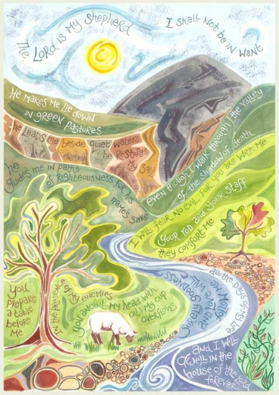
But God has put the body together, giving greater honor to the parts that lacked it, so that there should be no division in the body, but that its parts should have equal concern for each other. If one part suffers, every part suffers with it; if one part is honored, every part rejoices with it.
1 Cor :24-26
Notes:
Psalm 23 (Image by Hannah Dunnet) Begin by reading the passage aloud.
As school communities each individual experience will have been and for some, still is, different, however, our personal journeys shape how we interact with and feel about our communities –you may have turned into yourself or at different stages you may have suffered together or found moments of joy together. As the Psalmist does, it is good to recognise that through it all, God leads and journeys with us.
St Paul in Corinthians, talks of God bringing the body together, creating a physical group around that can reflect his presence with each of us, all of value, each having equal concern for one another and walking that journey together – that requires us to be both honest, and vulnerable with the people around us, in a place of trust.
Play the reflection song, “The Lord’s my shepherd” Stuart Townend, (or if you’d prefer a more modern take on the theme, you could use “Oceans” by Hillsong Music https://www.youtube.com/watch?v=6GGFb6LcX3U )
have a visual time line of Psalm 23, (it could be as simple as a rope with quiet waters, valley of death, green pastures, house of the Lord marked on, if you have time you could be more creative or even just an enlarged copy of the picture will do… each person when and if they feel able during the song, can place a stone / pebble / petal where they feel they are at on that time line – no explanation needed.
Jeremiah 30:17 – For I will restore health to you and heal you of your wounds says the Lord. This verse may be a comfort in your prayer time.
Prayer time:
Spend a moment in quiet prayer and reflection.
Perhaps, finish with the words of Psalm 23 again.

