Slide 1
Biblical Reflections as our school community comes back together
Suitable for staff meetings or could be adapted for use Collective Worship
Notes:
Each slide contains a bible verse and reflections around it, that can be used to begin a staff meeting or be developed further to form an act of Collective Worship for pupils. There are suggestions for songs that could be sung, or musical background for a time of reflection / personal prayer. Each slide can be taken as a stand alone reflection and is expected to last no more than 10 minutes. The musical aspects are time for reflection rather than singing along with due to advice to avoid collective singing for the time being.
It is hoped that these will facilitate schools in coming together to reflect on the heartbeat of what makes your school distinctive, to put the faith aspect of the school right at the centre of returning – of looking back and acknowledging the difficulties and pain, and also the blessings that have gone on during this time of lockdown – but also in looking forward with confidence, to what may be familiar or new, trusting in God’s goodness for our schools.

Slide 2

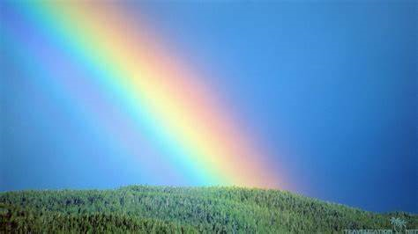
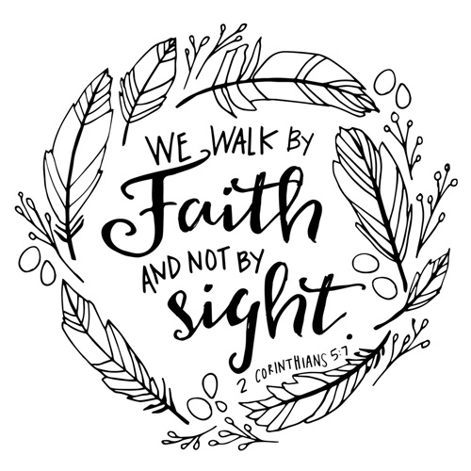
Notes:
2 Corinthians 5:7 “We live by faith and not by sight.”
Noah, locked in for 40 days and nights, with a hoard of animals, physically impossible to get out – sound familiar?!
I wonder how he felt?
A relatively small space (137m long, 22.8m wide, 13.7m high - (if using for CW you may want to set a challenge to measure this on your yard / field / home task at a park) Noah was on the look out for dry land, sending several birds to check, we’ve been looking forward to being allowed out too! Never-the-less, our hope to get out doesn’t take away that it’s daunting to step into the world again, to begin something new – we may not get it right, (Noah’s story ended in disgrace!)
Yet the ending of Noah and the ark remains true today for those that trust in God, there is the assurance that he is faithful to keep his promises, even, if like Noah, we can’t see initially why he’s asking us to do something. Just as God was in control shutting and opening the ark door, so we can have confidence in his timings and protection for us too.
While you listen to the song ‘Trust’ by Lauren Daigle, perhaps create a rainbow to have on your desk or notice board in the classroom as a reminder (lego / ribbon/ playdough – not to be returned - mindful colouring etc)– not just to be grateful for the NHS, but for the one who promises to faithfully go with us as we go forward.
A prayer to trust in God:
Lord God,
Sometimes we find it difficult to understand why events happen,
We are limited in our view of the big picture,
We see only the difficulties and hurt.
Lord God,
Would you meet us in our time of wrestling,
That we would know the peace that comes from trusting in you,
Even when we can’t see the way ahead.
Lord God,
Help us to trust in your loving nature,
Your mercy and grace.
Help us to live by faith and not by sight.
Amen

