Slide 1
Biblical Reflections as our school community comes back together
Suitable for staff meetings or could be adapted for use Collective Worship
Notes:
Each slide contains a bible verse and reflections around it, that can be used to begin a staff meeting or be developed further to form an act of Collective Worship for pupils. There are suggestions for songs that could be sung, or musical background for a time of reflection / personal prayer. Each slide can be taken as a stand alone reflection and is expected to last no more than 10 minutes. The musical aspects are time for reflection rather than singing along with due to advice to avoid collective singing for the time being.
It is hoped that these will facilitate schools in coming together to reflect on the heartbeat of what makes your school distinctive, to put the faith aspect of the school right at the centre of returning – of looking back and acknowledging the difficulties and pain, and also the blessings that have gone on during this time of lockdown – but also in looking forward with confidence, to what may be familiar or new, trusting in God’s goodness for our schools.

Slide 2
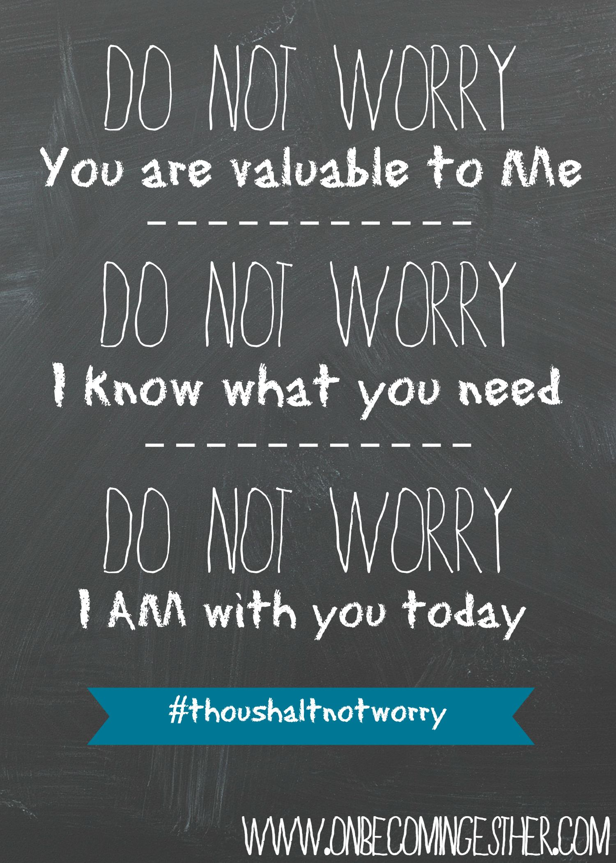
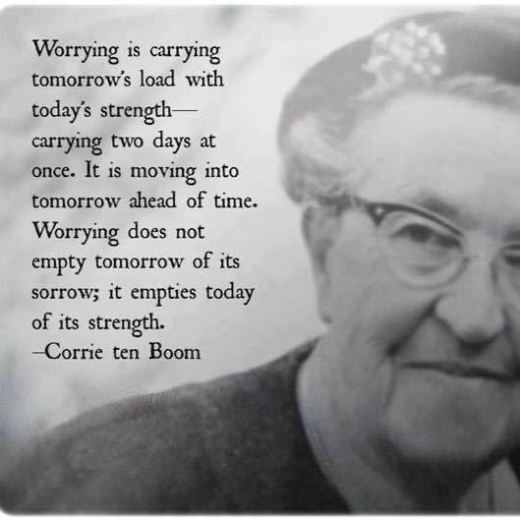
Notes:
Matthew 6:25-34
Overwhelmed by guidance and advice papers coming out? Worried about how to bring back your children? Anxiety creeping up over what ‘tomorrow’ may hold?
This passage tells us to take a day at a time Corrie-ten-Boom, a German Christian, sent to concentration camps for hiding Jews, lost her family but survived herself.
She learnt during that period to take one day at a time and to trust God’s promise to give her the strength she needed, it would have been so easy to be overwhelmed.
She recalls that she had discovered the truth of St Paul’s words, “But he said to me, ‘My grace is sufficient for you, for my power is made perfect in weakness.’ Therefore I will boast all the more gladly of my weaknesses, so that the power of Christ may rest upon me.” (2 Corinthians 12:9) We can’t do anything to change tomorrow, but we can change the way we feel about it by taking our cares to God.
Consider your 3 biggest worries currently – with a piece of ribbon or string, tie a knot to represent each one – as you listen to the song, ‘Sparrows’ by Jason Gray, take each of those worries, one at a time, and hand it over to God, ask for his strength to deal with each thing, as you do, undo the knot to show you’ve given it over to him.
A prayer for inner peace:
Father God,
Thank you for being the God who never sleeps,
Who cares for me in a way that is greater than I can know.
Help me to rest in your love, knowing that you are in control,
Watching over us and guiding us.
Your word says that we can cast our cares on you,
That we can live in your strength each day.
Help me to trust in this and receive your peace for today.
Amen

