Slide 1
Biblical Reflections as our school community comes back together
Suitable for staff meetings or could be adapted for use Collective Worship
Notes:
Each slide contains a bible verse and reflections around it, that can be used to begin a staff meeting or be developed further to form an act of Collective Worship for pupils. There are suggestions for songs that could be sung, or musical background for a time of reflection / personal prayer. Each slide can be taken as a stand alone reflection and is expected to last no more than 10 minutes. The musical aspects are time for reflection rather than singing along with due to advice to avoid collective singing for the time being.
It is hoped that these will facilitate schools in coming together to reflect on the heartbeat of what makes your school distinctive, to put the faith aspect of the school right at the centre of returning – of looking back and acknowledging the difficulties and pain, and also the blessings that have gone on during this time of lockdown – but also in looking forward with confidence, to what may be familiar or new, trusting in God’s goodness for our schools.

Slide 2
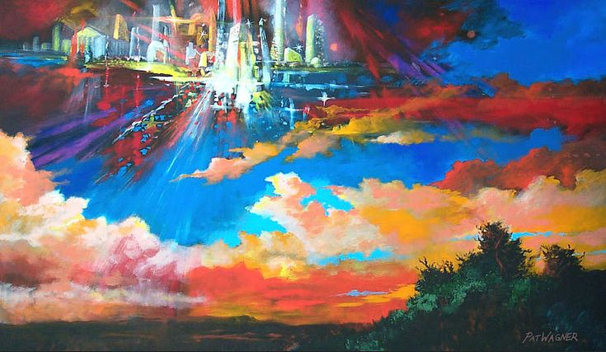
They will be his people, and God himself will be with them and be their God. 'He will wipe every tear from their eyes. There will be no more death' or mourning or crying or pain, for the old order of things has passed away." He who was seated on the throne said, "I am making everything new!" Then he said, "Write this down, for these words are trustworthy and true."
Notes:
Revelation 21:1-5
Gorgeous images have adorned social media, of the sights and sounds of people’s daily walk or exercise – many of them sunset skies as people seek exercise in the quieter end of the day – take a moment to share your lasting images from this time.
Many of these have offered hope in a time of difficulty, something greater to hold onto – many have reflected on the benefits to the environment of this lockdown and how a return to normal impact of pollution might be mitigated in some way – these may be points that form part of your conversations with the children as they return, perhaps they have a renewed sense of courageous advocacy over a particular area!
The Bible talks of a permanent change, one that offers hope without a return to a norm that will continue to fail in one way or another. John, in the book of Revelation offers a vision of this future; “'He will wipe every tear from their eyes. There will be no more death' or mourning or crying or pain, for the old order of things has passed away." ⁵He who was seated on the throne said, "I am making everything new!" Then he said, "Write this down, for these words are trustworthy and true.“ 21:4-5
The path to future joy is never promised to be a smooth one, we are called to focus on it as we move forward, having an eternal perspective, and enduring by faith in God.
Spend time watching Audrey Assad’s version of a classic, “Be Thou My Vision”
Prayer focus:
Look at your school vision, a path forward in what you want to achieve for your school community. As God to help you live this out unswervingly as you make decisions in the days ahead, as you bend and change in ways unexpected, as you seek to do the impossible, as you celebrate all that your community has done and will do – ask him to be at the heart of your vision moving forwards.

