Slide 1
Biblical Reflections as our school community comes back together
Suitable for staff meetings or could be adapted for use Collective Worship
Notes:
Each slide contains a bible verse and reflections around it, that can be used to begin a staff meeting or be developed further to form an act of Collective Worship for pupils. There are suggestions for songs that could be sung, or musical background for a time of reflection / personal prayer. Each slide can be taken as a stand alone reflection and is expected to last no more than 10 minutes. The musical aspects are time for reflection rather than singing along with due to advice to avoid collective singing for the time being.
It is hoped that these will facilitate schools in coming together to reflect on the heartbeat of what makes your school distinctive, to put the faith aspect of the school right at the centre of returning – of looking back and acknowledging the difficulties and pain, and also the blessings that have gone on during this time of lockdown – but also in looking forward with confidence, to what may be familiar or new, trusting in God’s goodness for our schools.

Slide 2
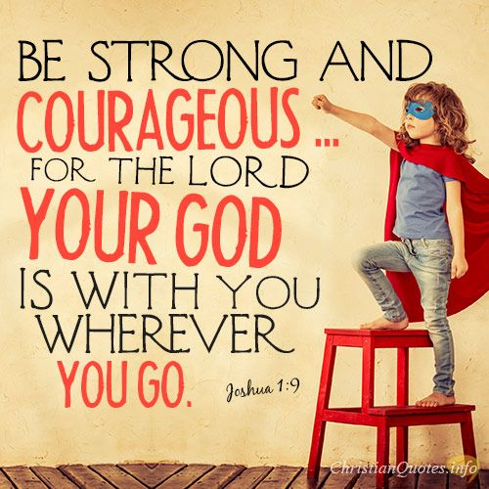
Notes:
Joshua 1:9
How do you feel about returning to school? Do you feel nervous, anxious, perhaps wishing you were back home where you felt safe?
In this passage, Joshua was standing at the edge of the land of Canaan, Moses had died, and God was commanding Joshua to take the Israelites forward into the promised land. It was new, they were leaving what they had known, to step into a future that God had planned.
God gave this command to Joshua in verse 9 to encourage him, to put a strong heart into him, whatever the future holds, God would be with him. I wonder how this made Joshua feel strong and courageous? As Joshua and the people of Israel recalled how God had been with them through the desert, it gave them certainty of the truth of this going forward, this is a common pattern throughout the Bible of looking back to God’s faithfulness to stand strong in going forward.
Joshua probably felt the same as we do now, as we begin again, our community, coming back together and settling down into our school – some things will feel familiar, some will feel different. Corrie ten Boom, a German Christian who survived concentration camps during the Holocaust, said, “Never be afraid to trust an unknown future to a known God.” What do you know of God? Reflect back – how has God been with you before Covid-19? How has he been with you through this? How might this make you feel strong and courageous?
Listen to the track “Good Good Father” by Chris Tomlinson. Joshua spent time talking with God – it gave him courage to go forward into something new…spend time talking to God now, recall how he has shown goodness over that past months and even years, tell him your feelings and ask him to give you courage for the future.
A prayer for courage:
Lord, I’m afraid
I don’t feel bold or courageous today
Help me to remember that bravery isn’t the absence of fear, it’s doing the right thing no matter what.
Give me a courageous heat.
I know that you will be with me, I am not alone.
You are greater than any obstacle I face.
Help me to step forward knowing that you are trustworthy
And my source of strength.
In Jesus’ name. Amen

