Slide 1
Biblical Reflections as our school community comes back together
Suitable for staff meetings or could be adapted for use Collective Worship
Notes:
Each slide contains a bible verse and reflections around it, that can be used to begin a staff meeting or be developed further to form an act of Collective Worship for pupils. There are suggestions for songs that could be sung, or musical background for a time of reflection / personal prayer. Each slide can be taken as a stand alone reflection and is expected to last no more than 10 minutes. The musical aspects are time for reflection rather than singing along with due to advice to avoid collective singing for the time being.
It is hoped that these will facilitate schools in coming together to reflect on the heartbeat of what makes your school distinctive, to put the faith aspect of the school right at the centre of returning – of looking back and acknowledging the difficulties and pain, and also the blessings that have gone on during this time of lockdown – but also in looking forward with confidence, to what may be familiar or new, trusting in God’s goodness for our schools.

Slide 2
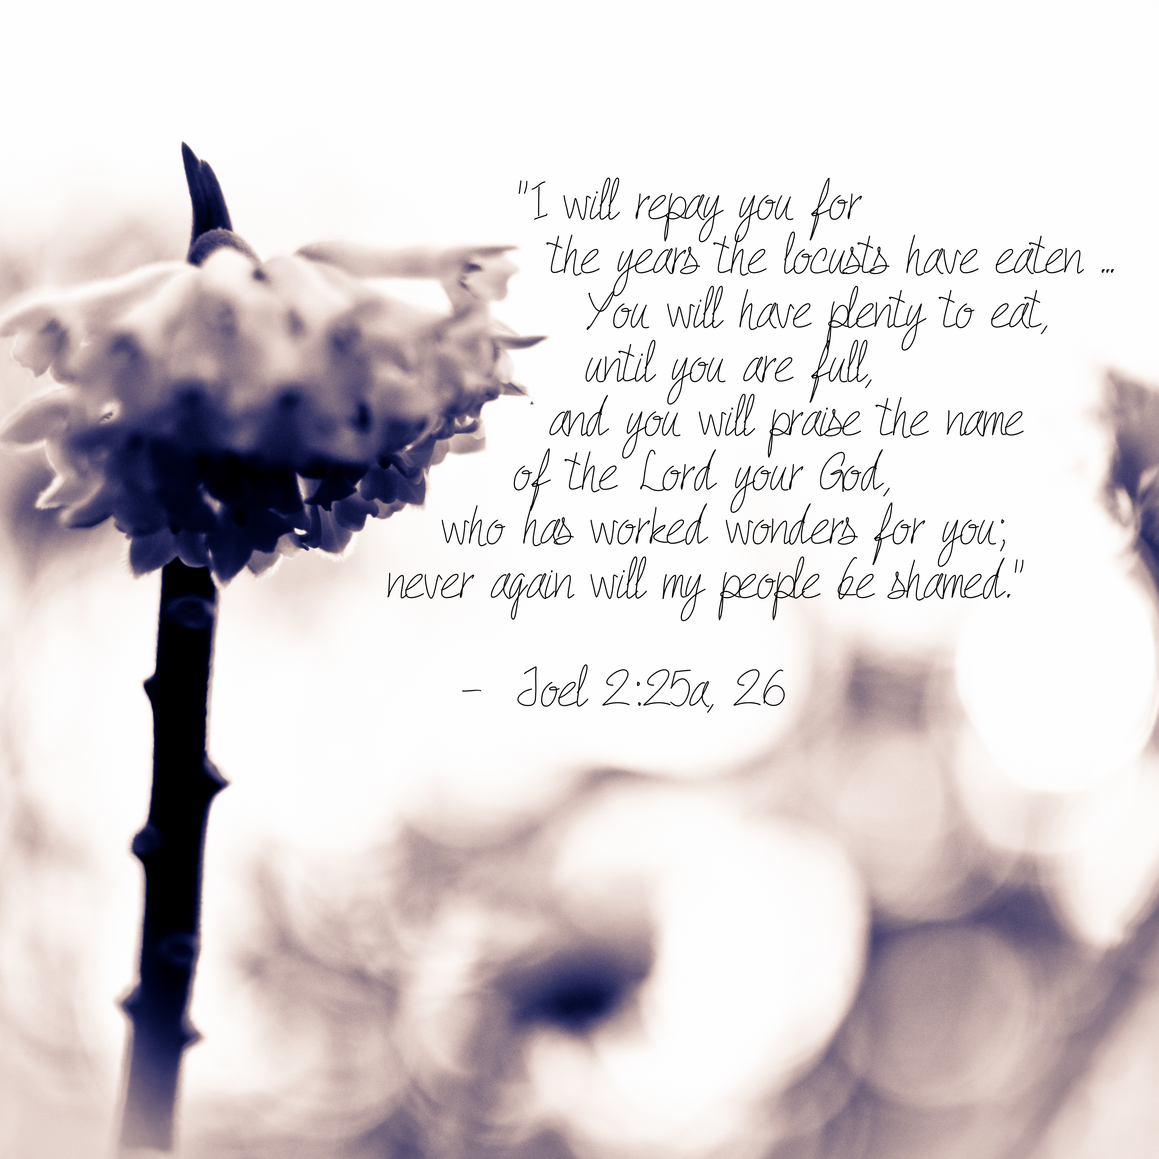
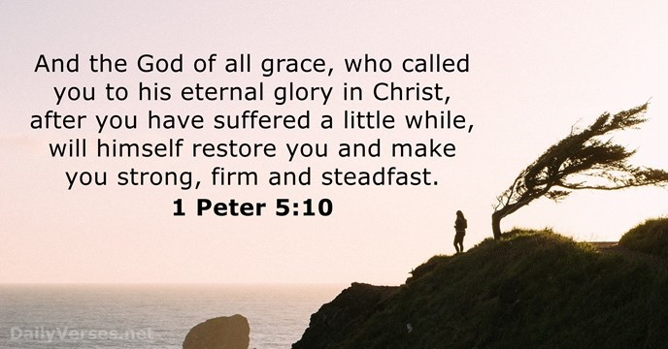
Notes:
Joel 2:25-26
"I will repay you for the years the locusts have eaten- the great locust and the young locust, the other locusts and the locust swarm- my great army that I sent among you. You will have plenty to eat, until you are full, and you will praise the name of the LORD your God, who has worked wonders for you; never again will my people be shamed.”
This isn’t a promise of 100% perfect exam results next year, or even a smooth year ahead…The Israelites prayed that God would spare them, and he did.
He promises a time of peace for those who trusted in him, some think this passage points to the hope of Heaven – that Heaven itself is more than enough to recompense for the struggles endured on earth. What is true in the here and now for Christians, is allowing God to use the struggles
Take time to listen to Page CXVI – ‘I’ve got peace like a river’ - reflect on the opportunities that you have had to grow (spiritually, socially, mentally, academically…) during the time of lockdown and how that can and maybe already has had an impact going forward.
“I’ve got love like an ocean in my,
soul
come to the, waters
watch it flow, with his love
where your heart won’t, wither
but grow
it will grow.”
Prayer:
Father God,
Help us to embrace all that has happened during this time,
Knowing it has shaped who we are today.
Help us to trust that you, a good God, have a reason for bringing us to this point.
Show us how to serve you in moving our school forward,
Help us to live in a way that fulfils your purpose here
For we know that nothing is impossible with you.
In Jesus’ name
Amen

