Slide 1
Buildings for Mission
Emily Allen, Church Buildings Missioner

Slide 2
Parish support
Fundraising for capital works
Godly vision (& process) for church buildings
Open doors
PM

Slide 3
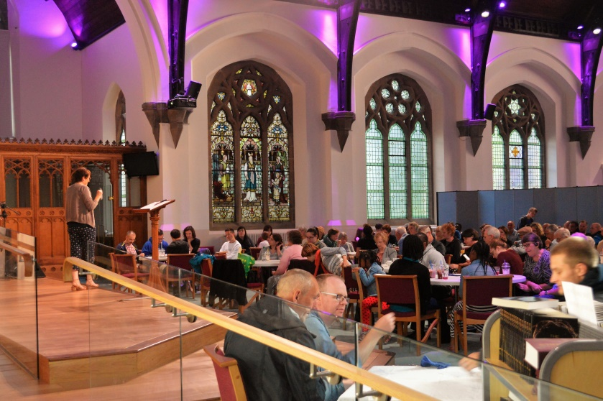
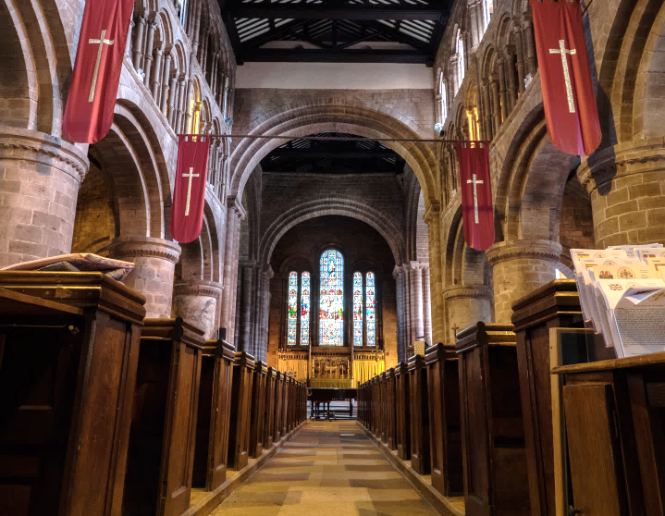
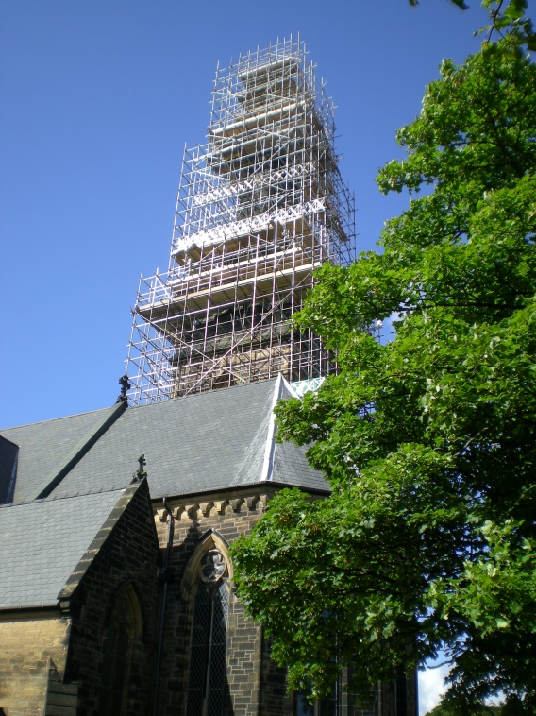
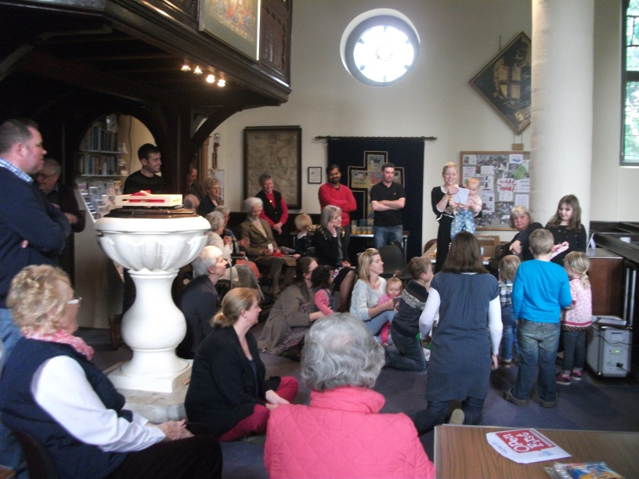

Slide 4
Sacred spaces as one conduit to enable people to encounter Christ
What do you want FROM your building in line with a Godly vision?
What do you want to do TO your building?

Slide 5
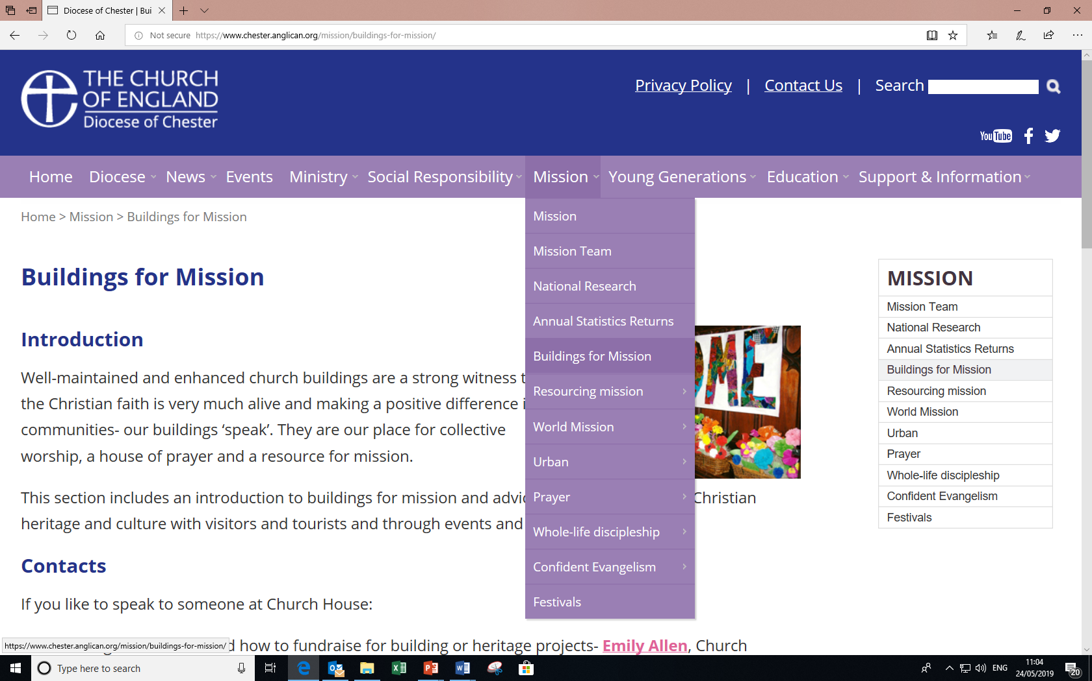
www.chester.anglican.org / Mission / Buildings for mission

Slide 6
Missional fundraising

Slide 7
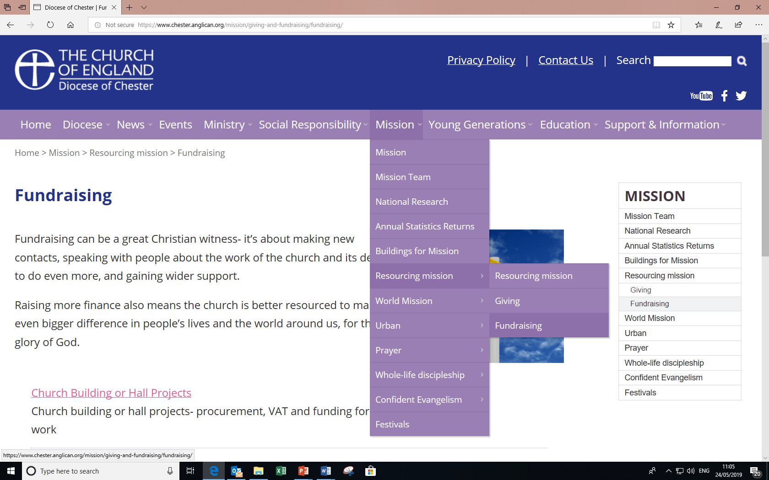
www.chester.anglican.org / Mission / Resourcing Mission

Slide 8
Preventative Maintenance www.chester.anglican.org/mission/buildings-for-mission/buildings-maintenance

Slide 9
www.maintenancebooker.org.uk

Slide 10
Training 2019 www.chester.anglican.org. Click on ‘Events’
Explorers of church building projects
26th Sept (A/V) and 31st Oct (ecumenical)
Managing Events in Your Church
Sat 7th Sept
Writing a Successful Grant Application
Weds 2nd and repeated Sat 12th Oct

Slide 11
Buildings for Mission
Emily Allen, Church Buildings Missioner
E: emily.allen@chester.anglican.org
T: 01928 718 834 ex268

