Slide 1
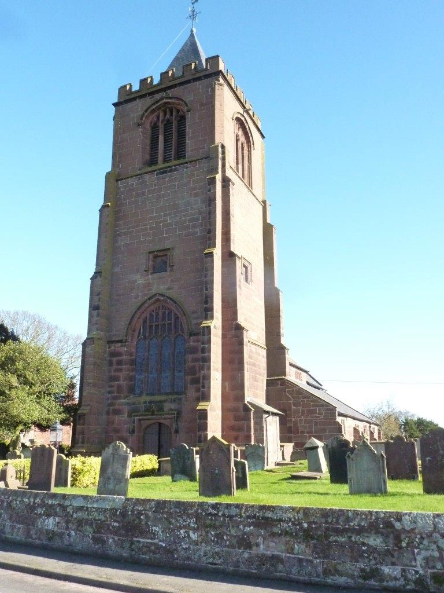
Welcome to the DAC
Introduction to Faculties

Slide 2
Introduction to faculties…
Faculty Jurisdiction has existed since 19th century
Ecclesiastical Exemption means the Church has a control over works to church interiors through Faculty Jurisdiction
A faculty is a legal permission – required for works to a church building or churchyard that includes changes
Need for parity if the Church is to retain Ecclesiastical Exemption
Faculty Jurisdiction runs parallel to secular planning

Slide 3
Types of permission
List A – minor works with no permission needed – if in doubt ask
List B – Archdeacon’s permission - proposals usually need review
Faculty – needs consideration by DAC, and is approved by the Diocesan Chancellor
Submitted via the Online Faculty System

Slide 4
Record List A works
Submit requests for List B works
Submit faculty applications
Submit requests for temporary minor re-ordering
Remember the DAC office is happy to help!

Slide 5
Diocesan Advisory Committee for the Care of Churches
Chairman
Archdeacons
Clergy members
Architect members
Lay members

Slide 6
The DAC considers…
Church buildings
Churchyards
Boundary walls
Trees in churchyards
Structures in churchyards

Slide 7
What the DAC does
Around 9 meetings per year
Considers faculty applications
Considers requests for informal advice
Informal advice to parishes
Formal recommendation to Chancellor

Slide 8
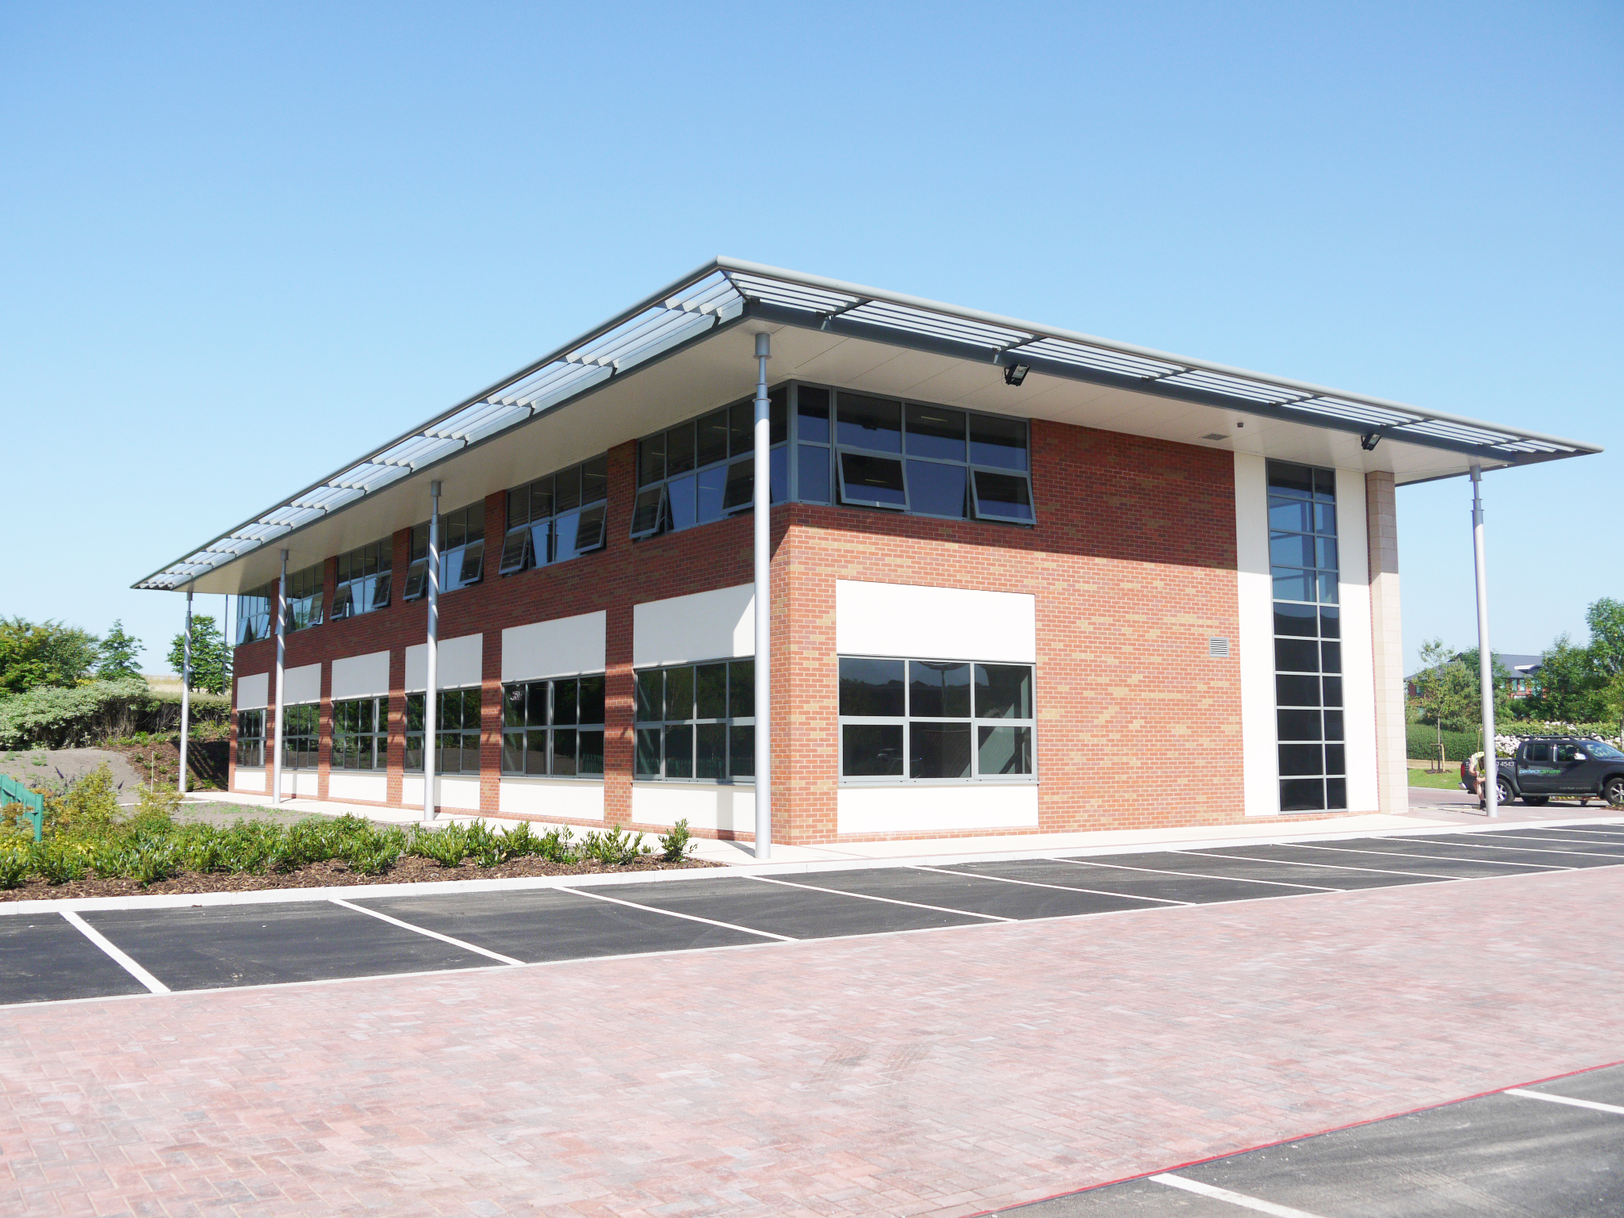
The office
DAC Secretary – Caroline Hilton
Assistant to DAC Secretary – Katy Purvis
We liaise with:
Registrar – Lisa Moncur
Clerk – Joanne Williams
Archdeacons - Michael Gilbertson, Ian Bishop
Church Buildings Missioner – Emily Allen

Slide 9
DAC office: what we do
Faculty applications
Requests for List B permission
Referrals to DAC Advisers
Consultation
Answering queries
Administration of quinquennial inspection reports system
We’re here to help!
Large complicated matters may take longer to process. Needs to be worked through carefully as it is legal documentation
We try to deal with applications and queries as swiftly as possible
DAC office is a busy office!

Slide 10
Site visits
DAC Secretary can visit informally for a chat at the early stages, eg to think about Statement of Need, and to outline the process and any need for consultation
DAC Sub-committee visits are more formal, consist of Chair, DAC Secretary, Architect, Clergy member and Archdeacon if available. Reports back to DAC and advice offered to parish.*
*A Statement of Need must be provided in order for a DAC Sub-Committee visit to take place. Template available - ask the DAC office or visit Church Buildings Council webpages

Slide 11
Faculty Fees
There is a standard statutory fee, currently £296.20 which is payable on the lodging of all faculties. This amount is stipulated by legislation made by Parliament and is fixed.
This fee is usually payable by the Parish.
The Faculty Fee should be paid when you send your Public Notice and Certificate of Publication to the Registrar. The Registrar will then be able to progress your petition and submit it to the Chancellor for his determination.

