Slide 1


Emily Allen
Church Buildings Development Officer
Mission team
Email: emily.allen@chester.anglican.org
Tel: 01928 718 834 ex 268
Notes:
Emily Allen- apologies for not being here today. Very happy to be contacted after today with any questions or requests for support.
Emily is part of the Mission team at Church House. Her role is support churches realise the potential of church buildings for supporting mission and ministry. Part of Emily’s role is to offer fundraising advice for capital projects, such as repairs, heating, lighting, changing the internal space, new facilities etc etc.

Slide 2
Today’s presentation
How is fundraising Godly work?
Latest fundraising news
Fundraising tips
Fundraising online resources
Future training courses
Contact details for further support

Slide 3

The right frame of mind- how is fundraising Godly work?
Fundraising is missional
‘Excellent fundraising for a better world’. Motto of the Institute of Fundraising
Notes:
First click
Fundraising is not separate from Christian activity but is missional at its heart.
It’s about speaking with people about the work of the church, the positive difference it makes, and the even greater difference it can make with others support.
Done in the right way, it’s a positive witness in itself, as well as enabling the church to flourish through greater financial investment in mission and ministry.
Second click
Even in secular terms, such as the motto for the Institute of Fundraising, it’s clear that the activity of fundraising is all about making a positive difference in the world.
How much more so when we’ve been invited to be part of God’s redemptive plan.

Slide 4

Latest news- VAT reclaim scheme
Listed Places of Worship Scheme
(VAT reclaim for grade listed churches on eligible items)
http://www.lpwscheme.org.uk/.
Notes:
Listed places of worship scheme is a government grant to reclaim VAT on eligible items for grade listed places of worship, for example, building repairs.
The Church Buildings Council was pleased to announce in September 2017 that it has received written confirmation from the Heritage Minister, John Glen MP, that following the General Election the Listed Places of Worship Grant Scheme will continue at its current levels until March 2020.
There are no changes planned to the eligibility criteria or application process. Information on applying can be found on the dedicated website:
http://www.lpwscheme.org.uk/.

Slide 5
Latest news- Heritage Lottery Fund
‘Grants for Places of Worship’ (GPOW)- now closed
Churches directed to existing other grant programmes, including:
  ‘Our Heritage’ (£10k-£100k)
  Heritage’ (£100k-£m)
  ‘Resilient Heritage’- small and large grants
Notes:
The Heritage Lottery Fund, often abbreviated to HLF, is the largest grant funder for heritage in the UK. It is not government funding, as this ceased when the repairs grant transferred from Historic England (then English Heritage) to the HLF c. 10 years ago. HLF is funded by national lottery players.
One of their grant schemes, Grants for Places of Worship (GPOW) closed on August 2017. Churches are now directed to apply to other grant programmes, which include:
Our Heritage (£10k-£100k)
Heritage (£100k-£m+)
Resilient Heritage
See handout for a summary of all their programmes.
Tips
- Focus on making a lasting difference to heritage and people- sustainable investment
Good news-
No longer need to be a grade listed building to apply. But need to tell the story of how heritage (building and/or social history) matters to people
More flexibility on ‘outcomes’- (what difference the project will make), bigger selection to choose from.
Our heritage is a quicker and simpler application – one round, result in 8 weeks
Heritage grant
Similar application to GPOW. Two stage application
No cap on new works such as lighting and heating (GPOW was up to 15% of total project cost), but need to justify how the new works will lead to more people engaging with heritage
No cap of max £250k grant. Can go up to £2m if judged in the North West and higher if judged nationally

Slide 6
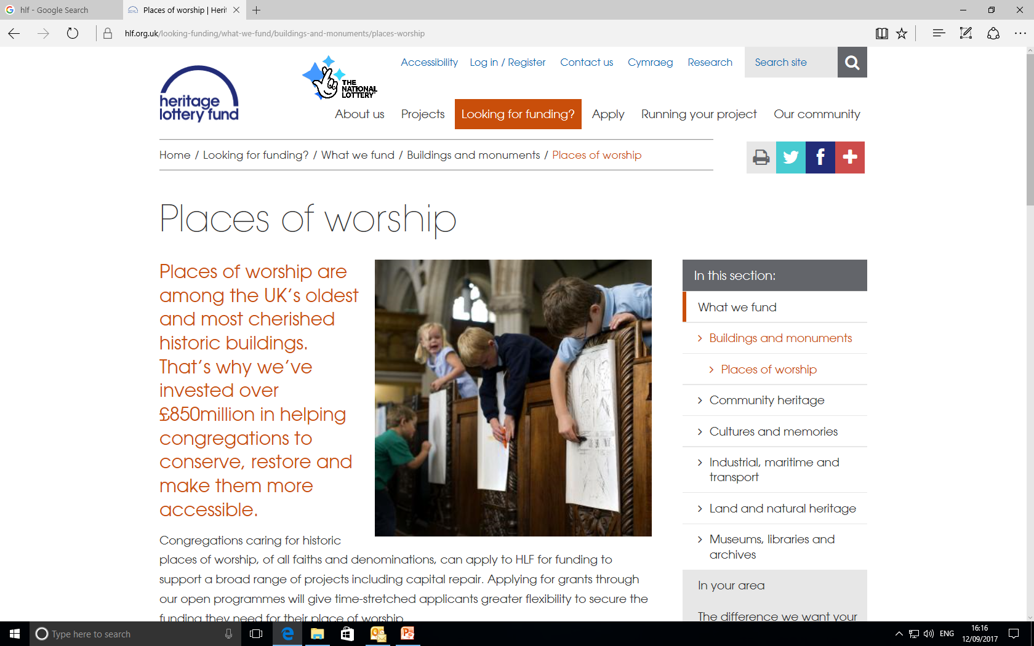
www.hlf.org.uk/looking-funding/what-we-fund/buildings-and-monuments/places-worship
Notes:
Website
Dedicated page for places of worship to explain the changes
Update from the Church Buildings Council (CBC) at the Church of England, Sept 2017
The Church Buildings Council have continued discussions with the HLF on the closure of GPOW, which came into effect in August 2017. The CBC has made it clear that ‘it considers the abrupt closure of GPOW, particularly without consultation or the carrying out of an Impact Assessment, was a mistake’.
HLF has reassured the CBC in writing that the amount of their funds spent on places of worship as a percentage of their total budget will remain at levels equivalent to 2016 and runs until March 2019, when their new strategic framework period begins.
Officers of the Church Buildings Council are working with staff at the HLF to put in place evaluation of the impact of the changes on places of worship.
The HLF has produced new guidance for churches considering applications, available on their website.
The Church Buildings Council will be producing practical notes on the ChurchCare website to give churches applying to the Heritage Grants and Our Heritage schemes clear ideas of how to demonstrate that their repairs-based project will meet HLF outcomes’.
We will let people know via the Diocesan e-bulletin when these ‘practical notes’ are available

Slide 7

Fundraising top tips
Notes:
A quick run-through top tips with fundraising

Slide 8

Top tip 1
Eligibility and appropriateness
Select the right funder(s) for your project. Beware of ‘mission-creep’
Prove you meet the criteria
Are you happy with t/c’s?
The top reason why grant applications fail is they have not followed the guidance notes/are ineligible
Notes:
Don’t find the funder first then select aims of project. It needs to be other way round. Discern God’s calling first for how the church building and its activities can best be used- what does God’s Kingdom look like in your area?
Read the guidance closely on all funding- research takes lots of time but is essential for funding for the right funding.
Eligibility and appropriateness
Select the right funder(s) for your project. Beware of ‘mission-creep’
Prove you meet the criteria
Are you happy with t/c’s?
The top reason why grant applications fail is they have not followed the guidance
notes/are ineligible

Slide 9
Eligibility and appropriateness- develop a fundraising strategy
Church
Communities
Major donors
Grant-making Organisations (government)
Grant-making Trusts & Foundations
Notes:
To avoid ‘mission creep’ where the focus of the project changes drifts to meet funding conditions, it’s important to first consider what funding sources are appropriate. Seek God in prayer for wisdom and discernment.
Church - Christian giving. Help from Martin Smith, Christian Giving and Pastoral Reorganisation Missioner, at Church House
Communities- public appeals and fundraising events
Major donors- individual benefactors- any good connections with the church? Also, businesses.
Grant-making organisations. E.g. council, landfill communities grant, Health Trust etc
Grant-making trusts and foundations. Set up by individuals or businesses. Each have their own priorities, criteria and terms and conditions
Grants tend to fall into either community focused, heritage focused or Christian focused.
Grants are rarely the sole answer. There is no set mix; it depends on the church’s particular circumstances and the nature of the project.

Slide 10


Top tip 2
2. Prove the need for the project
Evidence why this project is needed and why it's needed now
Who are the specific beneficiaries
The power of Numbers and People stories
Notes:
Prove the need for the project. This is essential.
Explain why your project is needed and who says it’s needed.
What consultation have you done to say this project matters to people?
How does this relate to wider local needs such as those expressed in a neighbourhood plan?
Present your case in terms of statistics- how many people are affected, what % of local area/perspective on how big an issue this is.
Also people stories- how the project will impact people’s lives, such as quotes from questionnaires and letters of support.

Slide 11

Top tip 3
3. Focus on the difference the project will make (outcomes)
How will it add value to the life of the church, communities and/or heritage, as appropriate?
Convey a journey from point 2- the problem to address, to this point 3- the solution and its impact.
Notes:
Focus on the difference the project will make- the outcomes.
How will it add value to the life of the church, communities and/or heritage, as appropriate?
Convey a journey from point 2- the problem to address, to this point 3- the solution and its impact.

Slide 12
Outcomes definition
‘Outcomes are the changes that your project can make over time to address the need(s) you have identified’.
Big Lottery definition
Notes:
Funders want to make a difference, just like we do.
‘Outcomes are the changes that your project can make over time to address the need(s) you have identified’.
Big Lottery definition
Focus on ‘change’ words, like more, less, better
E.g. our project will enable us to hold more activities

Slide 13

Top tip 4
4. Funders are risk adverse
Prove you're a capable pair of hands by
  - explaining the project team skills
  - track record of successful projects
  - risk assessment
Present the project professionally, e.g. an accurate budget sheet
Budget- contingency and inflation
Notes:
Funders are risk adverse
Prove you're a capable pair of hands by
- explaining the project team skills
- track record of successful projects
risk assessment
Present the project professionally, e.g. an accurate budget sheet
Budget- contingency and inflation

Slide 14

Top tip 5
5. Explain why you’re applying to the funder
Financial need, context
Detail who's already supporting the project
Notes:
5. Explain why you’re applying to the funder
Financial need, context
For example, are you in an area of deprivation that makes it difficult to raise substantial funds from Christian and community giving? How you already asked local communities for support with project a few years ago, so unlikely to raise sufficient funds again? Do you need to retain a proportion of funding for other work identified, e.g. in the QI?
Detail who's already supporting the project. Funders are keen to know your fundraising plan for raising the total amount.

Slide 15

Next steps- Case for Support
Captures the real message you want to convey
Use as template for drafting fundraising text
Notes:
A ‘Case for Support’ captures the essence of the project.
This is useful when speaking with the congregation and wider communities, as well as drafting grant applications. Useful to keep a Master copy of longer and shorter versions. Here is a simple Case for Support template (next slide)

Slide 16
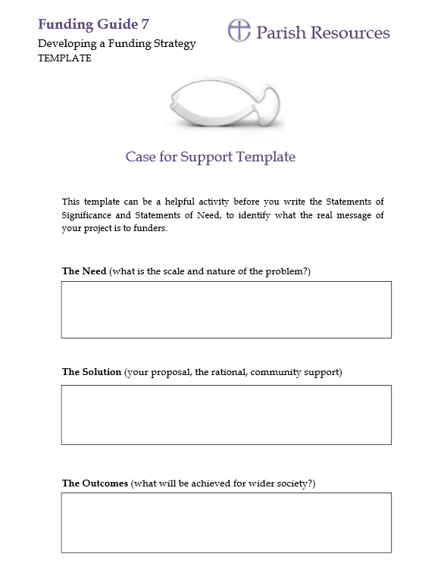
Notes:
See handout too.
Need- scale and nature of the problem
Solution- your proposal, rationale (why it’s needed and why now), what evidence of support is there for this project
Outcomes- what difference will the project make to people and/or heritage?
This handout is available on the parish resources website by the Church of England, as part of their Funding Guides (see next slide for screengrab)

Slide 17
Online fundraising resources
Notes:
A quick look at some useful websites

Slide 18
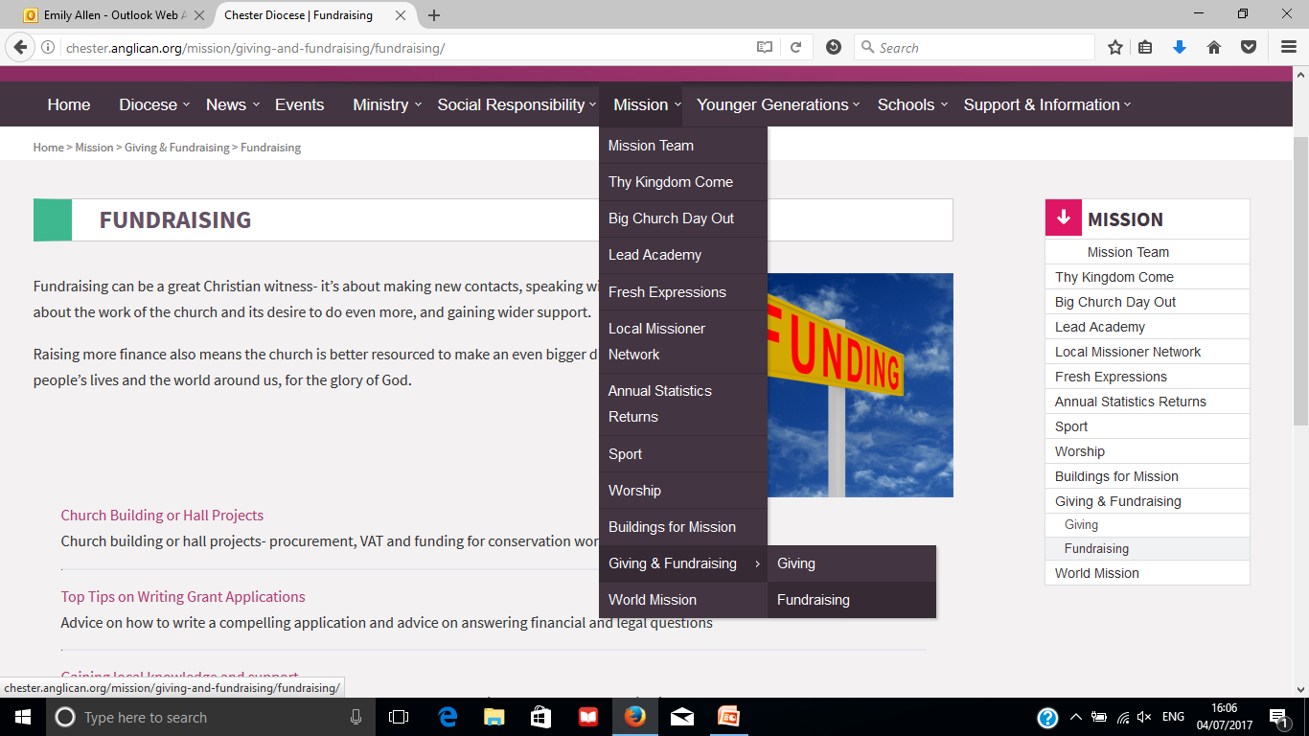
www.chester.anglican.org/ Mission
Notes:
The Diocese of Chester have a Fundraising section to the website.
This includes links to ‘how to’ guides, how to find grants, and how to gain support from local community organisations.

Slide 19
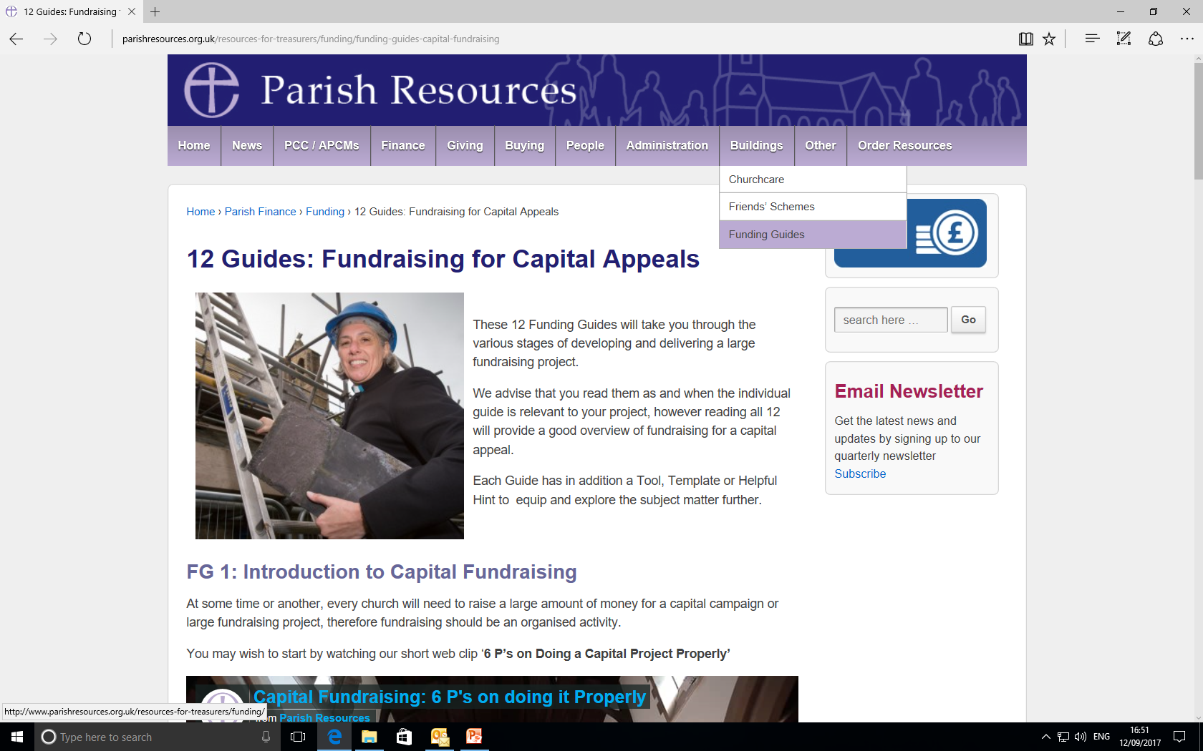
www.parishresources.org.uk
Notes:
Parish Resources is a website by the Church of England’s Stewardship team. They have fundraising ‘how-to’ guides as well as a national list of grant funders.

Slide 20
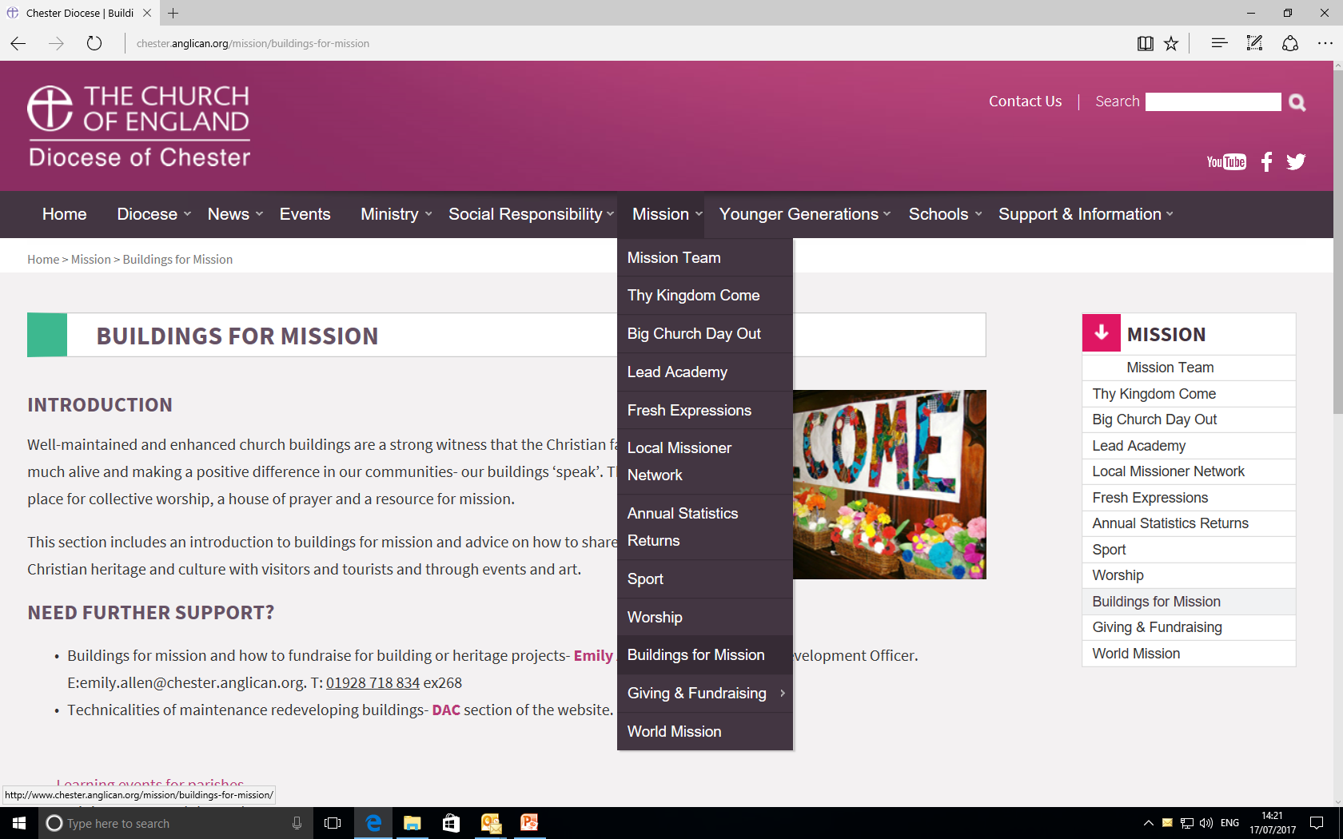
www.chester.anglican.org/ Mission
Notes:
The Diocese of Chester’s website also has a section for realising the missional potential of buildings, with links to the DAC section for more technical advice about caring for buildings.

Slide 21
Training: Buildings for mission
How to Get the Best From Your Church Hall
16th October 2017, St John’s Church Centre, Hartford
How to write a successful grant application
Thursday 15th February 2018, Church House
Welcoming visitors and sharing your story
Tuesday 6th March 2018, Church House
Advertised on the Diocesan website:
www.chester.anglican.org - Click on ‘Events’
Also, promoted in the e bulletin nearer the time.
Notes:
How to write a successful grant application
Wednesday 15th February 2018
Welcoming visitors and sharing your story
Thursday 2nd March 2018
Advertised on the Diocesan website:
www.chester.anglican.org - Click on ‘Events’
Also, promoted in the e bulletin nearer the time.

Slide 22
Training cont…
Explorers of Church Buildings
A new programme, visiting churches every two months to hear, first hand, about their experience of a building project.
More info see www.chester.anglican.org – Click on ‘Mission’, ‘Buildings for Mission’, ‘Learning events for parishes’
Notes:
Explorers of Church Buildings-
See handout
A new programme, visiting churches every two months to hear, first hand, about their experience of a building project, ask questions and look around.
More info see www.chester.anglican.org – Click on ‘Mission’, ‘Buildings for Mission’, ‘Learning events for parishes’

Slide 23
Training needs survey
Tell us what training you could like.
Survey closes 31st October 2017.
To take part, an email link will be sent round
Notes:
Training needs survey. Extended until end of October. Tell us what training needs you have and how we can support you.
An email link will be sent round.

Slide 24
Contact details
Emily Allen
Church Buildings Development Officer
Mission team
Email: emily.allen@chester.anglican.org
Tel: 01928 718 834 ex 268
Notes:
Feel free to get in touch with any queries/requests for support

