Slide 1
Church Wardens: Inspiring Younger Generations

Slide 2
First of all…
Thank you!

Slide 3
What do we want to get out of today?
An understanding of why it is important that younger generations are part of the church
An understanding of how we can encourage younger generations to be part of the church

Slide 4
What to expect…
Theology
Theory
Statistics
Discussion

Slide 5
Theology
Ministering with the marginalised
Trinity: a dance of love
Life to the full: John 10:10
The kingdom of Heaven belongs to such as these:
Matthew 19:14
Pass it on: Psalm 78

Slide 6
Theory - what is youth work?
Focusing on young people, their needs, experiences and contribution.
Voluntary participation, young people choose to become involved in the work.
Fostering association, relationship and community, encouraging all to join in friendship, to organize and take part in groups and activities and deepen and develop relationships and that allow them to grow and flourish.
Being friendly, accessible and responsive while acting with integrity. Youth work has come to be characterized by a belief that workers should not only be approachable and friendly; but also that they should have faith in people; and be trying, themselves, to live good lives.
Looking to the education and, more broadly, the welfare of young people
(Jeffs and Smith 2010)

Slide 7
https://vimeo.com/193766391

Slide 8
Your stories of Inspiration
Share with one or two people near you about a person, event or object which inspired your Christian faith

Slide 9
Some Statistics
86% of Christians decided to follow Jesus before the age of 25
Over 40% of Christians have been followers of Jesus since, or before, the age of 4.
50% of churches in Chester Diocese have five or fewer children or young people on an average Sunday
¾ of adults who decide to follow God experienced church of some kind when a child
89% of Christian 11-18s have followed Jesus since before the age of 11
EA Research, Griffiths 2009, Talking Jesus Research 2016, CofE Statistics for Mission 2015

Slide 10
More Statistics…
20% of 11-18s self identify as active followers of Jesus
13% of 11-18s identify as practising Christians
37% of 11-18s believe in the Resurrection
Top three reasons for 11-18s coming to faith:
Growing up in a Christian family
Reading the Bible
Sunday School

Slide 11
Discussion
Do any of these statistics surprise you?
Which ones would you like to question?
What are the implications of these statistics for the church?

Slide 12
Rooted in the Church
https://www.youtube.com/watch?v=IBe8vFPtSVQ

Slide 13
Discussion
Would you add anything else to this list?
Choose one you think your church is good at. Share with the group why this is.
How, if at all, will this help you think differently about children and young people in church?
Inclusion
Equality
Space
Leadership

Slide 14
Five Year Aims
To enable parishes to be relevant to families.
To see love and service of God prioritised by young people, children and families.
To see children welcomed and understood to be models for discipleship, having a voice which is heard at Diocesan and Parish level.
To equip parishes to welcome and support at risk and marginalised young people, including NEET young people, those in prison, those with individual needs, those from troubled families, on the street, excluded and those with mental health issues.
To aid parishes in being a safe haven and community for all children, young people and families.

Slide 15
Three Stranded Approach
Parishes
Schools
New ways of being and doing church

Slide 16
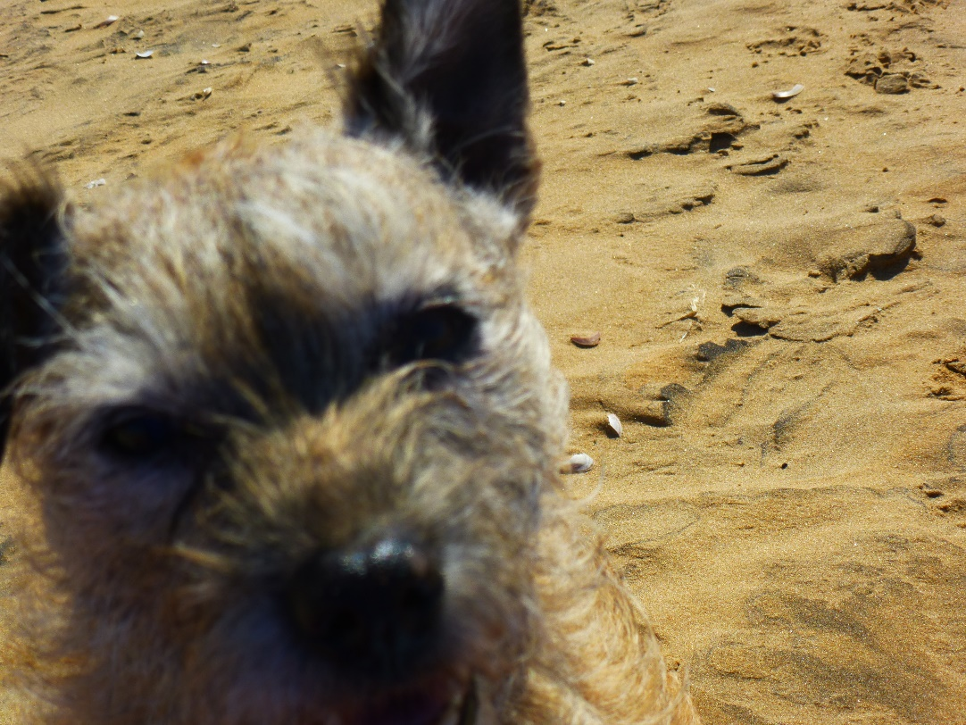
Any questions?

Slide 17
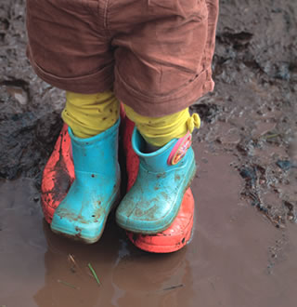
What’s Next?
It is for you to decide…

Slide 18
Contact Details
jonathan.masters@chester.anglican.org
Phone: 01928 718834 ext. 231

