Slide 1
The Difference We Make…
Care, compassion and cups of tea!

Slide 2
The Background
Committee for Social Responsibility is a Synodical Committee – we take this seriously!
Not just the Church House Staff Team
In the process of re-thinking / re-imagining!
Runs the risk of being everything and nothing as it really is about the place of Church in God’s World!

Slide 3
What have we been up to? (Phew!)
Ageing And Dementia
Deprivation And Finance
Signers
CMEAC
Criminal Justice
Rural Ministry
Mental Health Forum
Access and Inclusion
Safeguarding Training and Casework
Disability
Urban Ministry
World Concerns
Modern Slavery
Refugees and Asylum Seekers
Mediation
Counselling
Peer Support
Sexual Identities

Slide 4
The staff team comprises of:
Director of Social Responsibility - Debbie Dalby
P.A. to the Director of Social Responsibility / Departmental Assistant – Hannah Jones
Head of Counselling Services - Jane Knight
Vulnerability and Safeguarding Officer (VSO) - Pauline Butterfield
PA to the VSO - Stephen Ellis
Transforming Lives Together (TLT) is our joint venture set up with the Church Urban Fund and part of the Together Network in England. Our TLT Development Workers are:
Kath Leigh
(Archdeaconry of Macclesfield)
Lead Community Builder
Wendy Robertson
(Archdeaconry of Chester) Community Builder

Slide 5
Our Committee
Ex-officio: Chair | Archdeacon of Macclesfield
Clergy | Revd Margaret Jones Revd Shaun Conlon Revd Thia Hughes Revd Tina Upton
Laity | Mrs Vivien Ley Mrs Madeleine Watts Dr Christine Wetherell Mr Vincent Whitehead
Appointed by Bishop’s Council | Mr John Freeman Revd Andrew Greenhough
Up to two co-opted by CSR, up to two nominated by Bishop Peter

Slide 6
NATIONAL APPROACH – VISIBLE DISCIPLESHIP
National report key findings:
Social responsibility is at the heart of the gospel, building up the Kingdom of God.
Through social action, the church becomes relationally engaged with the wider community, establishing credibility and discovering the presence of God within his world.
Social responsibility is at the core of discipleship, as people live out their faith and reflect upon that experience.
Social responsibility is an intrinsic part of healthy church growth, seeking transformation at every level.
The challenge of social responsibility is as relevant to the church itself, as it is to the society of which the church is a part.

Slide 7
What would you think….?
You need to significantly grow your church numbers
You must start doing a wave of new things
You should see the world in a different way
You need to recruit a raft of new volunteers
You need to fundraise and bring in lots of extra resources
You must try and bring about big changes
You have to get to know a whole range of new people

Slide 8
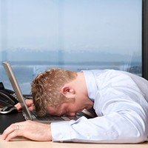
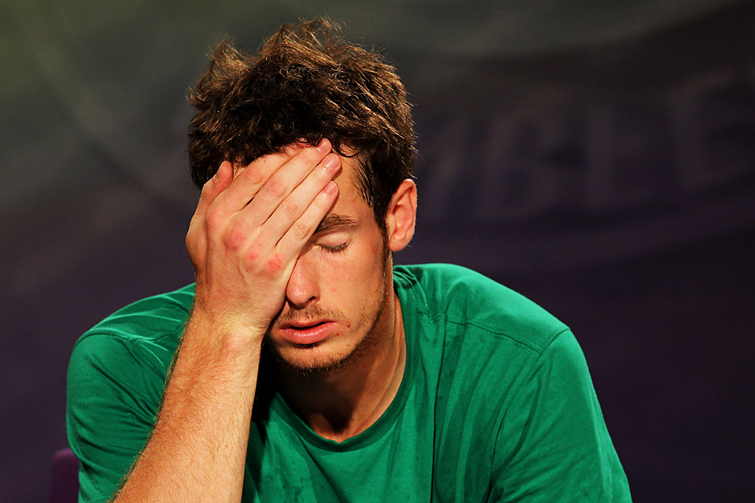

Slide 9
Good news…!!!
You have all you need
You know what you need to know
You have just enough people
Whatever you do will be good enough

Slide 10
Your starting point is your starting point!!

Slide 11
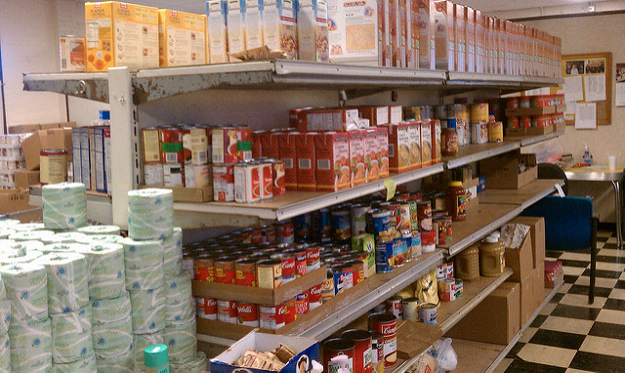
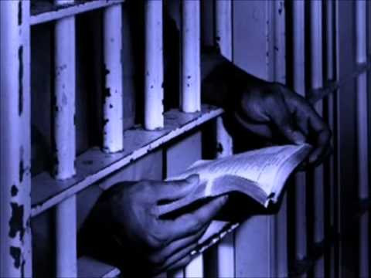
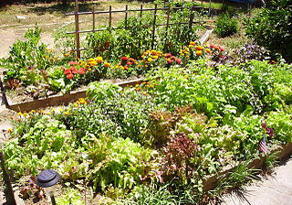
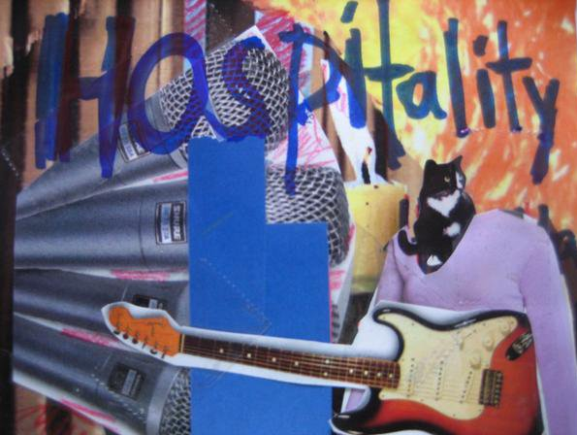
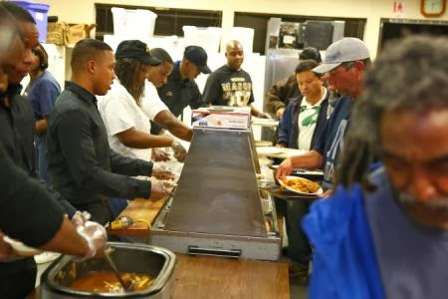
Social Responsibility is unique in every parish!

Slide 12
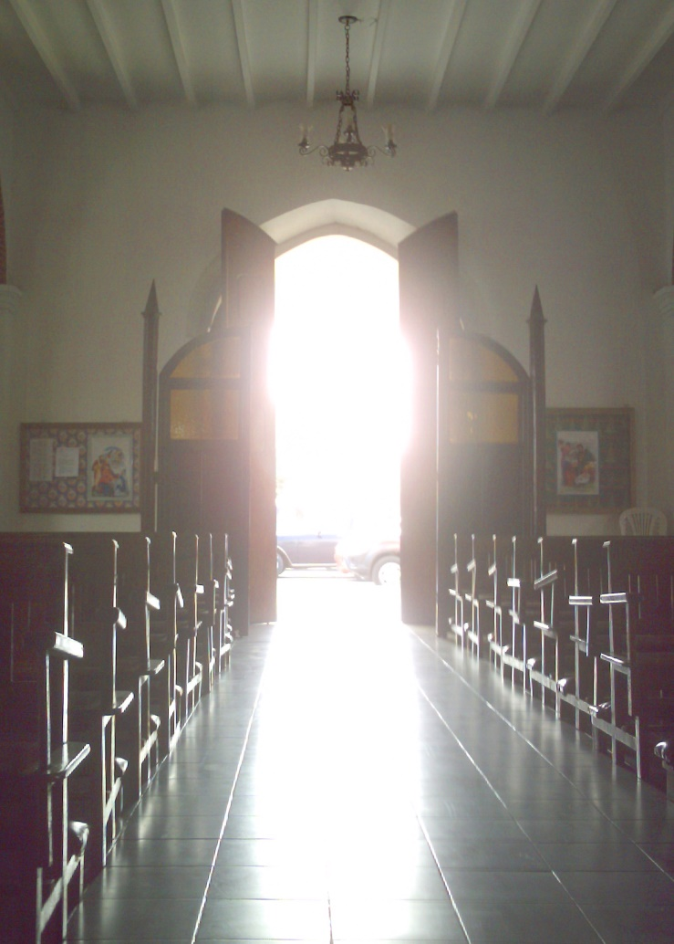
Good news brings…..
Good lives
Good communities
Good world
Go in peace to love and serve the Lord…

Slide 13
What we would like to see..
Parish level excitement about social responsibility and know what it means to you.
SR work is mission not an “add on” or optional “initiative”.
At the heart of Parish life and Parish life central/integral to good communities.
Safeguarding is ministry.
All clergy (& church members) feel… nurtured, supported, valued, safe, protected
and confident to
ask for help!

Slide 14
Committee Plans And Priorities 2017 to 2018
Headline Activity
Loneliness And Isolation
Disability And Access
Financial Resilience.

Slide 15
Thematic Development
Mental Health Forum
Criminal Justice Group
Disability Forum
Environment Forum
Older People (Dementia) Forum
Faithful Neighbours Forum

Slide 16
Geographic Focus
Urban Mission And Ministry Committee
Rural Steering Group
(TLT)
Know Your Church Know Your Neighbourhood
Places Of Welcome.

Slide 17
Our offer to you….
Facilitate conversations to help you decide / discern and plan.
Training and awareness raising opportunities
Outreach “surgeries”
Resources and sources of information
Signposting
Networking and partnership links / facilitation
Social media and I.T based activities – video shorts
Diocesan level events and groups

Slide 18
A quick fire approach to social responsibility…!
Yellow – something that you enjoy, really like or are interested in…..
Orange - an issue or problem that is most significant to your local community.
Green – how you might address the orange thing with the yellow activity or interest
Pink – who else might be interested in this in your congregation / Parish and local community
Take a sticky of each colour…….

Slide 19
Deborah Dalby
debbie.dalby@chester.anglican.org
Director of Social Responsibility
Tel 01928 718834 ext 235

