Slide 1
Churchwardens Morning Some ideas to help you cope!
22nd July 2017

Slide 2
Online Resources

Slide 3
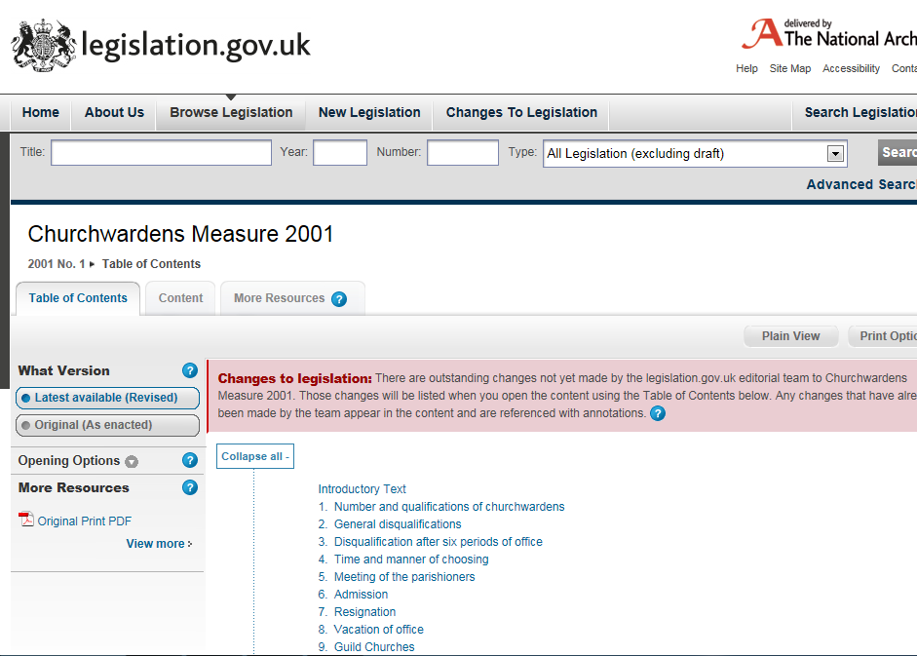
Available at

Slide 5
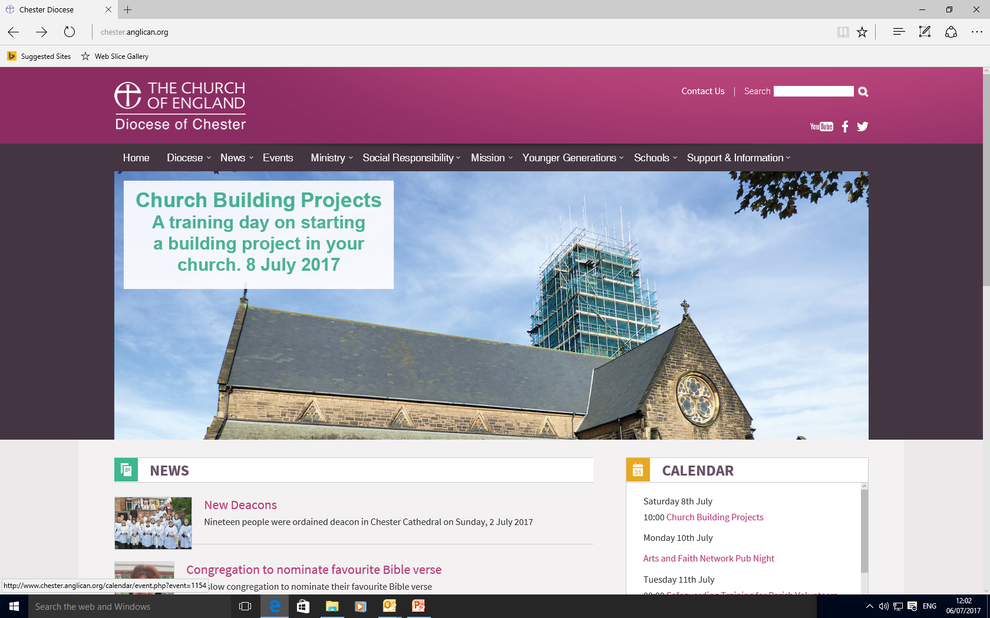

Slide 6
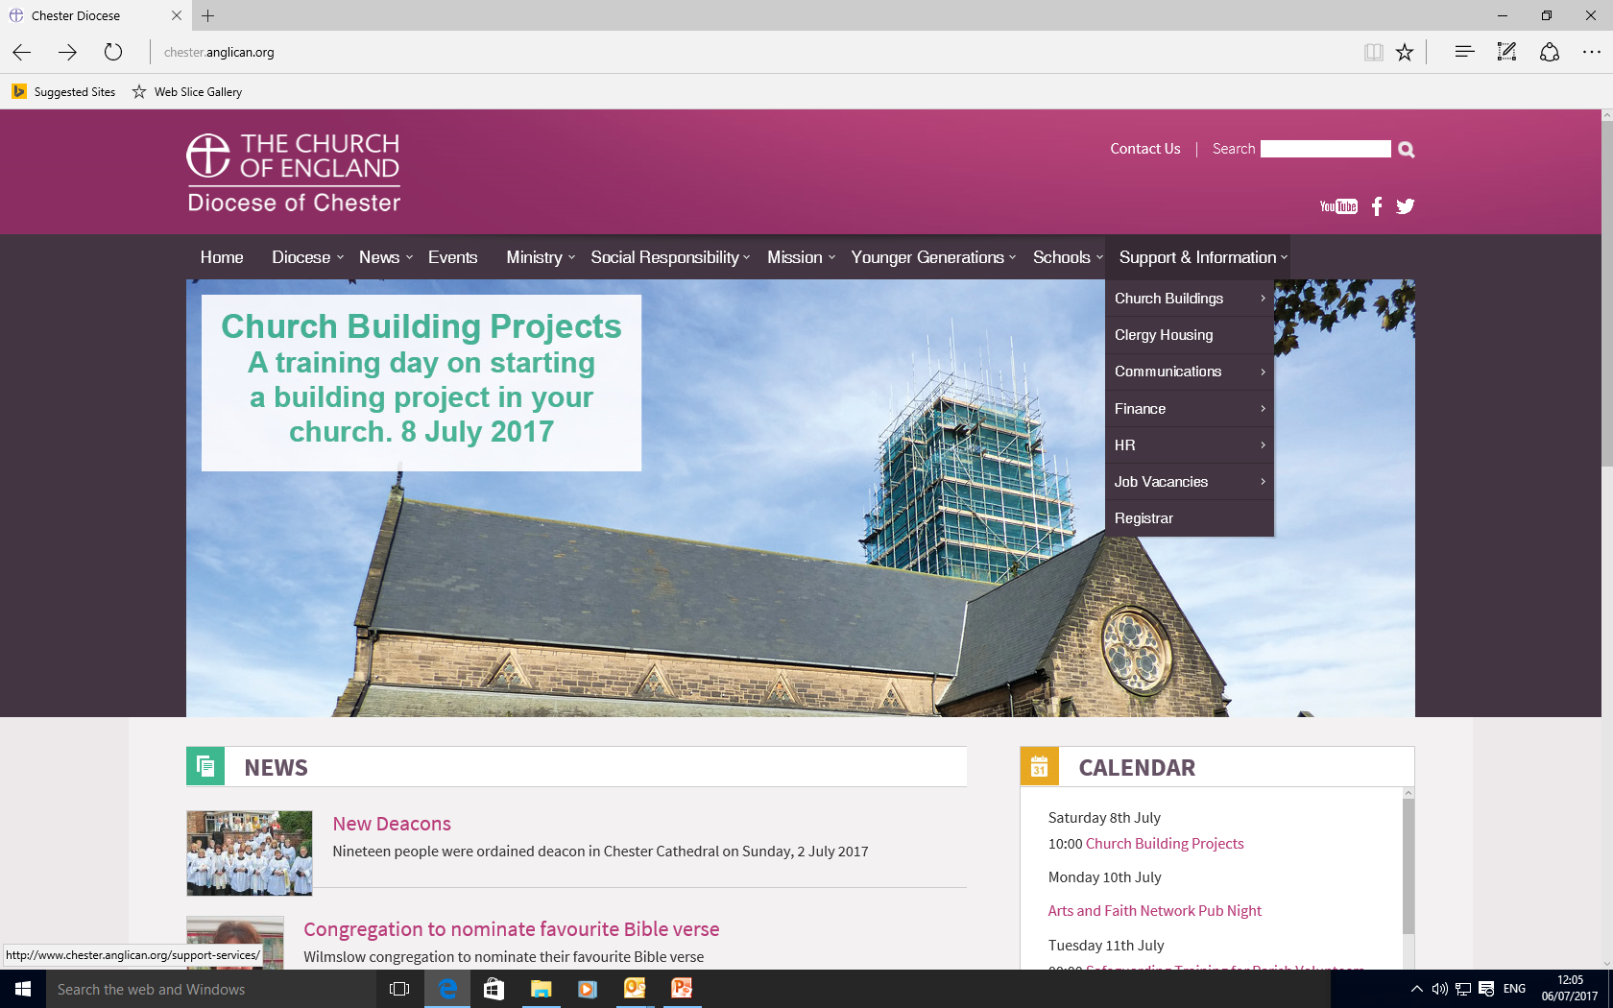

Slide 7
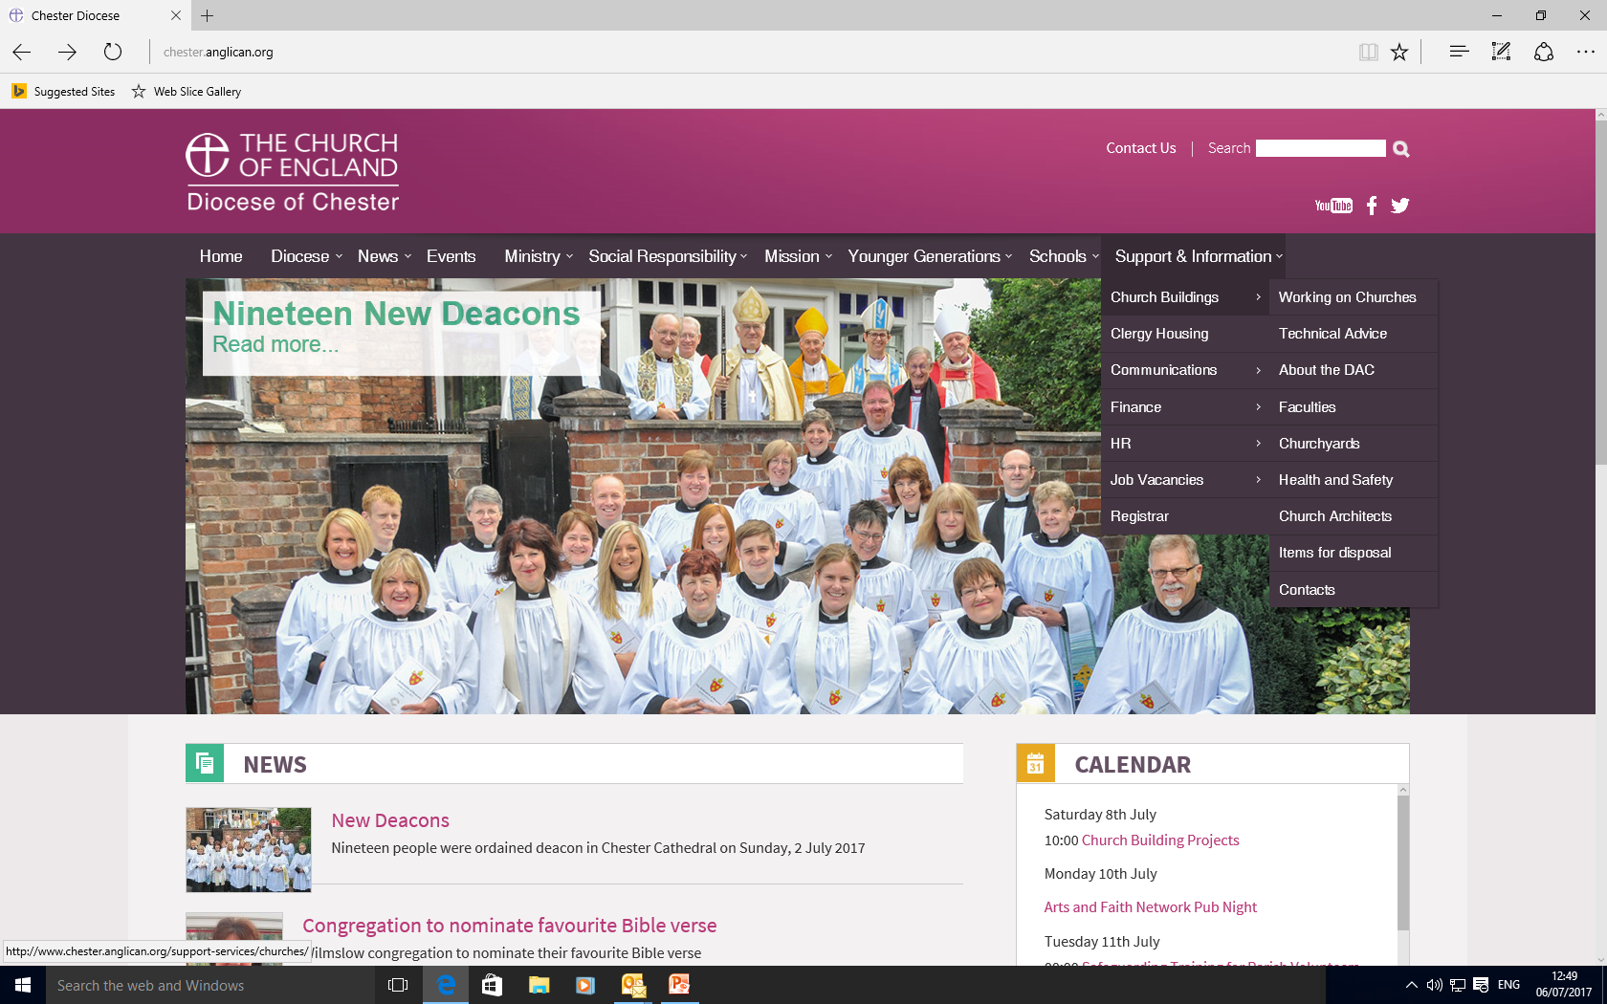

Slide 8
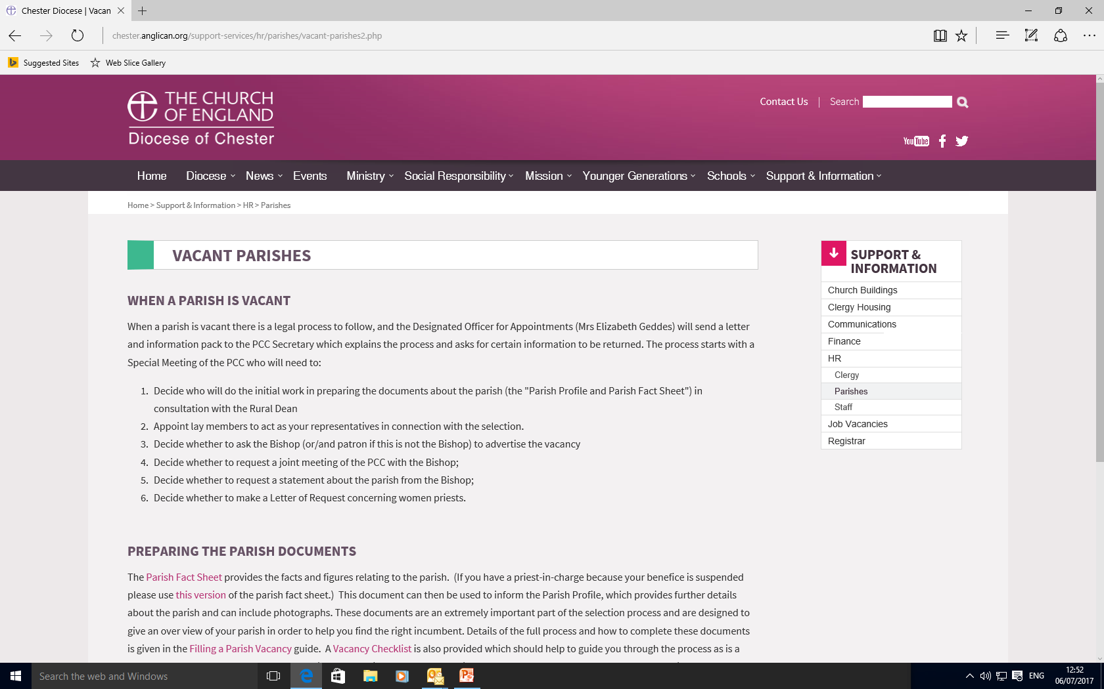

Slide 9
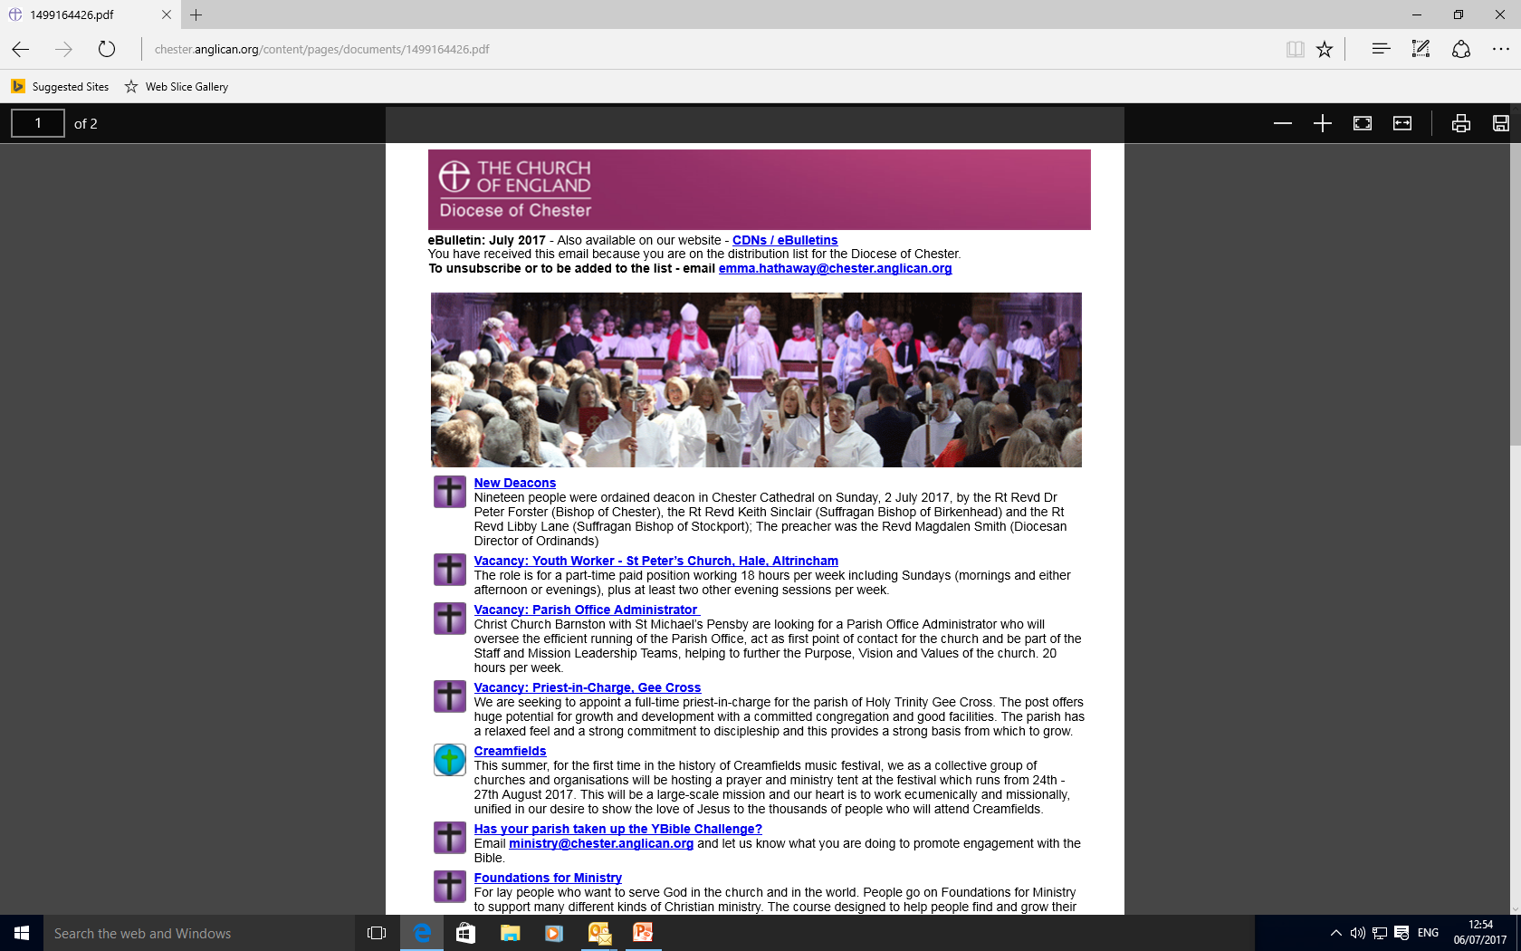

Slide 10
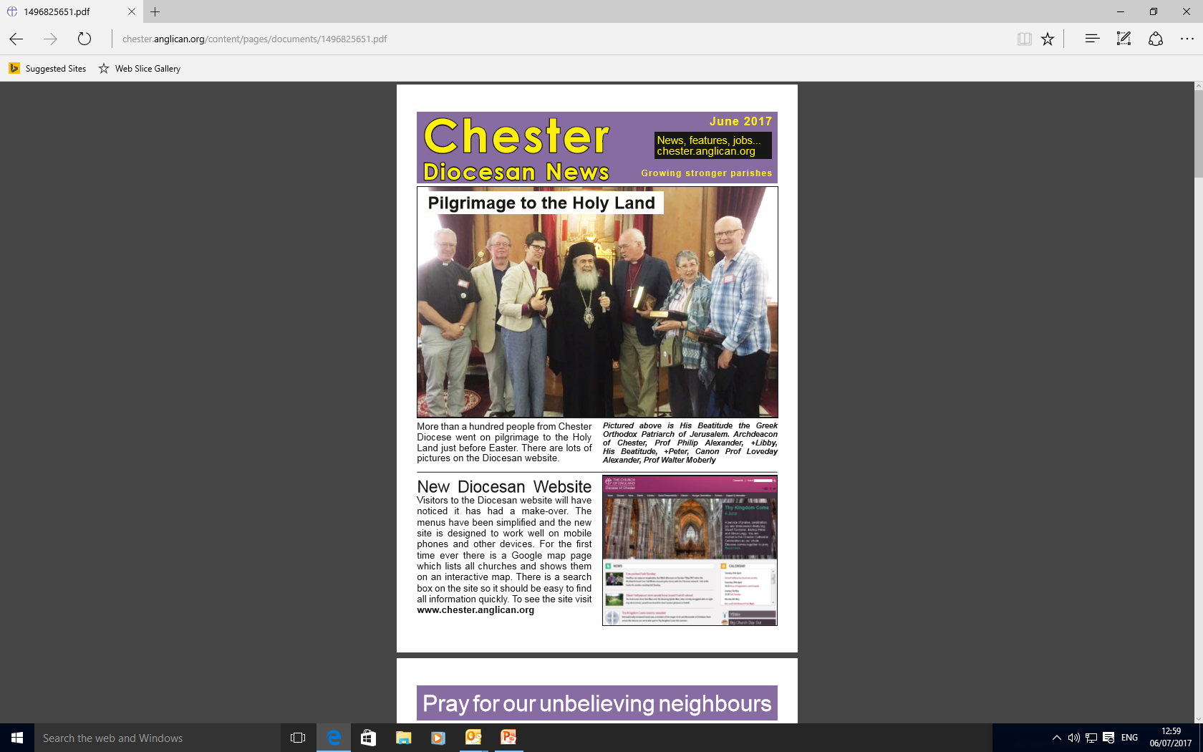

Slide 11
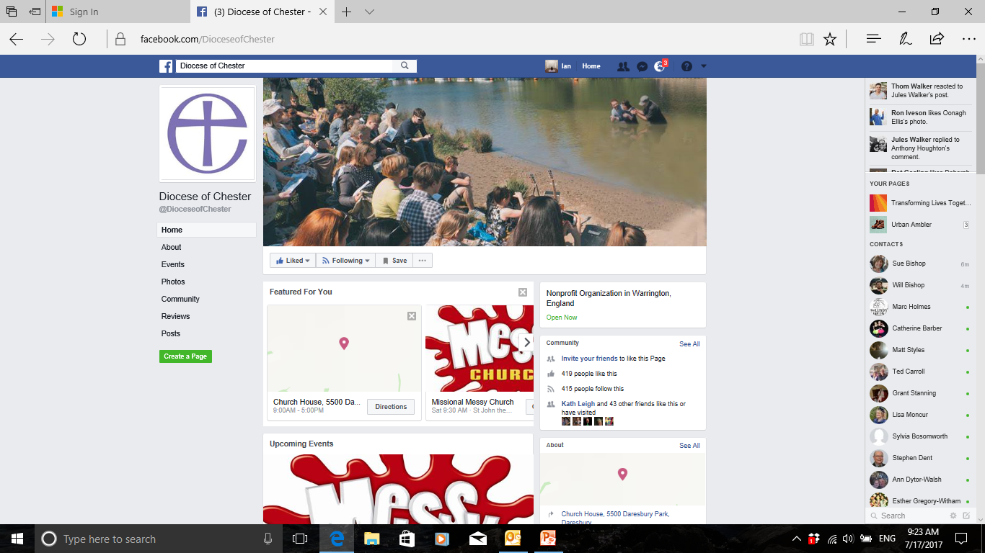

Slide 12
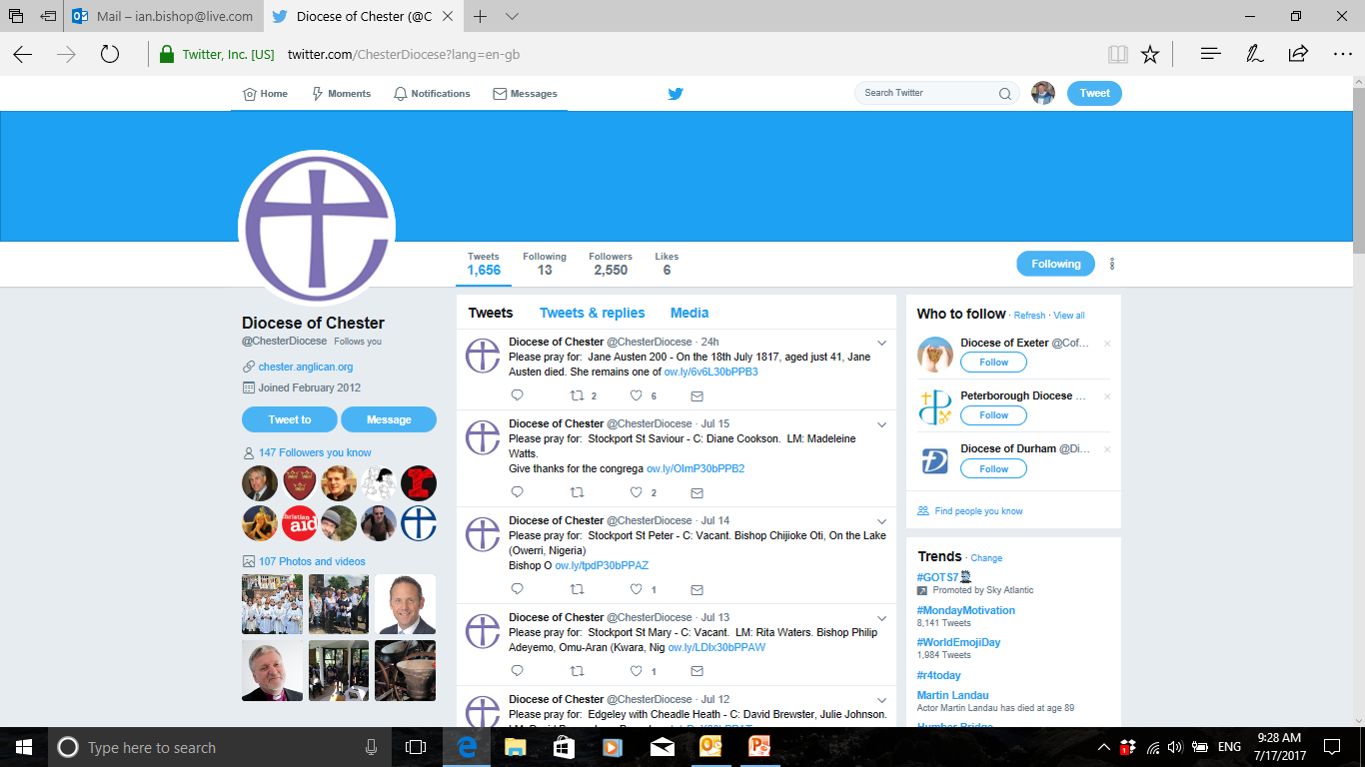

Slide 13
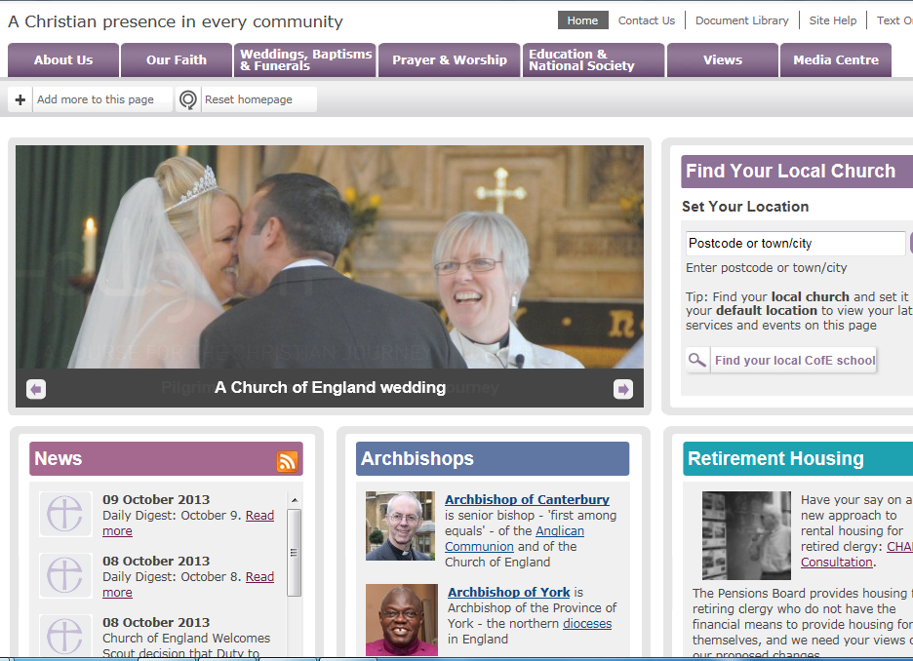

Slide 14
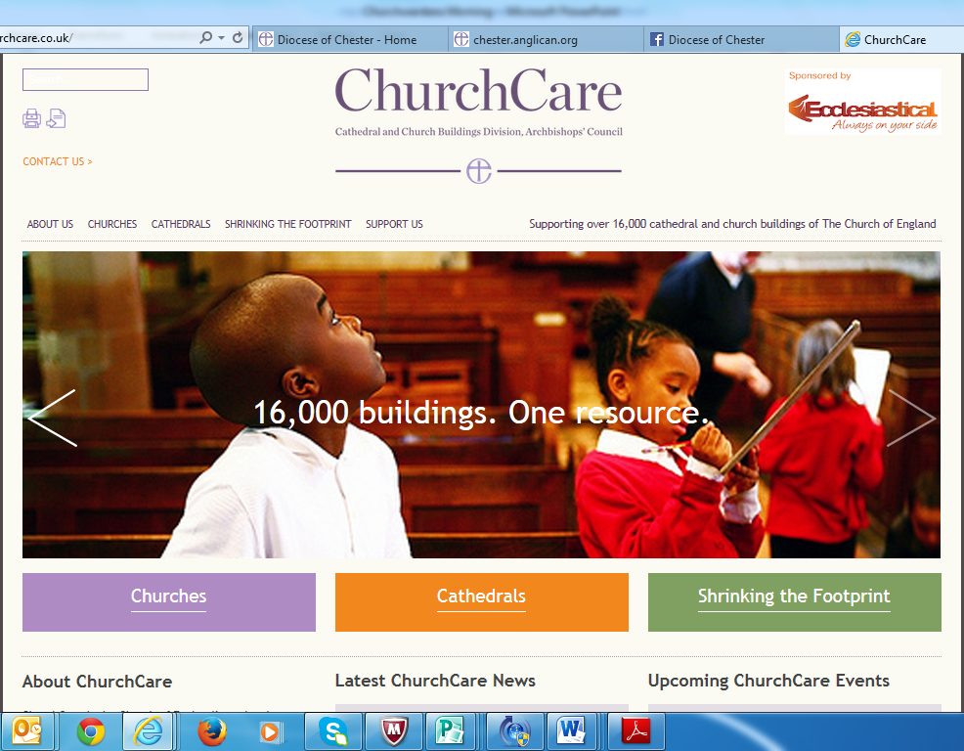

Slide 15
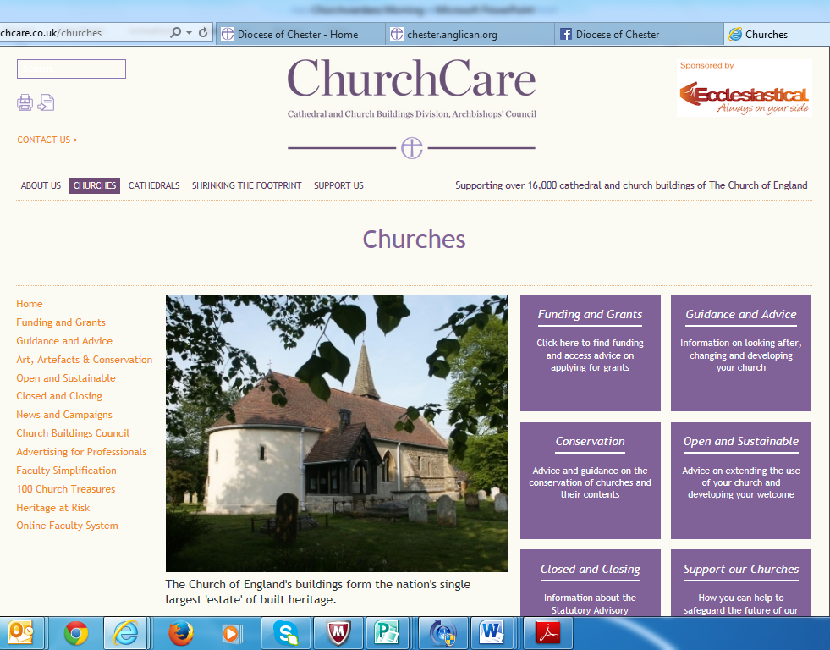

Slide 18
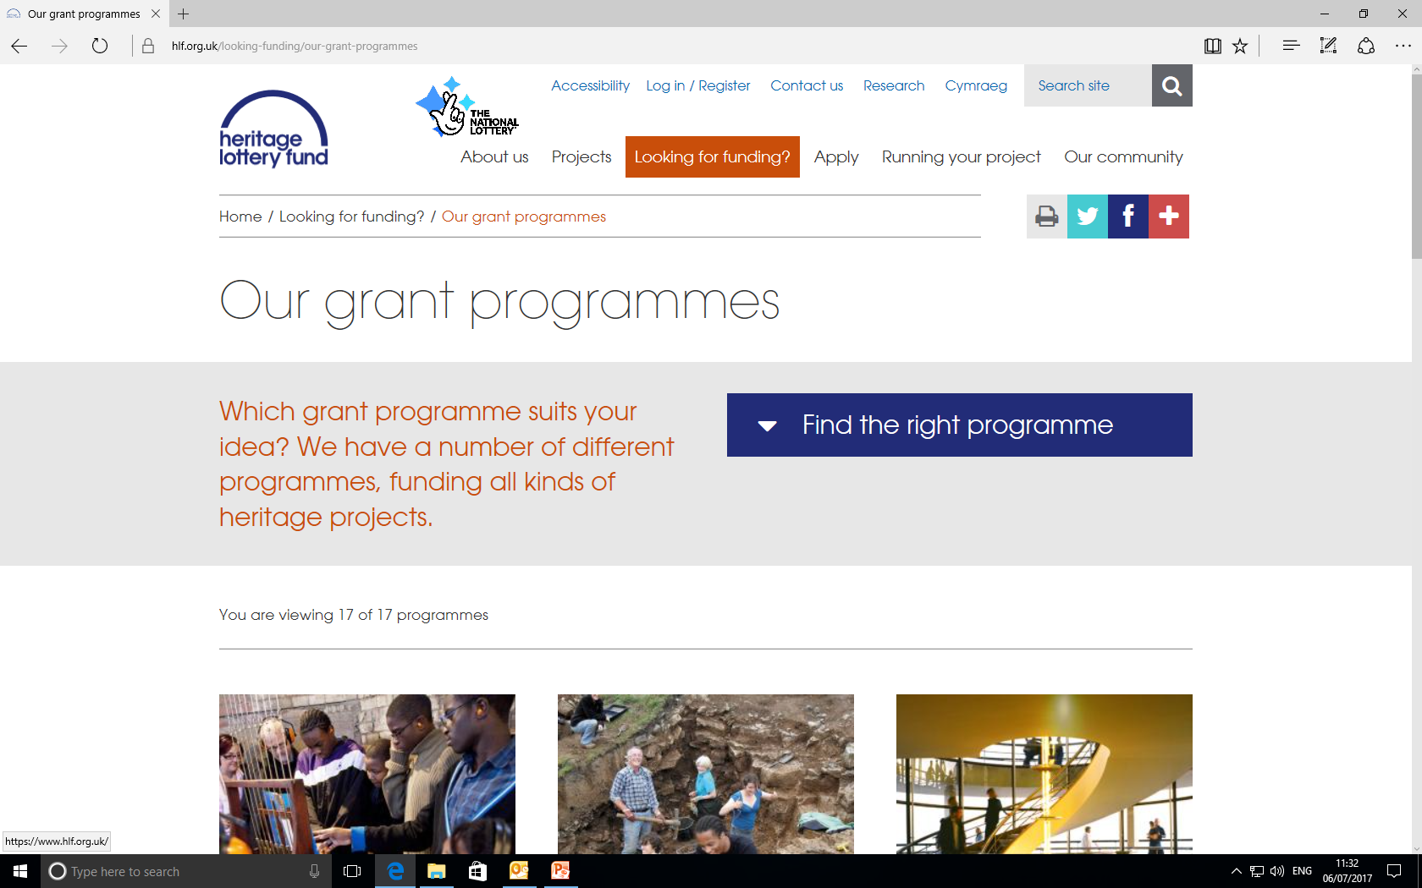
Grants for repairs, re-ordering and heritage projects: Heritage Lottery Fund - Replaced what was English Heritage grants since 2013 - HLF ‘GPOW’ ceases August 2017, but other grant programmes available. See www.hlf.org.uk
Notes:
Funding – main grant for urgent structural repairs. Now administered by Heritage Lottery Fund

Slide 19
Caring for buildings–watch a film! Faith in Maintenance film, free to download at www.spabfim.org.uk
Notes:
If you’d rather watch and listen to a guided tour of a church building, pointing out how to look after different features, then watch this free to download film. You can also purchase a book from the Society of Protection of Ancient Buildings bookshop online, called ‘Faith in Maintenance’, along with a maintenance calendar. c. 55 minutes long, very practical, easy to understand guide to maintaining the fabric of a church building.

Slide 20
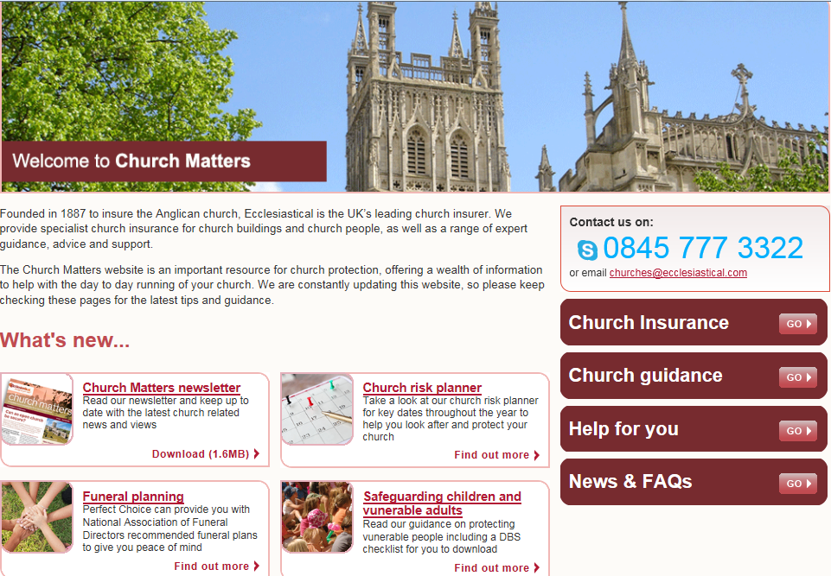

Slide 21
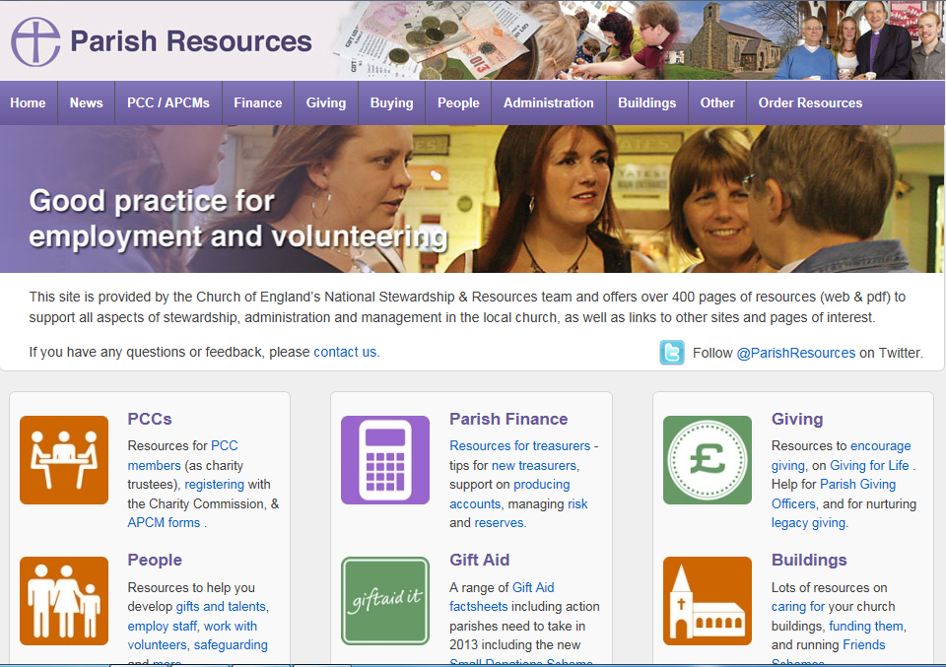

Slide 22
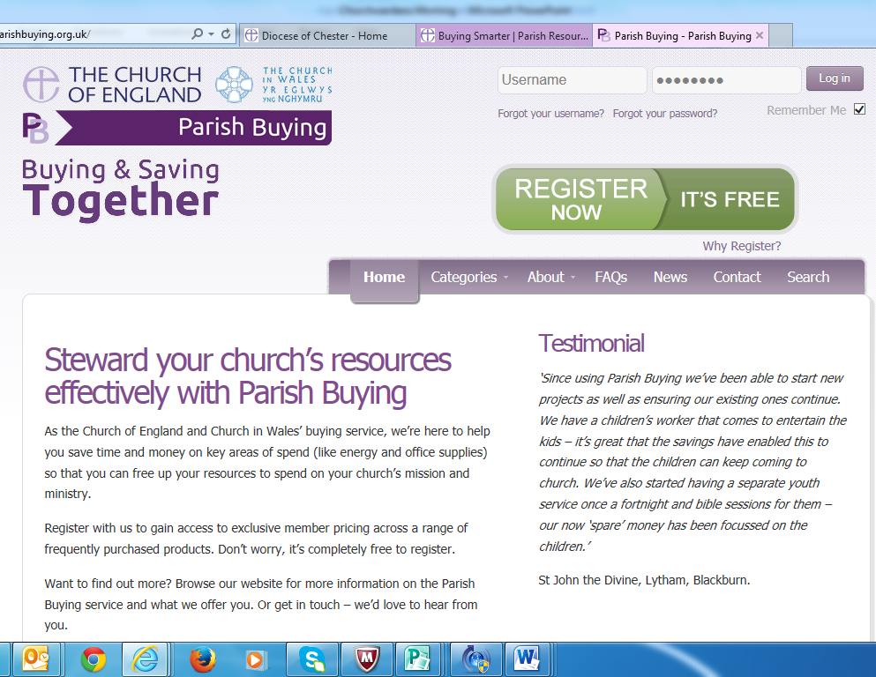

Slide 23
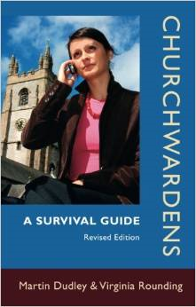
Useful books

Slide 25
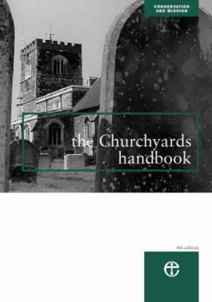

Slide 26
Useful people
Archdeacons - Ven Mike Gilbertson/ Ven Ian Bishop
Finance – Nigel Strange/ George Colville/ Sharon Taylor-Booth
Safeguarding – Pauline Butterfield
HR – Liz Geddes
Vicarages – Alan Kempster-Down
Church Buildings – Caroline Hilton/Emily Allen
Diocesan Missioner – Lyn Weston
Your Rural Dean
EIG

