Slide 1
Financial Update
George Colville
Diocesan Secretary

Slide 2
Churchwardens and Finance
Member of PCC
Churchwarden Trusts
All PCC members have financial responsibilities

Slide 3
Churchwardens and Finance
What to do in practice
May be cheque signatory
Member of standing committee
Take an interest
Encourage and support
Provide backup for treasurer
if unable to act or if no candidate
Ask questions, watch and check – Internal control
Problems are rare but they do happen

Slide 6
Parish Share
£59,806
Standard Parish Share = Total amount required
Number of clergy in Diocese
Clergy Number
X
Parish Share =
Banding
X
Standard Parish Share

Slide 7
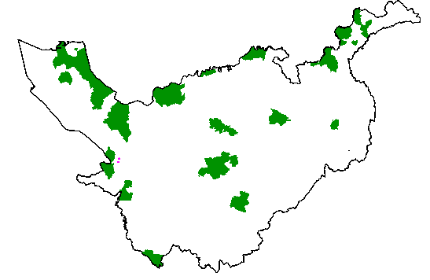
Parishes 0.25 – 0.95
Birkenhead / Wallasey
Stockport
Runcorn
Crewe

Slide 8
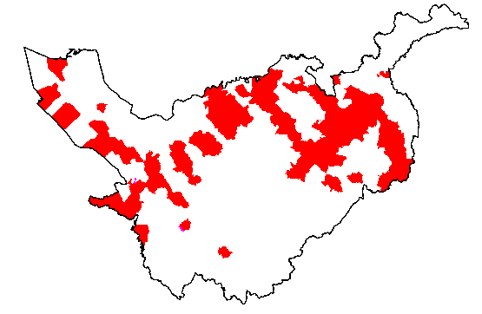
Parishes 1.15 -1.45

Slide 9
£54.5k

Slide 10
£5k

Slide 11
2018 and beyond?
Number of curates
Clergy stipends rise, housing inflation
Collection rate of parish share
Reform and Renewal
National Church
Clergy pension Scheme

Slide 12
More information
01928 718834
www.chester.anglican.org
firstname.lastname@chester.anglican.org

