Slide 1
Emily Allen Church Buildings Development Officer Mission team

Slide 2
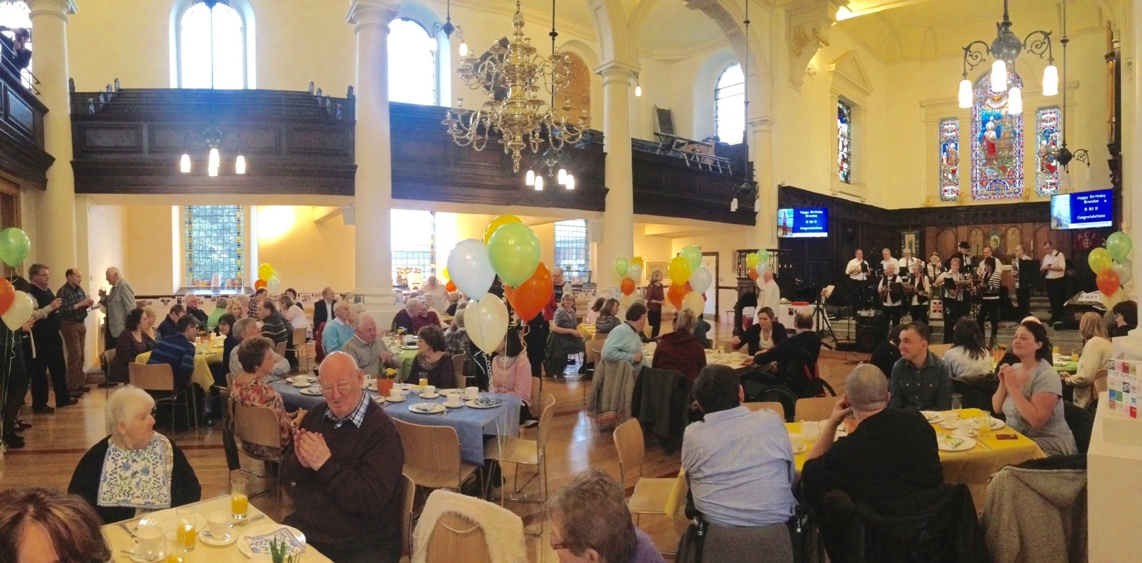
Aim of role
Realising the potential of church buildings (& halls) in furthering their mission
Secure the buildings’ best use and protect their future
Notes:
Aim- To provide assistance to parishes in using church buildings - particularly those identified as places of worship at risk - in furthering their mission thereby securing the buildings’ best use and protecting their future, with particular emphasis to those that are listed, historic, or of local interest.
Photo- St John’s Knutsford
Church buildings are places for collective worship, houses of prayer and resource for mission

Slide 3
Remit of role
Fundraising
Vision for buildings & project management
Heritage, Arts, Visitors
Notes:
Vision for building- can come before DAC for support with statements of significance, research for statements of need, growing project team etc
Fundraising – case for support, fundraising strategy, where to find grants, proof reading, writing style
Heritage/arts – visitor welcome, displays and interpretation, events, heritage projects

Slide 4
How I work
Capacity building for parishes
For 300+ churches; priority list
Strategic work
Project activity
Notes:
Capacity building – advice 1:1, web resources, training courses, advice 1:1
Strategic advice –national developments in managing buildings, identifying areas across teams where greater support is needed e.g. Buildings maintenance
Project activity – e.g. cycle trail

Slide 5
www.chester.anglican.org/ Mission

Slide 6
www.chester.anglican.org/ Mission

Slide 7
Training
1. Writing a Successful Grant Application
Saturday 2nd September 2017
2. Making the Most of your church hall
Monday 16th October 2017
3. Explorers Programme 2017-2018
4. Training needs survey

Slide 8
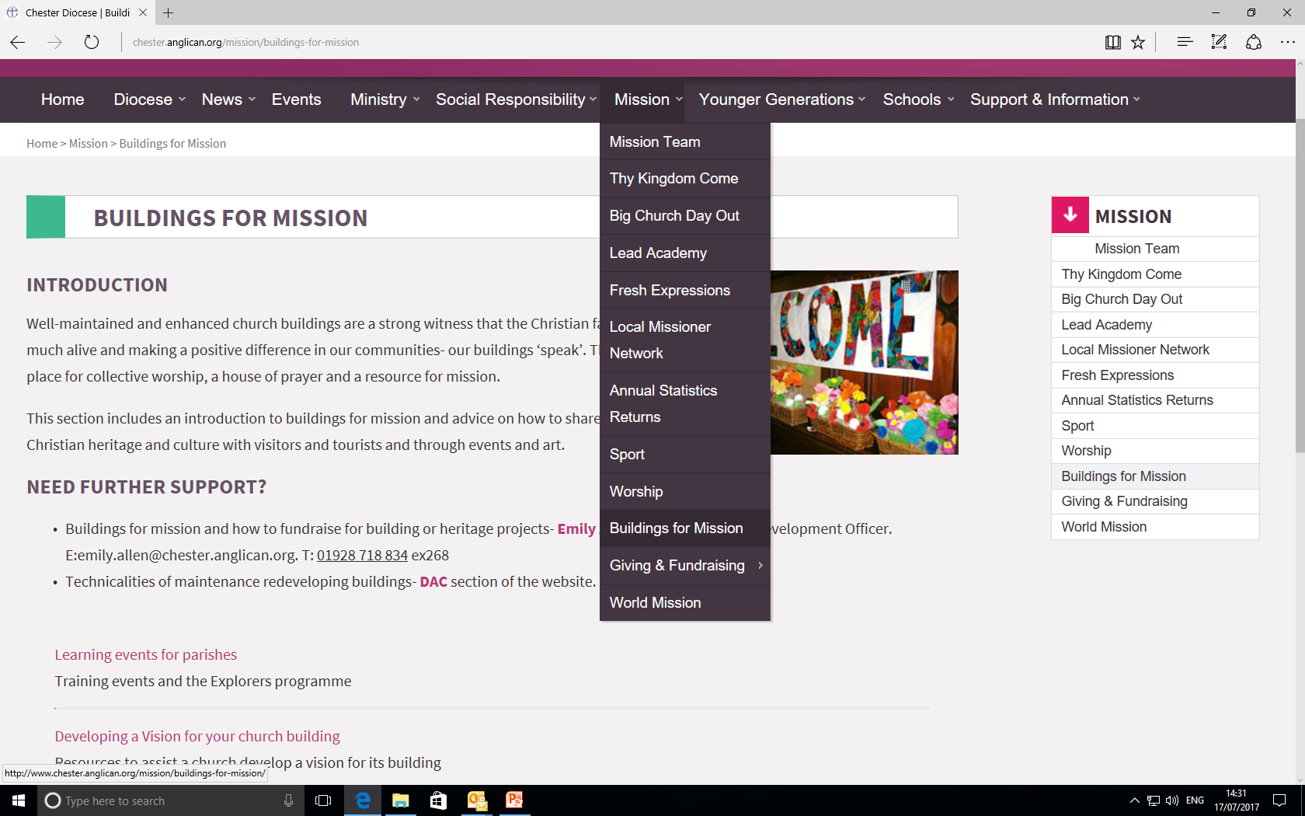
www.chester.anglican.org/ Mission

Slide 9
Contact details
Emily Allen
Church Buildings Development Officer
Mission team
Email: emily.allen@chester.anglican.org
Tel: 01928 718 834 ex 268

