Slide 1
Life of Jesus
Teaching on Kingdom of God
Key Stage 2

Slide 2
PowerPoint Introduction
This PowerPoint sample lesson is intended as a resource for schools to be
used ‘how and when’ they choose. This Year 4 lesson is planned to be set
in the context of developing the theme of ‘The life of Jesus’. It can be used
selectively as part of ongoing work in Religious Education based on the theme of
‘The Life of Jesus’ or ‘The Bible or as part of another area in the curriculum, eg
History; Special Books. There are notes on each slide for teacher reference.
Schools may prefer to edit the slides and use their own photographs.
The following slide gives the context of the lesson in the bigger picture. Schools
may like to explore other questions in different year groups within the theme
‘Kingdom of God.’
A PowerPoint Key Stage 2 Year 2 sample lesson also based on the theme of
‘Life of Jesus’ can be found on the Chester Diocesan website.

Slide 3
Context Overview
Area of Content from Chester Diocesan Guidelines to be studied: ‘Jesus’
Theme: The Life of Jesus Underpinning Christian Concept: The Kingdom of God
Definition: The reign and rule of God (Linked concept: prophecy).
Key Questions
Reception/Key Stage 1:
Reception: Why was Jesus special? What kind of king might he have been?
Year 1: Level 1: How and why was Jesus welcomed like a king at his birth?
Year 2: Level 2: Why did Jesus teach his disciples to pray the Lord’s Prayer;
‘Your kingdom come. Your will be done here on the earth as in heaven’?
Key Stage 2:
Year 3: Level 3: What do Jesus’ parables tell Christians the Kingdom of God is like?
Year 4: Level 3/4: What did Jesus mean when he taught about the Kingdom of God?
Year 5: Level 4/5: How does the local church community work to bring God’s kingdom on earth?
Year 6: Level 5: How does a belief in the Kingdom of God inspire and influence Christians
across the world?
Notes:
Teachers Notes: The context of a bigger picture

Slide 4
Key Stage 1 Lesson : Year 4
Theme: The Life of Jesus Concept underpinning work: Kingdom of God
Key Question : What did Jesus mean when he taught about the Kingdom of God?
Lesson Objective:
Teachers Notes
Teachers Notes
NB Teachers notes explaining how to use each slide within the context of the lesson can be found on the bottom of each slide in the notes section. These should be read before using the PowerPoint. Also read background information found on slide 26. Preview all Internet links before using on slides 7 & 22
Resources Needed: camera for freeze frame photos for activity on slide 23. Bible story used is found in Luke 14:15-24.
Slide 23/24: A4 Large copies for each table if preferred.
Where to start with a bible story Parables book Page 22
Next Steps: Examining other parables on the Kingdom of God eg Matthew 17:20, 13:44
Lesson Outcomes:
(Emerging)
I can describe some of Jesus’ teaching
from a parable about the Kingdom of
God .
(Expected)
I can describe several ideas from Jesus’
teaching on the Kingdom of God and
suggest how it might speak to Christians
today.
(Exceeding)
I can explain why the Kingdom of
God might be important to Christians
today and refer to different parables to
explain my answer.

Slide 5

Have you ever been invited to a very special party?
You are invited to
Queen Elizabeth's garden party in honour of the birthday of
Prince Charles
It will be held on June 22nd
at Buckingham Palace
At 4pm R.S.V.P.
Notes:
Teachers Notes: Instruction Play party music as the children come into the lesson
Ask the children if they have ever been invited to a special party. What did you think when you got the invitation? What did it look like? What was the party like?

Slide 6
Suppose you don't want to go to the party.
How many excuses can you find not to go to the special birthday party?
Notes:
Teachers Notes: Instruction: Read the above slide. In groups of three or four ask the children to quickly think of as many excuses as they can not to go to this special party at the palace. Feedback ideas and make a list on a working wall. Discuss: Which is the best excuse? Which is the worst excuse? Why? How would feel if you were holding the party and everyone refused to come? What would you do next?

Slide 7
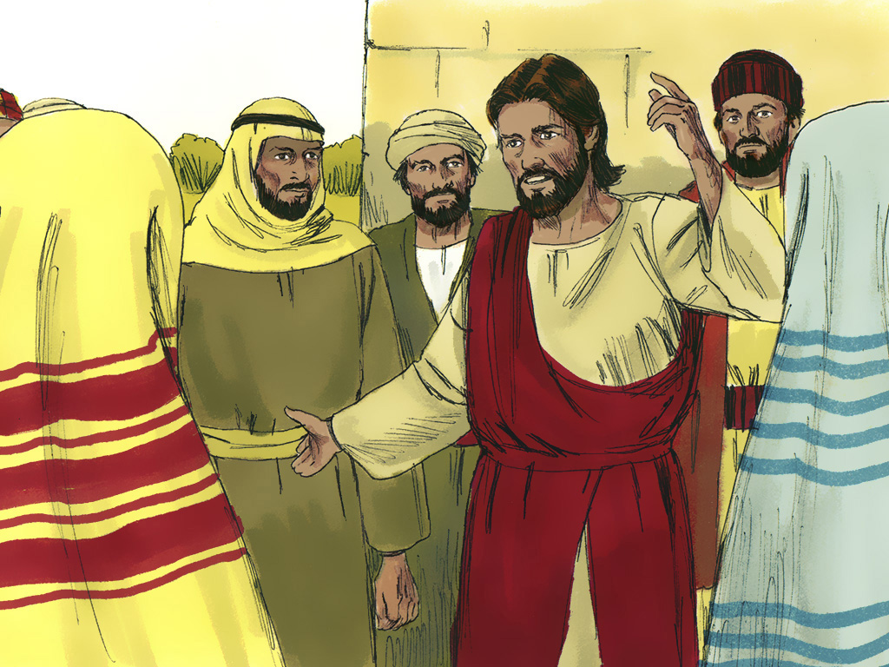
Notes:
Teachers Notes: Explain: I am now going to tell you a story Jesus once told about a party. Instruction: Tell the story using the following slides And/Or alternatively play the story from this video link https://www.youtube.com/watch?v=42PuQjgxOj4
Or use photos from a PowerPoint available www.freebibleimages.org/stories/?book=Luke

Slide 8
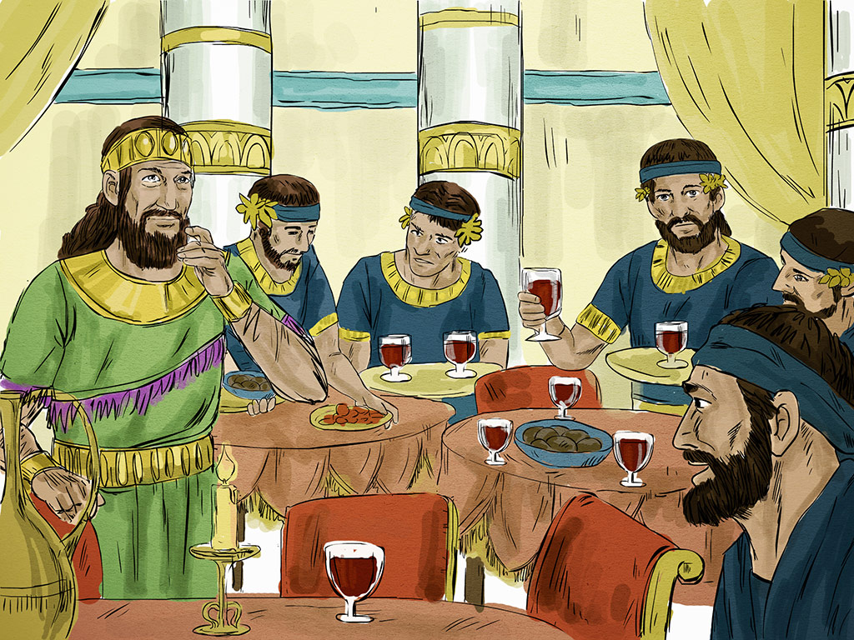
Notes:
Teachers Notes: Story Script: A man once prepared a great banquet.

Slide 9
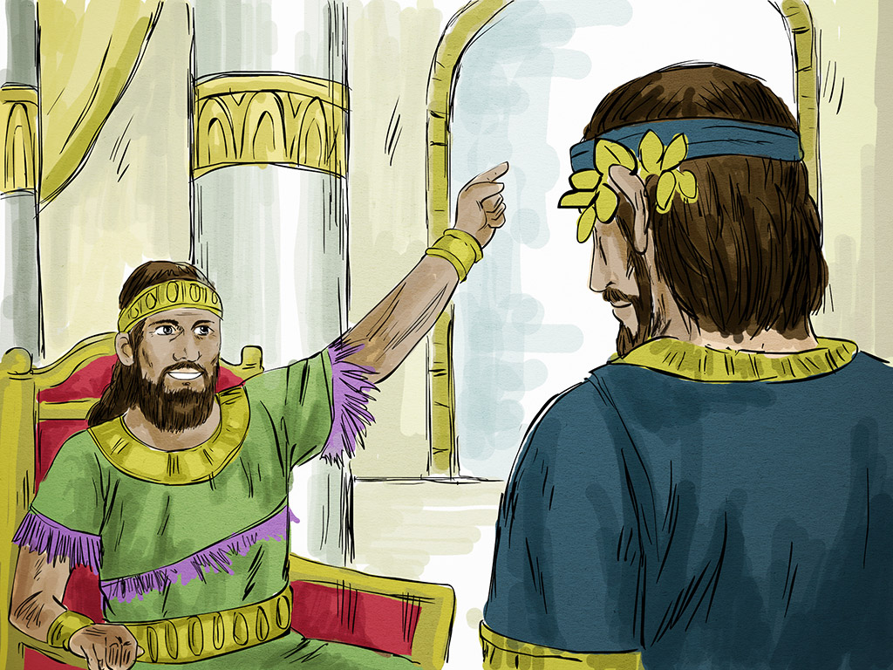
Notes:
Teachers Notes: Story Script: The man tells his servant all is ready for the feast and to go and invite the guests.

Slide 10
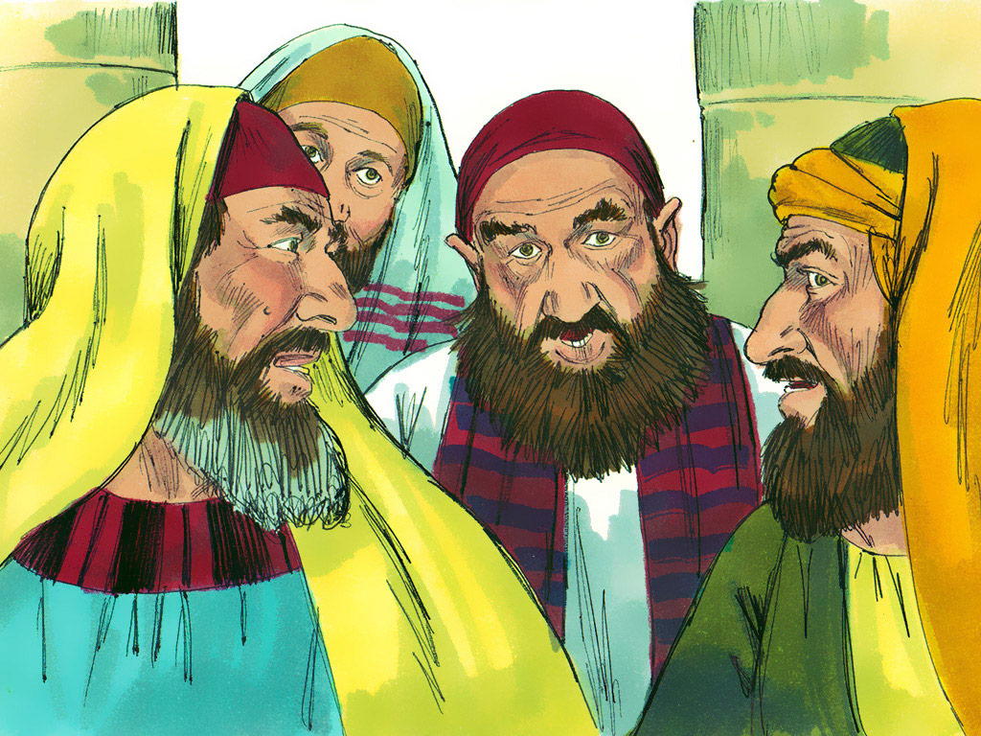
Notes:
Teachers Notes: Story Script: But the guests all refused to come & began to make excuses.

Slide 11

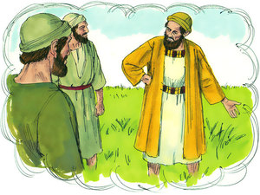
Notes:
Teachers Notes: Story Script: The servant invited a wealthy landowner. He says he has just bought a new field and can’t come because he needs to go and see it.

Slide 12
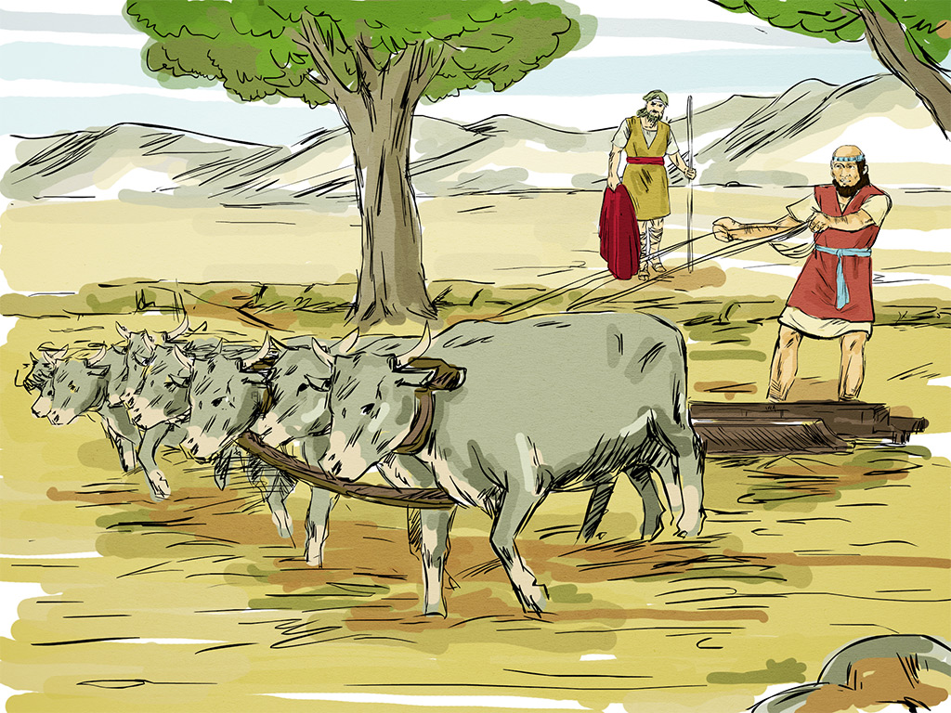
Notes:
Teachers Notes: Story Script: One said: I have just bought five yoke of oxen & I need to try them out. He went off to his field to examine them.

Slide 13
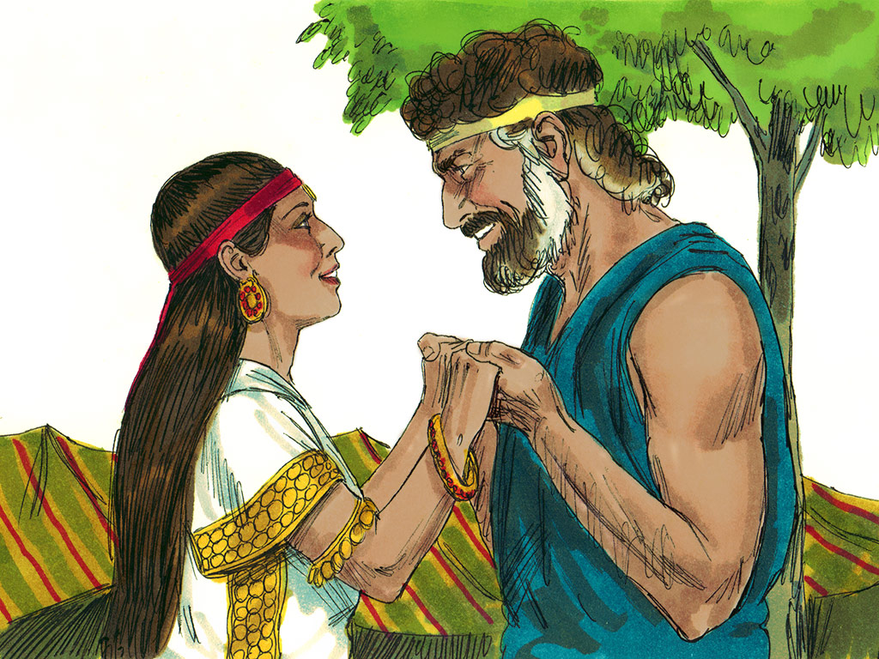
Notes:
Teachers Notes: Story Script: The servant goes to the home of another invited guest but he says, ‘ I have just got married and so I can’t be with you.’

Slide 14
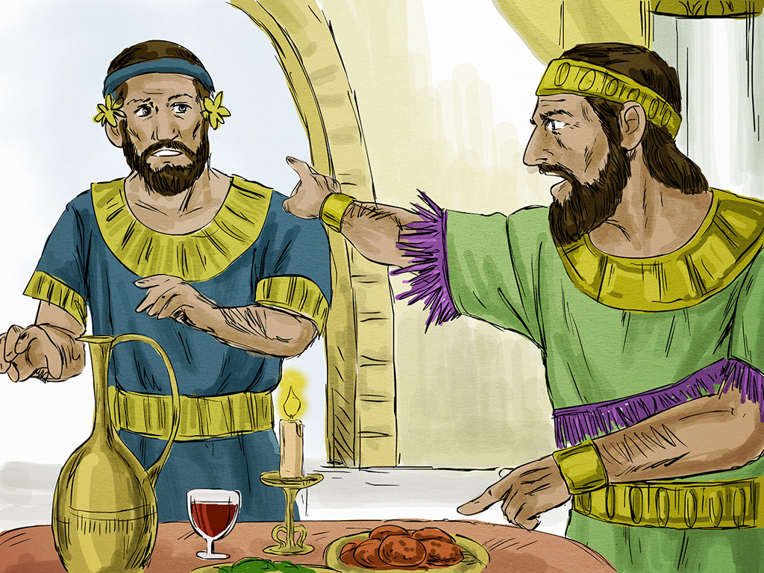
Notes:
Teachers Notes: Story Script: The servant reports back that none of the invited guests can come. The man is angry and tells the servant to go into the streets and alleys of the town and invite the poor, the crippled the blind and the lame.

Slide 15
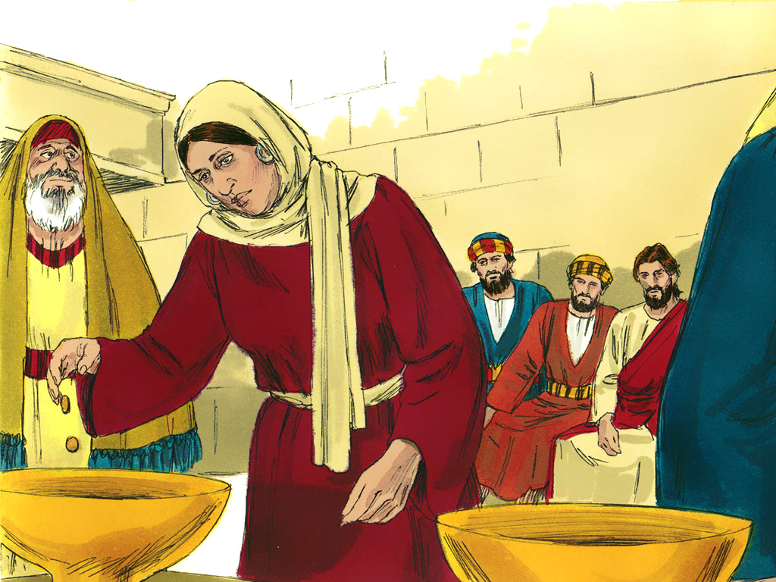
Notes:
Teachers Notes: Story Script: The servant finds a poor widow and invites her to the feast.

Slide 16
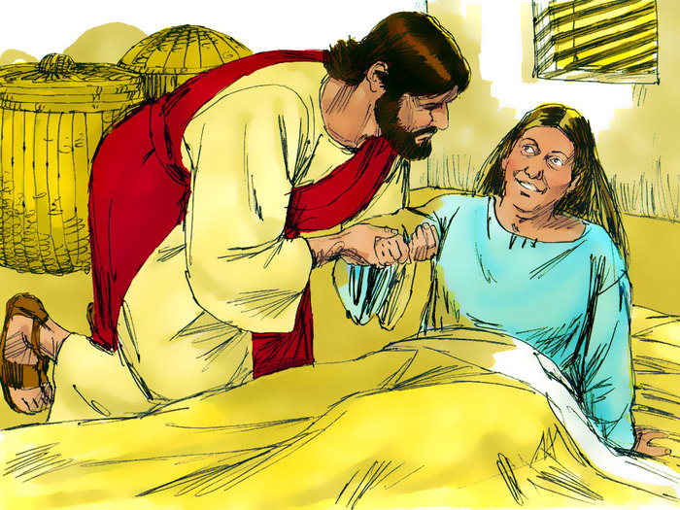
Notes:
Teachers Notes: Story Script: He finds a lame woman in an alley and invites her to the banquet’. He helps carry her to the banquet.

Slide 17
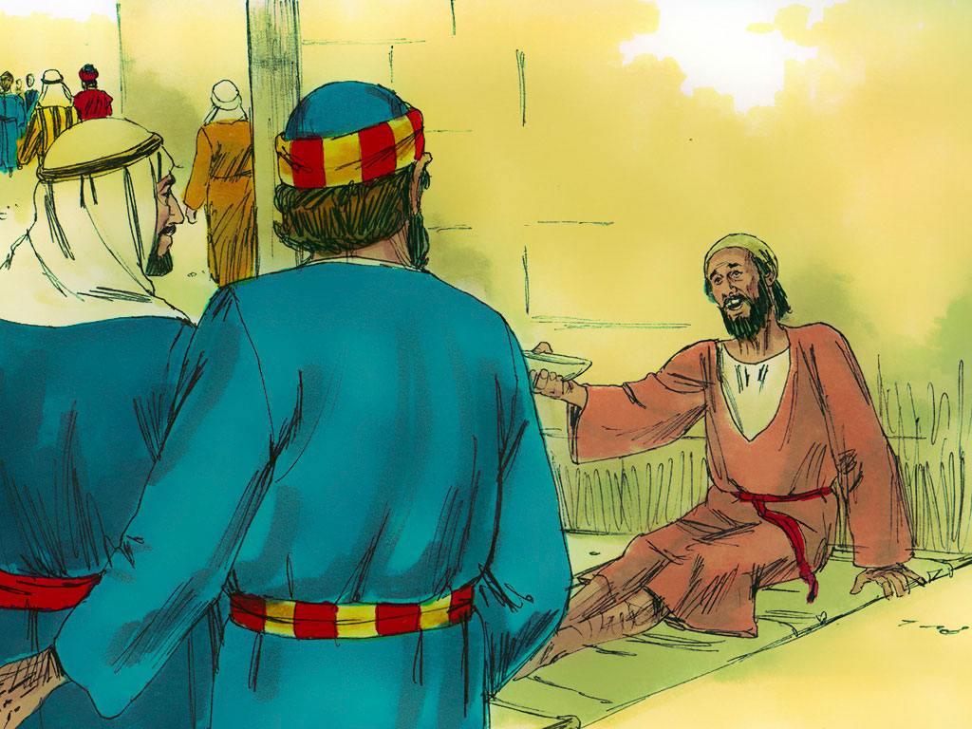
Notes:
Teachers Notes: Story Script: The servant finds a blind man and guides him to the banquet.

Slide 18
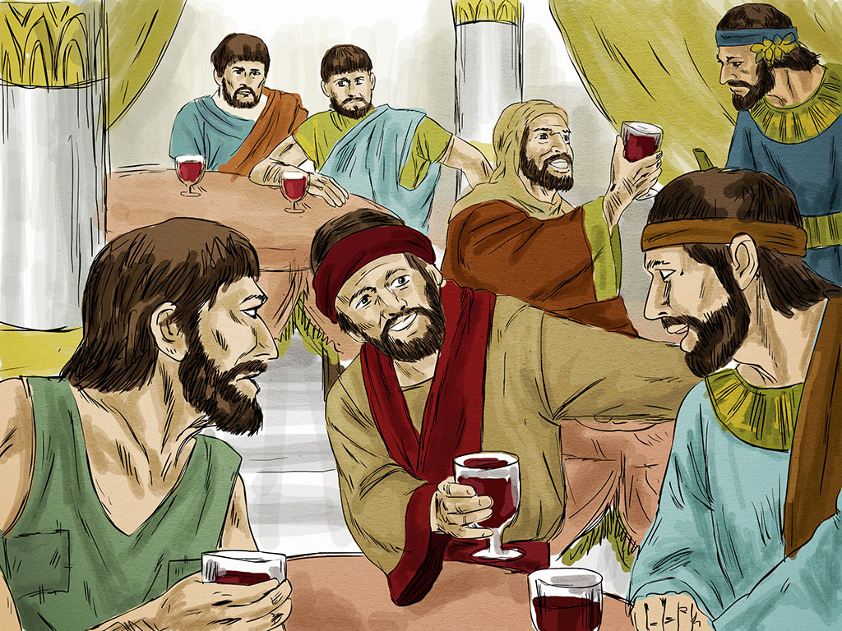
Notes:
Teachers Notes: Story Script: The poor, lame crippled and blind enjoy the banquet but there was room for more.

Slide 19
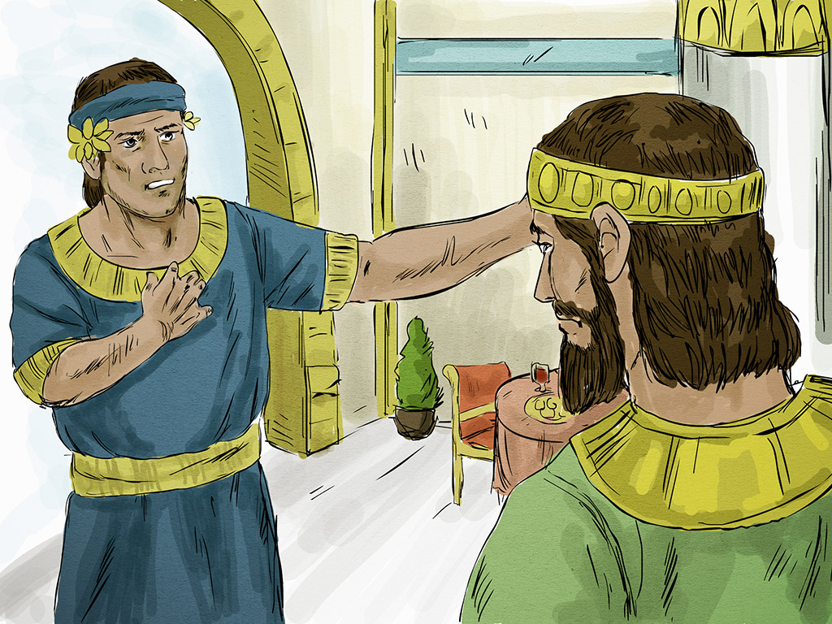
Notes:
Teachers Notes: Story Script: The man tells his servant to go outside the town and invite those on the roads and country lanes.

Slide 20
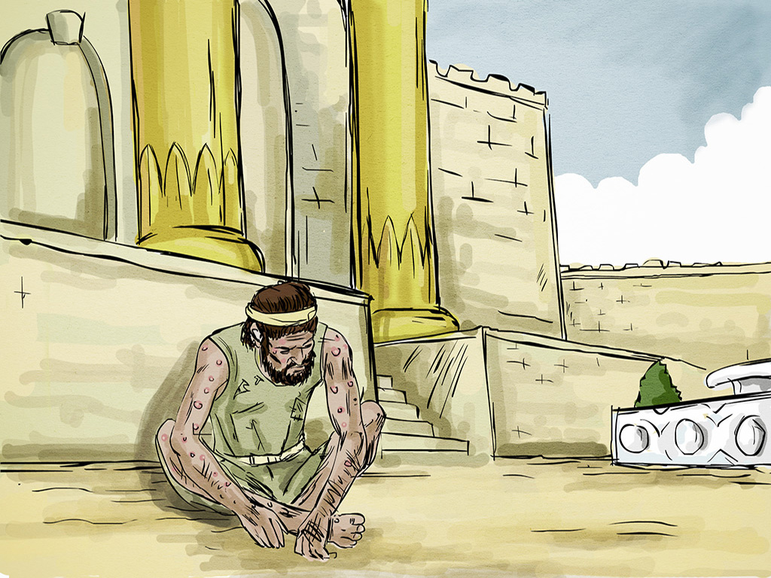
Notes:
Teachers Notes: Story Script: The servant finds a sick man and invites him to the banquet.

Slide 21
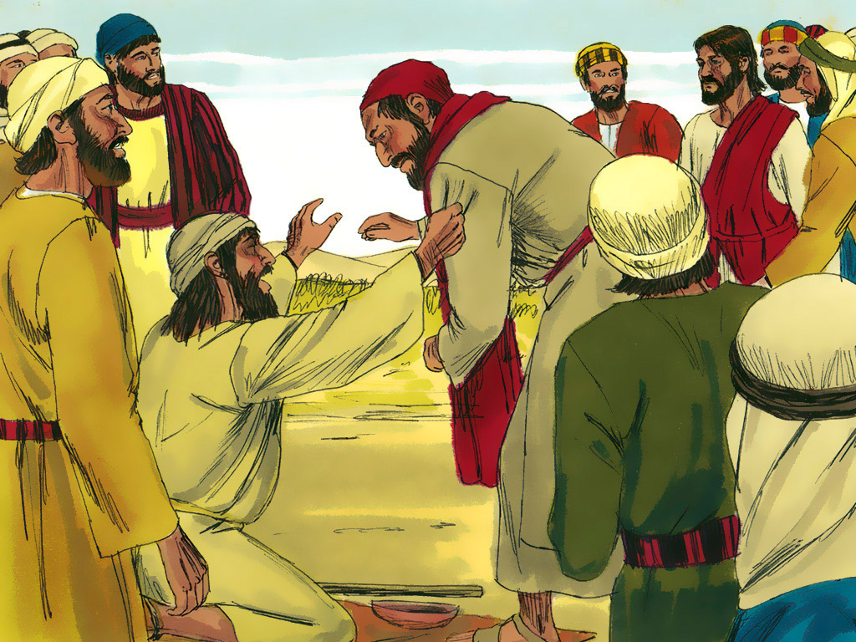
Notes:
Teachers Notes: Story Script: The servant finds some poor men on the country road and invites them to the banquet

Slide 22
Notes:
Teachers Notes: Story Script: The man is delighted to welcome his new guests and says that none of those who made excuses will get a taste of his banquet.
Re-enact this parable with the class using appropriate props at hand and encourage them to take different roles in the story.
Instruction: Take photos and freeze frames of the enactment.
Alternatively retell the story using the following link: https://www.youtube.com/watch?v=42PuQjgxOj4

Slide 23
Thinking Time
What do you think this story is saying to Christians today?
Notes:
Teachers Notes: Instruction: Show the above slide and read aloud the above question. Explain: Jesus said this story was to help people understand what he called the Kingdom of God (also called the Kingdom of Heaven).
Allow quiet thinking time heads down, eyes closed to think all about all the parts of this story. During the thinking time ask the following questions one at a time:
How did the man feel when his invitation was refused? What was the worst excuse and why? Who did he invite instead? Why do you think Jesus told the story?
What might Jesus be thinking about when he says this story is about the Kingdom of God? What might this story be saying about people and the way they think about God? What is the story saying to Christians today?
Ask: Get each child to draw a picture & write down in 2/3 sentences what they think the story is saying about God’s Kingdom to Christians today. Explain they only have 15 minutes to do this. Use sentence starters for those who need some support:
eg 1 I think Jesus was trying to say..... Eg 2: Christians today might read the story and think....... Eg3 I think the Kingdom of God is all about.....

Slide 24
Explain your reasons......
What do you think this story is saying about the Kingdom of God to Christians today?
Notes:
Teachers Notes: Instruction: Stop the class and gather in all pictures. Show the above slide and read the above question.
Ask: Which do you think is the best picture and writing that explains what Jesus is saying the Kingdom of God is like?
Instruction: Place the pictures out all over the room and ask the class to wander around them choosing which picture/words they think best explains what Jesus was trying to say. Ask them to vote for their top 3 being ready to give a reason for each choice. Give them stickers or post its to do this. Feedback and Record the answers if you have time.
To conclude: Ask Can you think of any other stories Jesus told about the Kingdom of God? (eg mustard seed, hidden treasure, lost pearl). Can you link the story with any other parables Jesus told about the Kingdom of God? Eg hidden treasure, mustard seed.
https://www.youtube.com/watch?v=42PuQjgxOj4
Next Steps: Look at other parables about the Kingdom of God and add your ideas to your working wall.

Slide 25
Teachers Background Notes
Background information
The Parable of the Great Feast Luke 14:15-24
A banquet was a well known symbol for the messianic kingdom ie the final banquet of all time, the beginning of the kingdom of God. The Eastern custom was that when a meal was ready, servants were sent out to give a final courteous invitation. When Jesus told the parable, he was probably thinking of the Jewish people needing to accept the invitation to ‘come, all is ready’. The listeners would see the ‘righteous’ as refusing it and the ‘publicans and sinners’ as accepting it. The first Christians would see that in Jesus’ rejection, now everyone is invited to the banquet.
(Taken from ‘Where to start with a Bible Story: Parables’ Chester DBE 2011)

Slide 26

Notes for using images
Internet Images
Slides 5 & 23: Images are copyright free and found in the Microsoft office collection.
See http://office.microsoft.com/en-us/images/
Slides 7-22
www.freebibleimages.org
The illustrations are made available for free download under a Creative Commons Attribution-Share Alike 3.0 Unported license. You can create a link from your website to http://www.freebibleimages.org to make these files available to others.
The original illustrations are the copyright of Sweet Publishing and Arabs for Christ the downloadable compilations of them the copyright of FreeBibleimages
The slides used in this PowerPoint are a compilation of various bible story images found as the above web site. Please note the site also contains photos which may be better for teachers to use. See http://www.freebibleimages.org/stories/?book=Luke

