Slide 1
Thy Kingdom Come
Creative Prayer Resource for Individuals

Slide 2
Folding the Resource…

Slide 3
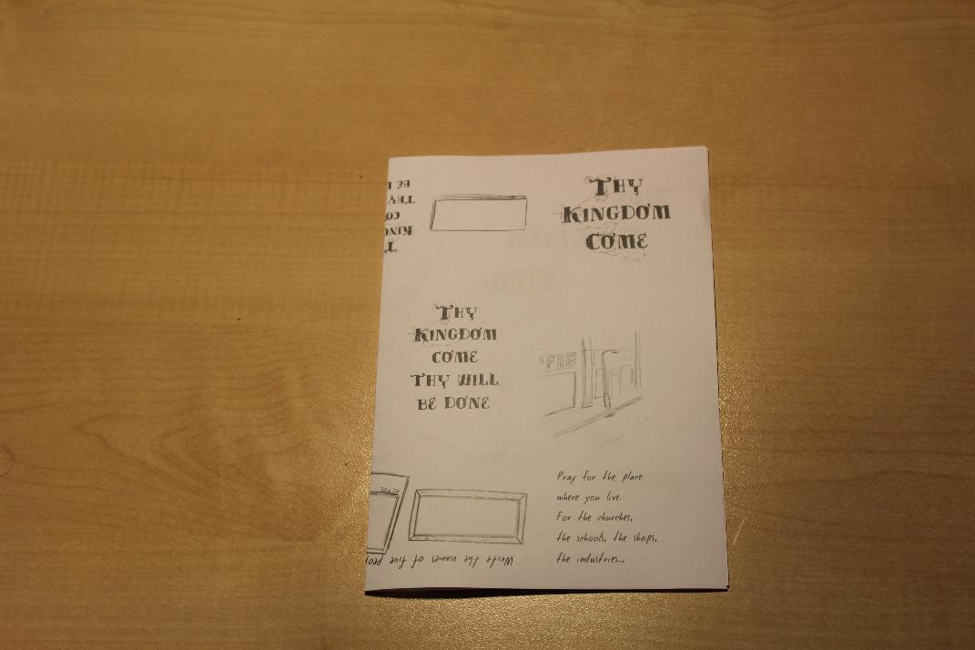
Fold the left edge to the right. This is to make a guide fold.

Slide 4
Open the fold again

Slide 5
Fold the left edge into the guide fold you just made

Slide 6
Fold the right hand edge to meet the guide fold you made.

Slide 7
Fold the bottom edge to the top of the page. This makes a second guide fold.

Slide 8
Open the fold out again.

Slide 9
Fold the bottom edge to the second guide fold.

Slide 10
Fold the top edge to the guide fold.

Slide 11
Fold the whole thing in half from left to right.

