Slide 1
The Holy Spirit
Key Stage 2

Slide 2
PowerPoint Introduction
This PowerPoint sample lesson is intended as a resource for schools to be used
‘how and when’ they choose. This Year 5 lesson is planned to be set in the context
of developing the theme of ‘The Holy Spirit’. It can be used selectively as part of
ongoing work based on the theme of ‘Descriptions of God’ or when comparing the
concept of God in different religions.
There are notes on each slide for teachers’ reference. Schools may prefer to edit
The slides and use photographs of their own. The following slide gives the context
of the lesson in the bigger picture. Schools may like to explore other questions in
different year groups within the theme ‘The Holy Spirit.’
A PowerPoint Key Stage 2 Year 1 sample lesson also based on the theme of
‘The Holy Spirit’ can be found on the Chester Diocesan website.
Teachers may find it helpful to refer to the Chester Diocesan document:
'How do I teach Christianity In my church school?’ (pages 21-23). This can also be
found on the Chester Diocesan website.

Slide 3
Context Overview
Area of Content from Chester Diocesan Guidelines to be studied: ‘Holy Spirit’
Theme: God the Holy Spirit Underpinning Christian Concept: Trinity
Definition: Three persons in one God; doctrine of the three-fold nature of God: Father, Son and Holy Spirit.
Key Questions
FS/Key Stage 1: Theme: God the Holy Spirit
Reception: What do Christians say the Holy Spirit is like?
Year 1: Level 1: How did the Holy Spirit change the disciples after the Day of Pentecost?
Year 2: Level 2: What do Christian symbols teach about the Holy Spirit?
Key Stage 2: Theme: God the Holy Spirit
Year 3: Level 3: What does Christian art teach people about the Holy Spirit?
Year 4: Level 3/4: What part do Christians believe the Holy Spirit plays in welcoming into the church community?
Year 5: Level 4/5: What part do Christians believe the Holy Spirit plays in confirmation?
What part do Christians believe the Holy Spirit played in helping the disciples in the early church ?
Year 6: Level 5 : How do Catholic and Pentecostal Christians believe the Holy Spirit is at work in their lives today?
Why is it important to Christians to celebrate Pentecost?
Notes:
Teachers Notes: The context of a bigger picture

Slide 4
Key Stage 2 Lesson : Year 5 Theme: The Holy Spirit
Concept underpinning work: Trinity
Key Question : What part do Christians believe the Holy Spirit plays in confirmation??
Lesson Objective: To understand how Christians believe the Holy Spirit is involved at confirmation.
Teachers Notes
Lesson Outcomes:
(All pupils)
I can describe the Christian
practice of confirmation and suggest how
the Holy Spirit might be involved.
(Most pupils)
I can describe three things about the Holy
Spirit that are important in
confirmation.
(A few more able pupils)
I can suggest and give reasons why the
Holy Spirit might influence believers at
their confirmation and afterwards.
Teachers Notes
NB Teachers notes explaining how to use each slide within the context of the lesson can be found on the bottom of each slide in the notes section. These should be read before using the PowerPoint. Preview all Internet links before using.
Resources Needed
Slide 7,9, 11 & 12 A4 Large copies for each table
NB This PPT is designed for use over more than 1 lesson.
Diocesan Document to refer to: 'How do I teach Christianity in my church school?’Pages 21-23
Prior Learning: symbols of H/S, Baptism, Believers baptism
Next Steps: Catholic and Pentecostal Christians
and the Holy Spirit

Slide 5
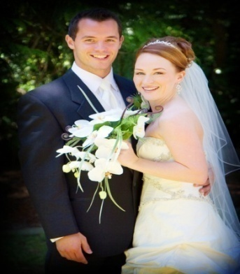
Save the date!
Have you ever been to a really special event?
Was there a special ceremony?
What happened? Why?
What made the event so special?
Notes:
Teachers Notes
Give the children a set of the questions above and a set of pictures of special events. These can be found at Google images.
Ask the class to answer the questions above on pieces of large card using post-its. Think, Pair, Swop & Share.
Collate ideas of things that happen in special events; eg words are spoken; promises are made; people might eat food or have a party; songs may be sung; the event might mark something important in a person’s life, Friends and family might come along; a speech may be made; thanks may be given etc.
Describe to the class a special event you went to what happened and what made it special.

Slide 6

Think Pair Share
What events are special to Christians?
How do Christians celebrate special events?
Notes:
Teachers Notes: Think, Pair, Share the 2 questions above then have class feedback. I wonder if a Christian would agree with us?

Slide 7
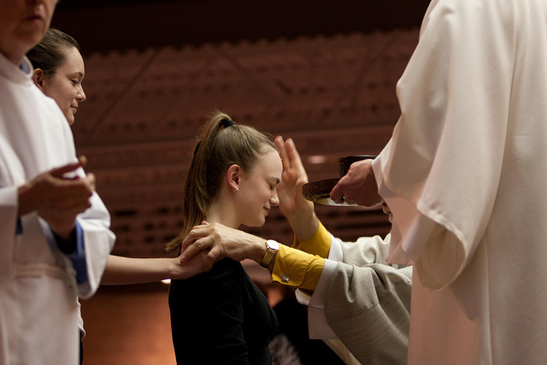
Notes:
Teachers Notes: Ask: Do you know what is happening in this picture? NB Ask the class for suggestions without telling them what is happening at this point. (FYI: This is an act of confirmation the bishop is laying hands on a candidate)

Slide 8
Two Video Clips
What is happening here?
How might these events be special to Christians?
How is the Holy Spirit involved?
What questions would you ask about what is happening?
Notes:
Teachers Notes : NB Look carefully at each video beforehand to see if suitable for your class as the language may be too adult.
Instruction: Enlarge and display the questions above on a large board. Watch these two videos and explain to the children beforehand that these videos are also special events that Christians celebrate. Ask the class to look carefully & think about the above questions. After the videos give some quiet thinking time individually to record any notes, questions, answers, (eg on small white boards).
(3 mins) request.org.uk/teachers/teaching-resources/life-resources/confirmation-life/2014/05/02/confirmation-2/
(Kev’s confirmation best used selectively start at 2:10 for 2 mins) https://www.youtube.com/watch?v=GPnillMETyA
NB The teacher may want to explore the children's questions at this point and allow them to research their own answers. Eg interview the vicar, parents, Internet research.

Slide 9
Digging deeper into confirmation
What do you think the bishop is asking God to do?
What do you think the person being confirmed is doing?
How do you think the person feels?
How do you think Christians believe the Holy Spirit is involved?
How do you think the Holy Spirit might affect the person after they have been confirmed?
Anything else you want to find out?
Notes:
Teachers Background Notes : Explain we are now going to discuss these two videos in more depth and try to find out more. Ask the children to look at these questions above in small groups of 3-4. Give each group a set of questions. Ask them to Post-it suggested answers alongside the questions. Give them 15-20 mins.
Ask: If not completed previously. How can we find out more about confirmation? What would you like to find out? Eg interview the vicar, parents, research etc. Give the class time over a few days to do this. Collate all they find out on large display wall based on these questions.
NB Notes can be found on confirmation for teacher on the last slide.

Slide 10
What did we find out?
Confirmation
Notes:
Teachers Notes: After a few days ask: how did we get on with our research about confirmation? Can we explain what happened in our first picture now (Show slide 7 again). Add ideas to display board.
There are background Notes for the teacher on Confirmation see final slide in PowerPoint.
NB If may be helpful to recap all the children know about baptism at this point. SEE SLIDE 12 for photo if required. Think about how baptism links with confirmation, you may like to watch a video about infant baptism to remind the children what infant baptism is all about. Ensure whatever clip you use it is Anglican baptism you are watching eg https://www.youtube.com/watch?v=JNmghD143T0
For infant baptism, adult baptism and confirmation all in one service, you can use later scenes from a messy church video clip on confirmation. See https://www.youtube.com/watch?v=vJctZixRgrM or Google messy church Lichfield.
NB Notes can be found on confirmation for teacher on the last slide.

Slide 11
Notes:
Teachers Notes: Ask: Can we explain what is happening in our earlier picture now?

Slide 12
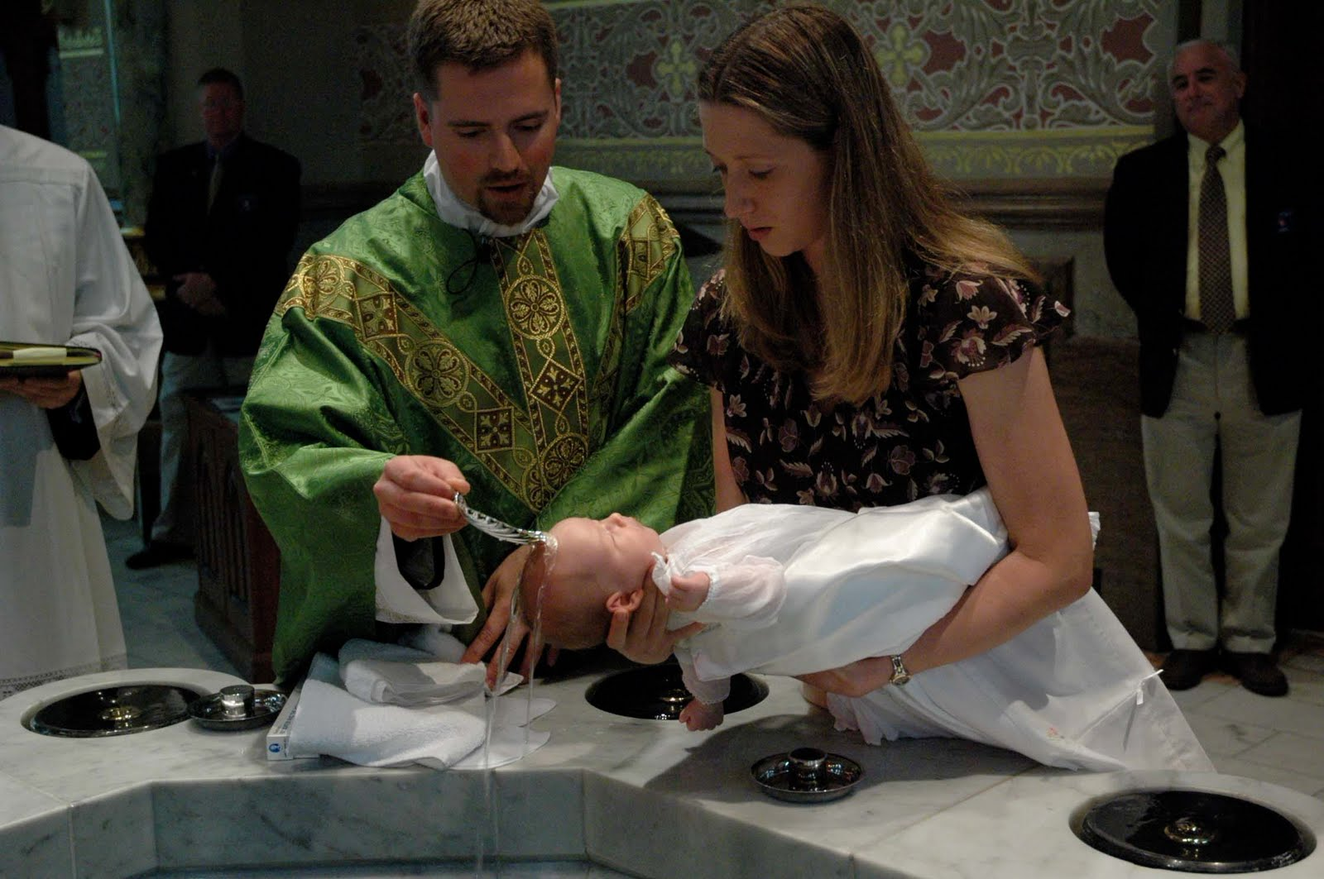
Notes:
Teachers Notes: Infant Baptism Photo: If Required?
Ask: For use with slide 11 only use if required. Baptism picture for recapping infant baptism. Recap and discuss what is happening in this picture? Share ideas.

Slide 13
A conversation between a friend and someone who just attended a confirmation.
Explain what part you think the Holy Spirit played on the day.
Role Play
Notes:
Teachers Notes: Instruction: Tell the children we are going to put all our learning about confirmation into role play. Using all their research and ideas as a class we have completed ask them to role play conversations as above swopping roles at a suitable point. Explain you would like them to bring into the role play all the main points they have learnt about the Holy Spirit and confirmation. (Adults in the classroom can circulate and note learning. You may want to include the local vicar and/or church members at this point)

Slide 14
Thinking Time
Why do Christians sometimes get confirmed?
What part do you think the Holy Spirit plays?
What happens next?
Notes:
Teachers Notes: Assessment: Allow quiet thinking time heads down, eyes closed to think all about all aspects of this topic on confirmation. Get each child to draw a picture & write down in 2/3 sentences what they think confirmation is really all about. Target different ability groups as per initial lesson outcomes. Explain they only have 10 minutes to do this. Use sentence starters for those who need some support: Eg 1: Christians today get confirmed because....... Eg2 I think the Holy Spirit .....

Slide 15
Teachers background notes: Anglican Confirmation
What we now call confirmation was originally part of a wider ceremony of Christian initiation. It only became a separate rite when bishops were no longer able to preside at all baptisms. When a baby is baptised, parents and godparents make promises on their behalf.
As a separate rite, confirmation is an affirmation of promises made at baptism. Confirmation marks the point in the Christian journey in which those who have been baptised affirm for themselves the faith into which they have been baptised & their intention to live a life of responsible and committed discipleship. Through prayer & the laying on of hands by the confirming bishop, the Church asks God to give them power through the Holy Spirit to enable them to live in this way. Confirmation happens in Anglican and Catholic churches.
Before people are confirmed candidates may go to‘ classes’. Here they will learn about important Christian beliefs ready for when they make their own promises before God. The purpose of confirmation preparation is to ensure that those who are confirmed have a proper understanding of what it means to live as a disciple of Christ within the life of the Church of England.
The Bishop asks the people being confirmed if they have been baptised. Anyone who has not been baptised will be baptised first. For those who have been baptised already they will be asked if they are willing to affirm their faith in Jesus Christ. Candidates join with the bishop and the rest of the congregation in reciting the Apostles’ Creed as an expression of the Christian faith into which they were baptised and which they are now affirming for themselves. In the service sometimes people being confirmed may talk about why they believe in Jesus and want to be confirmed. This is called a testimony. Some people may then be signed or sprinkled with water as a reminder of their baptism and of their need to remain faithful to the commitment to God. Using words based on Isaiah 11:2, the bishop leads the people in praying for the Holy Spirit to rest upon those being confirmed and following this confirmation prayer the bishop addresses each candidate by name and says:
‘[Name] God has called you by name and made you his own.’ When it is time for the confirmation each person comes to the front in turn and kneels down. The bishop then lays his hand on the head of each candidate, saying ‘Confirm, O Lord, your servant [Name] with your Holy Spirit.’ Each candidate replies Amen. The Bishop says, ‘God has called you by name and made you his own.’ or ‘Confirm your servant xxx with your Holy Spirit.
When all have been confirmed in this way, the bishop invites the congregation to join with him in praying:
‘Defend, O Lord, these your servants with your heavenly grace, that they may continue yours for ever, and daily increase in your Holy Spirit more and more until they come to your everlasting kingdom. Amen.’
The bishop may then use words of commissioning in which the candidates are able to express their determination, with the help of God,
through the Holy Spirit to live life as a Christian . Sometimes candidates may also be anointed with oil as an additional sign of their anointing by the Holy Spirit.
Anyone may be confirmed who has been baptised, who is old enough to answer responsibly for themselves, and who has received appropriate preparation. The local bishop may set an age limit.

Slide 16
Notes for using images
Internet Images: Schools must credit the images as per the information
below if they are reproduced.
All images are copyright free and found in the Microsoft office collection.
See http://office.microsoft.com/en-us/images/
http://answers.microsoft.com/en-us/windows/forum/windows_vista-windows_programs/what-are-the-copyright-rules-concerning-use-of/741f069b-a52e-4688-b19e-dee05180fc3a
Slide 7 & Slide 12 : Found on Flickr.com at website photograph taken by bquad 2011 2011 05 09_Confirmation_3646
https://www.flickr.com/photos/bquad/5789181010/in/photolist-9Pz4PG-9Pz4JS-9Pz4Ed-9Pz4z7-9PwdPX-9PwdJD-9Pz4iA-9PwdxP-9PwdsD-9PwdnD-9Pwdi4-9Pz3Ru-9Pz3Ky-9Pz3ES-9PwcUk-9PwcPn-9PwcJ6-9Pz3ds-9Pz385-9Pz31C-9Pwcgp-9Pz2Qb-9Pwc5F-9PwbZa-9Pz2x3-9PwbN8-9PwbGv-9Pz2f5-9Pwbw4-9PwbrD-9Pz1Zd-9Pwbfi-9Pwb9i-9Pz1FL-9PwaXg-9PwaRe-9Pz1nf-9PyZY3-9PyVZ7-9Pz1gf-9Pwaxn-9Pwarv-9Pwafi-9PyZKb-9PyZC7-9Pw9UM-9PyZqG-9Pw9He-9PyZdN-9Pw9vF
Infant Baptism: http://www.bing.com/images/search?&q=Catholic+Baptism&qft=+filterui:license-L2_L3&FORM=R5IR42

