Slide 1
Life of Jesus
Teaching on Kingdom of God
Key Stage 1

Slide 2
PowerPoint Introduction
This PowerPoint sample lesson is intended as a resource for schools to be used
‘how and when’ they choose. This Year 2 lesson is planned to be set in the context
of developing the theme of ‘The life of Jesus’. It can be used selectively as
part of ongoing work in Religious Education based on the theme of ‘The Life of
Jesus’ or ‘The Bible or as part of another area in the curriculum, eg History; Special
Books.
There are notes on each slide for teacher reference. Schools may prefer to edit
the slides and use their own photographs. The following slide gives the context
of the lesson in the bigger picture. Schools may like to explore other questions in
different year groups within the theme ‘Kingdom of God.’
A PowerPoint Key Stage 2 Year 4 sample lesson also based on the theme of
‘Life of Jesus’ can be found on the Chester Diocesan website.
Teachers may find it helpful to refer to the Chester Diocesan document:
'How do I teach Christianity In my church school?’ (pages 29-32).
This document can also be found on the Chester Diocesan website.

Slide 3
Context Overview
Area of Content from Chester Diocesan Guidelines to be studied: ‘Jesus’
Theme: The Life of Jesus Underpinning Christian Concept: The Kingdom of God
Definition: The reign and rule of God (Linked concept: prophecy).
Key Questions
Reception/Key Stage 1:
Reception: Why was Jesus special? What kind of king might he have been?
Year 1: Level 1: How and why was Jesus welcomed like a king at his birth?
Year 2: Level 2: Why did Jesus teach his disciples to pray the Lord’s Prayer;
‘Your kingdom come. Your will be done here on the earth as in heaven’?
Key Stage 2:
Year 3: Level 3: What do Jesus’ parables tell Christians the Kingdom of God is like?
Year 4: Level 3/4: What did Jesus mean when he taught about the kingdom of God?
Year 5: Level 4/5: How does the local church community work to bring God’s kingdom on earth?
Year 6: Level 5: How does a belief in the Kingdom of God inspire and influence Christians
across the world?
Notes:
Teachers Notes: The context of a bigger picture

Slide 4
Key Stage 1 Lesson : Year 2
Theme: The Life of Jesus Concept underpinning work: Kingdom of God
Key Question : Why did Jesus teach his disciples to pray the Lord’s Prayer;
‘Your kingdom come. Your will be done here on the earth as in heaven’?
Lesson Objective:
Teachers Notes
Teachers Notes
NB Teachers notes explaining how to use each slide within the context of the lesson can be found on the bottom of each slide in the notes section. These should be read before using the PowerPoint.
Resources Needed
Slide 8 & 9 A4 Large copies for each table
Large thought bubble for each pupil
Diocesan Document to refer to: 'How do I teach Christianity in my church school?’Pages 29-31
Next Steps: Additional study of the Lord’s Prayer to see if it gives further clues to what Jesus said was important in the kingdom of God eg forgiveness, thanksgiving.
Lesson Outcomes:
(all pupils)
I can talk about the Kingdom
of God .
(Most pupils)
I can describe three things that might
be important for Christians in the
Kingdom of God.
(Some pupils)
I can explain why the Kingdom of
God might be important in the Lord’s
Prayer.

Slide 5
Who is the most important person you know?
Notes:
Teachers Notes: Instruction: Show the question above. Allow the children to think quietly about the question. Ask each child to tell their neighbour their answer. Then class feedback. Draw out that we all know different people who we might think are important.

Slide 6
Who are these people?
Why might they be important?
Notes:
Teachers Notes: Ask: Who are these people? Why might they be important?
(Draw out they are a king and a queen)

Slide 7
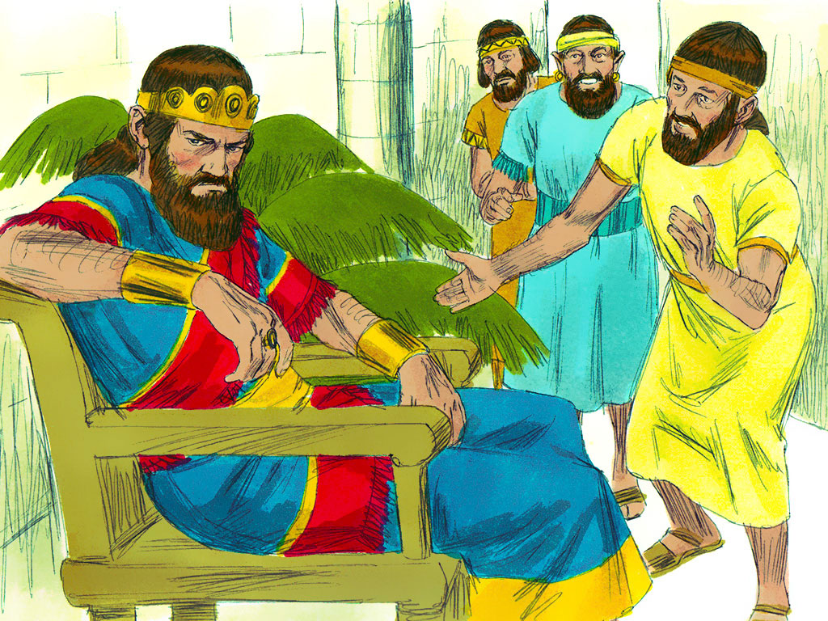
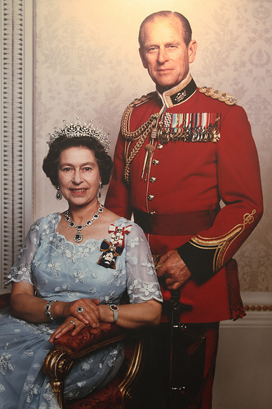
Who are these people?
Notes:
Teachers Notes: Ask: Who are these people? Why might they be important?
(Draw out they are the Queen of England and her husband and a king called Saul from a story in the Old Testament part of the Bible).

Slide 8
What would a king or queen do?
Notes:
Teachers Notes: Make a throne in class. Choose a child to be a king or queen to sit on the throne complete with mace. Ask the children to sit quietly and think: What would a king or queen do? What would you be like if you were a king or queen? What would you do? What would your kingdom look like?
(Draw out they are a king and a queen who are in charge of some things in a country)

Slide 9
Think Group Share
What would a king or queen do?
What would you be like if you were a king or queen?
What would your kingdom look like?
Notes:
Teachers Notes: Instruction: Split the children into groups of 3. Give one copy of the picture of a throne in the previous slide and the 3 questions in the above slide to each group: Ask the children to talk about the answers to the questions and to write or draw as many answers as they can think on their picture of the throne.

Slide 10

Let’s think about this a bit more………
Notes:
Teachers Notes: Explain: We are going to think about this a bit more.

Slide 11
What would God be like if God was a king here on earth?
Notes:
Teachers Notes: Instruction: Show the above slide and read the above question. Collect words to describe what God’s kingdom might be like. (Draw out what things might be important eg kindness, love). In same groups of three ask children to quickly draw a picture of an aspect/part of what God’s kingdom might look like if we could see it here from the earth. Could God be a queen?
(You could also create a collage and take more time if the children need to explore this idea more)

Slide 12
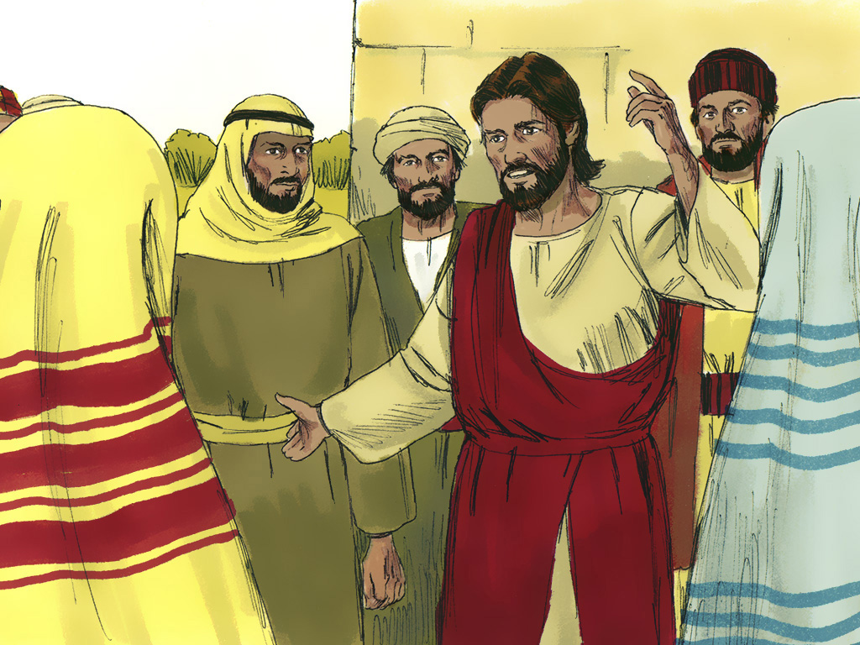
Notes:
Teachers Notes: Instruction: Show the above slide.
Ask children to imagine they are in a very hot country called Israel, they are sitting outside and they are listening to Jesus the teacher. Someone asks him how they should pray: He replies, When you pray.... pray like this: ‘Our Father in heaven, holy is your name, your kingdom come, your will be done,
on earth as in heaven. Give us today our daily bread. Forgive us our sins as we forgive those who sin against us. Lead us not into temptation but keep us safe from evil. For the kingdom, the power, and the glory are yours now and for ever. Amen.’
(NB They should be familiar with a version of the Lord’s Prayer used in collective worship in your school.)

Slide 13
Your kingdom come, your will be done.
Notes:
Teachers Notes: Instruction: Show the above slide and read the above statement. Remind the children this is part of the Lord’s Prayer
Ask: What do you think Jesus meant when he asked the disciples to pray;’ Your kingdom come Your will be done’.
Ask the children to write on post its their ideas around the words above.
Ask the children in pairs to create a picture with 2 parts:
1) Showing God’s kingdom ie God’s will eg pictures showing love forgiveness kindness joy. 2) Not God’s Kingdom/will.eg bad things.

Slide 14
How can Christians do God’s will on the earth?
Notes:
Teachers Notes: Final Reflection - light a candle and ask the children to think about: How can Christians do God’s will on the earth?

Slide 15
Notes for using images
Internet Images:
Slides 6-10
Schools must credit the images as per the information below if they are reproduced.
All images from slides 6-10 are copyright free and found in the Microsoft office
collection. See http://office.microsoft.com/en-us/images/
http://answers.microsoft.com/en-us/windows/forum/windows_vista-windows_programs/what-are-the-copyright-rules-concerning-use-of/741f069b-a52e-4688-b19e-dee05180fc3a
Second picture on slide 7 and slide 12
www.freebibleimages.org
The illustrations are made available for free download under a Creative Commons Attribution-Share Alike 3.0 Unported license. You can create a link from your website to http://www.freebibleimages.org to make these files available to others.
The original illustrations are the copyright of Sweet Publishing the downloadable compilations of them the copyright of FreeBibleimages.org

