Slide 1
The Holy Spirit
Key Stage 1

Slide 2
PowerPoint Introduction
This PowerPoint sample lesson is intended as a resource for schools to be used
‘how and when’ they choose. This Year 1 lesson is planned to be set in the context
of developing the theme of ‘The Holy Spirit’. It can be used selectively as part of
ongoing work based on the theme of ‘Descriptions of God’ or when comparing the
concept of God in different religions.
There are notes on each slide for teachers’ reference. Schools may prefer to edit
The slides and use photographs of their own. The following slide gives the context
of the lesson in the bigger picture. Schools may like to explore other questions in
different year groups within the theme ‘The Holy Spirit.’
A PowerPoint Key Stage 2 Year 5 sample lesson also based on the theme of
‘The Holy Spirit’ can be found on the Chester Diocesan website.
Teachers may find it helpful to refer to the Chester Diocesan document:
'How do I teach Christianity In my church school?’ (pages 21-23). This can also be
found on the Chester Diocesan website.

Slide 3
Context Overview
Area of Content from Chester Diocesan Guidelines to be studied: ‘Holy Spirit’
Theme: God the Holy Spirit Underpinning Christian Concept: Trinity
Definition: Three persons in one God; doctrine of the three-fold nature of God: Father, Son and Holy Spirit.
Key Questions
FS/Key Stage 1: Theme: God the Holy Spirit
Reception: What do Christians say the Holy Spirit is like?
Year 1: Level 1: How did the Holy Spirit change the disciples after the Day of Pentecost?
Year 2: Level 2: What do Christian symbols teach about the Holy Spirit?
Key Stage 2: Theme: God the Holy Spirit
Year 3: Level 3: What does Christian art teach people about the Holy Spirit?
Year 4: Level 3/4: What part do Christians believe the Holy Spirit plays in welcoming into the church community?
Year 5: Level 4/5: What part do Christians believe the Holy Spirit plays in confirmation?
What part do Christians believe the Holy Spirit played in helping the disciples in the early church ?
Year 6: Level 5 : How do Catholic and Pentecostal Christians believe the Holy Spirit is at work in their lives today?
Why is it important to Christians to celebrate Pentecost?
Notes:
Teachers Notes: The context of a bigger picture

Slide 4
Key Stage 1 Lesson : Year 1 Theme: The Holy Spirit
Concept underpinning work: Trinity
Key Question : How did the Holy Spirit change the disciples after the Day of Pentecost?
Lesson Objective: To recognise how the Holy Spirit changed the disciples after Pentecost.
Teachers Notes
Lesson Outcomes:
(All pupils)
I can talk about the Holy Spirit and say what
happened to the disciples in the Pentecost
story.
(Most pupils)
I can describe changes that
happened to the disciples after the
Holy Spirit came in the Pentecost
story.
(Some pupils: More Able)
I can suggest how the Holy Spirit changed
the disciples during and after the Day
of Pentecost.
Teachers Notes
NB Teachers notes explaining how to use each slide within the context of the lesson can be found on the bottom of each slide in the notes section. These should be read before using the PowerPoint. Preview all Internet links before using.
Resources Needed
Slide 17 & 18 A4 Large copies for each table
(optional).
Diocesan Document to refer to: 'How do I teach Christianity in my church school?’Pages 21-23
Next Steps: Looking at other verses in new Testament that describe baptism, eg Acts
Infant baptism.
Notes:
Teachers Notes:

Slide 5


Notes:
Teachers Notes: Explain: here are 4 pictures; sailboat, kite, windmill, hot air balloon.
Ask: What is the one thing all of these pictures need? (Draw out answer: they need wind):
Ask: What does the wind do in each picture? Draw out answers eg gives movement; gives energy-turns sails; helps them move.
Ensure they understand the effect of the wind is to change things.

Slide 6

What does fire do?
Notes:
Teachers Notes:
Ask: What is fire like? Ask for suggestions eg its hot, it warms us, it burns things. Ensure they understand the effect of fire is to change things.
Ask them if they can remember a bible story about the Holy Spirit from FS that had wind and fire in it?
Recap all they learnt about the Holy Spirit in FS.

Slide 7

Let’s think about a story you may have heard before ………
Notes:
Teachers Notes: Explain: We are going to look at this story a bit more now today. It is called the story of Pentecost.

Slide 8
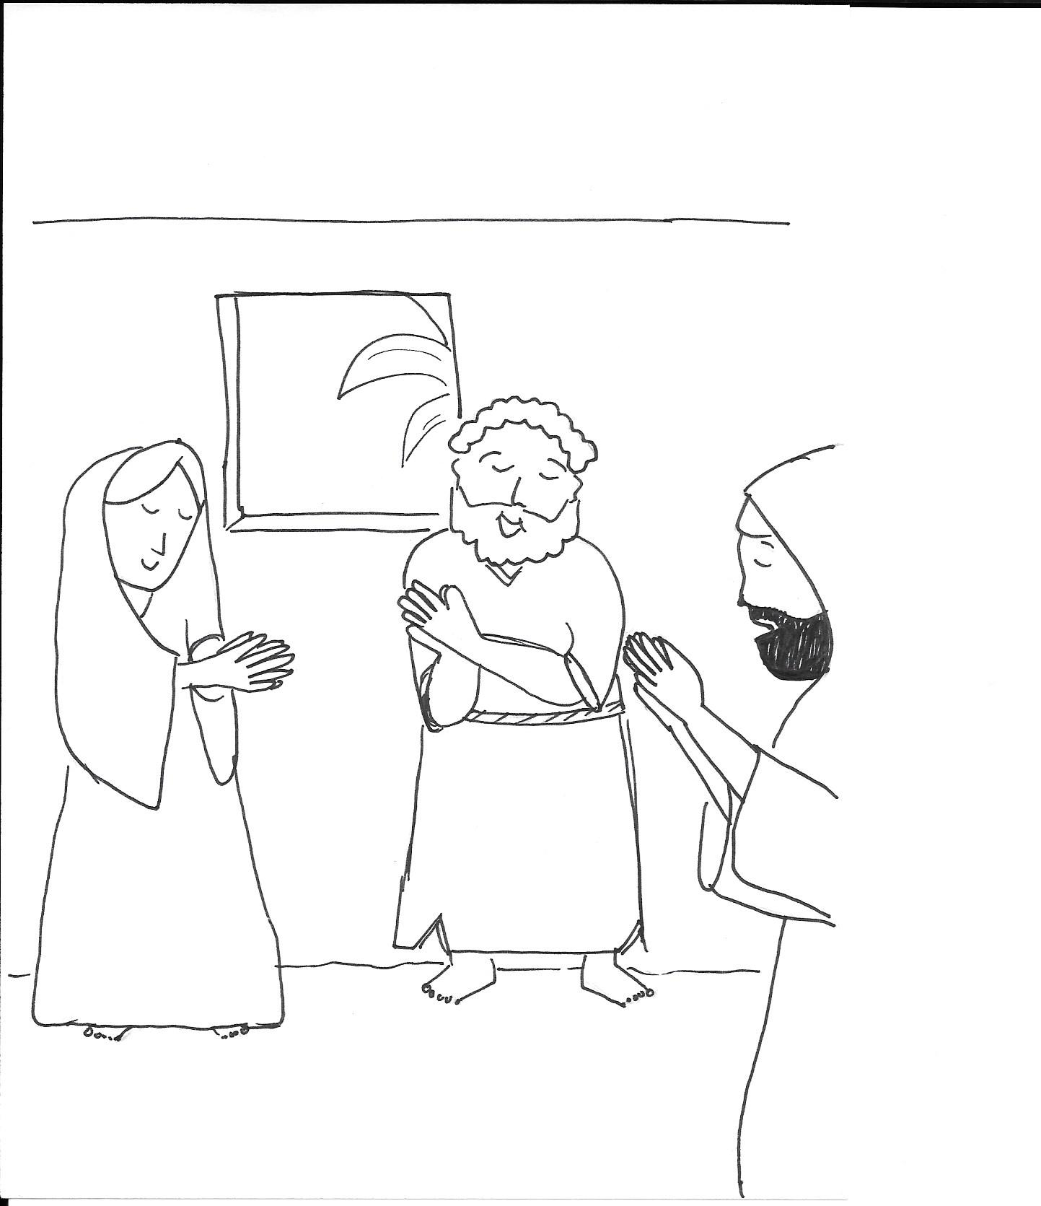
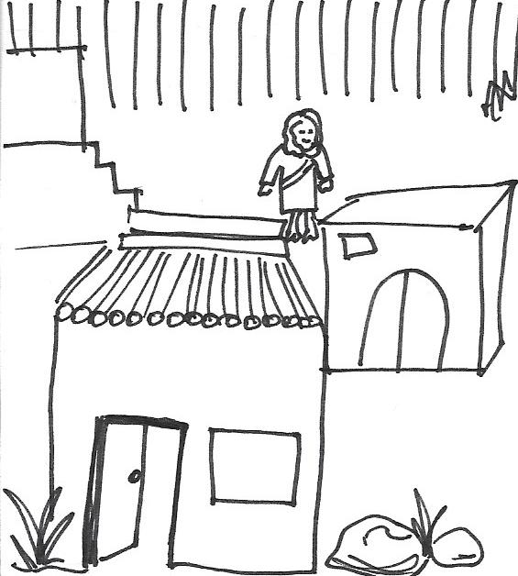
Notes:
Teachers Notes
Instruction: tell the story interactively & show each slide as you do. You could use puppets or toy people. Give sound effects or instruments and actions so the children can join in eg for wind and fire
‘After Jesus had left the disciples and gone to heaven, the disciples were very afraid that they might be killed. They waited in Jerusalem and often met to pray in peoples homes.’

Slide 9
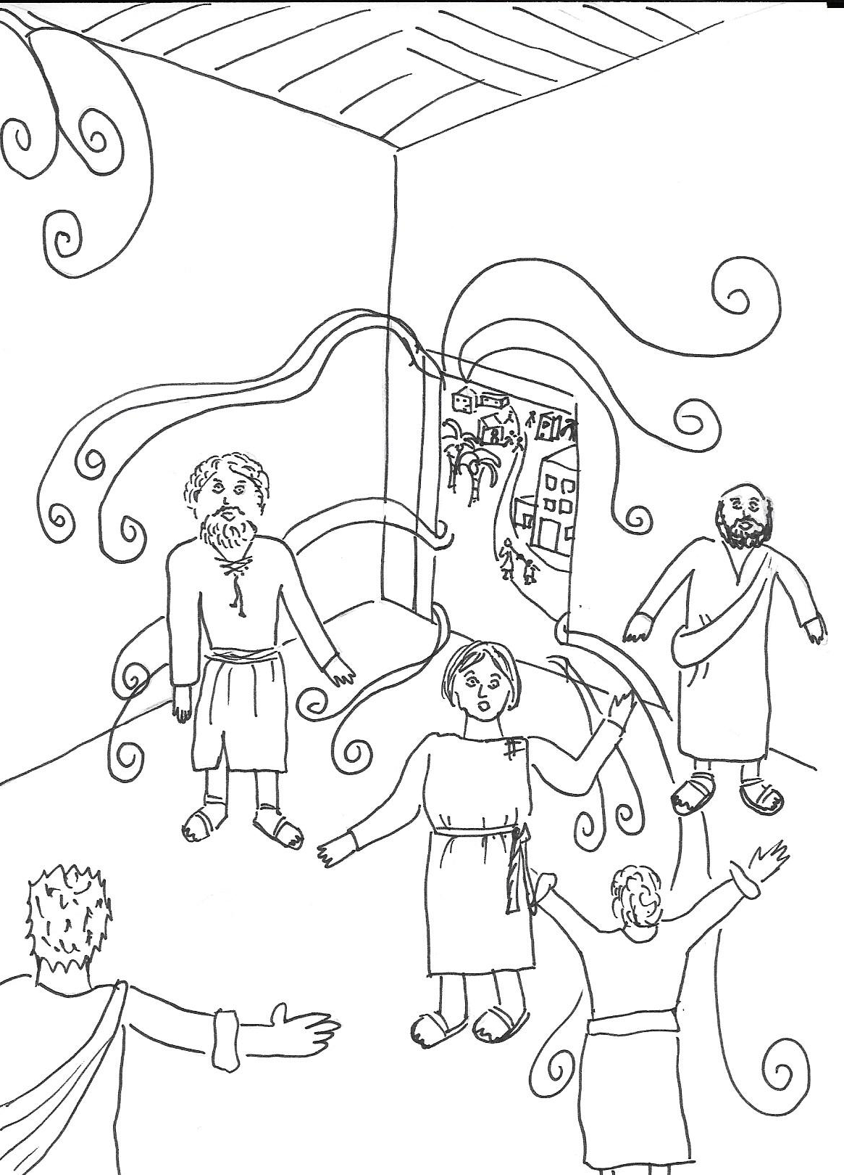
Notes:
Teachers Notes
On the day of Pentecost which is a special day, the disciples were upstairs in a house in Jerusalem.
Suddenly they heard a sound like the blowing of a very strong wind. It swirled all around them and went into every room in the house.

Slide 10
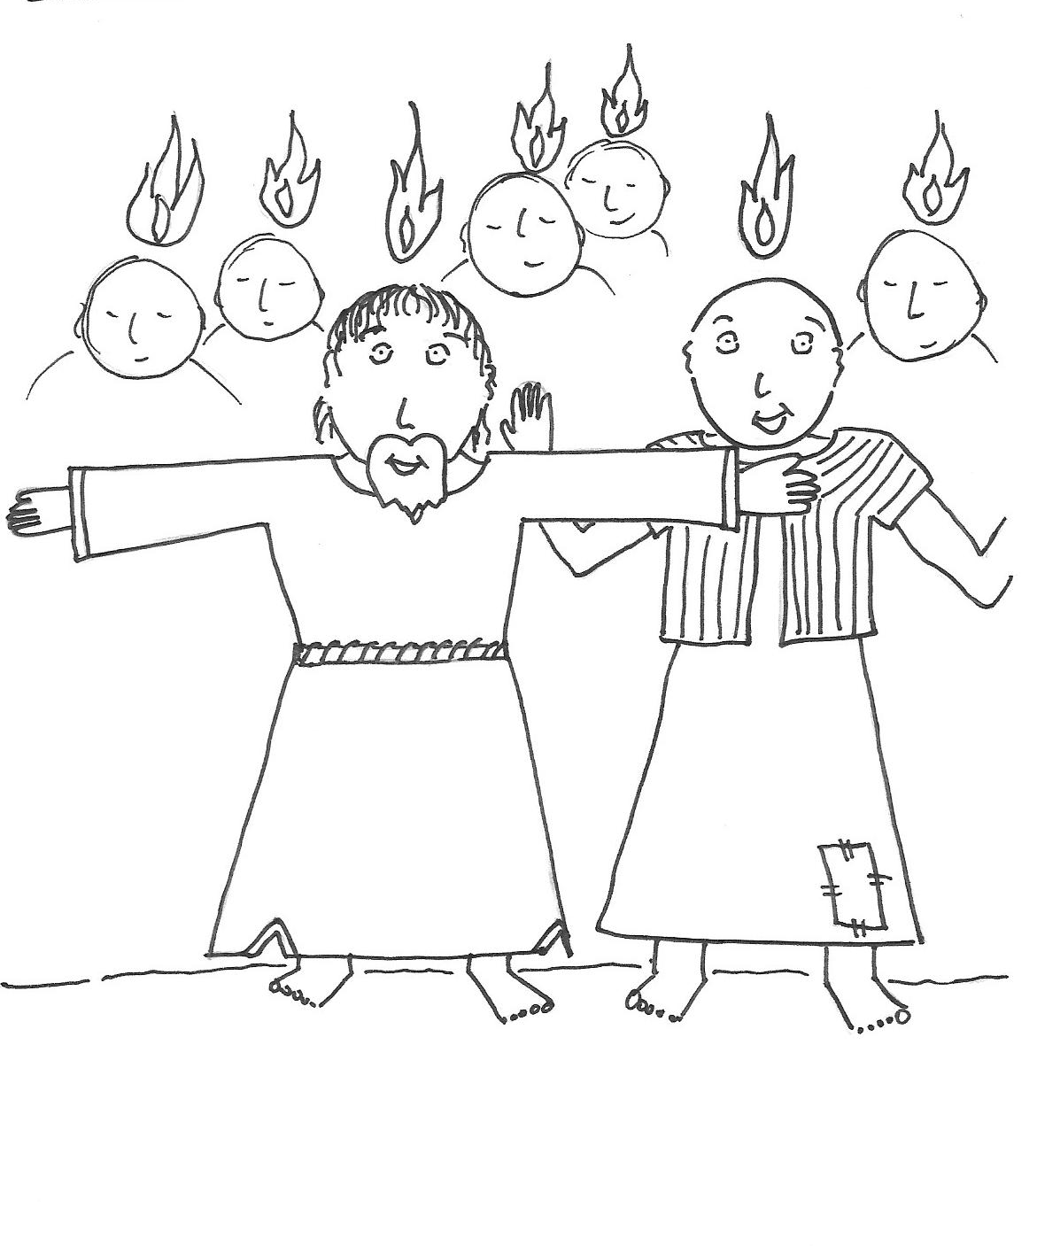
Notes:
Teachers Notes
When they looked at each other they saw flames on each others heads but nothing was being burnt up. Then they all began to speak in other languages.

Slide 11
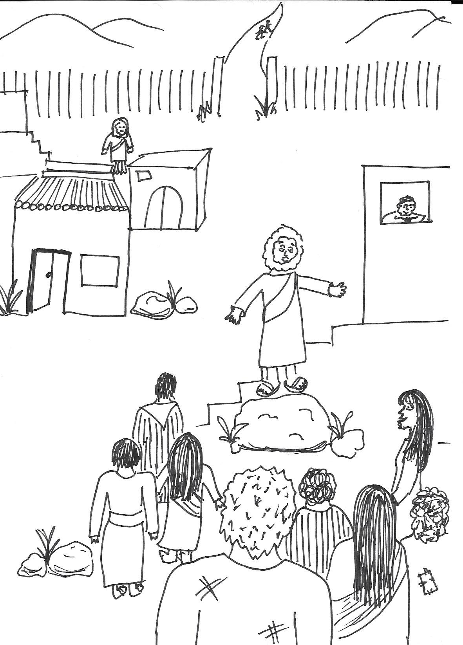
.....hgyutd
...hgghg
Notes:
Teachers Notes
They went outside and saw many visitors who had come to Jerusalem. When the disciples spoke the visitors were surprised to hear all the disciples speaking to them in their own languages. ‘What does this mean? they asked. Some thought they had drunk too much wine.

Slide 12
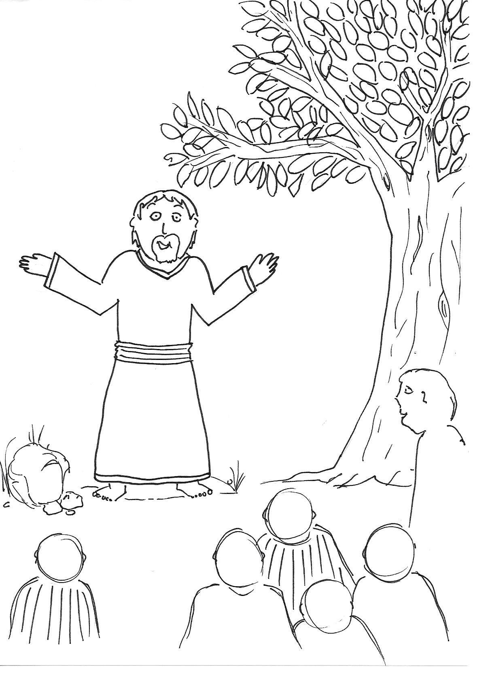
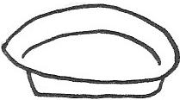
Notes:
Teachers Notes
Peter one of the disciples stood up and said, ‘No we have not drunk too much wine, we are not drunk, it is only 9 o’clock in the morning. God has filled us with his Holy Spirit. Jesus said this would happen. He came to teach us about God and then he was killed. He came back to life and spoke to us. He said he would send the Holy Spirit to us after he had left.

Slide 13
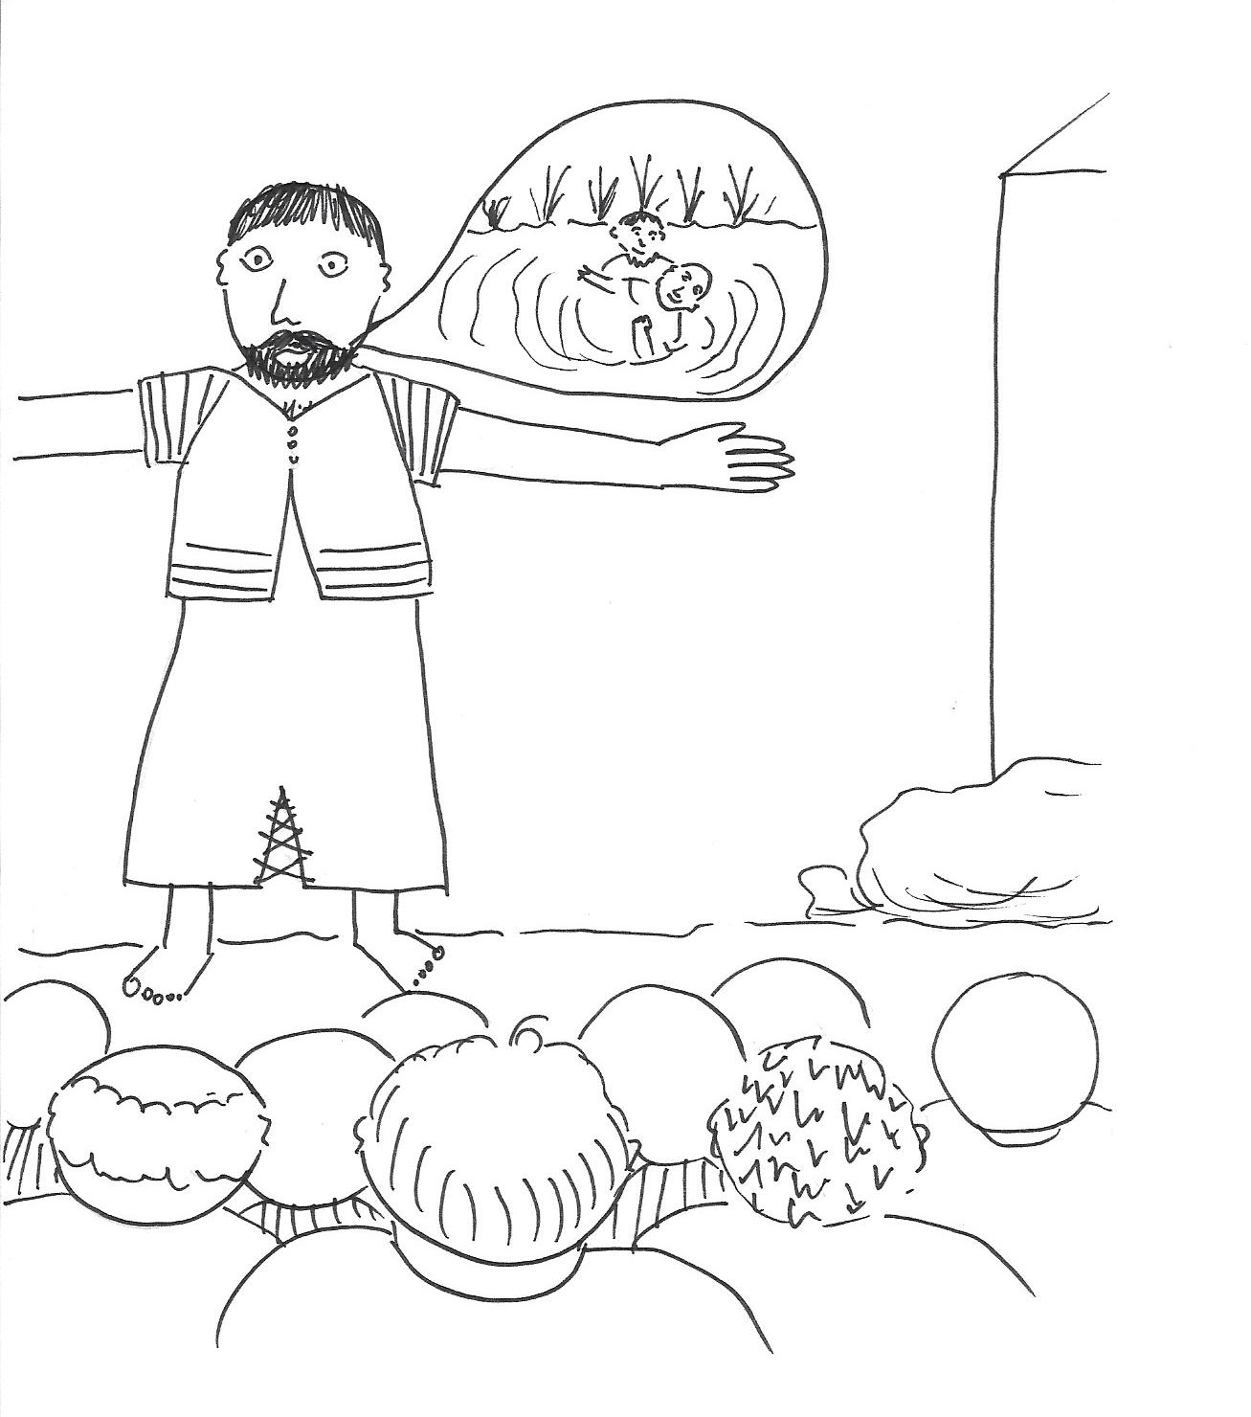
Notes:
Teachers Notes
The people said, ’What shall we do?’ Peter said ‘Tell God you are sorry for all the wrong things you have done and be baptised. Then the Holy Spirit will be given to you as gift. Many said sorry and were baptised that day.

Slide 14

I wonder.......
What do you think happened to the disciples after this day?
Notes:
Teachers Notes
Instruction: Ask the questions above. Explain to the class you are now going to show them a clip and you want them to see if they can answer these questions. They must keep their answers a secret until the end of the clip.
Show half of story Clip: Day of Pentecost. https://www.youtube.com/watch?v=IqG_lvZhU-A (3 mins)
Or alternatively use clip from https://www.youtube.com/watch?v=jNiApXVR9go (3 mins)
NB Pause your chosen clip halfway through before the disciples start healing and teaching people. Give the class quiet thinking time about the question above. Ask the questions above again. Then show the next part of the clip where the disciples start healing and teaching people.
Ask if the children have any questions of their own so far about the story. Display their answers and other questions they may have.

Slide 15
How did the Holy Spirit change the disciples after the day of Pentecost?
I think .......
because .......
Notes:
Teachers Notes: Instruction: Ask children to think about the answer to the question above. After watching the second half of the story from the clip ask them for heads down quiet thinking. Get pupils to picture the story. Ask: How did the Holy Spirit change the disciples after the Day of Pentecost?
Instruction: Ask the children to picture their answer. Ask pupils to draw a picture to show the changes that happened to the disciples. Can they explain what they drew? Can they write a sentence or 2 about the picture?

Slide 16
Notes for using images
Internet Images: Schools must credit the images as per the information
below if they are reproduced.
Clip art see: https://openclipart.org/search/?query=fire
All clip art images are copyright free and found in the Microsoft office collection.
See http://office.microsoft.com/en-us/images/
http://answers.microsoft.com/en-us/windows/forum/windows_vista-windows_programs/what-are-the-copyright-rules-concerning-use-of/741f069b-a52e-4688-b19e-dee05180fc3a
Story images: copyright free drawn by Lily & Evie Adams aged 10 & 12.

