Slide 1
Bishops

Slide 2
Jobs
Can you think of three jobs that a man and woman can do?
Notes:
List eg teacher, doctor, cleaner – any job apart from Pope!

Slide 3
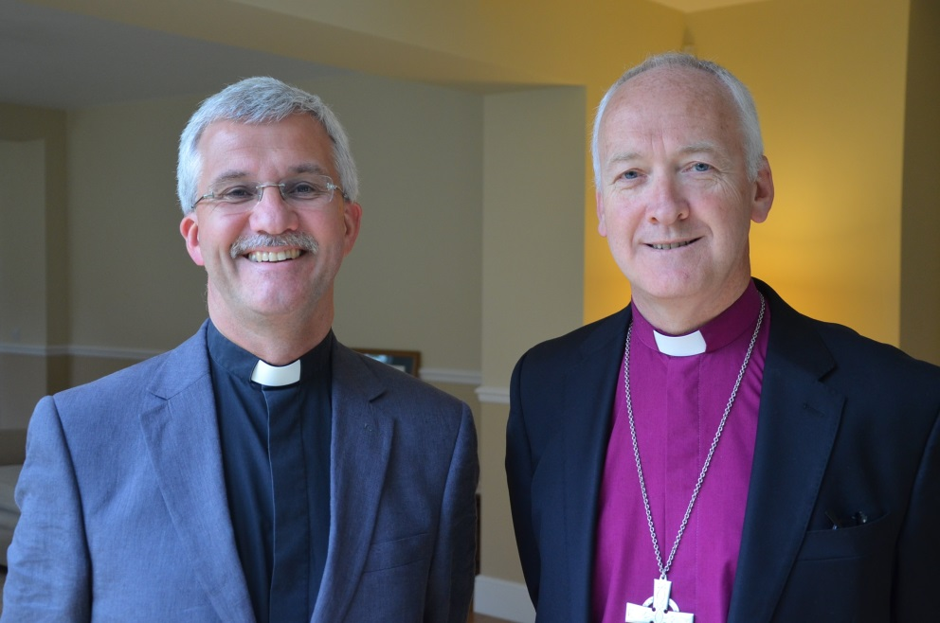
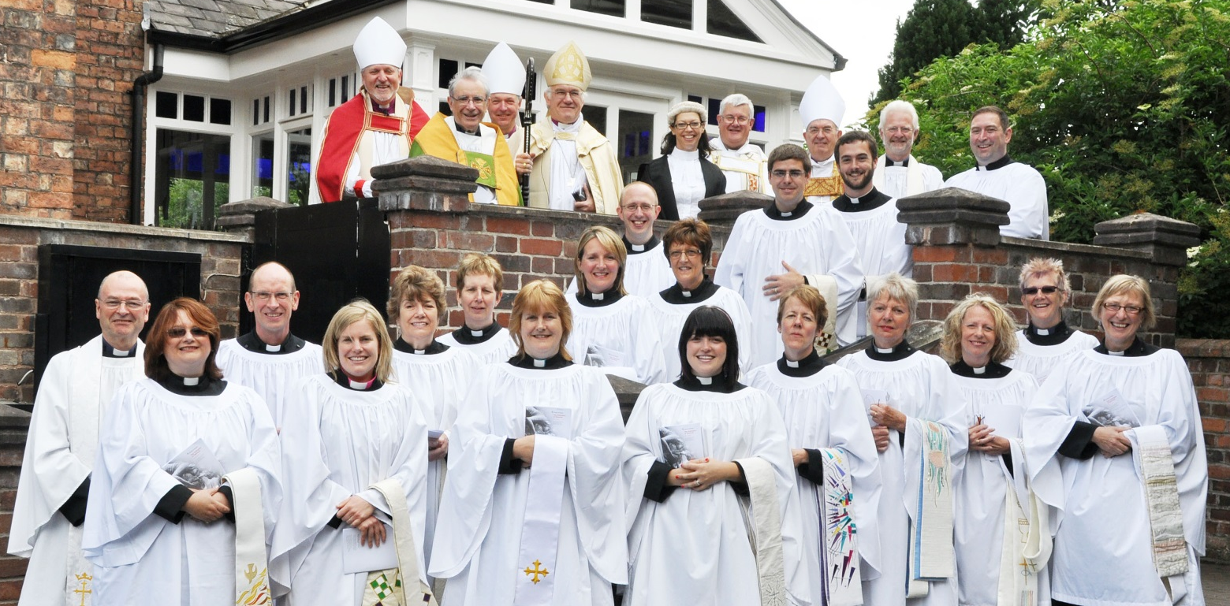
Notes:
What do these people do? How do you know?
(Answer – priests)

Slide 4
Priests
A priest looks after the people who live near to the church. There have been female priests in England since 1994.
Do you know the name of any priests?
Notes:
Local clergy or school clergy links
Priests can be called clergy or ministers. There are three aspects of ordained ministry in the Church of England: deacons, priests, bishops

Slide 5
Bishop
A Bishop looks after the priests and with them lets everyone know about our Saviour, Jesus.

Slide 6
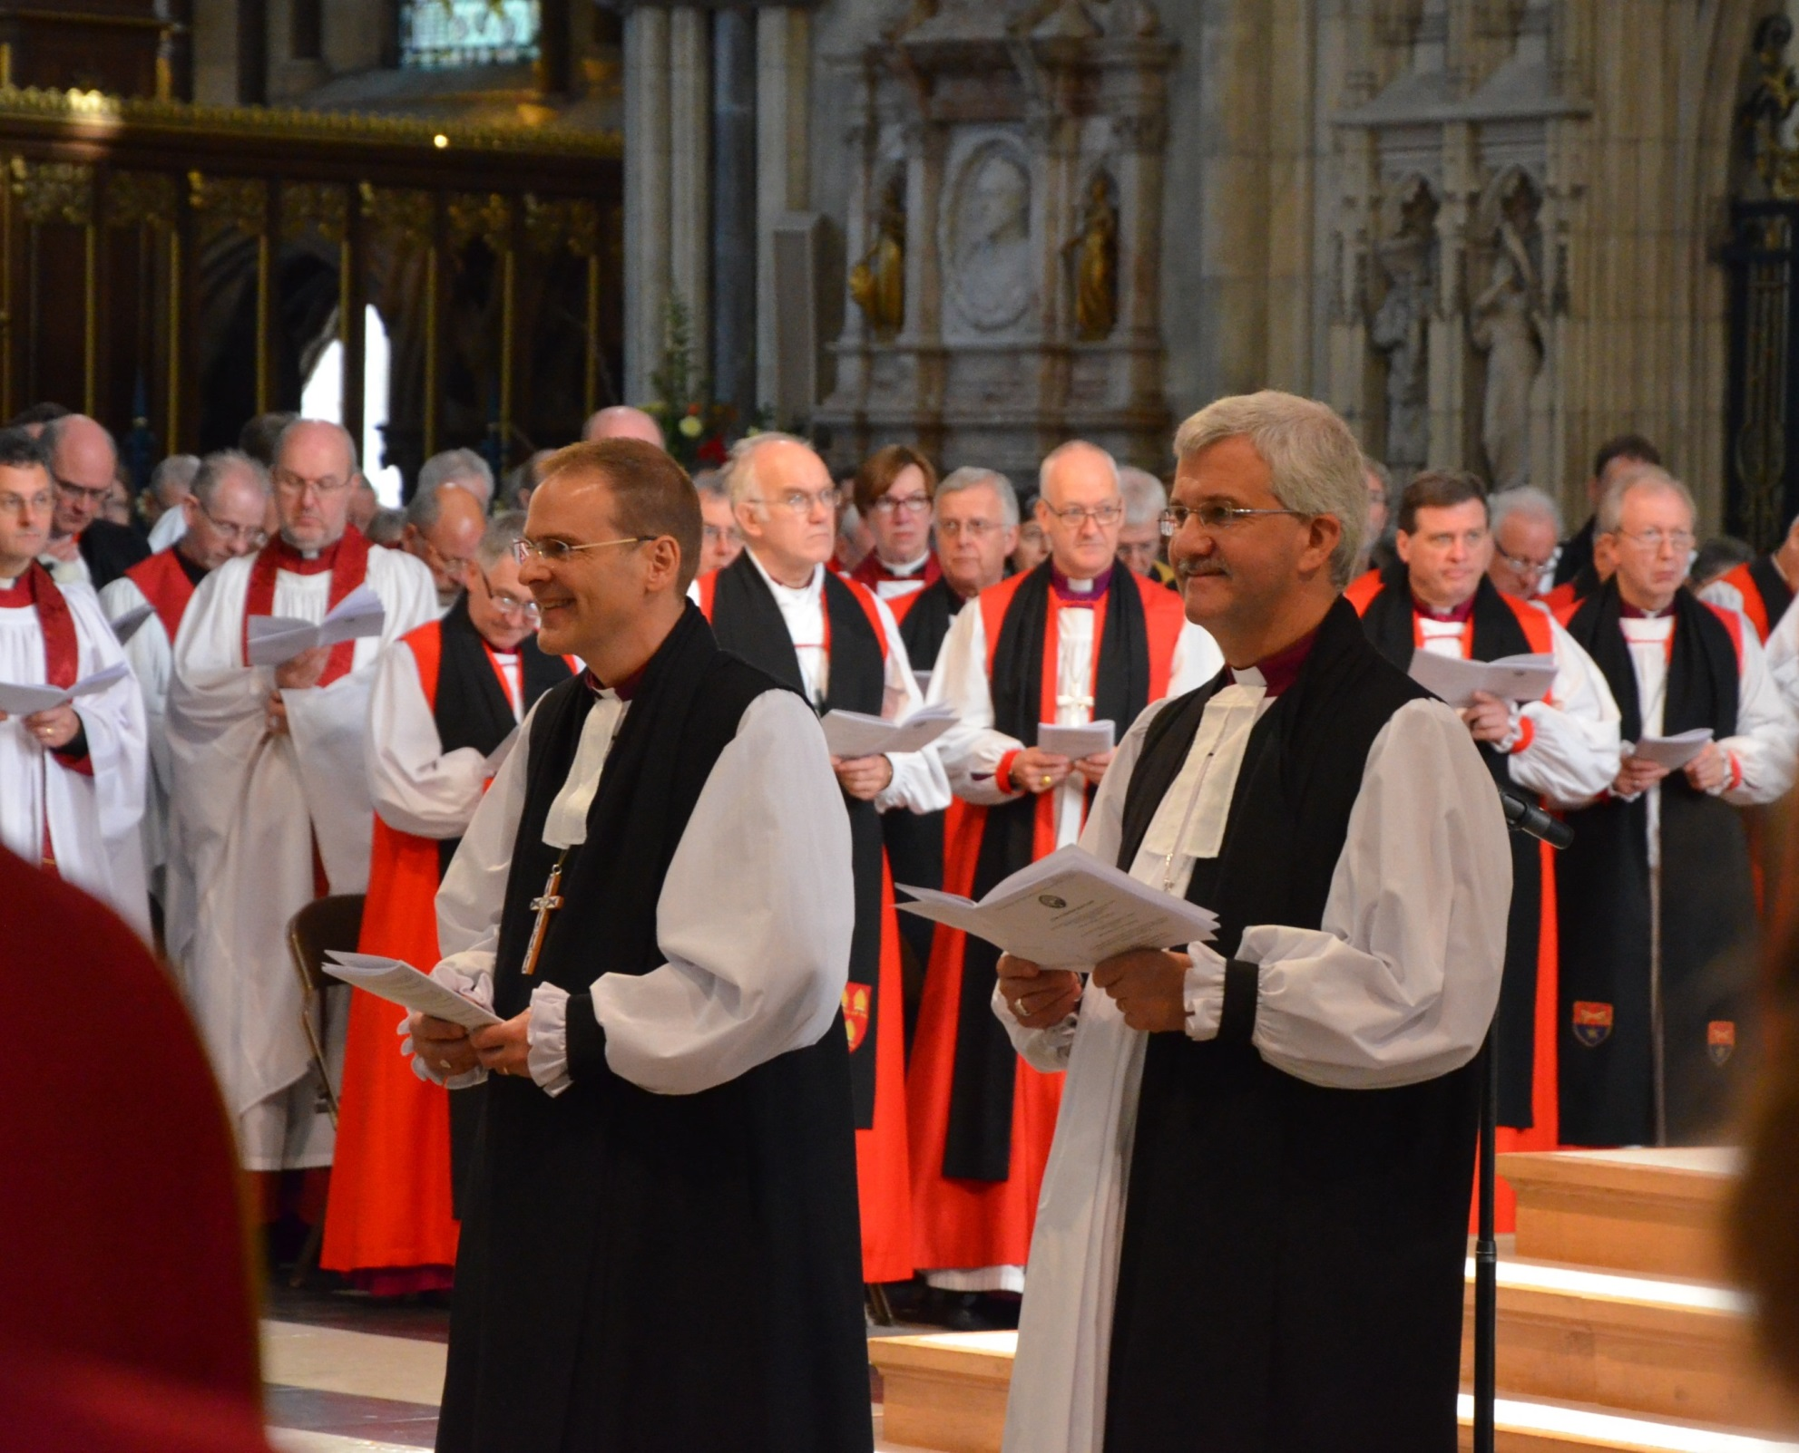
Notes:
What do you think is happening here?
Answer: Consecration – a new bishop beginning his time in office

Slide 7
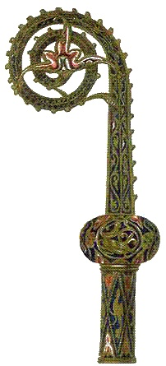
A shepherd’s crook
The bishop carries a crook. It is like a shepherd’s crook.
Can you think of reasons why it is carried?
Notes:
Shepherds people/priests like a shepherd looks after sheep.

Slide 8
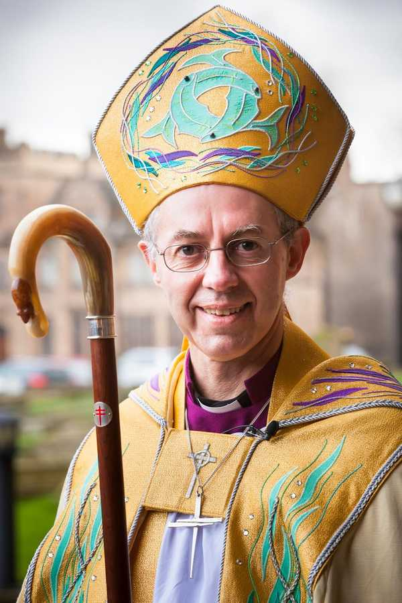
A bishop leads the people like a shepherd leads his flock.
This reminds us of God the Father leading all Christians.
Notes:
Justin Welby is the Archbishop of Canterbury. He is responsible for all the bishops

Slide 9
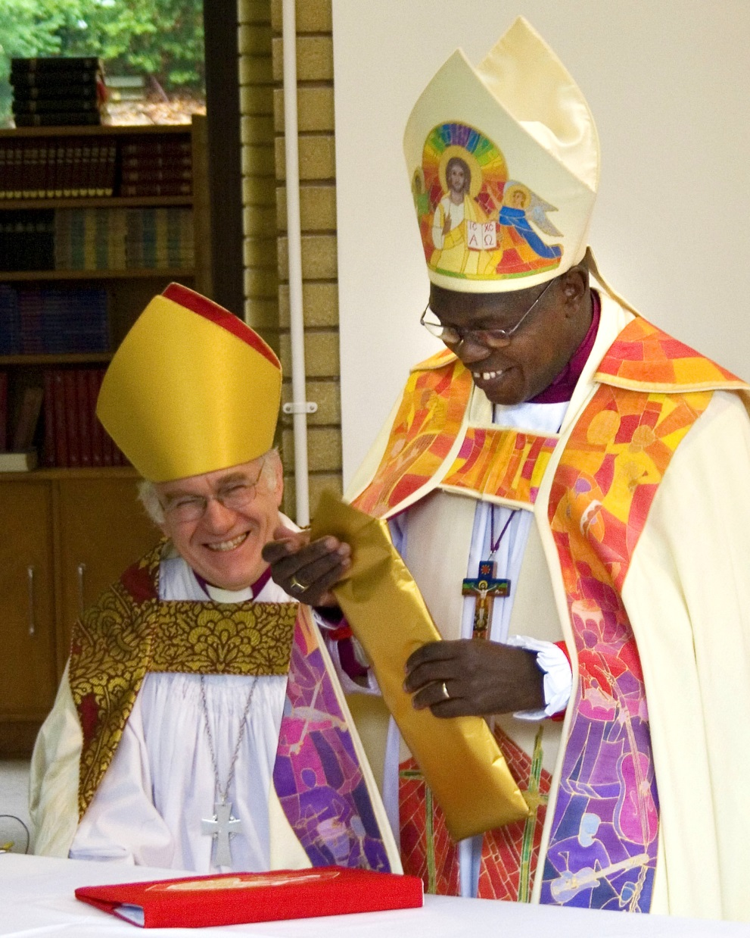
Cope
Bishops wear copes. These wrap around their other robes.
This reminds us of the love of Jesus which completely covers Christians.
Notes:
This is a picture of Bishop Peter, the Bishop of Chester and Archbishop Sentamu, the Archbishop of York (right)

Slide 10
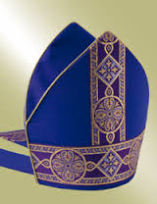
Mitre
Bishop’s wear mitres. They are like two flames.
This reminds us of the Holy Spirit which strengthens Christians to follow Jesus.
Notes:
Children use their hands to make the shape of flames to represent the Holy Spirit

Slide 11
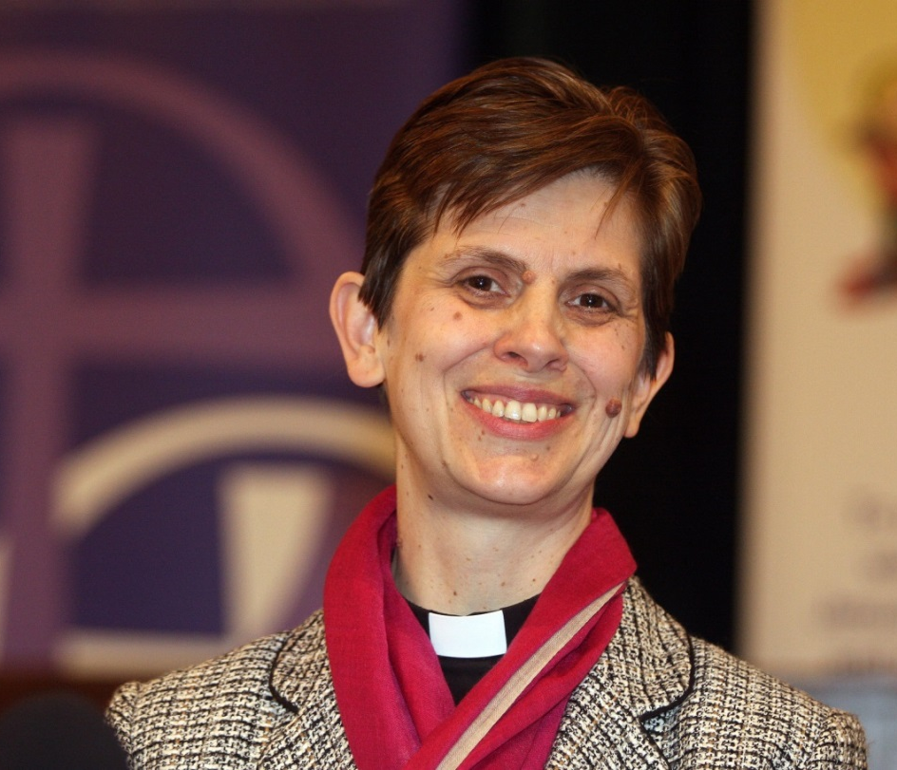
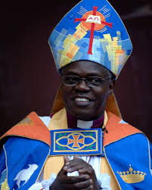
Women Bishops
On January 26th 2015 the first female bishop in England was consecrated. Libby Lane is Bishop of Stockport.
Notes:
The photograph is of Libby Lane. She will be made bishop by Archbishop Sentamu (right).

Slide 12
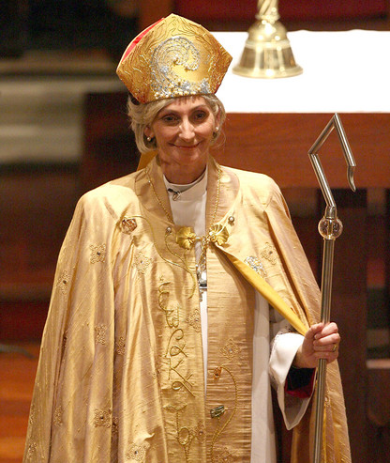
Notes:
A female bishop

Slide 13
Prayer
Loving God, we pray for Bishop Libby in her work as a bishop. We pray for everyone who works to make this world a better place. Amen

