Slide 1
George Colville
Diocesan Secretary

Slide 2
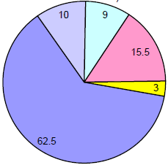
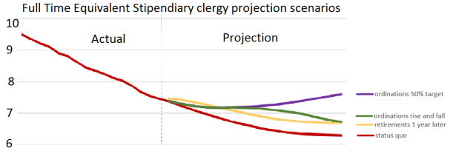
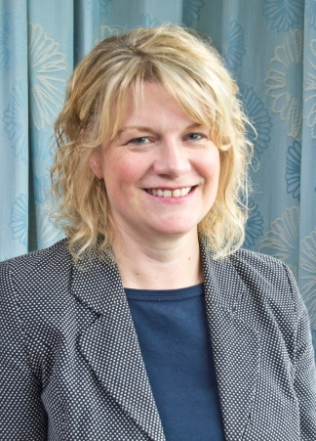
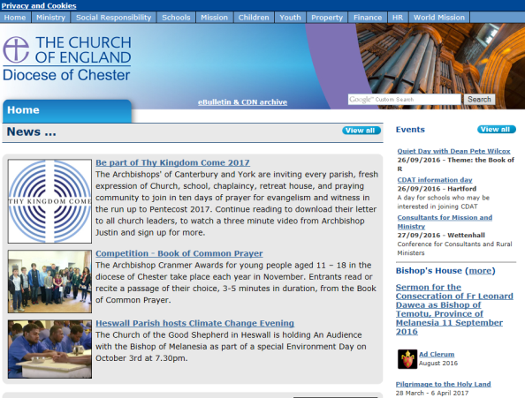
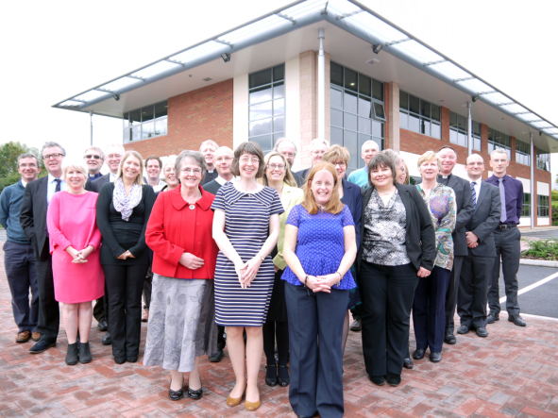
Quick update
Budget 2017

Slide 3
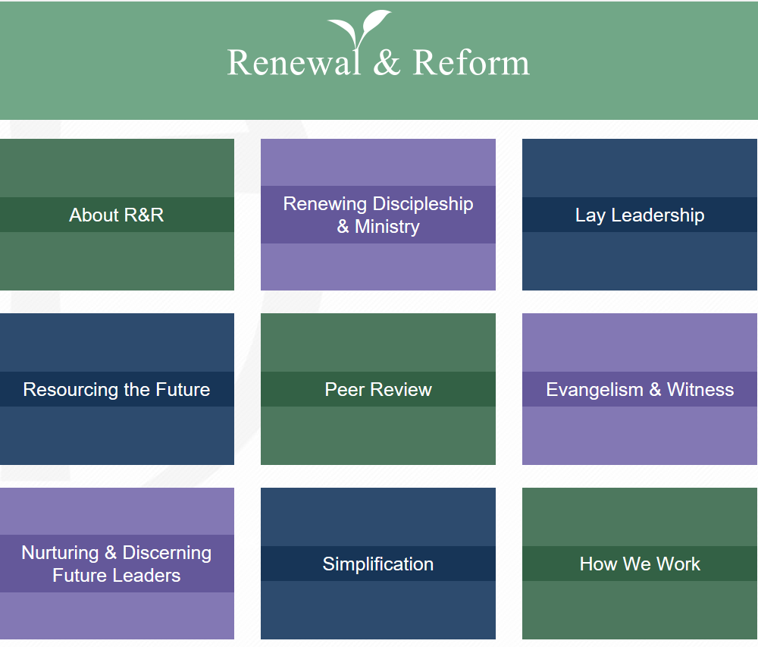
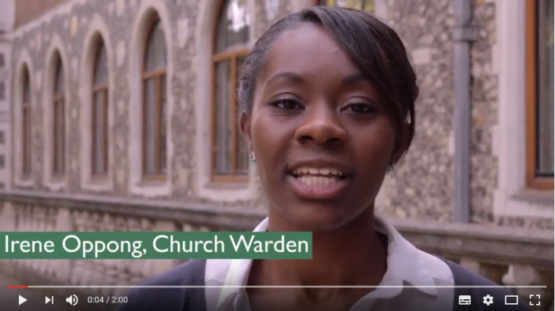
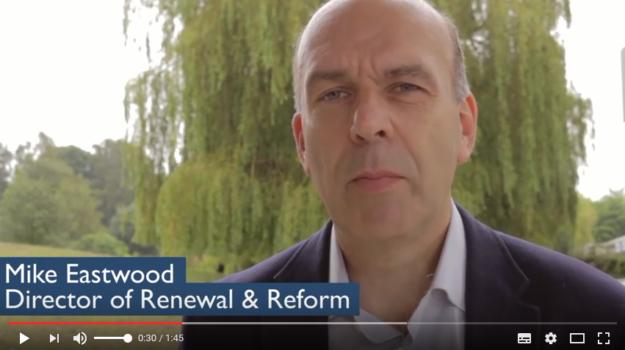
Short Videos
www.churchofengland.org/renewal-reform/about-rr/short-films.aspx
Website
www.churchofengland.org/renewal-reform.aspx

Slide 4
Budget 2017
2.5% rise in standard parish share
Mission & Development fund finishes
Net reduction in staff
1.5% stipend and salary rises
Housing repair budget frozen
Break even

Slide 5
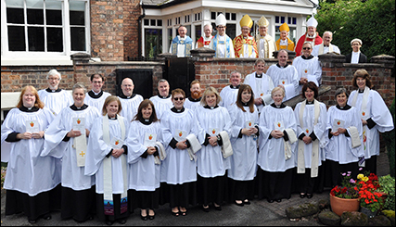
Budget 2017
Main story for future is significant increase in curate numbers
- National Numbers
2000
2015
2035

Slide 6
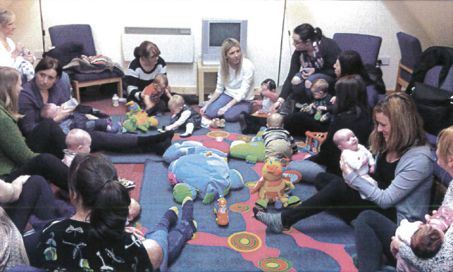
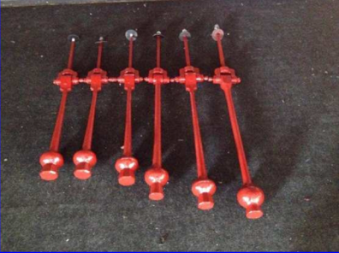
Review of Accounts (2014)
So far 250 (out of 273) 92%
62% surplus.
Net total for Diocese = £1.7m
Over £27m liquid funds in PCCs
Generally good quality understandable accounts.
A lot of good work taking place in the Diocese.

Slide 7
New Diocesan Registrar – Lisa Moncur
Based - Church House and Aaron & Partners
Starts 17 October
registry@chester.anglican.org
Will be recruiting a clerk to help Lisa soon (shared with Surveyors)

Slide 8
Diocesan Website

Slide 9
Church House
We are here to serve you
Do let me know how we are doing
Ask if in doubt
01928 718834
george.colville@chester.anglican.org
nigel.strange@chester.anglican.org
liz.geddes@chester.anglican.org

