Slide 1
Church Wardens' Training
1st October 2016

Slide 2
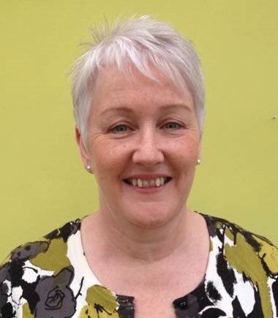
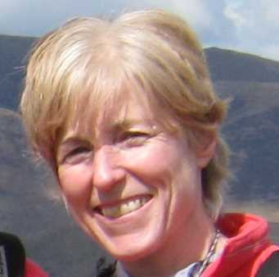
Who are Transforming Lives Together?

Slide 3
To work with churches to support them to make a greater contribution to the spiritual and social transformation of ourselves and our communities, specifically in tackling poverty and inequality

Slide 4
Asset Based Community Development
What we need
What we have !
What can you do with what you’ve got?

Slide 5
Asset Based Community Development
Deficit Based
• Problems
• Blame
• What’s missing
• Scarcity
• Risks
• Needs
• Control-outside in
• Top-down
• Do to
• Passive receivers
Asset Based
• Possibilities
• Shared ownership
• What’s there
• Abundance
• Courageous leadership
• Strengths, capacities, assets
• Lead by stepping back, Inside-out
• Citizen-led
• Do with, enabling to do
• Active producer & co-producers
Can do!
Can’t do!
Cormac Russell, ABCD Institute, 2013

Slide 6
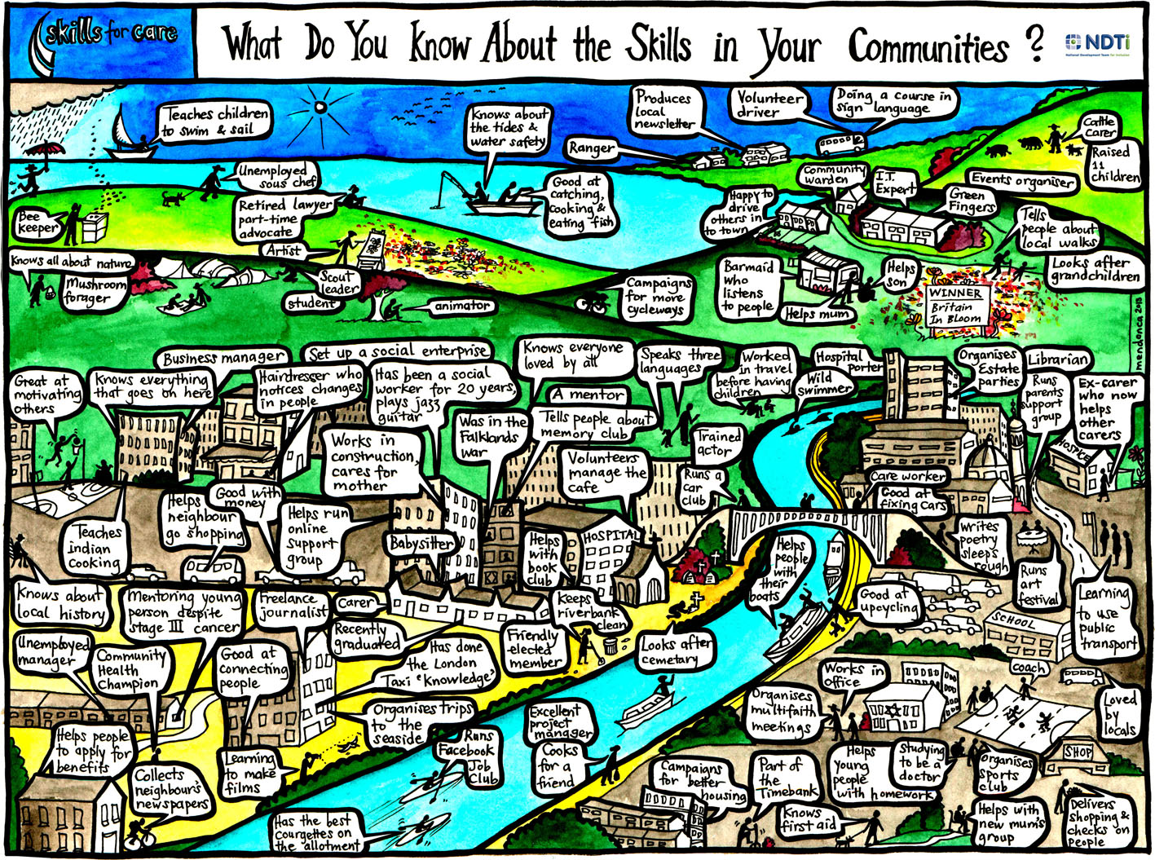

Slide 7
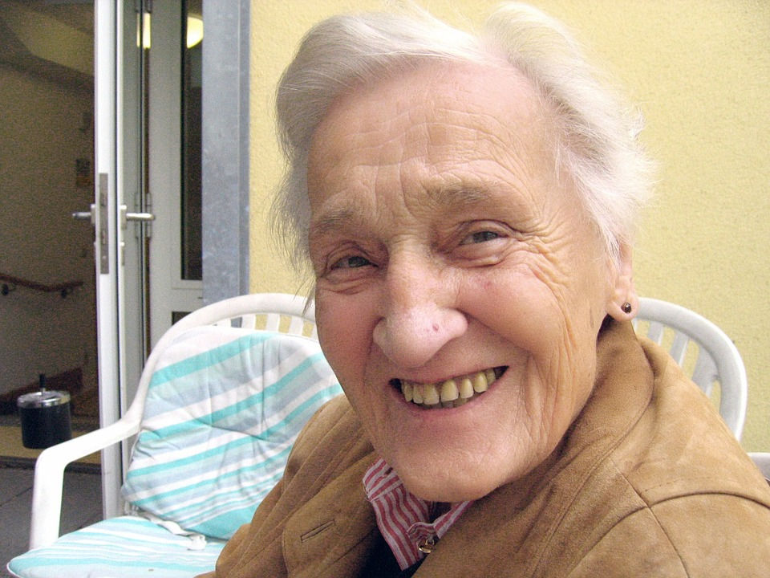
ABCD encourages us to look at the gifting and value of a person who may previously have been overlooked and dismissed. The too old, too young, too fragile, are drawn into relationships of mutuality, sharing and transformation. It seeks to see God’s abundant beauty and blessing in all people and places

Slide 8
Why Bother?
Now that I, your Lord and Teacher, have washed your feet, you also should wash one another’s feet​
John 13: 14​

Slide 10
Listening – feeding back, making connections, sharing good practice (through events, social media etc.)
Building partnerships between churches and between churches and other sectors
Offering practical support e.g. ‘Know Your Church Know your Neighbourhood’, Together Grant applications

Slide 11
Know Your Church Know Your Neighbourhood
A facilitated process to help churches to think about themselves in relation to the wider community they seek to serve and to make prayerful and informed decisions about their mission in their local area
It takes 6 months to complete and needs a church to nominate a group of committed individuals who could attend monthly meetings facilitated by TLT and who are prepared to complete some small tasks in the time between meetings.
It isn't suitable for all churches

Slide 12
Link, Listen, Liaise
Vision What might a flourishing neighbourhood look like and how might God be seen in it?
Understanding the church How do we communicate with the local community? How are our premises used by church members and others? What voluntary activities are our members involved in?
Learning about the local neighbourhood What activities and services are there in our neighbourhood? What do local people see as the key issues in the area? How is our church perceived by others?
Considering how the church can respond What have we learnt through this process? What should we do next?

Slide 13
The Together Grant programme provides small grants of up to £5,000 for faith based organisations to engage in social action, by supporting them to initiate or develop community work.
(This programme is coming to an end shortly as the funding for it is no longer available)

Slide 14
Tackling poverty:
The activity must be directly tackling poverty.
Faith basis:
The lead applicant should have a faith basis.
Working in partnership:
Applicants need to be working in partnership with at least one other organisation.
Local community focus:
The activity needs to be based in the local community.

Slide 15
“Places of Welcome” is a growing network of hospitality run by local community groups who want to make sure that everyone in their area has a place to go for a friendly face, a cup of tea and a conversation if and when they need it.

Slide 16
A network of individuals and groups committed to supporting us in our mission

Slide 17
Please check us out on our website
www.tltogether.org.uk
Like us on Facebook
@transforminglivestogether
Follow us on Twitter
@TLTChester

