Slide 1
Archdeacon’s Visitations
May 2017

Slide 2
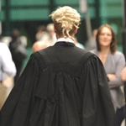
It is a legal requirement for a Churchwarden to be sworn into their post.

Slide 3
It is helpful to both the Archdeacon & Registrar if this takes place at a Visitation service

Slide 4
VISITATION SERVICES 2017 All the Visitation Courts will commence at 7.30 pm CHESTER ARCHDEACONRY DATES IN BLACK/ MACCLESFIELD IN RED (Due to Archdeacon Ian taking a sabbatical in 2017 there will only be 3 services in the Macclesfield Archdeaconry)
DATE | DEANERIES | VENUE
Tuesday 2nd May | Chester/ Malpas | St Boniface, Bunbury
Thursday 4th May | Birkenhead/ Wallasey/ Wirral North | St Saviour, Oxton
Wednesday 10th May | Wirral South/ Frodsham | St Paul Helsby
Monday 15th May | Great Budworth / Middlewich | St Helen Witton
Thursday 18th May | Mottram/ Chadkirk/ Stockport | St Thomas Stockport
Monday 22nd May | Nantwich/ Congleton/ Macclesfield | St Mary, Nantwich
Wednesday 24th May | Bowdon/ Knutsford/ Cheadle | St Mary Ashton upon Mersey

Slide 5
You can attend ANY service by telling Pat Pugh where you want to go.

Slide 6
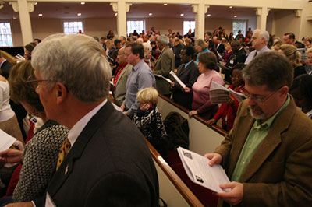
Please try to attend!

Slide 7
On another note………
If you would like the Archdeacons to lead a service or attend a meeting, please contact their PA Pat Pugh who will be happy to arrange a date.
Tel: 01928 718834 ext 258
pat.pugh@chester.anglican.org

