Slide 1
George Colville
Diocesan Secretary

Slide 2
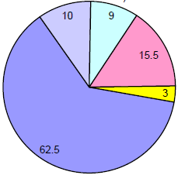
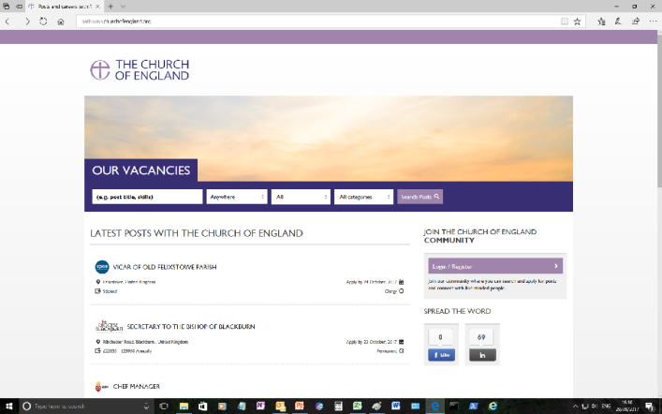
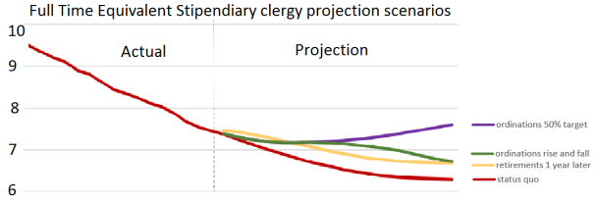
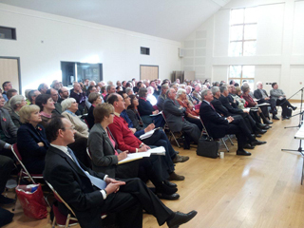
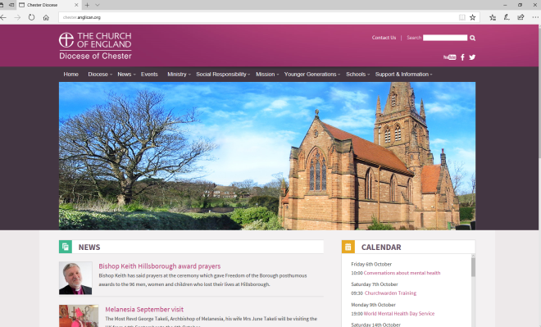
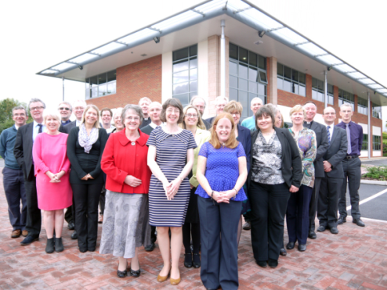
Quick update
Budget 2018

Slide 3
Budget 2018
Diocesan Synod – November
2.5% rise in standard parish share
94% parish share collection
Fees - reduced
2% stipend and salary rises
Housing repair budget frozen
Curates – 14 in July 2018
Deficit budget – funded pastoral account

Slide 4
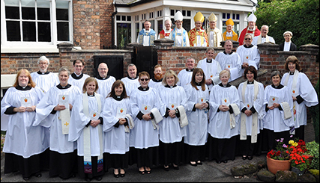
Budget 2018
Main story for future is significant increase in curate numbers
- National Numbers
2000
2015
2035

Slide 5
Budget 2018
Annual and cumulative deficits funded from pastoral account – house sales

Slide 6
Pathways
New Church of England Website for recruitment
Pilot Stage at present
Available for parish posts – Contact Liz Geddes
pathways.churchofengland.org

Slide 7
New Diocesan Synod
“Any lay person who is an actual communicant of 16 years or upwards and whose name is entered on the roll of any parish”
Deanery Synods are the electorates
Normally meets twice a year on Saturday morning

Slide 8
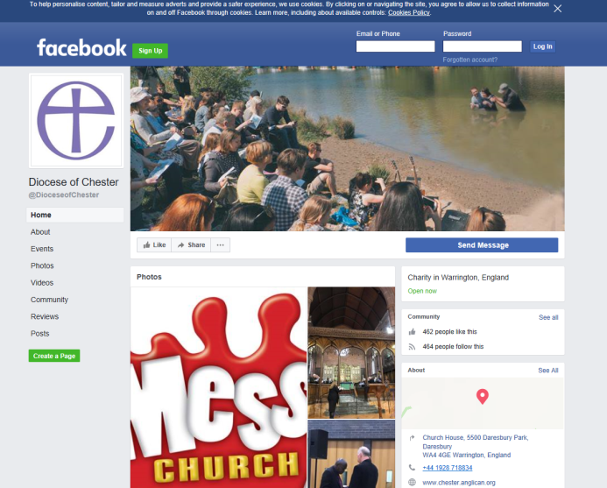
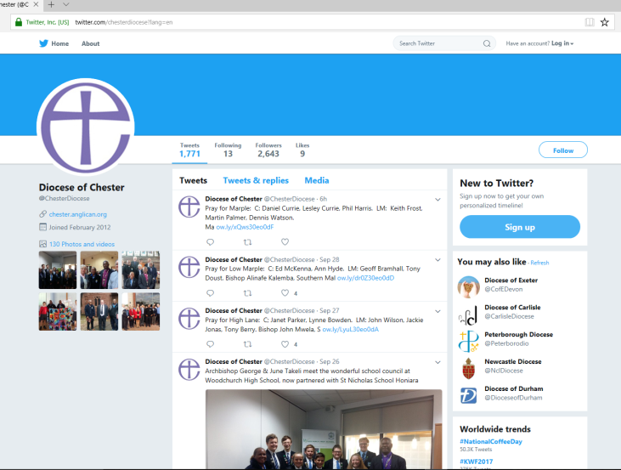
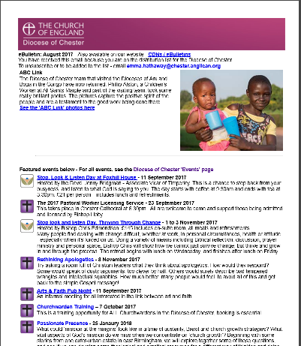
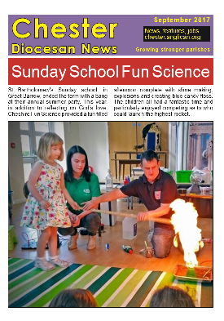
Diocesan Communications

Slide 9
Church House
We are here to serve you
Do let me know how we are doing
Ask if in doubt
01928 718834
george.colville@chester.anglican.org
nigel.strange@chester.anglican.org
liz.geddes@chester.anglican.org

