Slide 1
Revelation
Threads through Revelation
© Jacqui Parkinson 2016
www.revelation-threads.co.uk
www.jacqui-textile.com

Slide 2
Introduction for teachers
These textiles panels are from an exhibition called, ‘Threads through Revelation’ on tour at Chester Cathedral in 2017.
There is a slide of each panel with suggested questions for pupils in the notes section. The following slide includes the artist’s text alongside the picture.
The material can be used selectively for all pupils.

Slide 3
Some ideas for the classroom
Give the pupils some of the text and ask them individually or in pairs to represent the words visually through eg paint/collage/clay/pastels.
Pupils use the text and panel to represent the words through sounds/music.
Pupils decide on what they think the text means. Older pupils represent visually some current affair eg current political events/recent school event connecting it with a belief in God
Some panels may be used as a stimulus in worship eg ‘A new heaven and a new earth’

Slide 4
INTRODUCTION to the panels
Revelation is the last book in the Bible. It retells a series of visions recorded by John on the island of Patmos in the Mediterranean. Revelation is full of extraordinary images and ideas, which have challenged and inspired people for nearly two thousand years.
Threads through Revelation is a display of textile art created in response to Revelation.

Slide 5
Jacqui Parkinson, the artist says:
‘God - and the book of Revelation- will always remain full of deep mystery. But mysteries can speak to each of us in many ways. My hope is that as we untangle at least some of the mystery there will also be blessings’

Slide 6
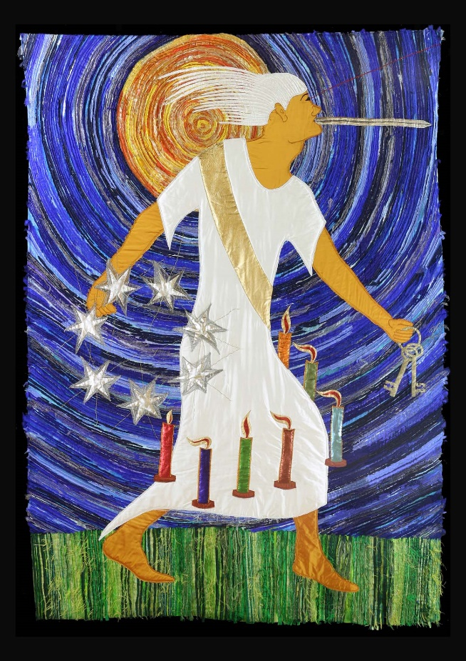
Revelation 1-3
The story begins: John is simply praying when he has the most breath taking
vision which takes him to strange places to see the most amazing sights.
First, he hears a voice like a trumpet, and turns to see someone walking between seven golden lamp stands –
his hair white as snow, his eyes like blazing fire, his feet glowing like bronze in a furnace, his voice like the sound of rushing waters.
The first sight of ‘this Someone’ makes John fall down at his feet as if dead! Then ‘this Someone’ lovingly places his hand on John’s shoulder and tells him not to be afraid. He tells him that he is the one who was dead but is now alive - he is the First and the Last - he holds the keys of death and Hades. This Someone is Jesus!

Slide 7
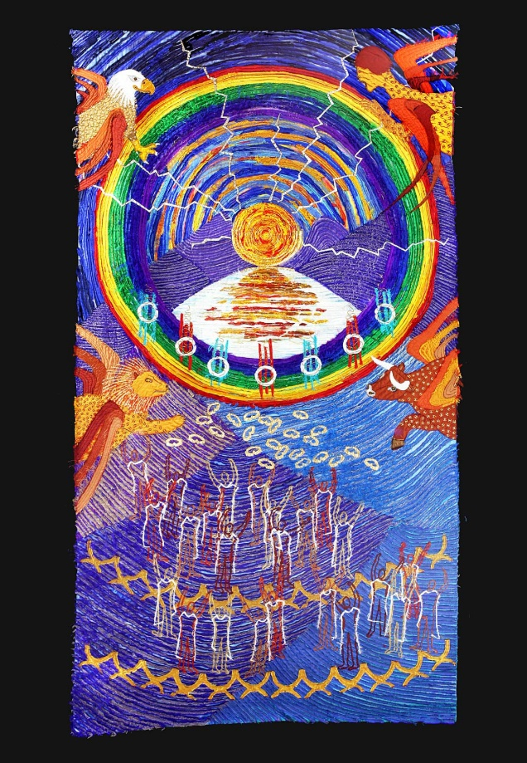
Revelation 4
John finds himself swept into the throne room of God himself! He sees something indescribable - certainly well beyond the limitation of silk and stitches! God is on the throne - and has the appearance of precious stones. There are lightning flashes and the throne is encircled with a rainbow!
Around the throne are four strange, fabulous creatures - each covered in eyes and with six wings. Twenty-four elders or kings lay down their crowns to worship God.

Slide 8
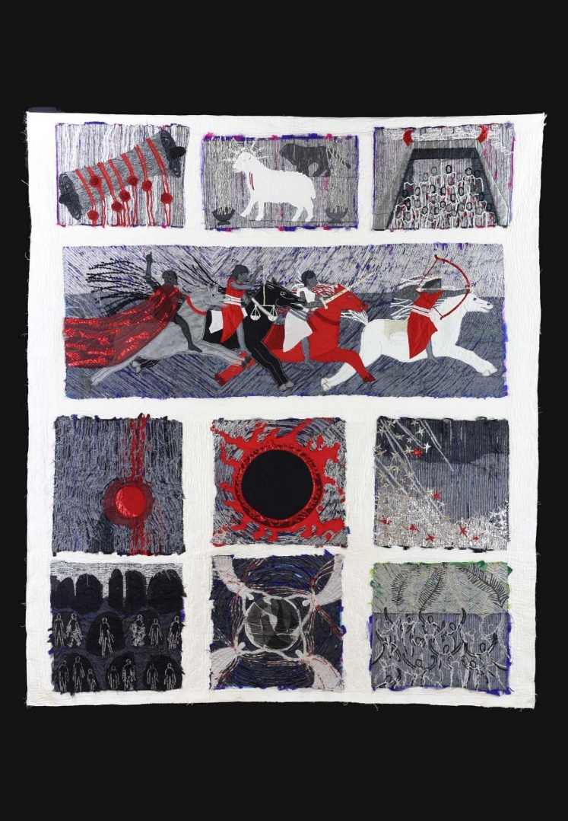
Revelation 5-7
In John’s vision, there’s a series of disasters which happen on the earth. But first a scroll secured with seven seals needs to be opened - and it will take someone who is blameless to do it. It looks like no one can. John weeps.
Then John sees a lamb (a symbol for Jesus) who is blameless and therefore can open the seals. As he breaks them open terrifying things happen - including the appearance of the four horsemen of the apocalypse.
God longs for us all to turn to Him

Slide 9
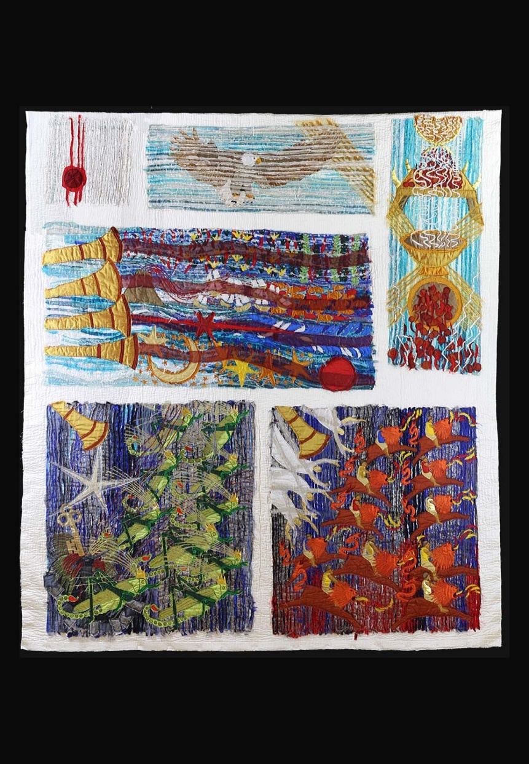
Revelation 8-9
When the seventh seal is opened everything suddenly goes quiet. There is time to think. An angel brings all our prayers to God. Then seven angels with trumpets begin to sound out the final judgement of God. All creation shudders. A lone eagle flies over, calling ‘Woe! Woe! Woe!’
Two armies arrive - one of locusts with scorpion tails that sting and one of strange horses with lion heads breathing out fire. They torment the world.
John will have to wait for the seventh angel to blow the seventh trumpet.

Slide 10
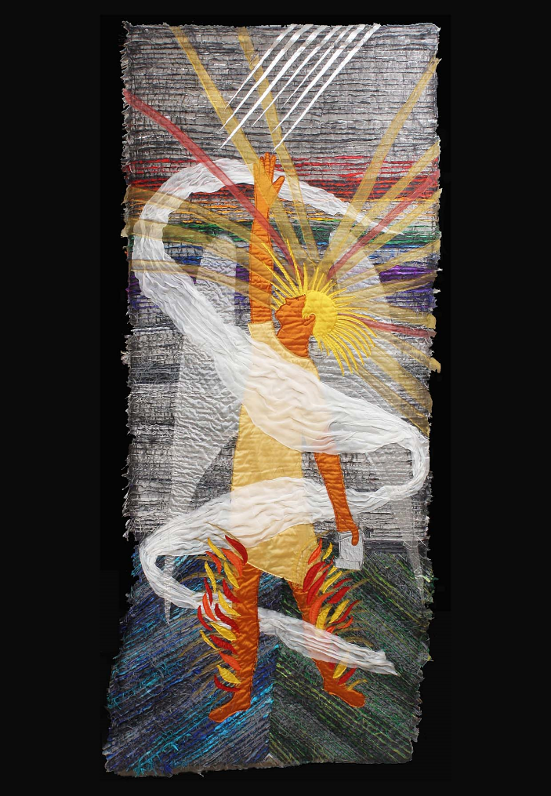
Revelation 10
John finds himself back on earth, and sees a mighty angel, wrapped in a cloud, talking with God. The angel’s voice is like the roar of a lion: God’s voice is like seven thunders.
John is told many mysteries - some he is to keep quiet about, some he is to speak about.
The angel tells John to eat a tiny scroll which tastes like honey in his mouth but turns sour in his stomach.

Slide 11
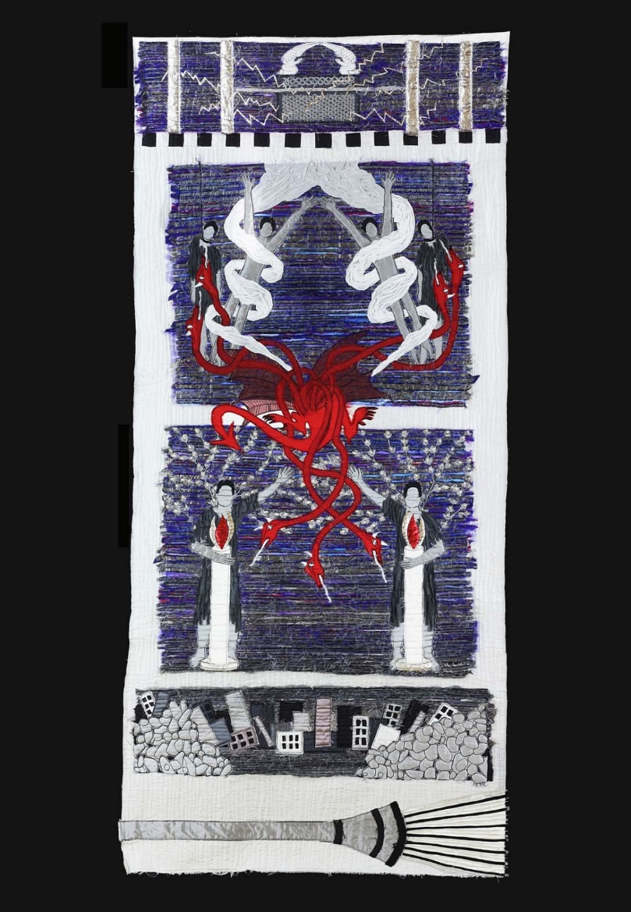
Revelation 11
John is told to measure the altar and count the worshippers in the temple.
He is told about two strong witnesses who ‘stand before the Lord of the earth’. They perform miracles and their message is full of power! They are like candles showing the way to God. But then they’re killed - and many celebrate the fact they’re dead - until they’re miraculously brought back to life!
The message - the good news - cannot be stopped. The seventh angel now blows the seventh trumpet

Slide 12
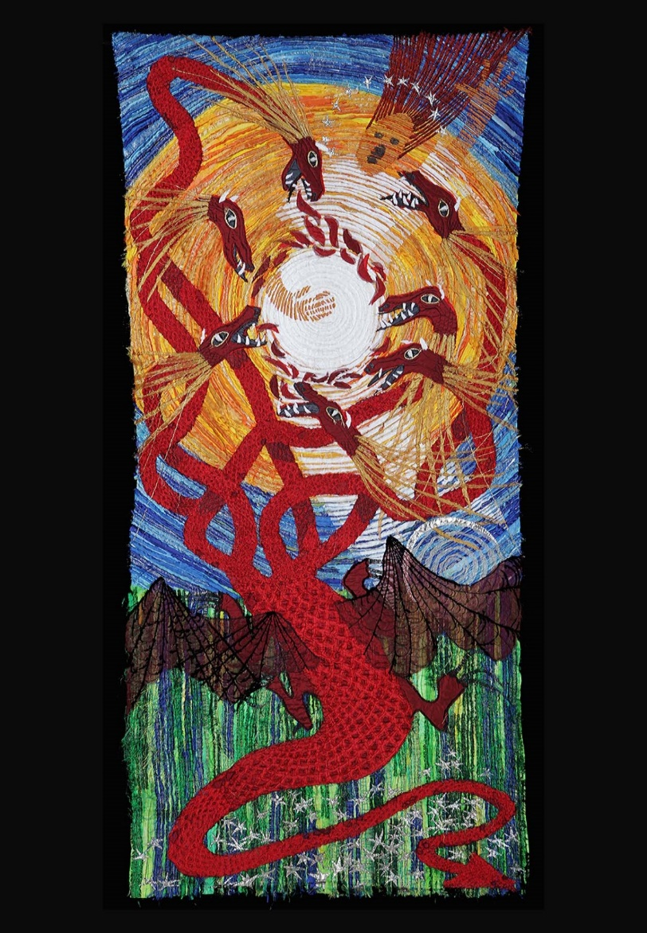
Revelation 4
John sees a pregnant woman about to give birth. A seven headed Dragon - a symbol for Satan and all that is evil - is waiting to devour the baby.
A baby is about to be born. An everyday event. But the birth of this baby will change the course of history. This baby will be Jesus Christ - the son of Mary - the son of God!
And not everyone will like it.

Slide 13
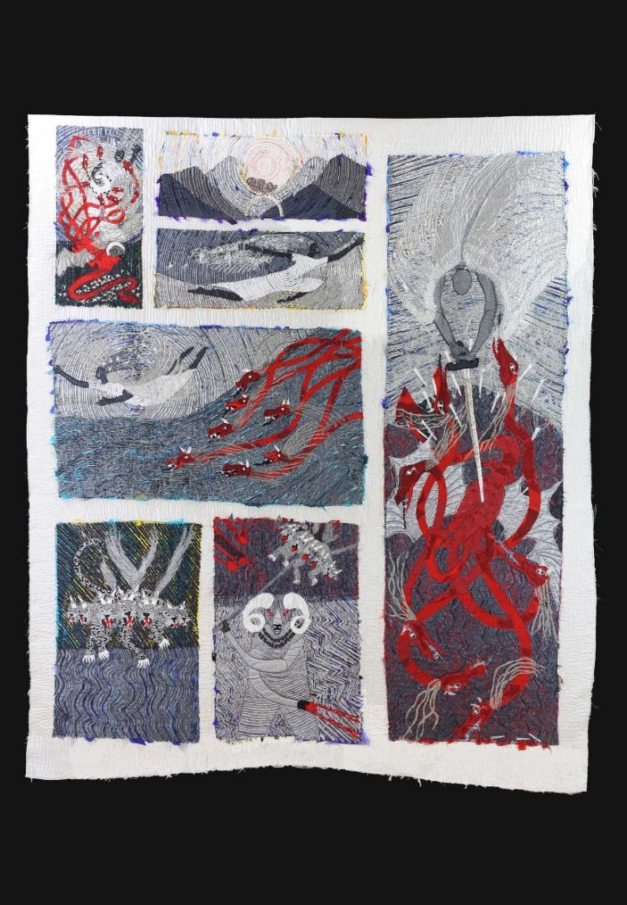
Revelation 12-13
This is a battle between good and evil - the people of God and the Dragon and his followers.
The baby is safe in Heaven. The Dragon and his angels are hurled to earth by the mighty angel Michael. The Dragon goes in pursuit of the woman (symbol for the people of God) but she is given the wings of an eagle to escape into the desert.
Then Satan’s two supporters emerge - the Beast from the sea and the Beast from the land

Slide 14
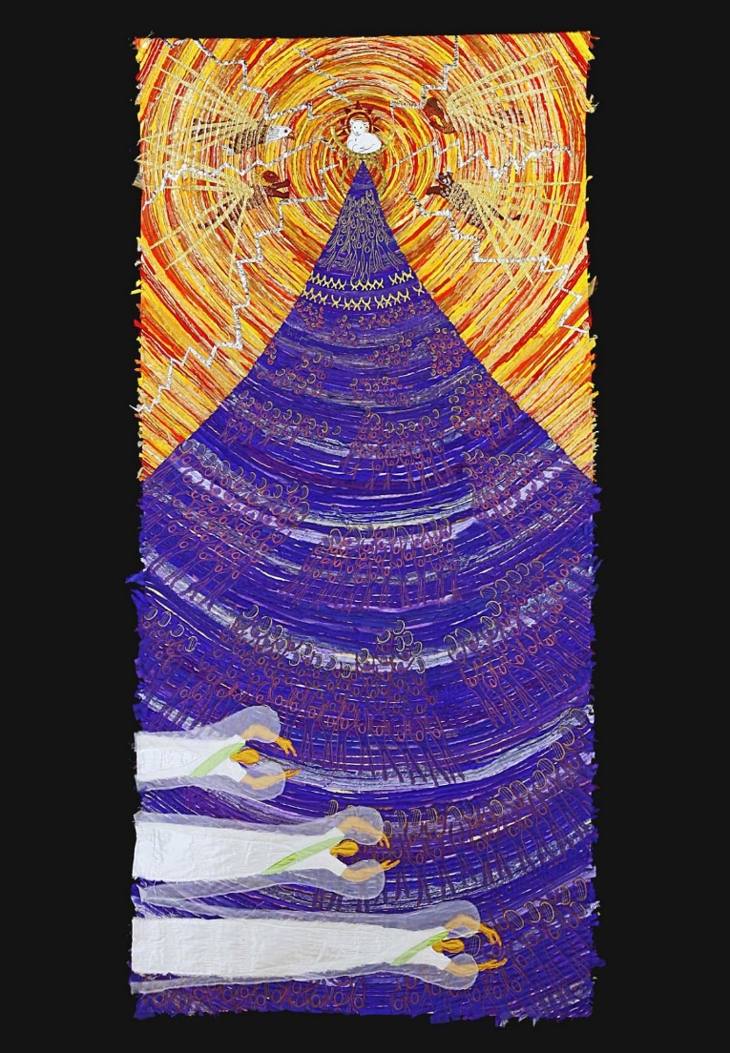
Revelation 14:1-13
John sees another view of God’s throne room, with the same four strange creatures and twenty-four elders. But now there are 144,000 others (a deeply symbolic number). They sing God’s praises with a song that no one else knows!
The focus is on the Lamb on the top of the mountain. Here is Jesus Christ - the Messiah - who has sacrificed his life on the cross to bring an end to all our sins - the sins of the whole world.
Three angels call on us to choose between our own way of life and God’s way of life.

Slide 15
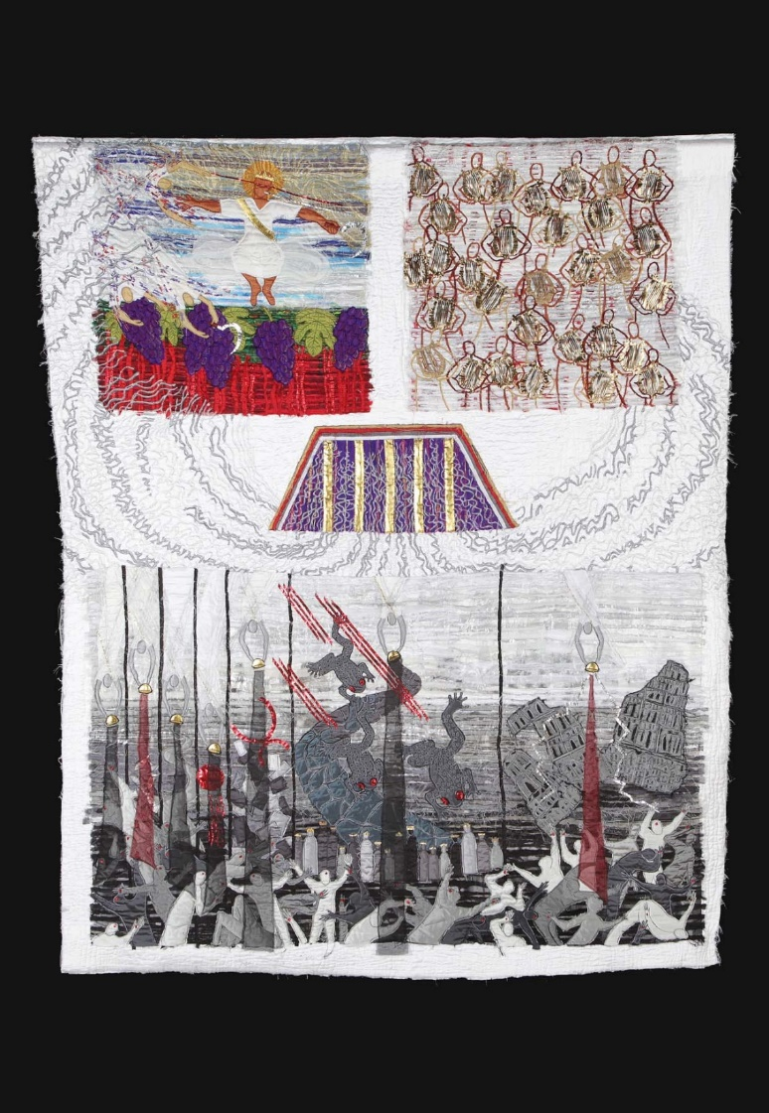
Revelation 14:14 - 16:21
God’s presence and glory - like smoke - now fill John’s vision.
There are many in Heaven playing harps and praising God with songs. And Jesus is ready to come to earth a second time - to bring judgement and to bring ‘home’ all of us who want to be ‘at home’ with God.
But down to earth - with a bump! John sees seven angels pouring out God’s anger on the earth. Demons call the leaders of the world to make ready for the war on all that is good - Armageddon. But they don’t stand a chance - the victory was always God’s!

Slide 16
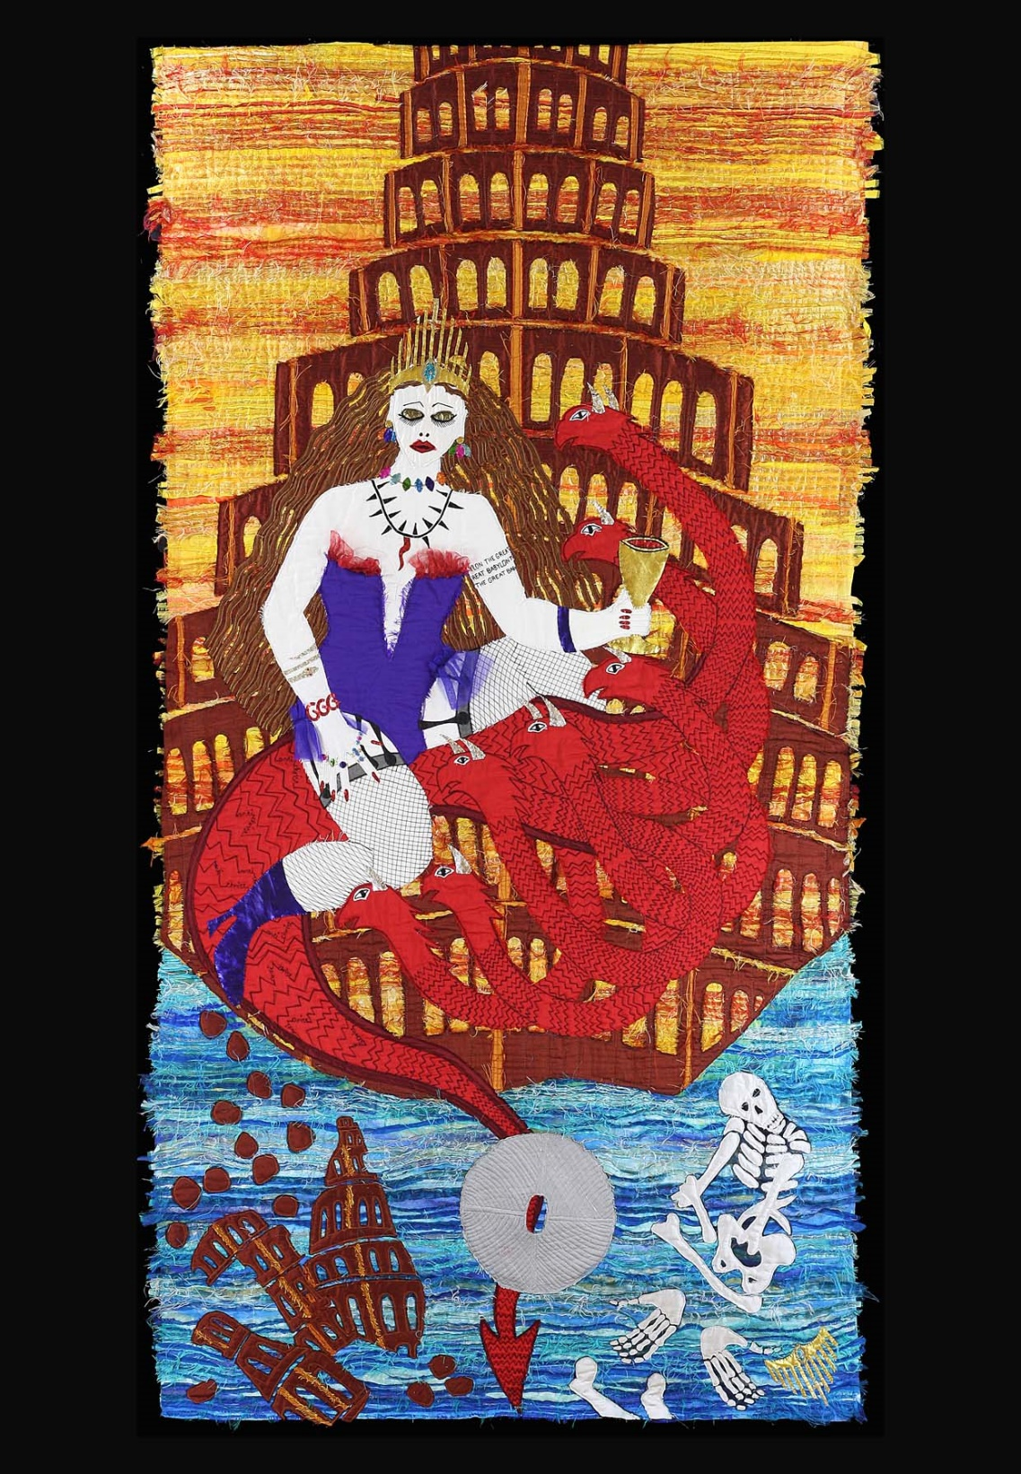
Revelation17-18
John sees a beautiful prostitute and the city of Babylon - both symbols of life lived with no concern for God or for others - both fabulously wealthy at the expense of the poor and marginalised.
‘The Great Whore’ or ‘Great Beauty’ rides on yet another Beast. Her goblet is full of the blood of those who have been killed because they lived for Jesus. But the city and the prostitute are doomed. They will fall. Then all those held captive will be set free. The city will be in ruins - the prostitute will be just bones!

Slide 17
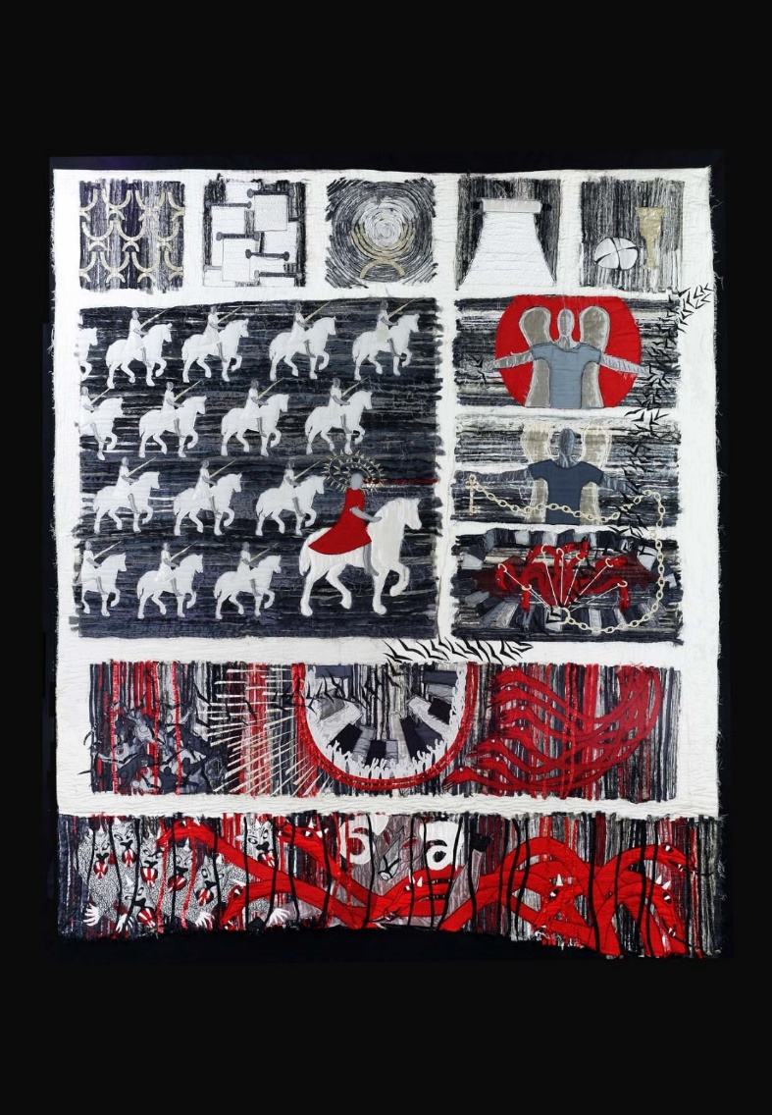
Revelation 19-20
‘Hallelujah’ means ‘God be Praised’ and this part of the story is full of hallelujahs even if we can’t hear them!
There is terrible judgement for the two evil Beasts, the Dragon and Death. Each is thrown into the lake of fire.
Then there is the judgement of the living and the dead. Everyone is to stand before God’s throne and be held to account for their lives. But then there is the scroll that contains the names of all those who have said ‘yes’ to Jesus and ‘yes’ to the wedding feast - an invitation open to us all!

Slide 18
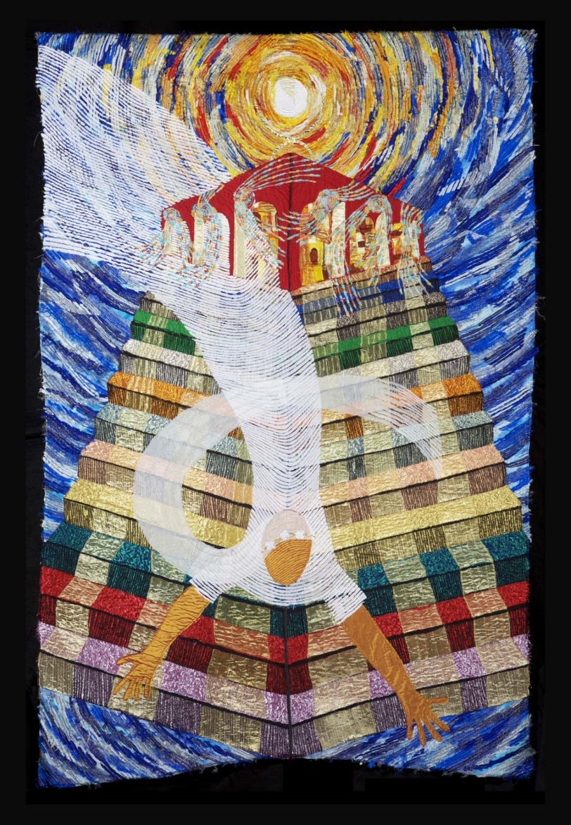
Revelation 21
John sees a beautiful bride! And he sees a wonderful city! Together they come down to earth.
The ‘Great Beauty’ and Babylon were symbolic of all that is wrong and evil: the bride and city are symbolic of all that is good and holy.
The twelve foundations of the city are made from precious stones. Whizzy angels invite everyone to enter in through the gates.
The One who sits on the throne speaks directly: ‘Behold, I make things new

Slide 19
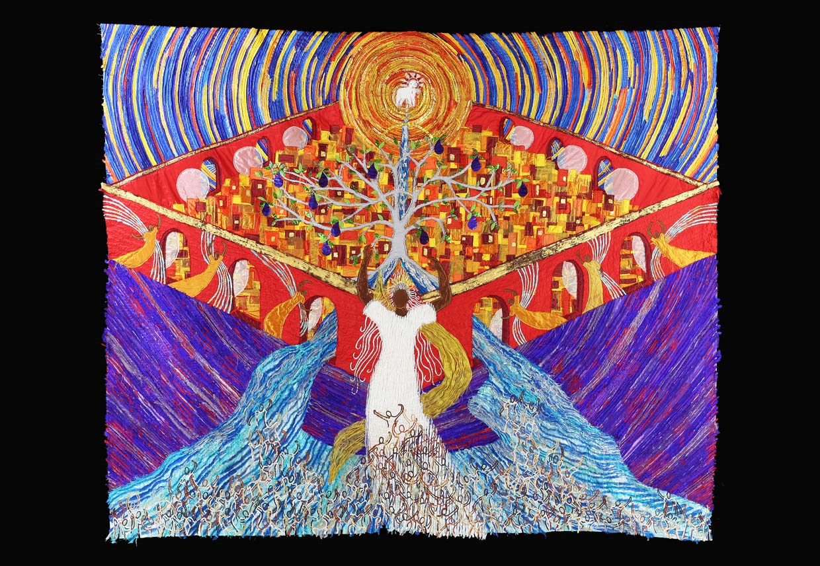
Notes:
Panel 14 New Creation
What do you think is happening in this picture?
Tell a partner what you can see. What colours are used?

Slide 20
Revelation 22
John sees a beautiful bride! And he sees a wonderful city! Together they come down to earth.
The ‘Great Beauty’ and Babylon were symbolic of all that is wrong and evil: the bride and city are symbolic of all that is good and holy.
The twelve foundations of the city are made from precious stones. Whizzy angels invite everyone to enter in through the gates.
The One who sits on the throne speaks directly: ‘Behold, I make things new.’

Slide 21
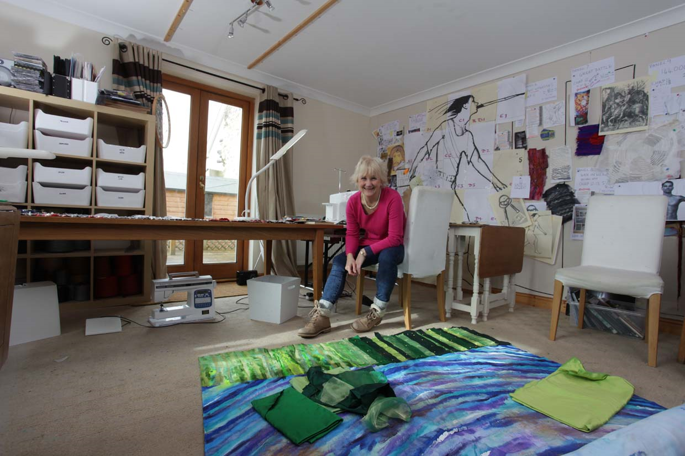
Notes:
Jacqui Parkinson lives in Devon.

Slide 22
Threads through Revelation © Jacqui Parkinson 2016
“Threads through Revelation” is a project which depends entirely on individual donations and sales of publications - please see www.jacqui-textile.com to see how you can help.
Images may be used free of charge, without specific permission, for non-profit teaching and church use. If using any material, please use a credit at some stage -
"Threads through Revelation © Jacqui Parkinson 2016"
Should you wish to use any of the material in publications, websites, paid-for teaching and any commercial activities, please get permission first - contact Andrew Parkinson 01626 853555 falcondm@aol.com.
This material has been compiled by Jane Brooke (RE Independent consultant and Canon Chancellor Chester Cathedral)

